Slide 1

Gaussian Processes for Optimal Sensor Position
MSc Project Presentation
Adrian Löwenstein
30 August 2019

Slide 2
Introduction
Optimisation of sensor positions, a classical problem.
Base our approach on near-optimal solution proposed by Krause et al.
Relying on Gaussian Processes and Mutual Information
Apply this approach to large scale environmental simulation
Solve the issues of Scalability and Modelling the Data

Slide 3
Outline
Context of the Problem
Near-Optimal Sensor Placement
Issues and Challenges
Solutions & Contributions
Results and Parameter Choice on Small Set
Results on Full Set
Conclusion

Slide 4
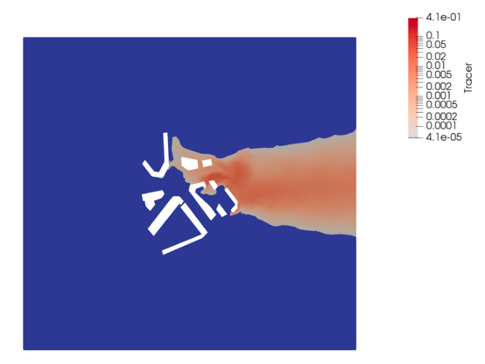
Context of the Problem
Objective : place optimally k Sensors in a given space
Environment: London South Bank University (LSBU)
Data: Fluid Simulation of Pollution Tracer
Tracer, Pressure, Velocity
Wind Blowing from West to East
Discrete Set of locations : p = 100’040
Samples in simulation : n = 988

Slide 5
Near-Optimal Sensor Placement
Developed by Krause et al. (2008) :
Near-Optimal Sensor Placement in Gaussian Processes.
Giving near-optimal solution to NP-hard problem.
Approach to Solving to problem:
Gaussian Processes
Mutual Information Criterion
Greedy Algorithm

Slide 6
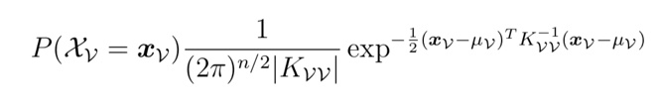

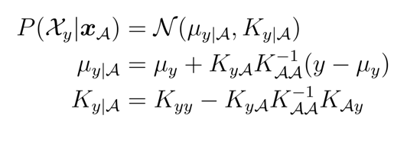
Gaussian Processes (GPs)
Assumption of Multivariate Gaussian distribution
GP defines a class of function
Mean Function
Kernel Function
Prediction of mean and variance conditioned by observations.
A: Observed set
y: predicted point

Slide 7



Mutual Information
Conditional Entropy: Uncertainty measure. Linked to covariance, and to GP
Mutual Information: mutual dependence between the sensor set and other points
Criterion for optimality:
Mutual Information is sub-modular : we can greedily place sensors. During this optimisation, MI gain is decreasing.

Slide 8



Greedy Sensor Placement (Krause et al. 2008)
Set of all locations: set V
4 Sensors are placed: set A
Placing 5th Sensor : candidate y
Iterating through the candidate set V
Mutual Information Gain:
Entropy of y knowing A :
Entropy of y knowing V\(A U y)

Slide 9
Issues and Challenges
Two main issues with the proposed algorithm:
Modelling the Data: Covariance Estimation
Application to big datasets: Scalability

Slide 10

Issues and Challenges 1: Covariance
Modelling the Data as Gaussian Distribution => Covariance Σ
Simple estimator : Sample Covariance Matrix
Often singular when the dimension of the data exceeds the number of samples. When p >> n. (Fan et al., 2015). Not positive definite.
Estimation error is very important. (Ledoit and Wolf, 2003)
Need for better covariance estimator

Slide 11



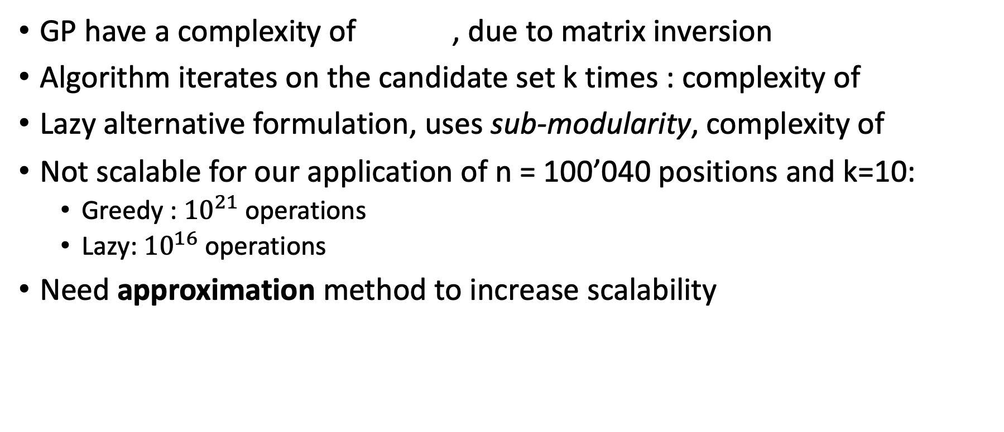
Issues and Challenges 2: Scalability
GP have a complexity of , due to matrix inversion
Algorithm iterates on the candidate set k times : complexity of
Lazy alternative formulation, uses sub-modularity, complexity of
Not scalable for our application of n = 100’040 positions and k=10:
Greedy : ${10}^{21}$ operations
Lazy: ${10}^{16}$ operations
Need approximation method to increase scalability

Slide 12
Solutions
We implemented four solutions to the previous issues:
Shrinkage Covariance Estimation – Covariance
Reduce the Candidate Space – Scalability
Local Kernels Algorithm – Scalability
GP with Truncated SVD – Scalability – Covariance

Slide 13
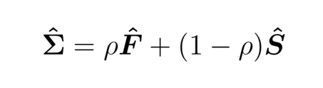
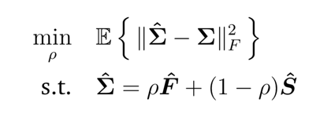
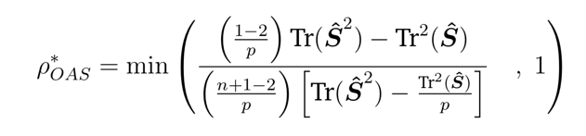
Solution 1: Shrinkage Covariance Estimation
Shrinkage Constant
Shrinkage estimate: a convex linear combination
Shrinkage Target
Sample Covariance
Close to Identity
Optimisation Problem: Minimise Froebenius distance to true covariance
Oracle Approximating Shrinkage: (Chen et al. 2010) closed-form, achieved by taking the limit of an iterative resolution.

Slide 14
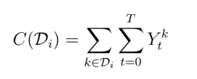
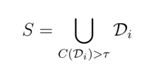
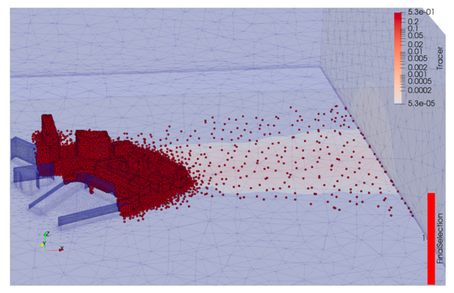
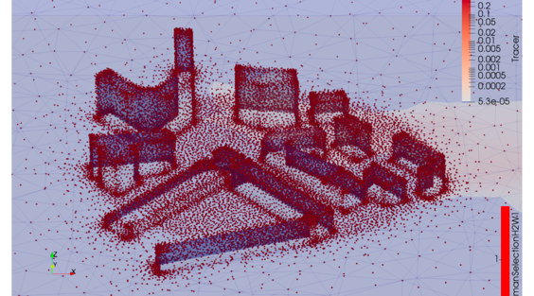
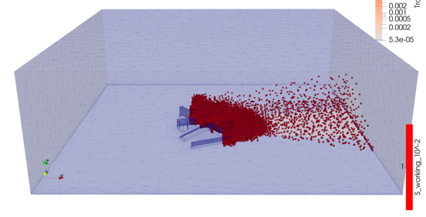
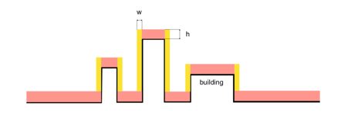
Solution 2: Reduce the Candidate Space
Selection based on field values:
Keep regions were there is sufficient data
Selected number : 57′725
Selection based on human reachability:
Selected number : 37′847
Intersection of both selections:
Selected number : 23′643

Slide 15




Solution 3: Local Kernels Algorithm
Solution Proposed by Krause et al. (2008)
Take advantage of the covariance : decreasing with distance
Define a set of points highly correlated to y :
Uses this set to:
Reduce the number of points to update at each iteration : remove highly correlated points to the last optimal.
Compute approximate Covariance and Entropy
Allows a complexity of
Threshold
Number of points
d << n

Slide 16







Solution 4: GP with Truncated SVD
TSVD on Data :
Data : p x n
Reduced Data : 𝜏 x n
Approximated Covariance:
Data : p x p
Reduced Covariance : 𝜏 x 𝜏
Approximated Gaussian Process :
Inversion bottleneck
Complexity reduced to:

Slide 17
Small Set Optimisation Results
Optimisation on smaller set: comparison and parameter selection.
Covariance Estimation with OAS
Selection of Small Subset
Greedy and Lazy Optimisation
Local Kernel Optimisation
TSVD Approximated GP

Slide 18
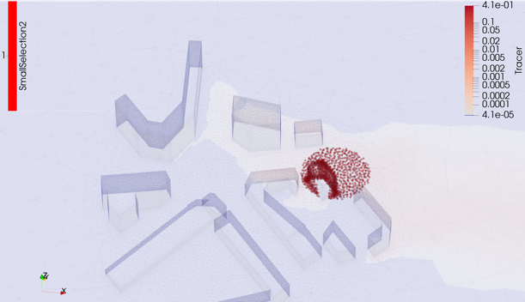
Small Subset Selection
Selection of locations contained in a sphere of radius 25m and centred at [60,35,0]
Intersection with the pre-selected dataset
Small selection of 1′295 locations

Slide 19
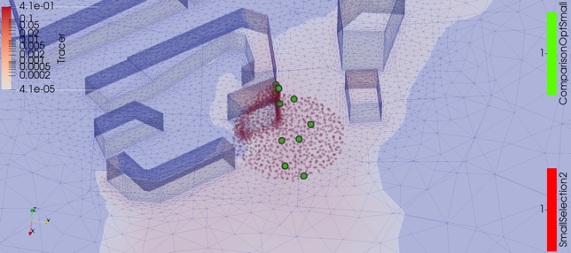
Small Set Results: Greedy and Lazy Optimisation
Optimisation of 10 sensors
Placed in the wind direction. Correlation is low
Spread accros the space.
No Approximation is used : reference for this small set.

Slide 20

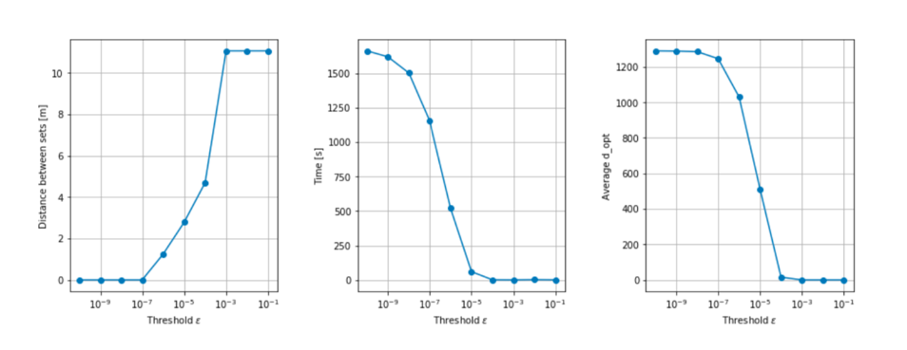
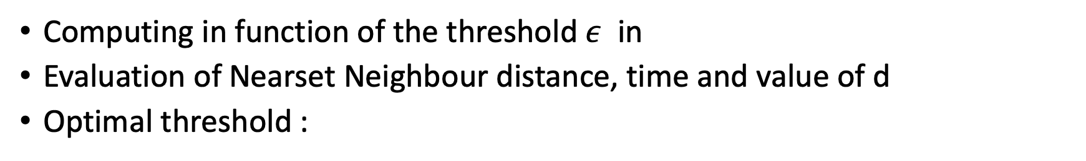
Small Set Results: Local Kernel Optimisation
Computing in function of the threshold $ε$ in
Evaluation of Nearset Neighbour distance, time and value of d
Optimal threshold :

Slide 21

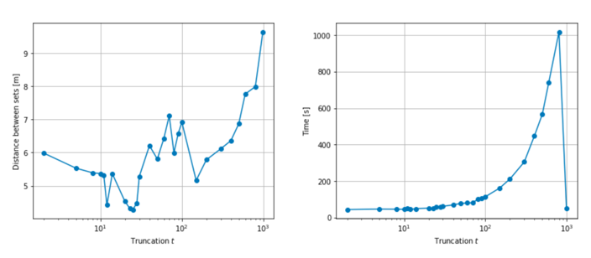
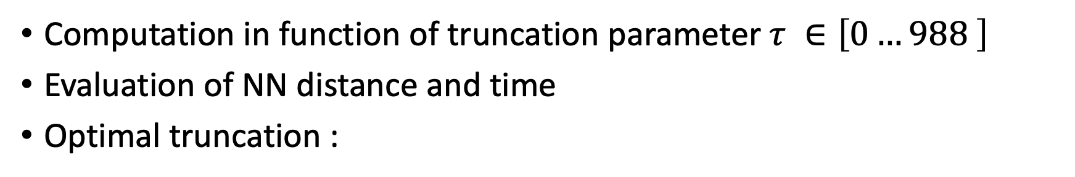
Small Set Results: TSVD Approximated GP
Computation in function of truncation parameter $τ ∈\left[0…988 \right]$
Evaluation of NN distance and time
Optimal truncation :

Slide 22
Full Set Optimisation Results
We compute our optimisation on the tracer field of the full LSBU simulation dataset.
Preselection of the data: 23′643 locations
Covariance Estimation with OAS
Test Cases Explored:
Algorithm with Local Kernel Approximation with threshold :
Algorithm: lazy version with TSVD GP approximation :
Use the results with Data Assimilation (DA)

Slide 23
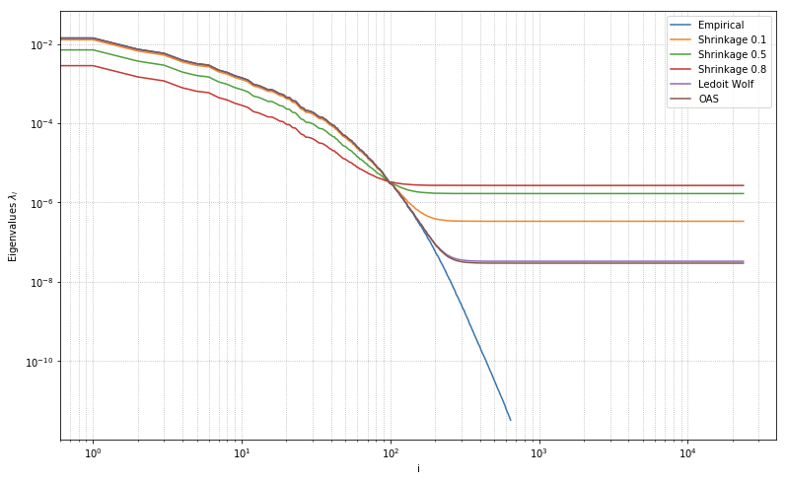
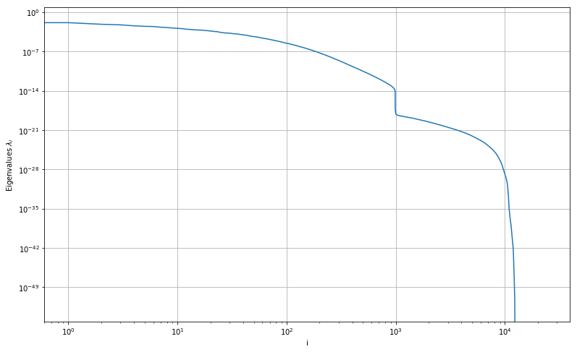
Full Set Results: Covariance Estimation
Sample Covariance:
Negative Definite
Singular
Small Eigenvalues
Influence of Shrinkage:
Regularise
Avoids small eigenvalues
Keeps Covariance Structure
OAS : 0.0087595

Slide 24
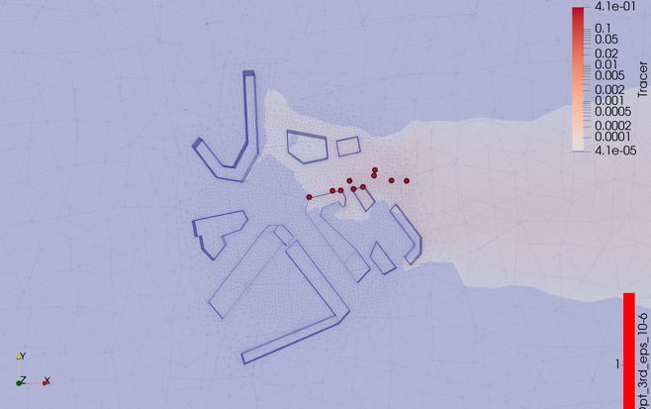
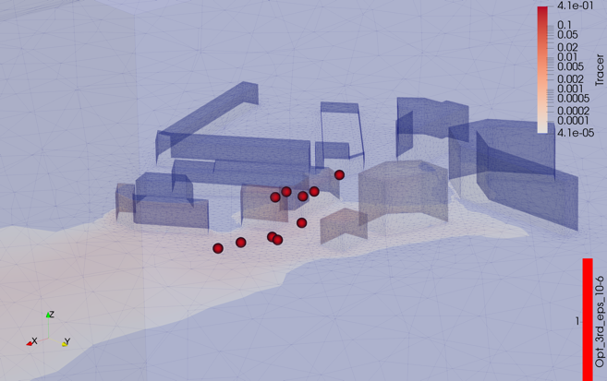
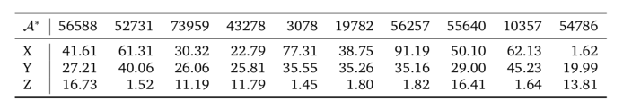
Full Set Results: Local Kernel Algorithm
Optimal set of 10 locations
Time : 6.61 hours.
Spread in the direction of the wind (East)
Placed in the centre of the domain where density is higher
Placed where the tracer concentration is higher.

Slide 25
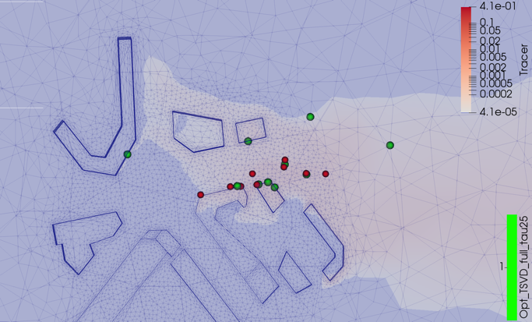
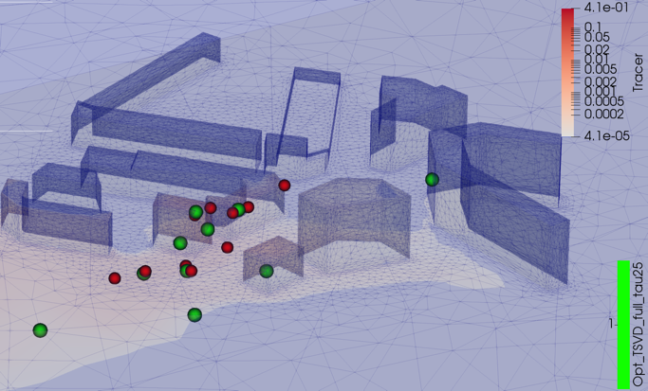
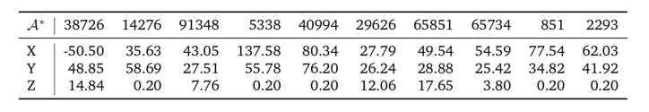
Full Set Results: TSVD GP Approximation
Optimal set of 10 locations
Time : 5.02 hours.
More widely spread than previously
Nearest Neighbours Distance to the other set: 13.84m

Slide 26
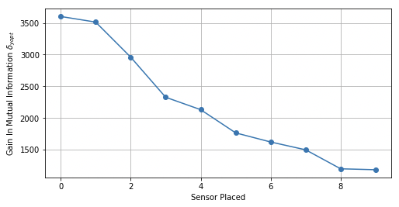
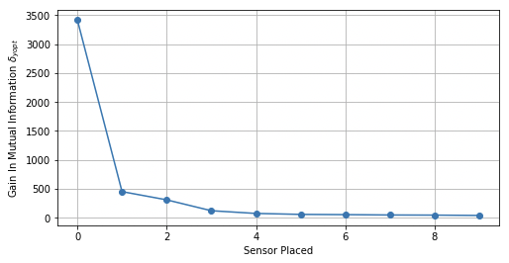
Full Set Results: Sub-modularity
Verification that the MI during Optimisation is submodular
Optimal MI gain is decreasing as we place sensors.

Slide 27
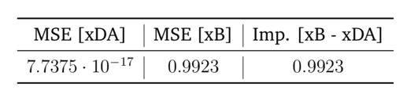
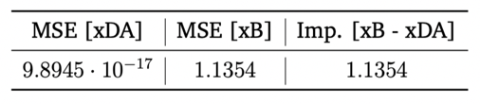
Application to Data Assimilation (DA)
DA is a procedure to assimilate measurements into a simulation.
DA with the previously selected points. Computation of MSE of DA
Results for Test Case 1:
Results for Test Case 2:
Limitations:
Error as good as random set taken within 10m of optimal.
DA error on assimilated points k=10
DA error right after Assimilation, should verify the error after simulation

Slide 28
Conclusion
Application of Near-Optimal Sensor Placement to Environmental Simulation.
Reduction of the size of the candidate sensor set
Covariance Modelling using Shrinkage Estimator
GP approximation using TSVD
Full-Set Optimisation with acceptable computational time.
Full Implementation of DA simulation. Comparison on all the space.
Try different covariance approximation and compare results
Other methods to optimise points, such as Sparse Gaussian Processes, which also allow of define a reduced set of locations.

Slide 29
Thank you for your attention !
Questions ?

