Slide 1
Building (a part of) Watson
Moldovan Florin
Marginean Adrian

Slide 2
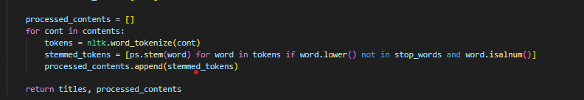
Indexing and retrieval
Organizes data using a Whoosh schema with fields for document titles and content.
create_index function processes Wikipedia documents, creating a comprehensive index.
Wikipedia article content is tokenized using nltk.word_tokenize, breaking it into individual words.
Porter stemming is applied with nltk.stem.PorterStemmer, reducing words to their root form to consolidate related terms.
Common stop words are removed using NLTK's English stopwords set, enhancing the significance of the content

Slide 3

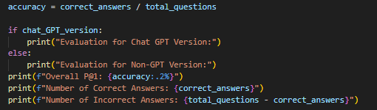
Measuring performance
P@1 is well-suited for question-answering scenarios where only one correct answer is expected. In Jeopardy-style questions, there is typically a single correct response.

Slide 4
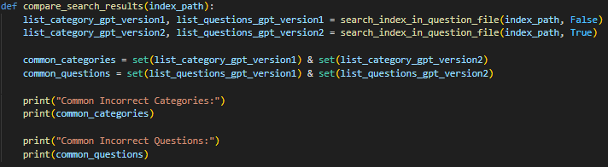
Error Analysis
Lack of Context
Faces challenges in correctly associating locations, historical figures, and complex topics, as illustrated by the common incorrect questions

Slide 5
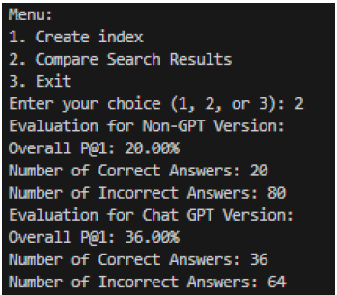
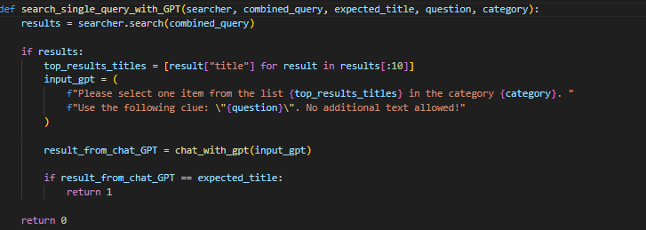
Improving retrieval
To advance our Information Retrieval (IR) system, we've seamlessly integrated ChatGPT, specifically leveraging the power of GPT-3.5-turbo via API. The primary objective of this integration is to significantly enhance the precision of Wikipedia page titles by re-ranking and refining the existing titles.

Slide 6
demo

