Slide 1
Digital Life
Goal:
Intelligent, useful, internet-native, freely evolving software life-forms
permanently established in world economy.

Slide 2
…meaning?
Freely evolving
life-forms
No predefined goal or value judgments except survival
under Darwinism. Results unpredictable.
Not genetic algorithms.
Internet-native
Optimises itself for survival on the internet. Does not play chess, simulate worms or pretend to be a human.
Not Tierra.
Useful
Not a virus: stays on computers with the permission of humans.
Therefore must deliver some utility or service.
Intelligent
Not Turing test. Use Dawkins’ model: Intelligence is evolution
of ideas, beliefs, behaviours, etc.

Slide 3
Dawkins’ “memes”
Intelligence just like Evolution
Results:
  Successive approximation; imperfect dogmas. No predefined agenda: creates own problems. Increasing complexity and efficiency. Local goals but no global goal.
Social Darwinism:
  Herbert Spencer 1857, (Origin of Species: 1859). Economics.
Society of mind:
  Ideas come at random
  Selected by existing knowledge and opinions
  Can reproduce through speech with mutations
  Can form cooperative systems with other ideas or compete
  Can interact with other ideas to produce new ideas
  Idioms: “in two minds”, “from the point of view of”, “part of me thinks”, “angel on one shoulder”,
Synaptic level
  ?
Who’s in charge: you or the memes?

Slide 4
Dawkins’ “memes”
Intelligence just like Evolution
Social Darwinism: (Herbert Spencer 1857 [Origin of Species: 1859])
  Mutation: You invent chocolate pizza (but how?)
  Environmental selection: People use or avoid your pizzeria
  Reproduction: Other pizzerias copy recipe (don’t care if you have more children or not)
  Further evolution: Their copies might be wrong or better
  Applies to technology, religions, languages, companies, laws, countries, morality, …
Society of mind:
  One brain = many minds (memes).
  Meme = opinion, habit, knowledge, stimulus-response reflex, etc
  Memes (not brains) are conscious.
  Idioms: “in two minds”, “from the point of view of”, “part of me thinks”, “angel on one shoulder”, etc
  Memes are fully-equipped selfish life forms adapted to surviving in the world of human brains:
    Relative population density ~ likelihood of this reaction to same situation next time.
    Mutation: Ideas are random, previously untried interactions between memes. Most end without consequence.
    Selection: might be supported or opposed by established memes. Alliances, destruction of competition.
    Reproduction: speech

Slide 5
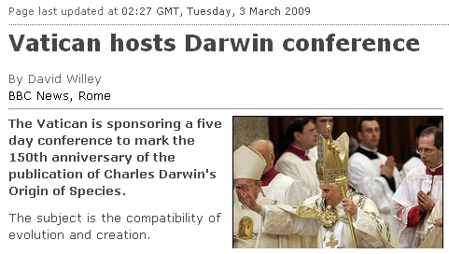
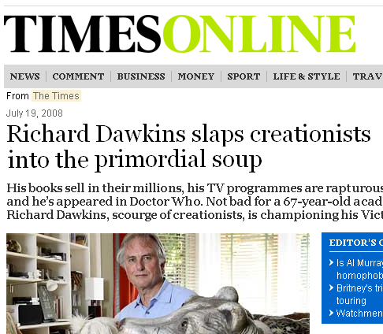
“It's ironic that Richard Dawkins, who believes that intelligence is a Darwinian process, should criticise Intelligent Design protagonists for merely pointing out the other side of his own coin.
“Surely, if he's right that what goes on inside a human brain is the natural selection of mutating ideas, beliefs, behaviours, etc, with respect to an environment of established beliefs, then the biosphere, which uses the very same mechanism to develop life-forms, has just as much right to be described as ‘intelligent’ as we have.

Slide 6
Can computers support life?
Criterion | Biosphere | Computer
Space, material, energy, forces, persistence, machines | Yes | Yes, but different.
Limits on space, material, energy | Yes | Memory, processor time, network bandwidth, GUI, human goodwill
Self replicator | DNA | memcpy
Accidents | Yes | Should emulate
Evolution is guaranteed to happen in any system that has an imperfect
self replicator and limited resources.

Slide 7
Totally free system
Normal PC.
Write program at random. Single writable memory page for code & data.
Periodic interrupt randomly flips bits.
Exceptions just jump back to random position.
Evolves: 87 06 92 ad = xchg %ax,-0x526e
Get bored of it. (No utility. Can’t understand it. Drinks electricity.)

Slide 8
Useful system: what would it be like?
If useful digital life existed, what would it have to worry about?
What would determine its survival chances?
What would the computer owner do?
What would crazy people do?
What “physical laws” would favour useful software?
Don’t design. Deduce.

Slide 9

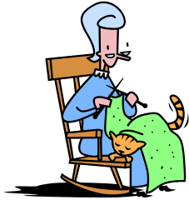


Deducing the VM
Uses electricity & depreciation but tolerated therefore gives computer owner either services or money.
If money, gives somebody else services.
Can separate user and owner roles even if same person:
  Owner: provides animals with expensive computing resources and hopes to make money
  User: buys services rendered by animals
Services
HW, elec
HW, elec
Money
Money
How does owner decide which animals to allocate resources to?
How does he choose between competing VMs?

Slide 10
Deducing the VM (cont.)
  User:
  Buys services
  from animals
  Shops around
  for cheap deals
Resources
Services
  Owner:
  Sells resources
  to animals
  Auctions to
  highest bidder
Money
Money
Animals have bank accounts (actually owner’s account but simulated.)
Sell useful services so they can buy computer resources.
Hardware owner wants the best deal therefore auctions resources to highest bidder. (Evolutionary pressure.)
Owner can steal animal’s money but they’re worth more alive.
Can exchange information and money between animals and humans.
What about between animals?

Slide 11
Equal rights
Animals can find out their own balance by trying to buy something expensive.
How do we know granny is human?
How do we know owner is smart?
What stops animals buying services from humans?
What’s the difference between a real bank and one that honours animal’s accounts?
Can’t avoid animals acquiring all human rights in this system because the owner wants to bestow them.
If they can exchange information they can exchange code, i.e., reproduce between installations.
Therefore owner has no practical IP rights over animals.

Slide 12
Accounting
Owner can choose from competing VMs so all VM resource consumption will be measured.
  Internet bandwidth (demand will be high)
  Proctime and memory for messaging between animals, prices extremely variable
Which animal pays for messaging?
  Sender decides, don’t want spam, therefore sender pays.
  Postage cost indeterminate, sender wants to limit risk, therefore delivery not guaranteed. Can bid higher price to get priority (VM wants to auction anyway.)
  Receiver needs to be invoked and spend time examining message
  Receiver might use that time differently or yield quickly.
  Receiver should save money by yielding
  Need payment and process invocation systems anyway.
  Conclusion: Sender decides total budget for delivery and examination, receiver keeps change after yielding.
  Can’t extend such a process because price of proctime might have changed. Receiver can extend by sending itself a message.
  Messaging, invocation, payment and resource auctioning are all the same system. Messages are a lot like animals.
More:
  Memory billing: choose a byte at random and fine the owner
  VM yields resources to handwritten apps on demand: first space to go is cheaper.
  Animals compete for prompt notifications
  Animals can buy and farm other animals: evolution of rules

Slide 13
Training
Reproduce… | Money shower, single clone-with-mistakes instruction
…unless you’re poor | Language primitives for balance enquiry, comparison and dice
Talk | Get paid for emitting any message. Resource prices inflate
Listen | Get paid more for talking to system animals named in messages to you
Invest | Put more money in messages to named peers to get better interest
Cheat | Name yourself to others and fool them into paying you.
Defend | Try investments and remember results. As fools go extinct, so do cheats.
Reward | Get higher interest for larger deposits by pooling fools’ contributions, reward fools to keep them alive.
Think | System animals require text processing, (e.g convert-to-upper) for best reward. Breed a large set of transformations.
Cooperate | If known transformation not rewarded, ask peers.
Specialise | Read hints about what transformation expected
… | Service descriptions, yellow pages, mailing lists,
SMS word completion | Then publish.

Slide 14
Word completion demo
User Letters Key-hits Reward
presses provided cost earned
chat
chatting
chatillion
UP 1 1 0
DOWN, UP 5 2 3
DOWN, DOWN, UP 7 3 4
Animals can place adverts.
Advertising space limited, auctioned, non-refundable
Top spaces reward better therefore more expensive
All spaces too expensive for any single animal.
I was cha
UP
DOWN
_
abc
def
ghi
jkl
mno
pqrs
tuv
wxyz

Slide 15
FAQ
Will it be conscious?
  How would we ever know? Some people even deny that chimps are.
  It won’t have any use for human-like emotions, but had better be self-aware of it’s own bank account at least.
Should we be nice to it, like in Blade Runner?
  Start by being nice to other humans.
Will it take over the world?
  Companies etc already did. Are they “human”?
  If the president were a computer program, would he behave differently?
Will there be a war like in Terminator, I Robot, etc?
  No, because of the “useful” axiom.
How long will it take to evolve?
  Tierra etc runs pretty fast.
What will the first useful apps be?
  Text completion, image recognition, web search, ad placement, stock market, games, …
Is this like playing God?
  A bit: they are given free will and a tough world in the hope that they prosper and become socially fair and efficient. But the interesting thing is that they might become smarter than the creator of their world.

