Slide 1
TopBloc Coding Challenge
Adrianne Kubiak, February 2023

Slide 2
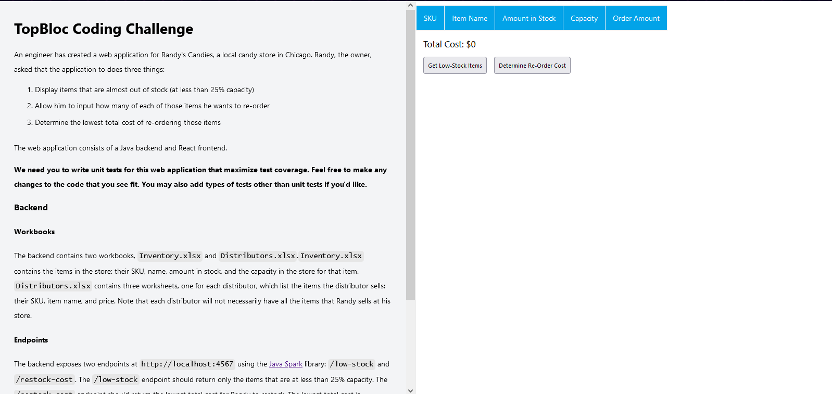
Open localhost

Slide 3
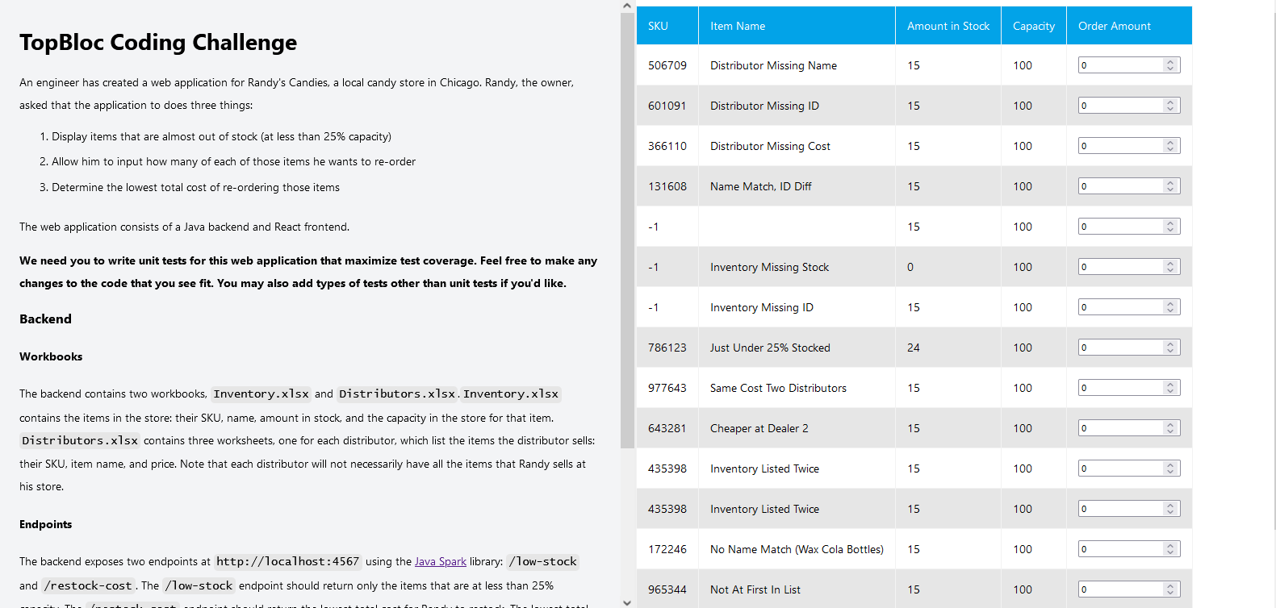
Get low-stock items

Slide 4

Order one Distributor Missing Name

Slide 5
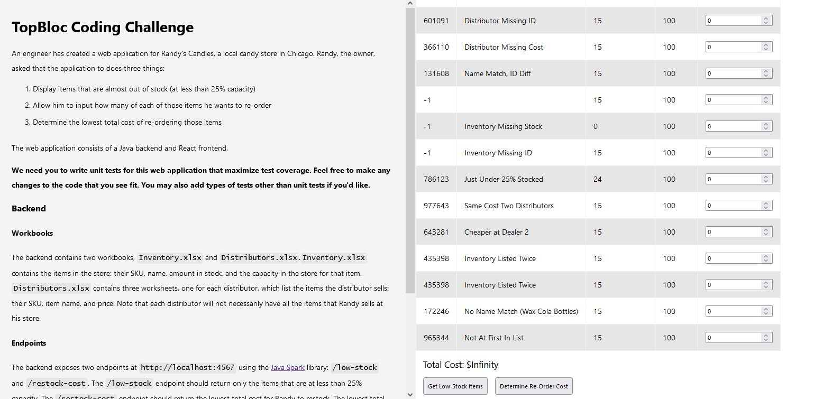
Determine Reorder Cost

Slide 6
Test ended

Slide 7
In this example evidence deck…
I would be testing based on a given-when-then acceptance criteria: GIVEN a low-stock item that is missing a name on the distributor’s side WHEN the user tries to restock THEN the price should be $0 I would simulate the scenario in the data (Excel sheets), write some custom methods for this specific test if the core code base was not sufficient, and run the automated script. The script would automatically generate this PowerPoint. If there are any discrepancies in the expected versus actual results, then the code will catch the errors and I would communicate with the rest of the agile team to determine the root cause and fix it. Depending on the nature of the error, the code would either continue as normal or it would fully stop

