Slide 1
Diffusion of Innovation and the Characteristics of Seeds
Sebastian Lechner, Adrian Oesch & Amrollah Seifoddini
December 2014

Slide 2
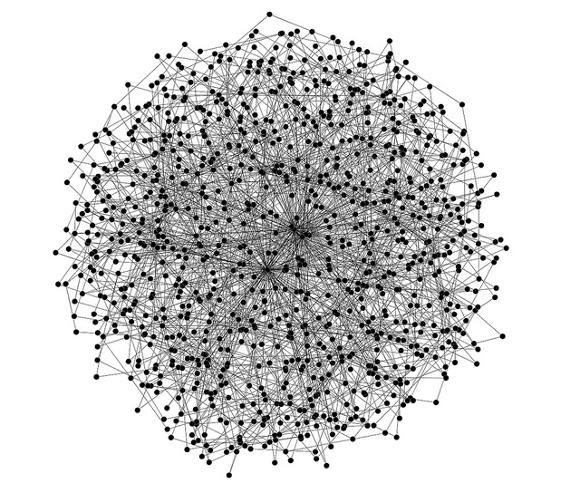
You have news for this given world. Whom do you tell first?
Degree
Betweenness Centrality
Eigenvector Centrality
Local Clustering Coefficient
?
Scale-free network by Simon Cockell
(https://www.flickr.com/photos/sjcockell/4684828794/l)

Slide 3
Goal: Which parameters of innovation seeds have an effect on the diffusion success?
No knowledge on the seeds
Very few parameters of nodes are known to be important
Degree and Eigenvector Centrality (Delre et. al JPIM, 27: 267-282 (2010)
Number of easily influenced neighbors (Watts & Dodds, JCR, 34(4): 441-458 (2007)
Main possible application: programmability of innovation diffusion
Increase initial speed of news messages
Introduction of (disruptive) technology
Marketing strategies for novel products
...

Slide 4
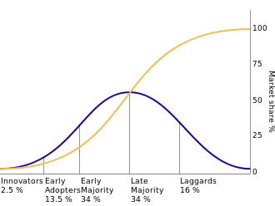
The Theory of Innovation Diffusion
Founded in 1960s
Fourt & Woodlock, Journal of Marketing, 25(2), 31-38 (1960)
Rogers, Diffusion of Innovations (1962)
others
Research mostly dominated by Marketing Research, Business Administration, Social Sciences
Few work by Network Sciences
Most common model
Social contagion model with threshold and memory of past events

Slide 5
Model

Slide 6
Model cont.

Slide 7
Model cont.

Slide 8
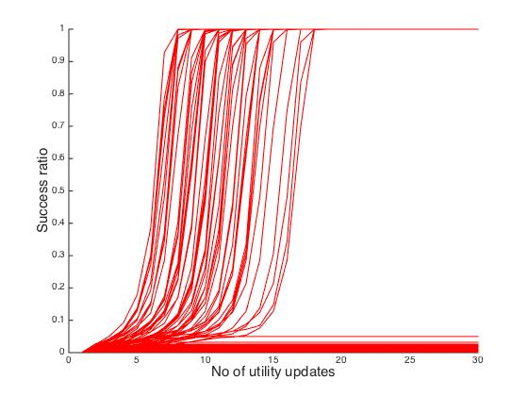
Implementation
%10 success

Slide 9
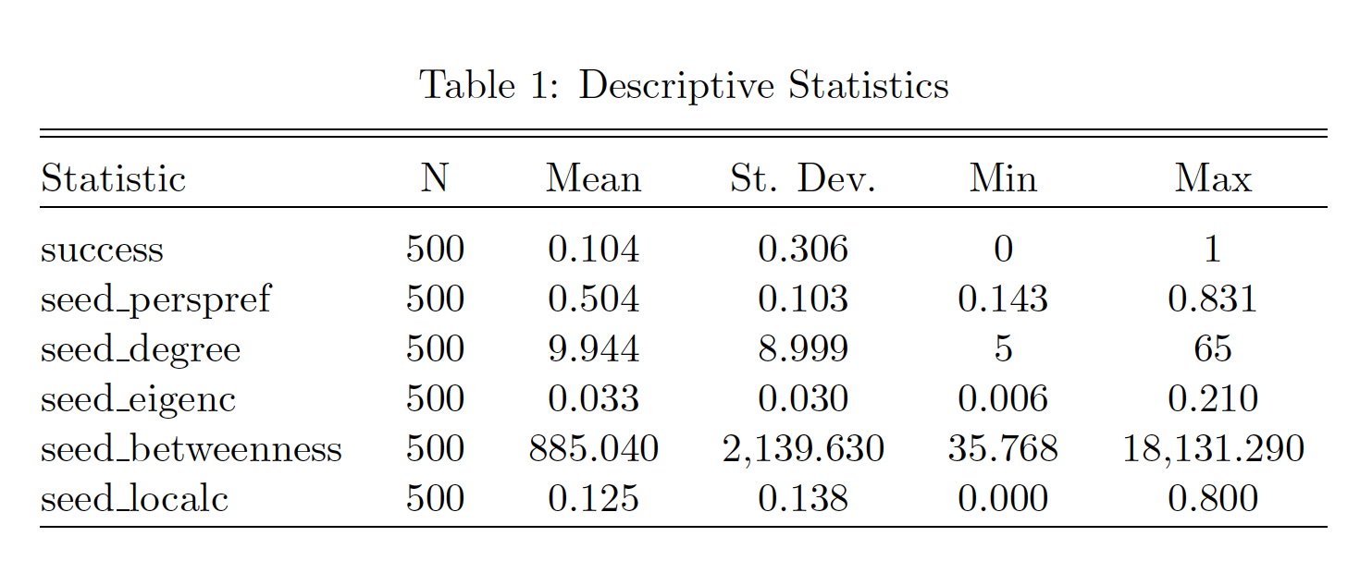
Results I - Descriptives

Slide 10
Results II - Plots

Slide 11
Results III - Plots

Slide 12
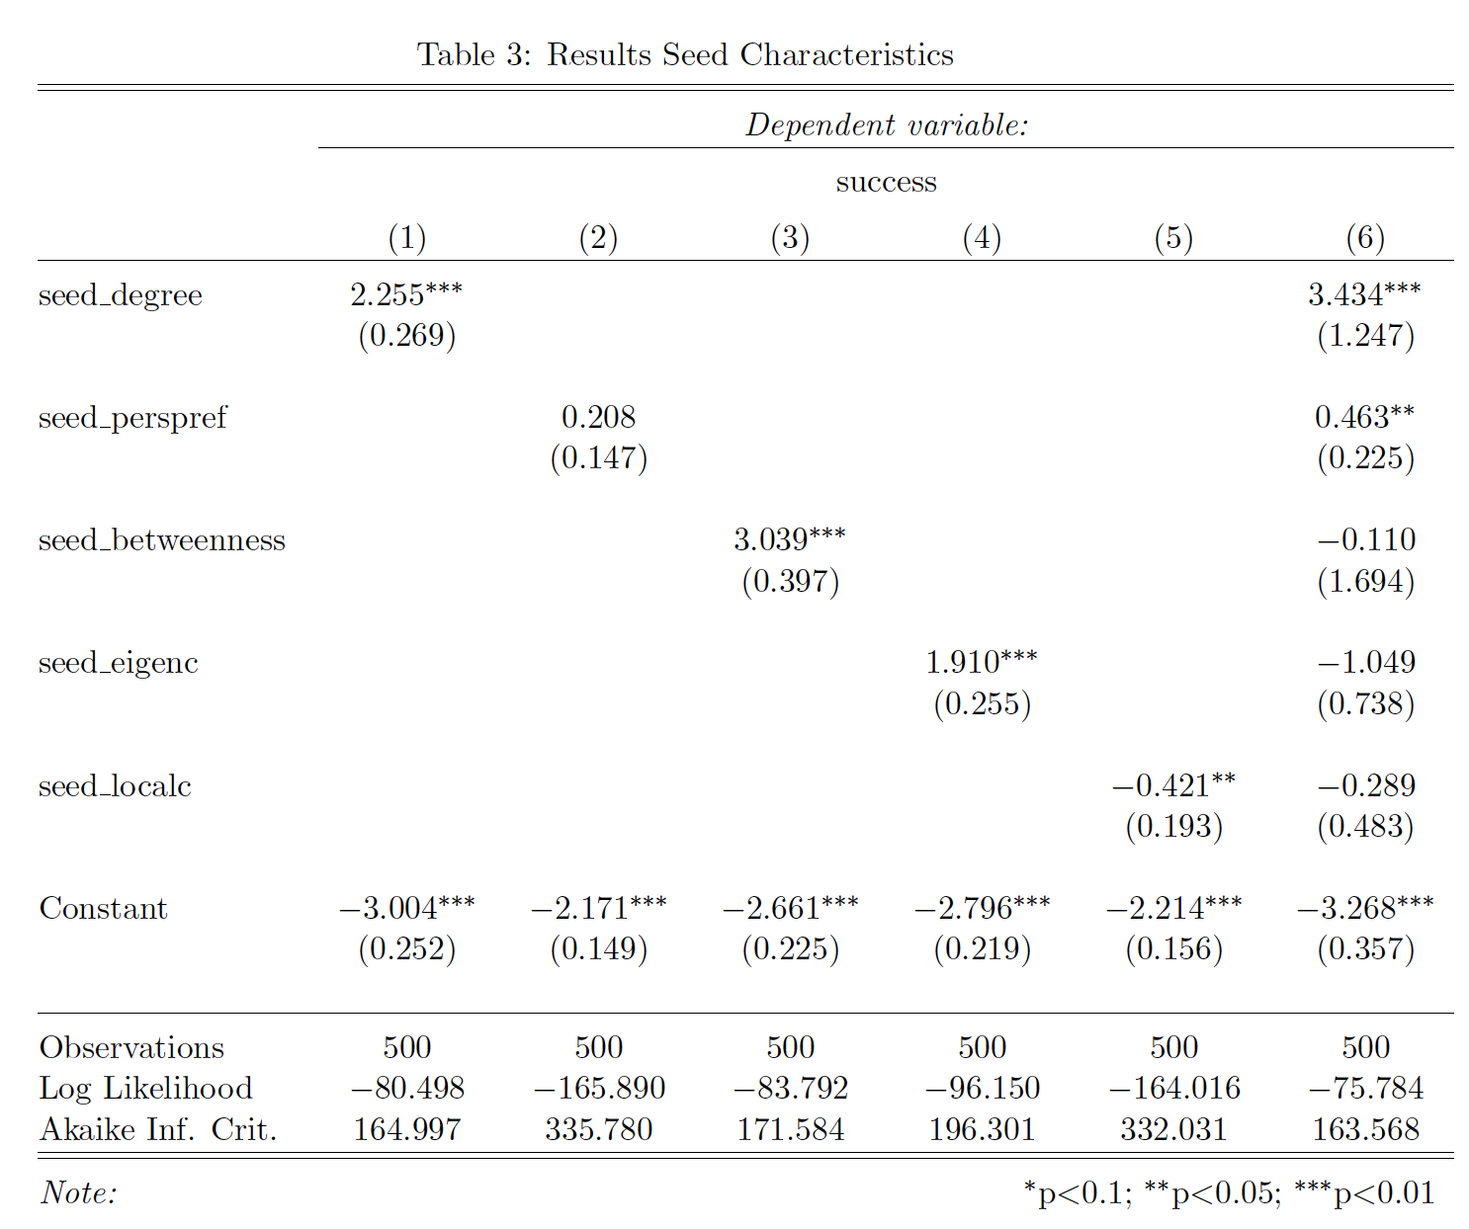
Results IV

Slide 13
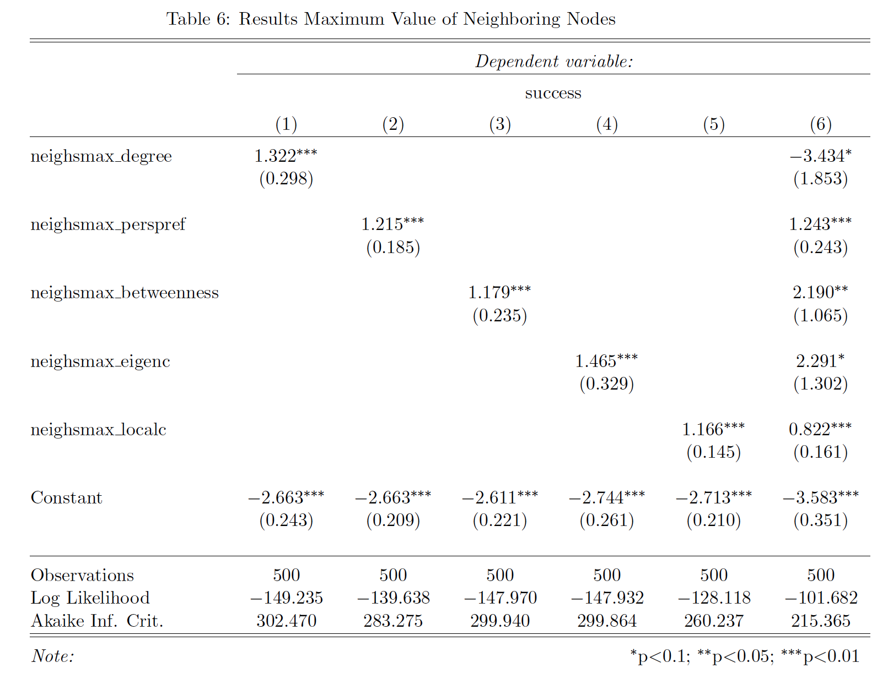
Results V

Slide 14
Conclusion and Outlook
Seeds
Centrality measures of seeds positively correlate with diffusion success
Local clustering negatively correlates (Reason: inert local clustering)
Degree is best predictor
Neighboring Nodes
Complex results
Local clustering positively correlates
Outlook
Network: Use empirical scale-free network with directed and weighted edges, and others
Model: Threshold model is new (2013); improved future models can be easily incorporated into simulation

Slide 15
Thank you for your attention!

Slide 16
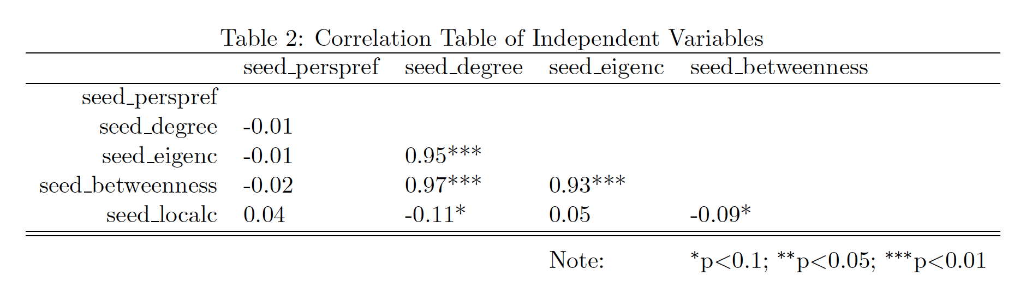
Appendix I

Slide 17
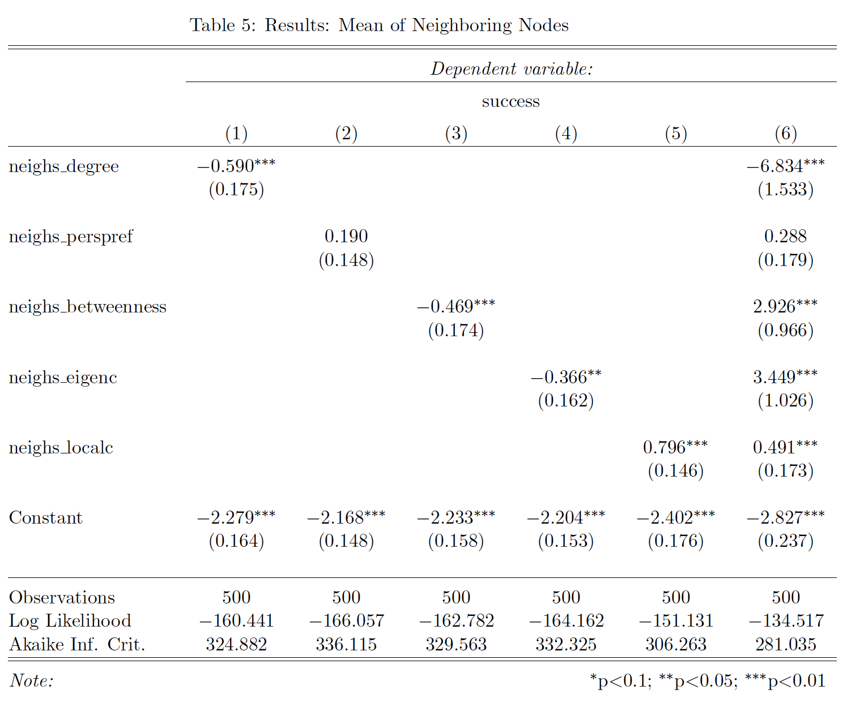
Appendix II

