Slide 1
Diffusion of Innovation and the Characteristics of Seeds
Sebastian Lechner, Adrian Oesch & Amrollah Seifoddini
December 2014

Slide 2
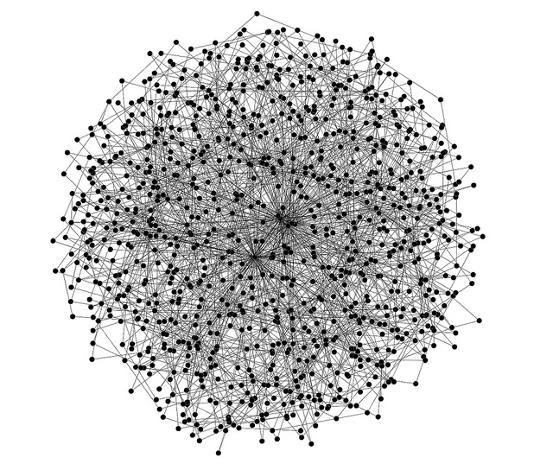
You have news for this given world. Whom do you tell first?
Degree
Betweenness Centrality
Eigenvector Centrality
Local Clustering Coefficient
?
Scale-free network by Simon Cockell
(https://www.flickr.com/photos/sjcockell/4684828794/l)

Slide 3
Goal: Which parameters of innovation seeds have an effect on the diffusion success? How large is it?
No knowledge on the seeds of innovation
Very few parameters of nodes are known to be important
Degree and Eigenvector Centrality (Delre et. al JPIM, 27: 267-282 (2010)
Number of easily influenced neighbors (Watts & Dodds, JCR, 34(4): 441-458 (2007)
Main possible application: programmability of innovation diffusion
Increase initial speed of news messages
Introduction of (disruptive) technology
Marketing strategies for novel products
...

Slide 4
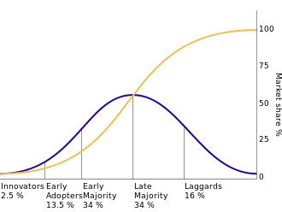
The Theory of Innovation Diffusion
Founded in 1960s
Fourt & Woodlock, Journal of Marketing, 25(2), 31-38 (1960)
Rogers, Diffusion of Innovations (1962)
others
Research mostly dominated by Marketing Research, Business Administration, Social Sciences
Few work by Network Sciences
Start at: Freeman, Research Policy, 20, 499-514 (1991)
Most common model
Social contagion model with threshold and memory of past events

Slide 5
Model
McCullen

Slide 6
Model cont.
Neighborhood utility has big effect
Threshold based synchronous update

Slide 7
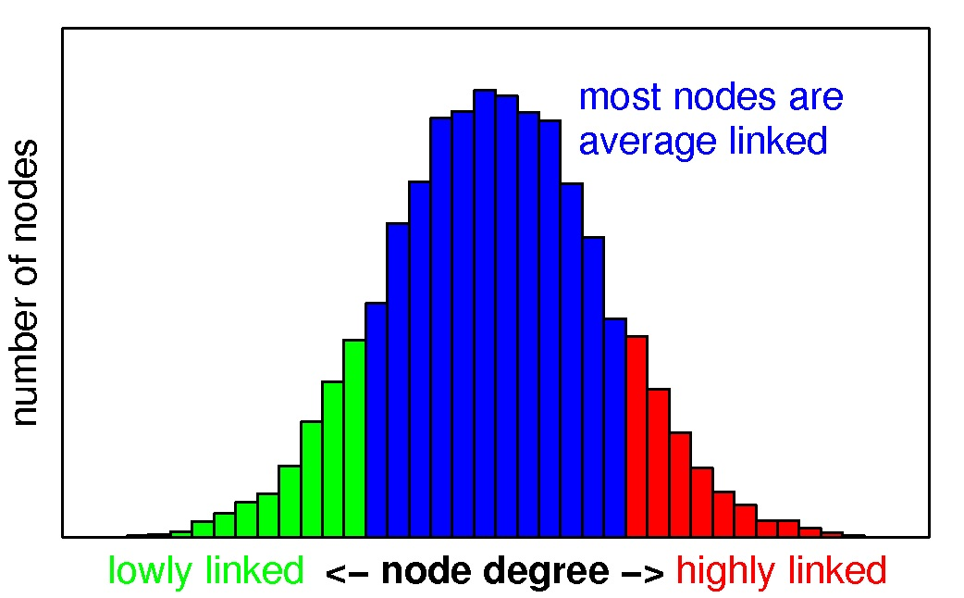
Network topology
Small-world

Slide 8
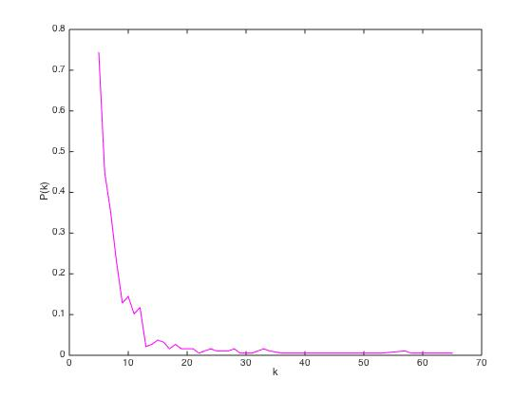
Network topology
Power-law

Slide 9
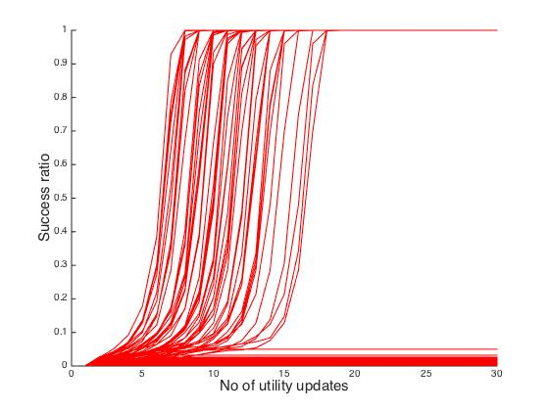
Implementation
%10 success
30 iterations

Slide 10
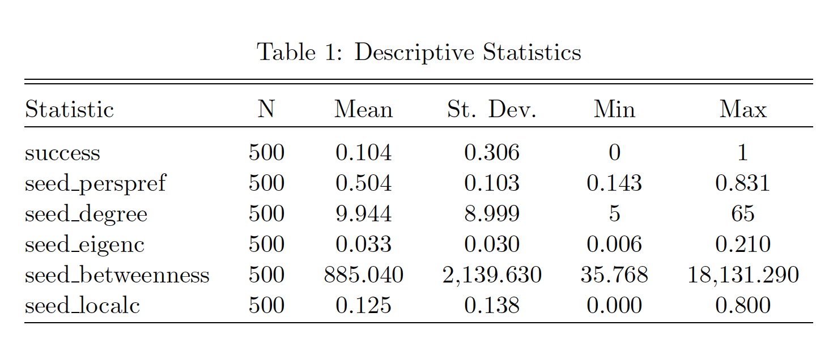
Results I – Descriptives

Slide 11
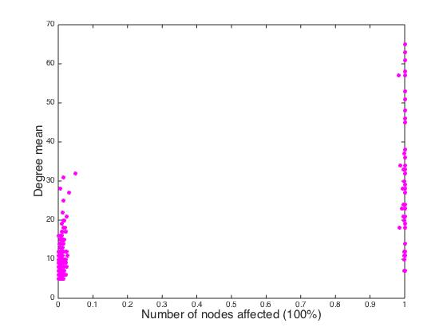
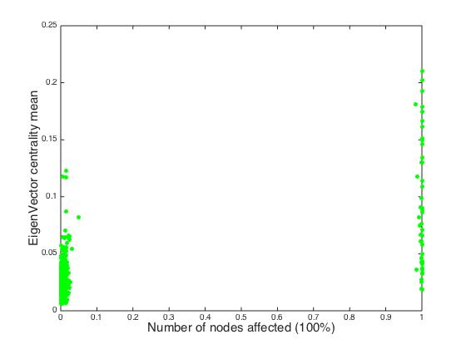
Results II - Plots

Slide 12
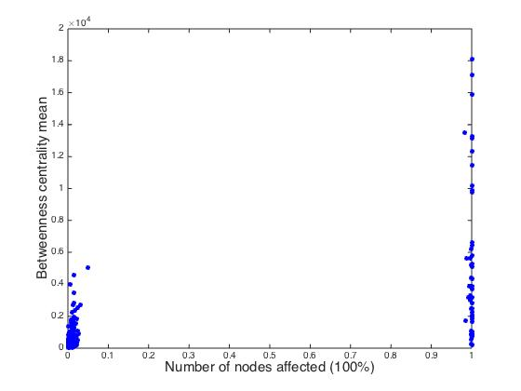
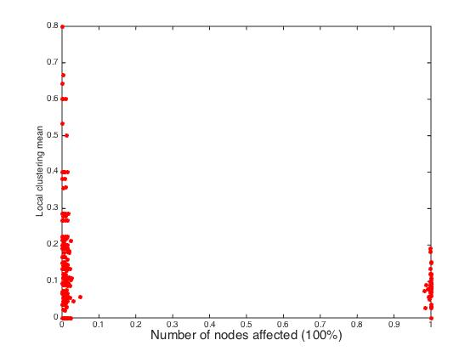
Results III - Plots

Slide 13
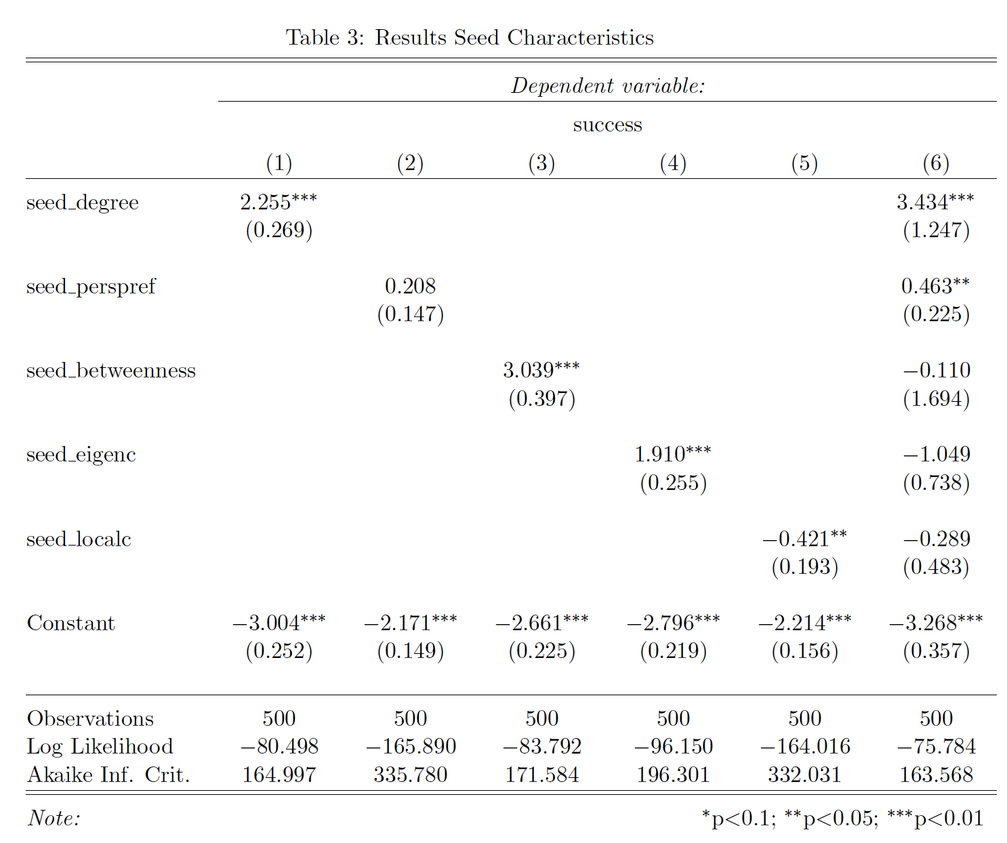
Results IV

Slide 14
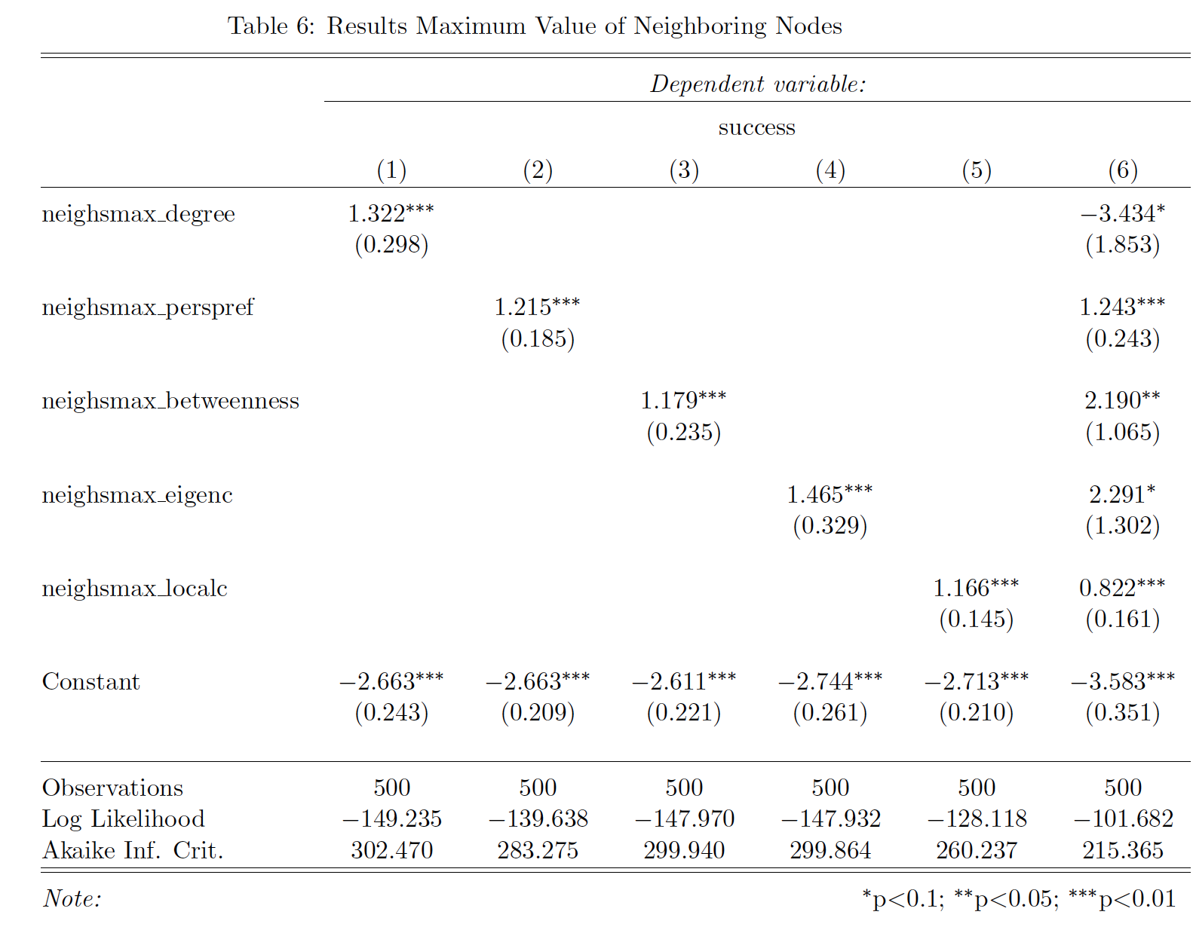
Results V

Slide 15
Conclusion and Outlook
Seeds
Centrality measures of seeds positively correlate with diffusion success
Local clustering negatively correlates (Reason: inert local clustering)
Degree is best predictor
Neighboring Nodes
Complex results
Local clustering positively correlates
Outlook
Network: Use empirical scale-free network with directed and weighted edges, and others
Model: Threshold model is new (2013); improved future models can be easily incorporated into simulation

Slide 16
Thank you for your attention!

Slide 17
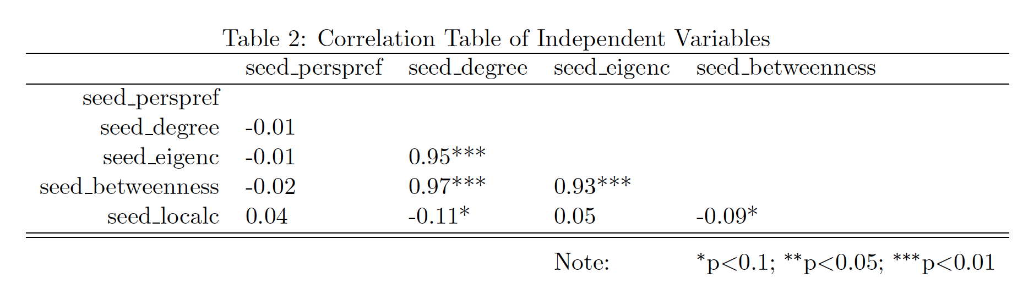
Appendix I

Slide 18
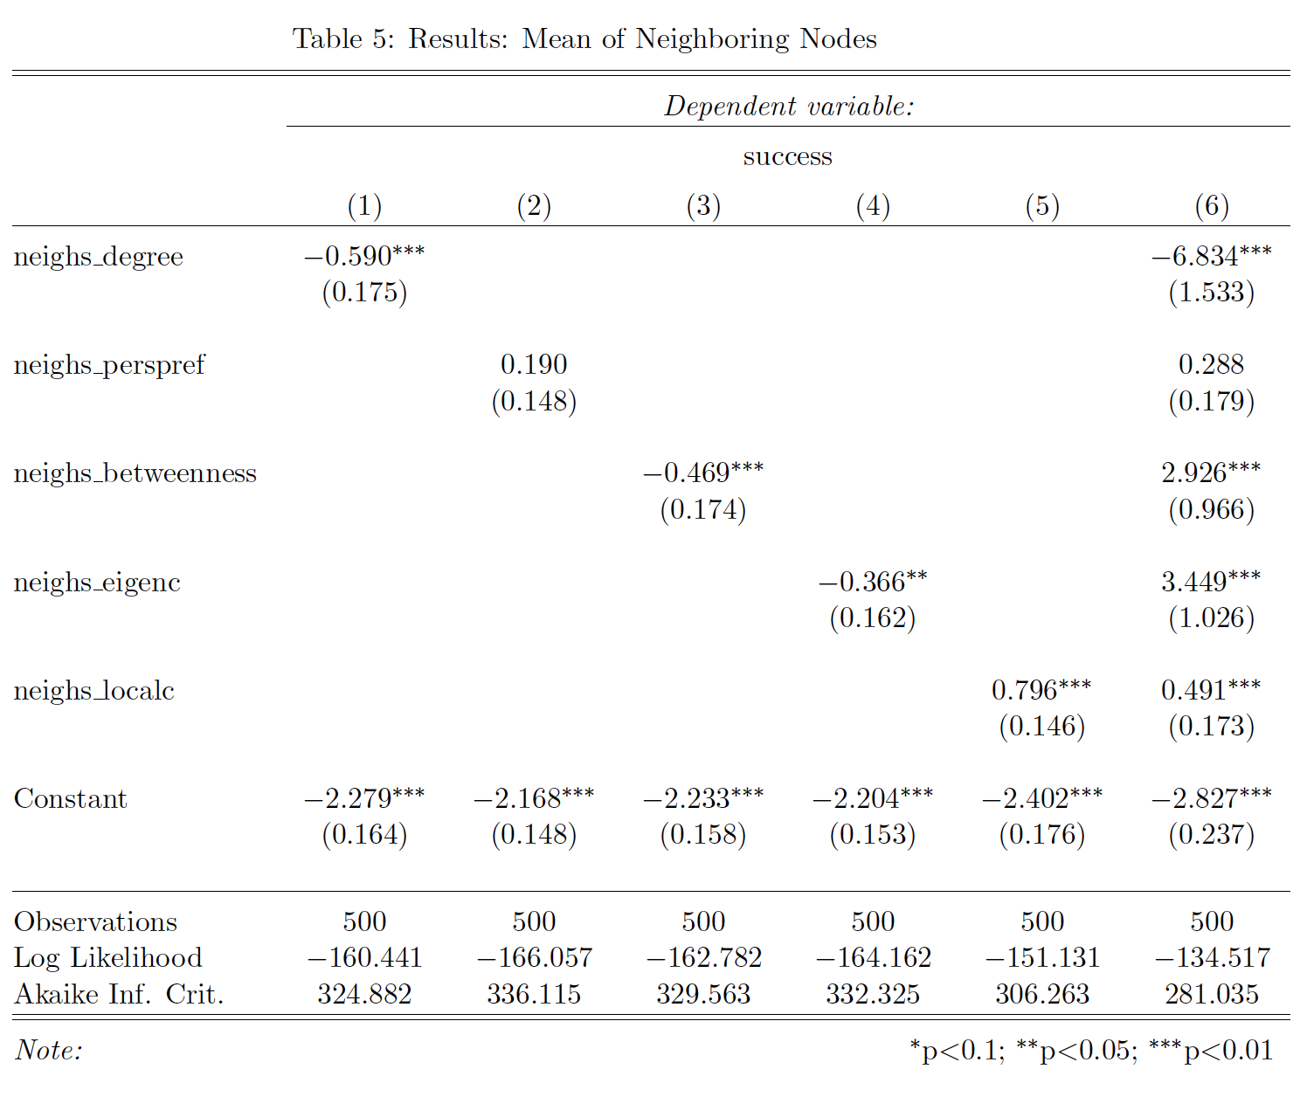
Appendix II

Slide 19
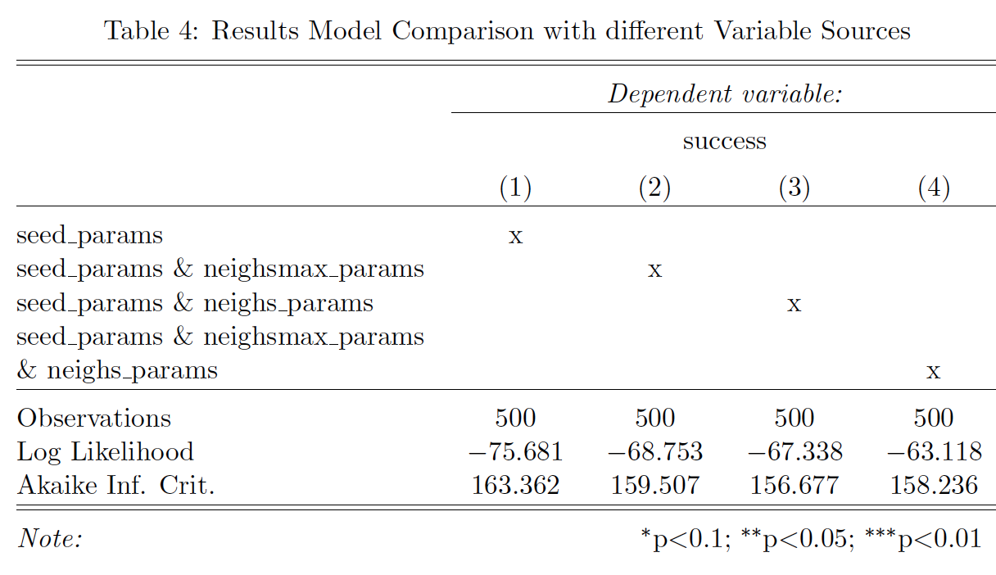
Appendix III

