Slide 1
Jupyter Notebooks with Virtualbox with Vagrant
Stat1400 and DATA1001

Slide 2
Software requirements
You will need to install a few open source tools.
These are Virtualbox, Vagrant and Git.
https://www.virtualbox.org/
https://www.vagrantup.com/downloads.html
Macbooks typically have git installed.
Windows may or may not have git installed if not here is a link.
https://gitforwindows.org/

Slide 3
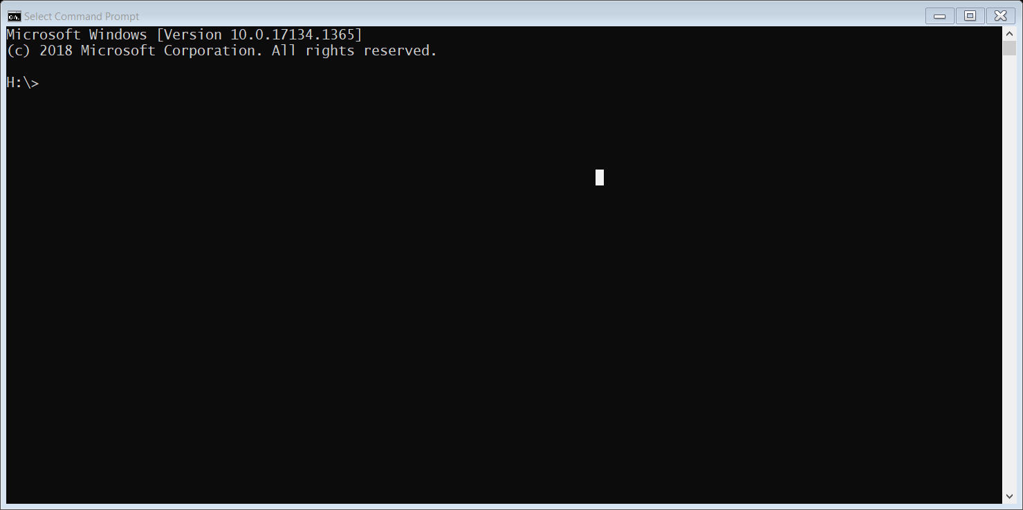
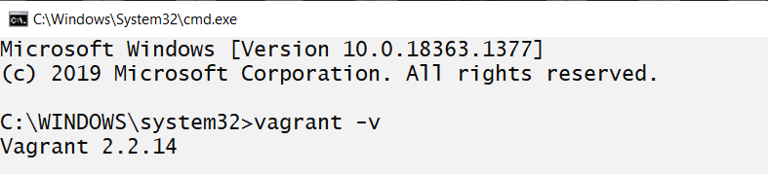
How to test if you have correctly installed virtualbox and vagrant.
On windows laptop open a “Command Prompt Terminal window”
On a macbook open the “terminal” window
Enter the command “vagrant –v”
If it returns the version number as shown above you are almost there! Next test if git is installed.

Slide 4
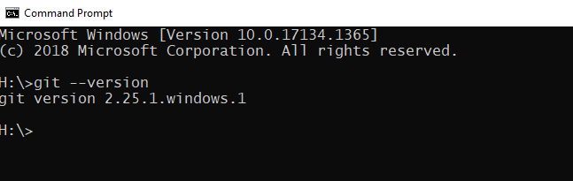
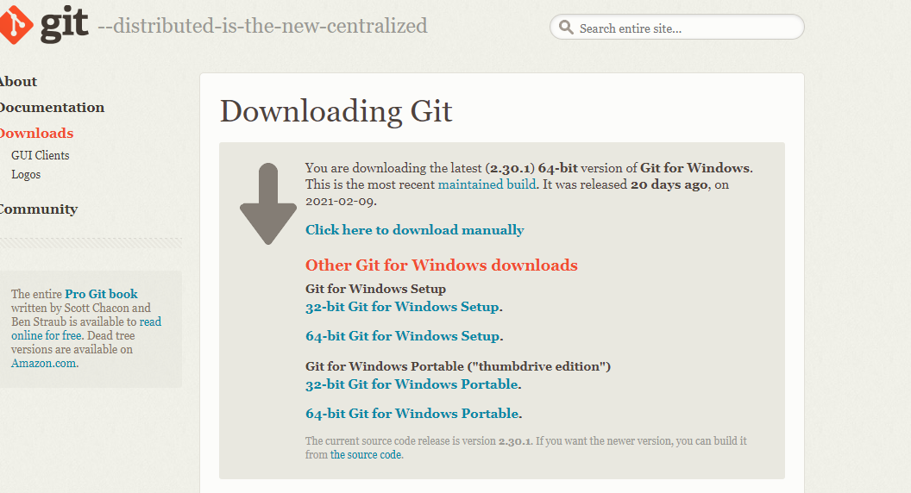
Test for git on Windows
To check if Git is install on your computer us the command git --version
If it is does return something similar to the example shown. Here is a link to the current version (2.30.1) of the software. It does not need to be the exact same version as shown!
https://gitforwindows.org/
Recommend the 64-bit Git for Windows Setup

Slide 5
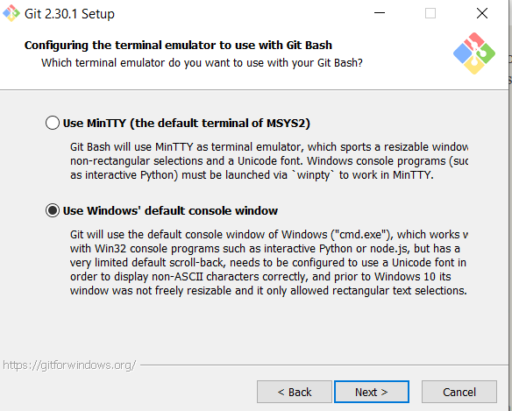
GIT INSTALLATION ISSUE for Windows
CAUTION!!
In the Git Setup / installation step:
Configuring the terminal emulator to use with Git Bash
Select the “Use Windows’ default console window”
Not the default which is set to “Use MinTTY”

Slide 6
Setup VM
Once Vagrant VirtualBox and Git are installed and working, you can then begin setting
up a Virtual Machine or VM that will run locally on your laptop.
Step 1 – create the directory structure for this project.
For Windows using the Command Prompt terminal the command is:
% mkdir Courses
For MacOS and linux the command is:
% mkdir Courses
To make the courses directory the working directory, use the command “cd”
it is the same for Windows and MacOS
% cd Courses

Slide 7
Setup VM - continued
Step 2: clone the vagrant file repository from github
For Windows and Macs this step the command is identical.
% git clone https://github.com/adrianopolpo/stat1400.git
To verify that the command worked you can inspect the current directory for the new folder.
On Windows:
dir --- this shows all the files and sub-directories in the current folder
On Macbooks/Linux
ls -- LIST so that is lower case L
You should see a directory stat1400.

Slide 8
Setup VM - continued
Step 3: Change director into the course/stat1400 directory
% cd stat1400
You can check that it worked using the “ls” or “dir” command and you should see a file named
“Vagrantfile” it contains the instructions to setup the Virtual Machine. You don’t need to make
changes to it.
Step 3a: Creating the VM
To create the VM, you must be in same directory as Vagrantfile which is the stat1400 directory.
To create the VM the Vagrant command is
% vagrant up
Coffee/Tea Break:
This will take some time as it automatically downloading and configuring the base Ubuntu OS image that is used for your VM. It is dependent on your internet connection and laptop.

Slide 9
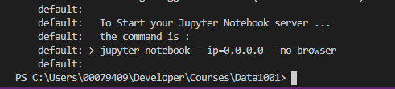
VM success
Coffee/Tea Break:
This will take some time (UP to 15 MINUTES!) as it automatically downloading and configuring the base Ubuntu OS image that is used for your VM. It is dependent on your internet connection and laptop.
When Vagrant up command finishes you should see the follow message!
You are now ready to login to your VM and start your jupyter notebook!

Slide 10
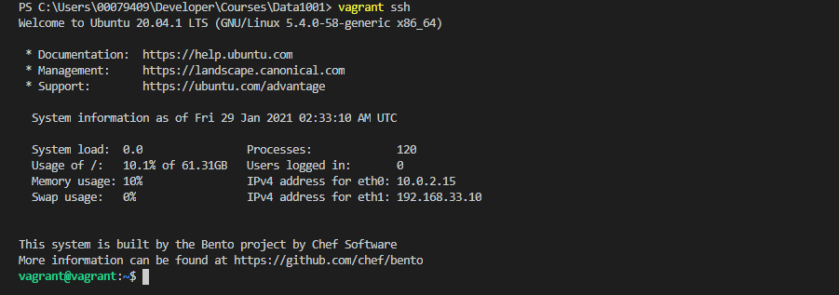
Accessing your VM
Step 4: Secure Shell (SSH) is used to login to your VM. This process of accessing you VM
has been greatly simplified with Vagrant. The command is:
> vagrant ssh

Slide 11
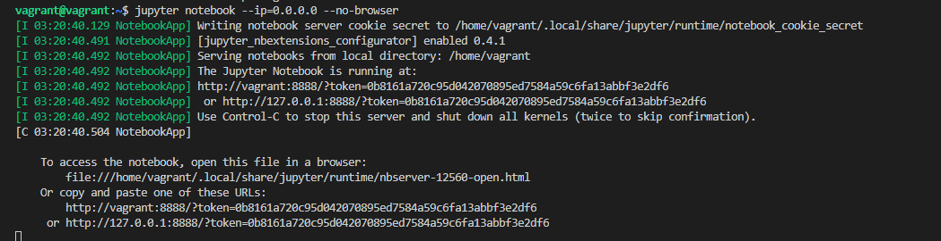
Starting the Jupyter Notebook Server
Step 5: Starting the jupyter notebook server your VM. From the command line on your VM
the command to start the jupyter notebook server is:
> jupyter notebook --ip=0.0.0.0 --no-browser
NOTE: there are 2 dashes before “ip” and “no-browser”

Slide 12

Open the Jupyter Notebook Server on a browser
Step 6: Once the jupyter notebook server is running on your VM you can then open a browser and copy and paste the URL that starts with http://127.0.0.1:8888/?token=... into
your address bar.
The token number is unique to a juptyer notebook lab SESSION while you are running the juypter notebook server.
Restarting the jupyter notebook is a new session and will generate a new token!

Slide 13
Summary of commands To Install and BUILD your VM and Start Jupyter Notebook
Step 1 - Create the project directory
mkdir courses
cd courses
Step 2 - Clone the repository with Vagrantfile
git clone https://github.com/adrianopolpo/stat1400.git
Step 3 - launch the Virtual machine
cd stat1400
vagrant up
Step 4 - use ssh to login to the virtual machine (VM)
vagrant ssh
Step 5 - start the jupyter notebook server in your virtual machine (VM)
jupyter notebook –-ip=0.0.0.0 –-no-browser
Step 6 – open jupyter notebook in browser

Slide 14
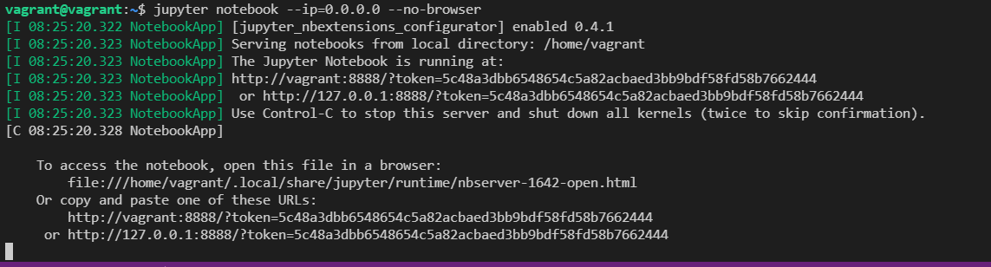
Stopping the Jupyter Notebook Server
The jupyter notebook command tells you how to stop the Jupyter Notebook Server
Use Control-C to stop this server and shut down all kernels (twice to skip confirmation)

Slide 15


How to cleanly exit the VM
There are multiple ways to exit the VM cleanly.
exit
Or
Control-D or logout

Slide 16
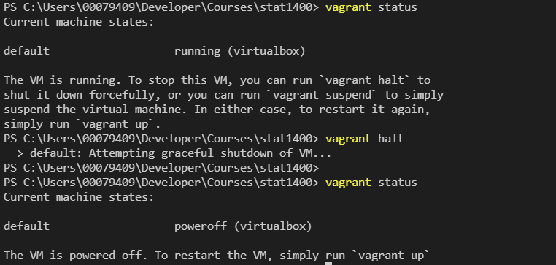
HOW TO POWEROFF your VM with VAGRANT It is important to Poweroff the VIRTUAL machine gracefully so IT restarts properly.
Vagrant Status to show the VM state.
Running - machine state
SHUTDOWN the VM
Vagrant Status to show the VM state.
POWEROFF – machine STATE

Slide 17
BASIC VM and JUPYTER NOTebook Daily management
Step 1 - Change to the project directory
cd courses
cd stat1400
Step 2 - launch the Virtual machine
vagrant up
Step 3 - use ssh to login to the virtual machine (VM)
vagrant ssh
Step 4 - start the jupyter notebook server in your virtual machine (VM)
jupyter notebook –-ip=0.0.0.0 –-no-browser
Step 5 – open jupyter notebook in browser and do the lab session
Step 6 - logout from the jupyter notebook and shutdown the juptyer notebook server
Control-C
Step 7 – exit or logout of the Virtual Machine
exit
Step 8 – shutdown the virtual machine (VM)
vagrant halt

