Slide 1
Introducing Speculation
Edward Kmett

Slide 2
Speculation
Speculation in C#
What is it?
Benchmarks!
Speculation in Haskell
Naïve Speculation
Abusing GHC
Heap Layout
Dynamic Pointer Tagging
Observing Evaluation
Speculation With Observed Evaluation
STM Issues
Downloading

Slide 3
Adding Parallelism With Guesswork
A lot of algorithms are inherently serial.
However, you can often guess at the output of an intermediate step without doing all the work.
Subsequent steps could proceed in parallel with that guess, bailing out and retrying with the actual answer if it turned out to be wrong.
The speedup is based on the accuracy of your guess and granularity of your steps. Of course it only helps to speculate when you have more resources than can be used by simpler parallelization means.

Slide 4
Speculation in C#
Prabhu, Ramalingam and Vaswani “Safe Programmable Speculative Parallelism” presented last month (June 2010) at PLDI!
Provides a pair of language primitives:
‘spec’ and ‘specfold’ for adding speculation to a program.

Slide 5
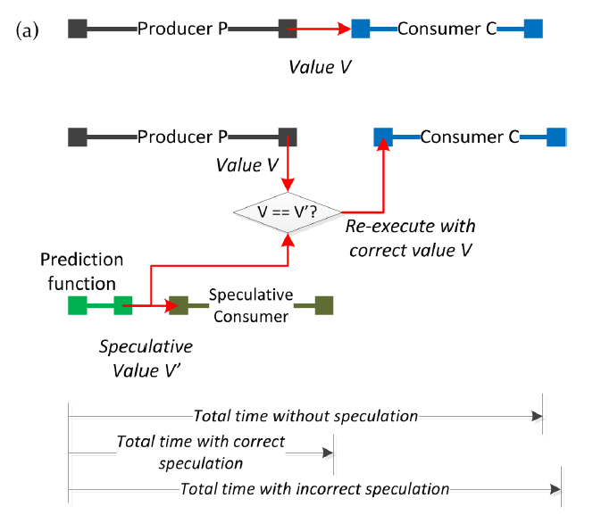
Speculation Timeline

Slide 6
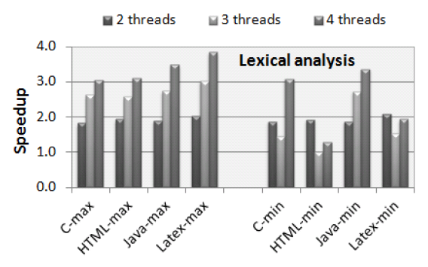
Speculative Lexing

Slide 7
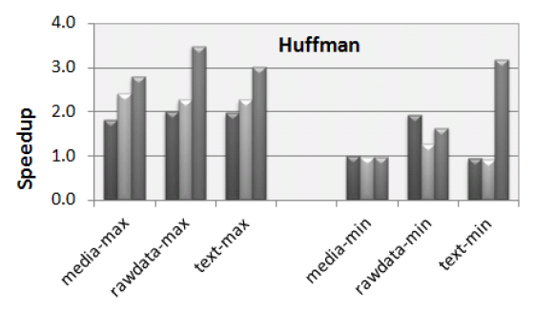
Speculative Huffman Decoding

Slide 8
Speculation in C#
Prabhu, Ramalingam and Vaswani “Safe Programmable Speculative Parallelism” presented last month ( June, 2010 ) at PLDI.
Provides a pair of combinators:
‘spec’ and ‘specfold’ for adding speculation to a program.
Easy to follow semantics...

Slide 9
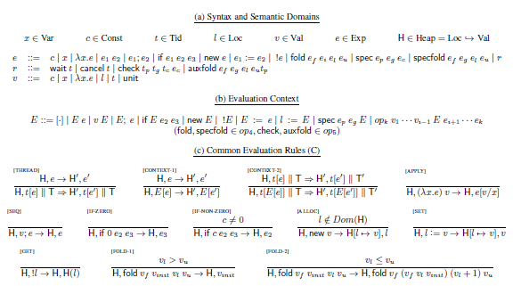
Semantics of Speculation in C# (1of 2)

Slide 10
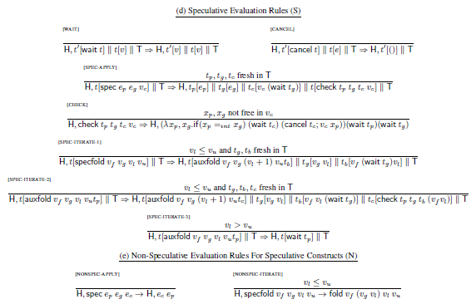
Semantics of Speculation in C# (2 of 2)

Slide 11
Any Questions?

Slide 12
Speculation in Haskell
Within 5 minutes of the paper reaching reddit, I replied with an implementation in Haskell.
Sadly, it has yet to accumulate any upvotes.

Slide 13
Speculation in Haskell
spec :: Eq a => a -> (a -> b) -> a -> b
spec guess f a =
let speculation = f guess in
speculation `par`
if guess == a
then speculation
else f a

Slide 14
Speculation in Haskell
spec :: Eq a => a -> (a -> b) -> a -> b
spec guess f a =
let speculation = f guess in
speculation `par`
if guess == a
then speculation
else f a
Without Speculation
a
f a
f $! a
With Speculation (Best Case)
a
check g == a
f guess
spec guess f a
With Speculation (Worst Case)
a
check g == a
f a
f guess |  |  |  | XXX
spec guess f a

Slide 15
Naïve Speculation
Under load the spark doesn’t even happen. Therefore we don’t kill ourselves trying to speculate with resources we don’t have! This is an improvement over the C# implementation, which can start to diverge under speculation.
If we speculated wrongly, the garbage collector (in HEAD) is smart enough to collect the entire spark!

Slide 16
I want more!
What if we already know ‘a’ by the time we go to evaluate the spec? (it may have been sparked and completed by now)
Then by construction any time spent computing a guess is wasted.
How can we check to see if ‘a’ is already known without heavyweight machinery (IO and MVars)?

Slide 17
Heap Layout
GHC uses a virtual machine called the “Spineless Tagless G-machine.” That said, It is neither truly spineless, nor, as we shall see, tagless.
Values of types that have kind * are all represented by closures. More exotic kinds exist for dealing with unboxed data.

Slide 18
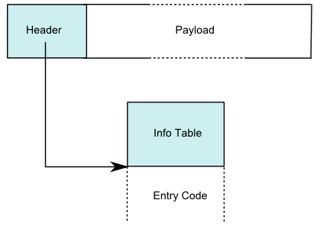
Heap Layout
The entry code for a (saturated) data constructor just returns itself.
Indirections entry code just returns the value of the target of the indirection.
Thunk entry code evaluates the thunk, and then rewrites its header into an indirection!
Garbage collection removes indirections!

Slide 19
Evaluation
ones :: [Int]
ones = 1 : ones
thunk_1234
ones =

Slide 20
Evaluation
ones :: [Int]
ones = 1 : ones
STG_IND
ones =
(:)
I# 1

Slide 21
Evaluation
ones :: [Int]
ones = 1 : ones
(:)
ones =
I# 1

Slide 22
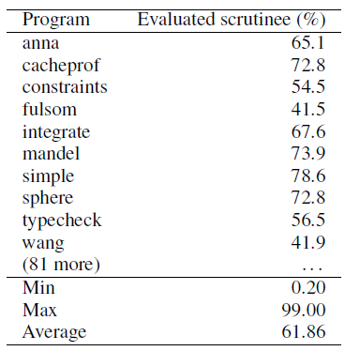
Dynamic Pointer Tagging
Jumping into unknown code to “evaluate” already evaluated data is inefficient.
More than half the time, the target is already evaluated.

Slide 23
Dynamic Pointer Tagging
Adapts a trick from the LISP community.
Steal a few unused bits (2 or 3 depending on architecture) from each pointer to indicate constructor -- they were aligned anyways!.
If unevaluated or too high an index to fit, use 0
Let GC propagate the tags!
~13% Speed Increase. Implemented in 2007.

Slide 24
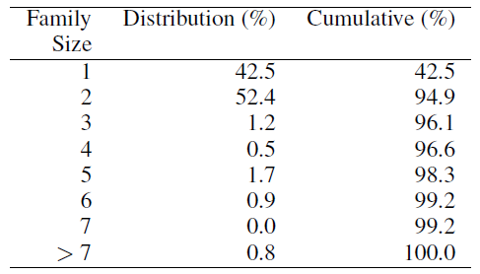
Dynamic Pointer Tagging
Handles 99.2% (96.1%) of constructors in practice

Slide 25
Abusing Dynamic Pointer Tags
Can we get at the tag from Haskell?
data Box a = Box a
unsafeGetTagBits :: a -> Int
unsafeGetTagBits a =
unsafeCoerce (Box a) .&.
(sizeOf (undefined :: Int) – 1)
Relies on the fact that we can treat a Box as an Int due to tagging! In practice we can use the unsafeCoerce# primop to directly coerce to an unboxed Word#, and avoid the extra box.

Slide 26
Abusing Dynamic Pointer Tags
This function is unsafe! It may return either 0 or the final answer depending on if the thunk it is looking at has been evaluated and if GC has run since then, but it’ll never lie about the tag if not 0.
You have an extra obligation: Your code should give the same answer regardless of whether or not unsafeGetTagBits returns 0!
But that is exactly what ‘spec’ does!

Slide 27
Smarter Speculation
spec :: Eq a => a -> (a -> b) -> a -> b
spec guess f a
| unsafeGetTagBits a /= 0 = f a
| otherwise =
let speculation = f guess in
speculation `par`
if g == a
then speculation
else f a

Slide 28
Is that it?
The complicated semantics for the C# implementation come from checking that the speculated producer (guess) and consumer could read and write to references, without seeing side-effects from badly speculated code.
We don’t have any side-effects in pure code, so we can skip all of those headaches in the common case, but how can we model something where these transactional mutations occur?

Slide 29
Speculating STM
specSTM :: Eq a => STM a –> (a -> STM b) -> a -> STM b
specSTM mguess f a = a `par` do
guess <- mguess
result <- f guess
unless (guess == a) retry
return result
`orElse`
f a

Slide 30
Problems with Speculating STM
specSTM :: Eq a => STM a –> (a -> STM b) -> a -> STM b
specSTM mguess f a = a `par` do ...
Before we could spark the evaluation of f guess, so that if it was forgotten under load, we reverted more or less to the original serial behavior.
Here we are forced to evaluate the argument in the background! The problem with this shows up under load.

Slide 31
Problems with Speculating STM
Under load, the spark queue will fill up and ‘spec’ will skip the evaluation of the spark, in its case, ‘f guess’, before returning either ‘f a’ or ‘f guess’ based on comparing ‘guess’ with ‘a’. So the only wasted computation is checking ‘guess == a’
However, specSTM can merely skip the evaluation of ‘a’, because evaluating ‘f guess’ needs the current transaction, which is bound deep in the bowels of GHC to the current thread and capability, etc. Therefore, it can only skip the only thing we know it will actually need, since it ultimately must check if ‘guess == a’, which will need the value of ‘a’ that we sparked.

Slide 32
Paths to Resolution
In order to ape the behavior of ‘spec’ in ‘specSTM’ we need a mechanism to either hand off a transaction to a spark and get it back when we determine the spark isn’t needed -- blech
Or we need a mechanism by which we can determine if the system is ‘under load’ and avoid computing ‘f guess’ at all.

Slide 33
How Loaded is Loaded?
Ultimately the definition of under load is somewhat tricky. You can’t just look at the load of the machine. It is the depth of the spark queue that determines if you’re loaded!
All we need to do is count the number of entries in the spark queue for the current capability. In “C--”:
dequeElements(cap->spark)

Slide 34
Adding numSparks#
What we need is a new “primop”:
numSparks# :: State# s -> (# State# s, Int# #)
GHC has even added the ability to let third-party libraries define their own primops so that they could factor out the use of GMP from base and into its own library!
Sadly, the details of ‘cap’ and ‘spark’ are buried in GHC’s “private” headers and so we can’t exploit this mechanism. The extension has to be done in GHC itself. (feature request #4167)

Slide 35
Speculative Folds
foldr :: (Foldable f, Eq b) => (Int -> b) -> (a -> b -> b) -> b -> f a -> b
Takes an extra argument that computes the guess at the answer after n items, the last n items.
This way the estimator is counting the number of items being estimated. Otherwise foldr over the tail of a list would be receiving entirely different numbers.

Slide 36
Speculative Folds
foldr :: (Foldable f, Eq b) => (Int -> b) -> (a -> b -> b) -> b -> f a -> b
foldr guess f z = snd . Foldable.foldr f’ (0, z)
where
f’ a (!n, b) = (n + 1, spec (guess n) (f a) b)

Slide 37
Speculation on Hackage
‘speculation’ on hackage is currently at version 0.9.0.0
It provides:
Control.Concurrent.Speculation
spec, specSTM, unsafeGetTagBits and generalizations
And a number of modules full of speculative folds:
Data.List.Speculation (scanl, etc.)
Data.Foldable.Speculation (foldl, foldr, etc.)
Data.Traversable.Speculation (traverse, etc.)
Control.Morphism.Speculation (hylo!)

Slide 38
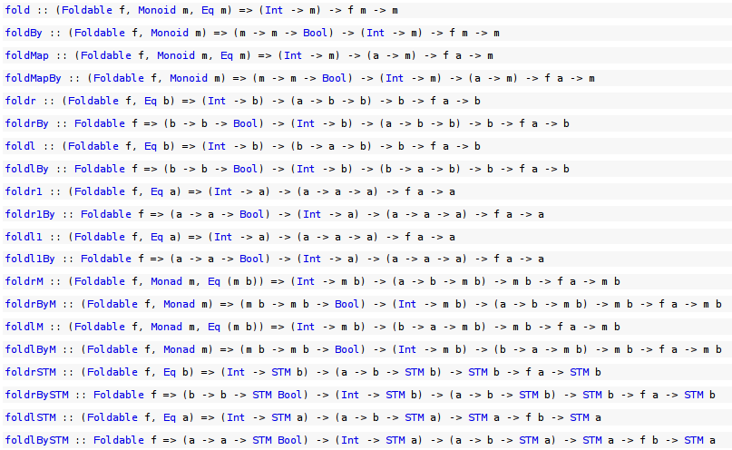
Lots of Combinators! Data.Foldable.Speculation

Slide 39
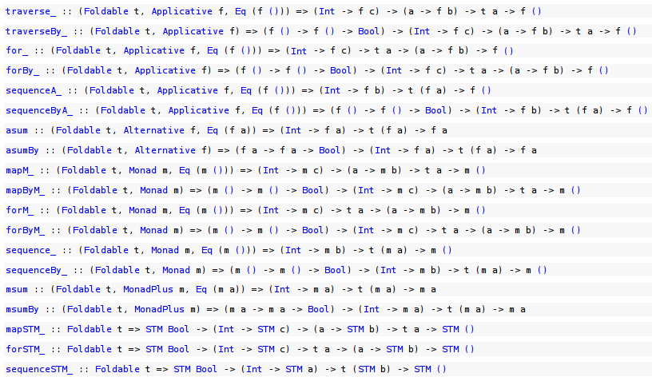
Lots of Combinators! Data.Foldable.Speculation
...

Slide 40
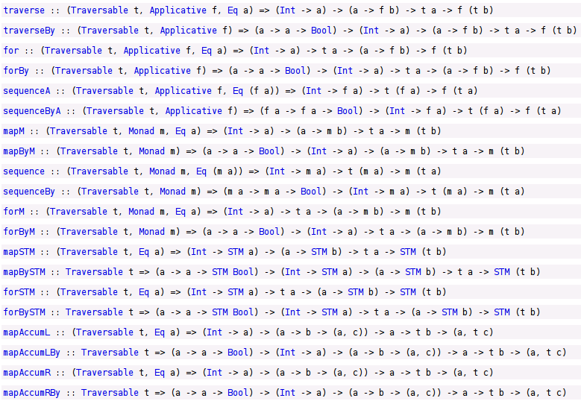
Lots of Combinators! Data.Traversable.Speculation

Slide 41
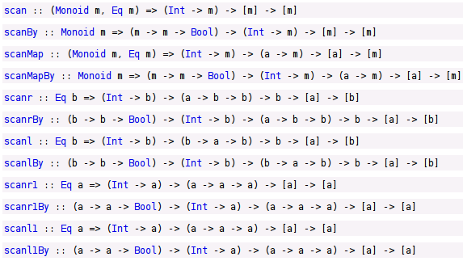
Lots of Combinators! Data.List.Speculation

Slide 42

Lots of Combinators! Control.Morphism.Speculation

Slide 43
Future Directions
Feedback, so that if an estimator is consistently not working, we can eventually give up
Common estimators
e.g. evaluating a fold over a fixed sliding window
Benchmarks! Building a speculative lex clone
I speculate that it will be fast!
“Partial guesses” and early exit from obviously wrong speculations
Spoon?
Exploiting unsafeGetTagBits in other environments
Faster Data.Unamb/Data.Lub?

Slide 44
Lessons for the Real World
If you don’t know what to tell someone, guess!
Then send them off with that, while you finish computing the real answer.
If you find out you were wrong, kill them, hide the body, and tell their replacement the real answer.
If they would bottleneck on you, and you are a good guesser, your (surviving) team may get to go home a little bit earlier.

Slide 45
EXTRA SLIDES

Slide 46
Dynamic Pointer Tagging
Simon Marlow, Alexey Rodriguez Yakushev, Simon Peyton Jones, Faster Laziness using Dynamic Pointer Tagging.

