Slide 1
Going Serverless
Adrian Pomilio

Slide 2
bio
Adrian Pomilio
Github/Twitter : adrianpomilio
20+ years of application design and development
Mapp Digital
Opinions and ideas expressed are solely my own and do not express the views or opinions of my employer
I’m learning everyday

Slide 3
Agenda
What is it
Why do it
How to do it

Slide 4
Who’s doing it!
Google Cloud Functions
IBM Open Whisk
Microsoft Azure
AWS Lambda
Kubernetes - Kubeless
Iron.io
And more…

Slide 5
What is Serverless
Functions as a service?
Events based programming?
An HTTPS interface? (https://serverless.zone/everything-is-an-https-interface-ead2e888b31)
No DevOps?
Collection of services?
Magic?

Slide 6
What is Serverless
“Serverless architectures refer to applications that significantly depend on third-party services or on custom code that’s run in ephemeral containers (Function as a Service)”
-- Martin Fowler
https://martinfowler.com/articles/serverless.html

Slide 7
Why Serverless
Scalable
Managed
Services
Cost

Slide 8
Use Cases we will see this again
3 Tier Web Application
Batch Processing
Stream Processing
Automation
Mobile backends
IoT backends

Slide 9
Why NOT Serverless
Fine grained environment control is needed
On-premise/co-location applications not available in the public cloud
PII issues with data and customer contracts

Slide 10
Scalable
Auto scaling based on calls
Manually scale with settings
Scale units of computing instead of servers
Scales back down

Slide 11
Managed
No runtimes to install
No servers to provision
No “INFRAopps”
No logging setup
Data replication
Etc.

Slide 12
Cost
Pay for usage
Pay for capacity
No need to over-provision

Slide 13
The AWS view

Slide 14




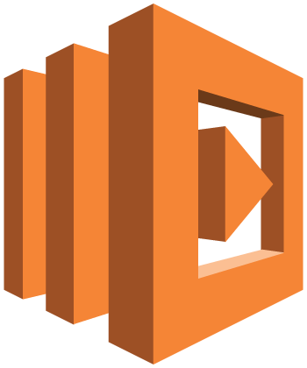




AWS Serverlesss pieces (some)
Amazon API Gateway*
AWS CloudFormation
Amazon S3
IAM
AWS
Lambda
Amazon DynamoDB
Amazon Cognito
Amazon CloudWatch
AWS CLI

Slide 15
Use Case patterns
3 Tier Web Application
Batch Processing
Stream Processing
Automation
And more…

Slide 16
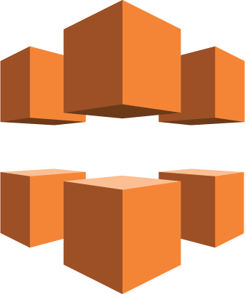

3 Tier Web Application
Amazon CloudFront
Amazon S3
Browser
Amazon API Gateway*
AWS
Lambda
Amazon DynamoDB

Slide 17

Batch Processing
S3 Object
AWS
Lambda
Amazon DynamoDB
Amazon S3

Slide 18
AWS Cost a closer look
Lambda
Free tier (1 million requests)
https://aws.amazon.com/lambda/pricing/
API Gateway
$3.50 per million API calls + data transfer
$0.09 / GB for the first 10 TB
https://aws.amazon.com/api-gateway/pricing/
S3
$0.023 / GB for the first 50TB per month
https://aws.amazon.com/s3/pricing/
DynamoDB
Free tier (200 million requests per month: 25 read/25 write, 25GB of storage)
https://aws.amazon.com/dynamodb/pricing/

Slide 19
Lambda the rabbit hole

Slide 20
Lambda what is it
AWS Lambda is a compute service that lets you run code without provisioning or managing servers
— AWS Documentation
The FUNCTION in FaaS
Scalable
Pay per use
Managed
No admininstration

Slide 21
Lambda language/runtime support
NodeJS
Python
C#
DLLs too
Java
This includes JVM languages… Scala, Kotlin, etc.
Shell scripts
Executables
Pretty much anything within reason ☺
https://aws.amazon.com/blogs/compute/running-executables-in-aws-lambda/

Slide 22
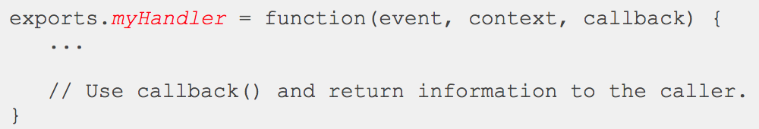
Lambda function signature
Event – passes the event data into the handler
Context – runtime information
Callback – (optional)
http://docs.aws.amazon.com/lambda/latest/dg/nodejs-prog-model-handler.html

Slide 23

Lambda what it really looks like
Lambda Metadata is stored in DynamoDB
Lambda code and dependencies are stored in S3
Lambda runtime
EC2 Container
AWS
Lambda

Slide 24
API-Gateway
REST endpoint provider
Built in monitoring (CloudWatch)
Run APIs without servers
Scalable
Develop efficiently

Slide 25
How to
Console
Manual
Frameworks

Slide 26
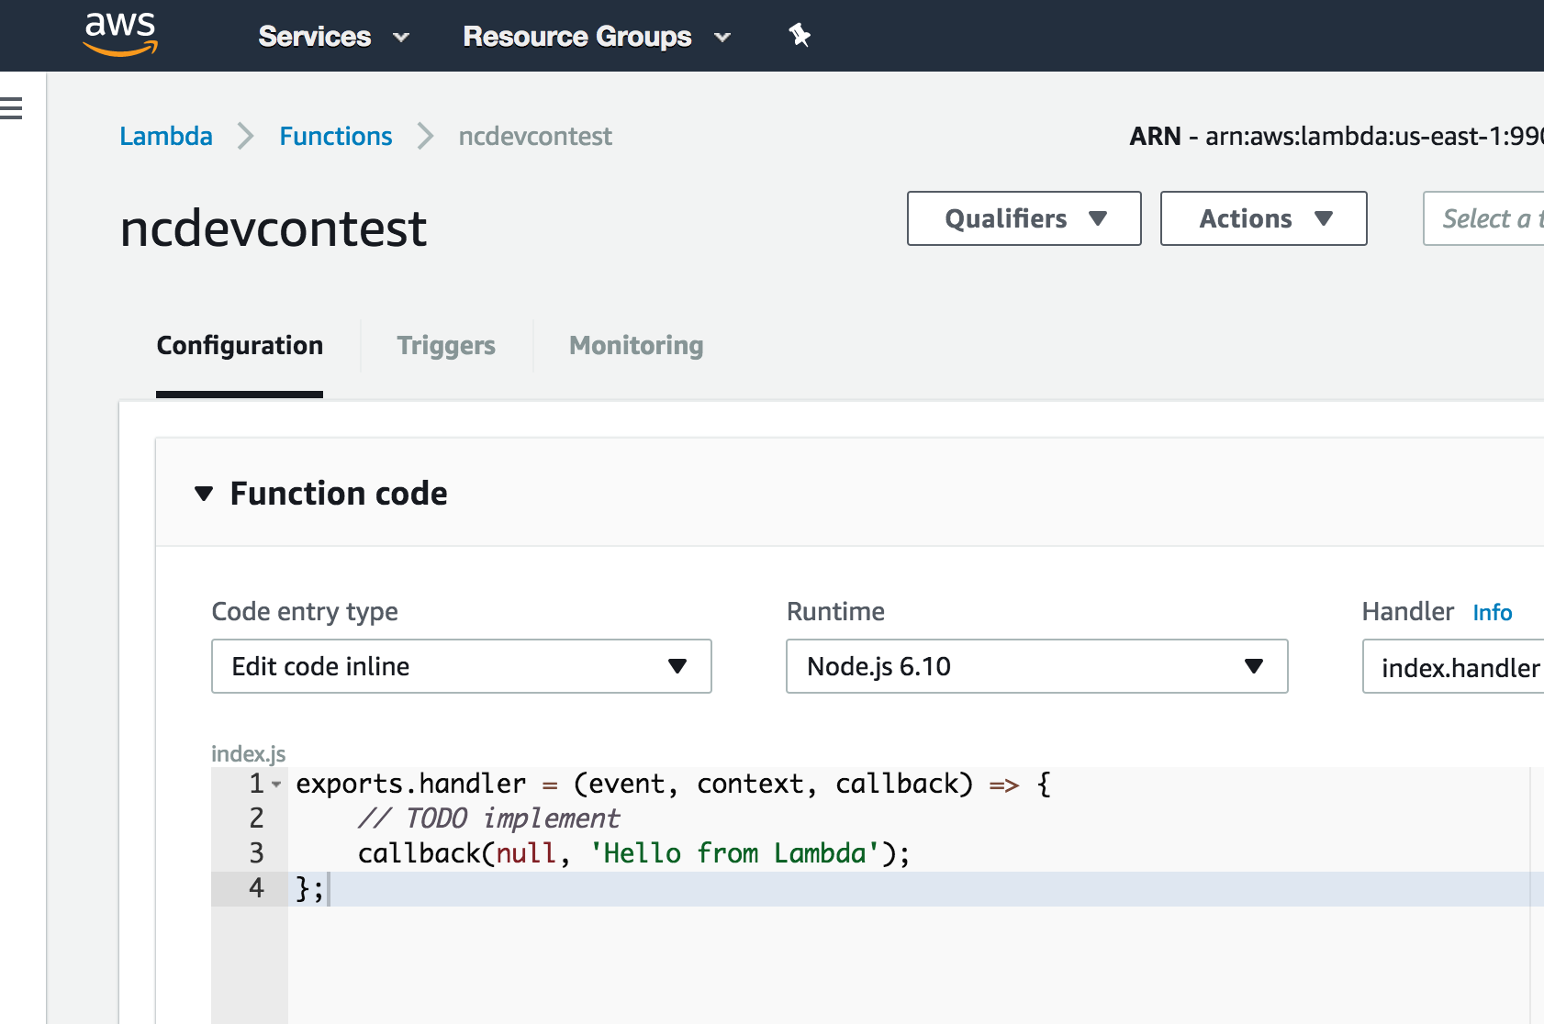
Console just don’t

Slide 27
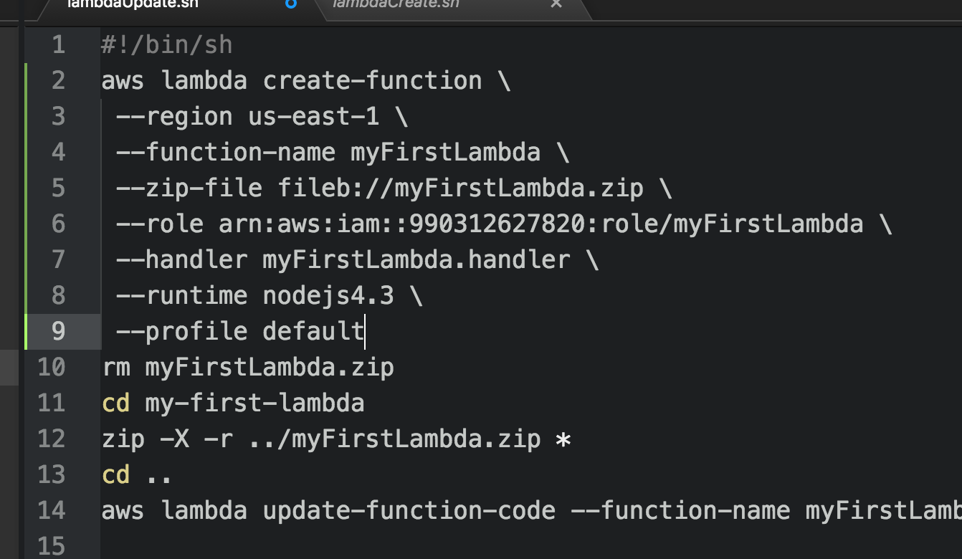
Manual oh joy!

Slide 28
Frameworks now we’re getting somewhere
Apex
AWS Sam
Serverless

Slide 29
Serverless the framework
Serverless: https://serverless.com
Works for multiple providers
Works with multiple templates
Very similar to cloud formation templates
Sanity for the developers

Slide 30
Additional resources
AWS Labs: https://github.com/awslabs
Pricing example: https://alestic.com/2016/12/aws-invoice-example/
A Cloud Guru: https://acloud.guru/
Serverless: https://serverless.com/
AWS Serverless: https://aws.amazon.com/serverless/
Optimizing Enterprise Economics for Serverless Architecture: https://d0.awsstatic.com/whitepapers/optimizing-enterprise-economics-serverless-architectures.pdf

Slide 31
Questions

