Slide 1
Going Serverless
Adrian Pomilio

Slide 2
bio

Slide 3
Agenda
What is it
Who provides it
Why do it
How to do it

Slide 4
Who
Google Cloud Functions
IBM Open Whisk
Microsoft Azure
AWS Lambda

Slide 5
What is it
Functions as a service
Events
Everything is an HTTPS interface (https://serverless.zone/everything-is-an-https-interface-ead2e888b31)
APPopps not INFRAops

Slide 6
Why
Scalable
Managed
Leverage Services
Cost

Slide 7
AWS Focus

Slide 8




Lambda – what it really looks like
AWS
Lambda
Lambda Metadata is stored in DynamoDB
Lambda code and dependencies are stored in S3
Lambda runtime
EC2 Container

Slide 9
Managed

Slide 10
Lambda scaling
Lambda – on a unit of work
Streaming source types
Synchronous source types
(https://cloudncode.blog/2017/03/02/best-practices-aws-lambda-function/)
Concurrent Invocations = events (or requests) per second * function duration (in secs)
(http://docs.aws.amazon.com/lambda/latest/dg/concurrent-executions.html)

Slide 11
Leverage Services
Cognito
S3
SNS
Kinises
Etc..

Slide 12
Cost

Slide 13
Patterns
3 Tier Web Application
Batch Processing
Stream Processing
Automation
And more…

Slide 14
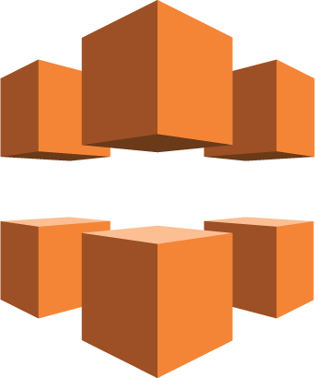


3 Tier Web Application
Amazon CloudFront
Amazon S3
Browser
Amazon API Gateway*
AWS
Lambda
Amazon DynamoDB

Slide 15

Batch Processing
S3 Object
AWS
Lambda
Amazon DynamoDB
Amazon S3

Slide 16
Stream Processing

Slide 17
Automation

Slide 18
How to
Console
Manual
Frameworks

Slide 19
Console
STOP right now

Slide 20
Manual
Here’s an anchor to swim with

Slide 21
Frameworks
Apex
AWS Sam
Serverless

Slide 22
Questions

