Slide 1
Going Serverless
Adrian Pomilio

Slide 2
bio

Slide 3
Agenda
What is it
Who provides it
Why do it
How to do it

Slide 4
What is it
Functions as a service
Events
Everything is an HTTPS interface (https://serverless.zone/everything-is-an-https-interface-ead2e888b31)
APPopps not INFRAops

Slide 5
Who
Google Cloud Functions
IBM Open Whisk
Microsoft Azure
AWS Lambda

Slide 6
Why
Scalable
Managed
Leverage Services
Cost

Slide 7
Managed

Slide 8
Scalable

Slide 9
Leverage Services
Cognito
S3
SNS
Kinises
Etc..

Slide 10
Cost

Slide 11
Patterns
3 Tier Web Application
Batch Processing
Stream Processing
Automation
And more…

Slide 12
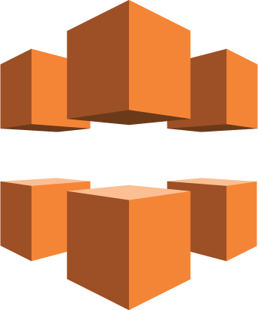
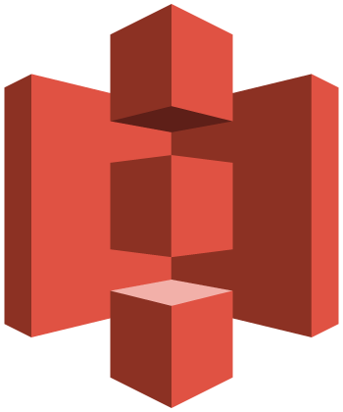


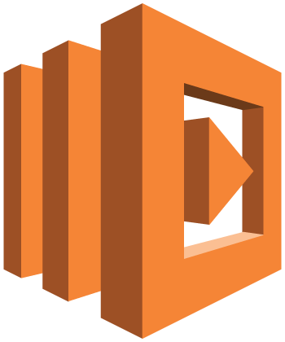

3 Tier Web Application
Amazon CloudFront
Amazon S3
Browser
Amazon API Gateway*
AWS
Lambda
Amazon DynamoDB

Slide 13

Batch Processing
S3 Object
AWS
Lambda
Amazon DynamoDB
Amazon S3

Slide 14
Stream Processing

Slide 15
Automation

Slide 16
How to
Console
Manual
Frameworks

Slide 17
Console
STOP right now

Slide 18
Manual
Here’s an anchor to swim with

Slide 19
Frameworks
Apex
AWS Sam
Serverless

Slide 20
Questions

