Slide 1
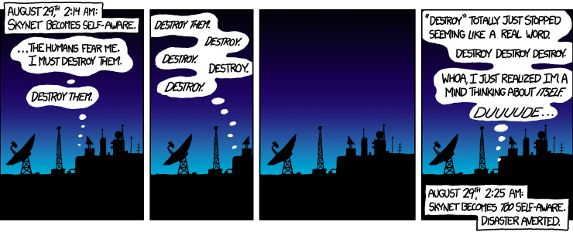
Our JavaScript can beat up Skynet
Not really, but maybe someday
Just go with it..

Slide 2
About me
UI Architect at Teradata
Love to hack on something new all the time
DJ on @Codebass
On twitter @adrianpomilio

Slide 3
“They” are watching
No fun list
http://www.faa.gov/uas/publications/model_aircraft_operators/
FAA shuts down drone program at university
http://www.forbes.com/sites/gregorymcneal/2014/08/31/faa-grounds-university-plan-to-educate-students-with-drones/
Notes:
Who’s doing what?
Amazon
Google
Lakemaid Beer
https://www.youtube.com/watch?v=qmHwXf8JUOw

Slide 4
Rise of the machines
Archimedes – 3rd century BC
Automatons – 3rd century BC to present
Heron (Hero) of Alexandria – 10 -75 AD
Villard de Honecourt – 1230 ish
Galileo – 1600
Jacques de Vaucanson - 1737
William Grey Walter – 1948
Unimate - 1954
Notes:
Archimedes discovers the principle of mechanical advantage
levers
pulleys
screw
Automatons – self acting
Heron of Alexandria
described 5 mechanisms to put a load in motion
pneumatics and hydralics
Galileo – completed the theory of simple machines
first to understand machines don’t create energy but transform it
Vaucanson – succesfully buil first biomechanical automaton , The Flute Player
Walter – creates first electronic autonomous robot
Unimate – first digital Programmable robot invented by George Devol

Slide 5
Rise of our machines
Arduino – 2005
Google V8 - 2008
NodeJS - 2009
Raspberry Pi Foundation – 2009
Node Serialport – 2011
Johnny-five - 2012
Notes:
http://en.wikipedia.org/wiki/Villard_de_Honnecourt first sketches of mechanical devices

Slide 6
Atwood’s Law
Any application that can be written in JavaScript, will eventually be written in JavaScript.
– Jeff Atwood, July 17, 2007
Notes:
Atwood’s Law: Any application that can be written in JavaScript, will eventually be written in JavaScript. – Jeff Atwood, July 17, 2007

Slide 7
Native JavaScript machines
Tessel - https://tessel.io/
Espruino - http://www.espruino.com/
Notes:
JavaScript microcontrollers http://makezine.com/magazine/first-look-javascript-micro-controllers-for-web-developers/
A quick look at the Tessel.

Slide 8
Pitfalls
Documentation can be spotty
What to buy
Instructions or parts list are a luxury
Libraries and modules change names
Hidden requirements (aka drivers)
Doh! Serial port!
Debugging hardware as well as software
You make people nervous
Notes:
Joystick example: https://www.npmjs.org/package/cylon-joystick
http://tattiebogle.net/index.php/ProjectRoot/Xbox360Controller/OsxDriver#toc1
Show
reversed led
serial port display on when trying to listen with node
Sphero disconnecting from bluetooth (fun)
Tessel command should be run from the appropriate directory

Slide 9
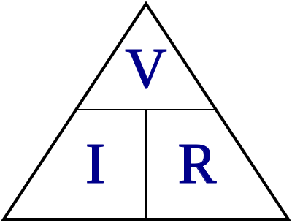
Caution – it’s about electricity
Always unplug your boards from your computer and the power source when making hardware changes

Slide 10


Slide 11
What do I need?
Hardware
Tools
Software
Patience

Slide 12
Hardware
Microcontrollers and Microprocessors
Arduino
Boards
Shields - http://arduino.cc/en/Main/ArduinoShields
RasberryPi
Beagleboard
Pinoccio
Tessel
Pre-built (AR Drone, Crazyflie, Sphero, etc..)
Notes:
Shields are boards that can be plugged in to extend the capabilities of the Arduino board
Pinoccio - for building FULLY wireless projects that are connected to the web
Backpacks are their shields
Scout is the heart and soul
Communicates via wifi and radio to create a mesh

Slide 13
Tools
Soldering iron
Basics (screwdrivers, pliers, etc.)
Multi-meter
Helping hand (big help)
Heat gun

Slide 14
Software
Arduino IDE - http://arduino.cc/
Firmata - http://www.firmata.org/wiki/Main_Page
Serialport - https://www.npmjs.org/package/serialport
Johnny-Five - https://github.com/rwaldron/johnny-five
CylonJS - http://cylonjs.com/
Etc..

Slide 15
Getting started
Install Arduino Software
Plug-in your controller
Install Firmata
Install Nodejs
Install libraries from NPM
Or go native JS machine
Notes:
Firmata is a standard protocol for computers to communicate with hardware.

Slide 16
Hello world Blinky light

Slide 17
Fun stuff
Makey Makey
Leap Motion
Sphero
Tessel
Flying stuff

Slide 18
Community
Nodebot Community Forums - http://forums.nodebots.io/
Nodebots.io - http://nodebots.io/
Arduino Blog - http://blog.arduino.cc/
Twitter sphere

Slide 19
Continuing the hack
Are you local?
Do you want to hack on devices?
Would you attend a monthly or every two month meetup?

