Slide 1
01
Kelompok
14
_
Mentoring IF Unpas

Slide 2
02
ADRIAN RACHMAN 203040103
BILQIS ALPA SYAHRINA 203040161
FARHAN ALFAUZI 203040085
HIFKI YUDA PRATAMA 203040071
HERYANI 203040169
MUCHAMAD TAUFIK MULYADI 203040142
Anggota
_

Slide 3
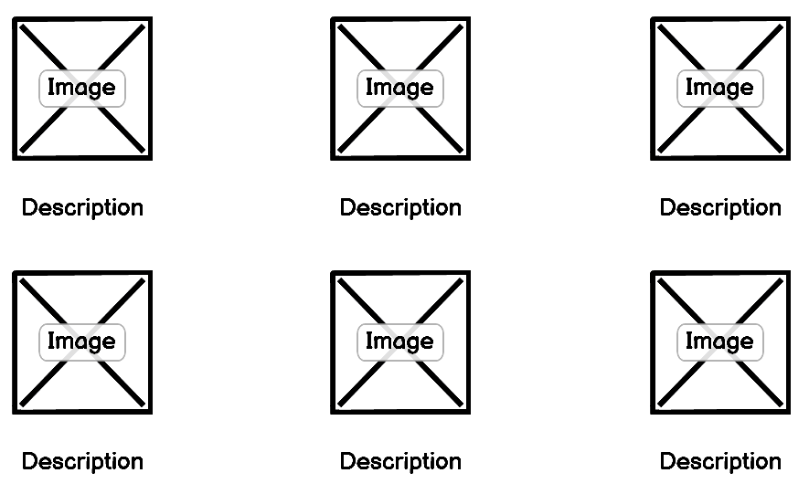
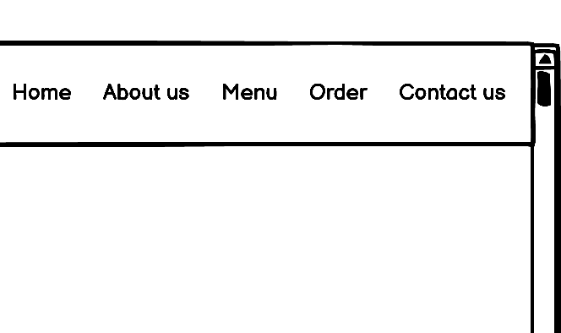
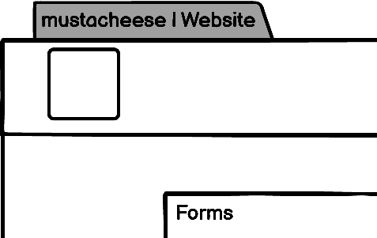
03
Mockup
_

Slide 4
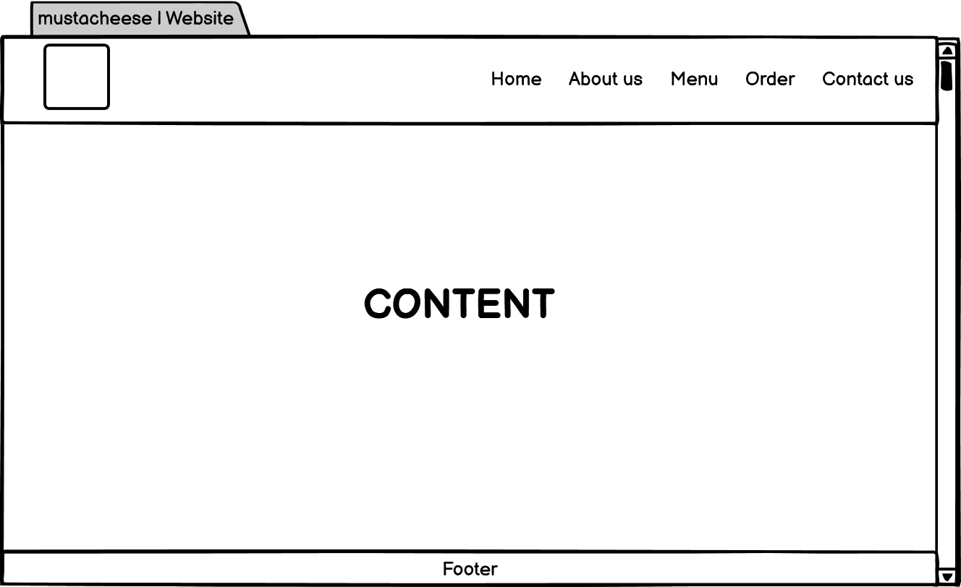
04
Home

Slide 5
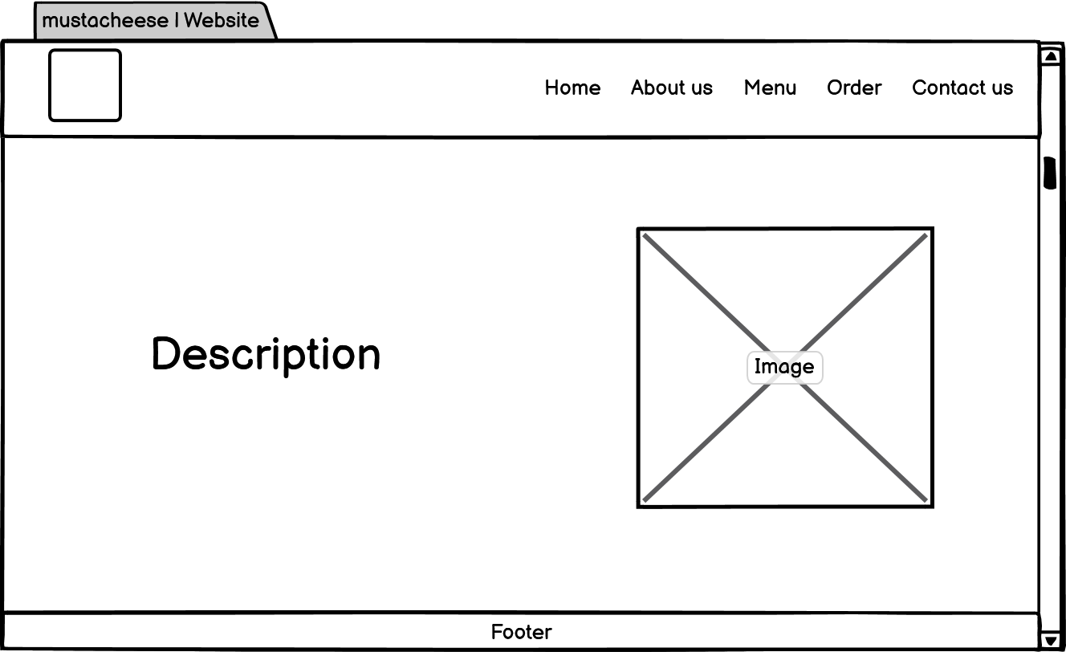
05
About Us

Slide 6
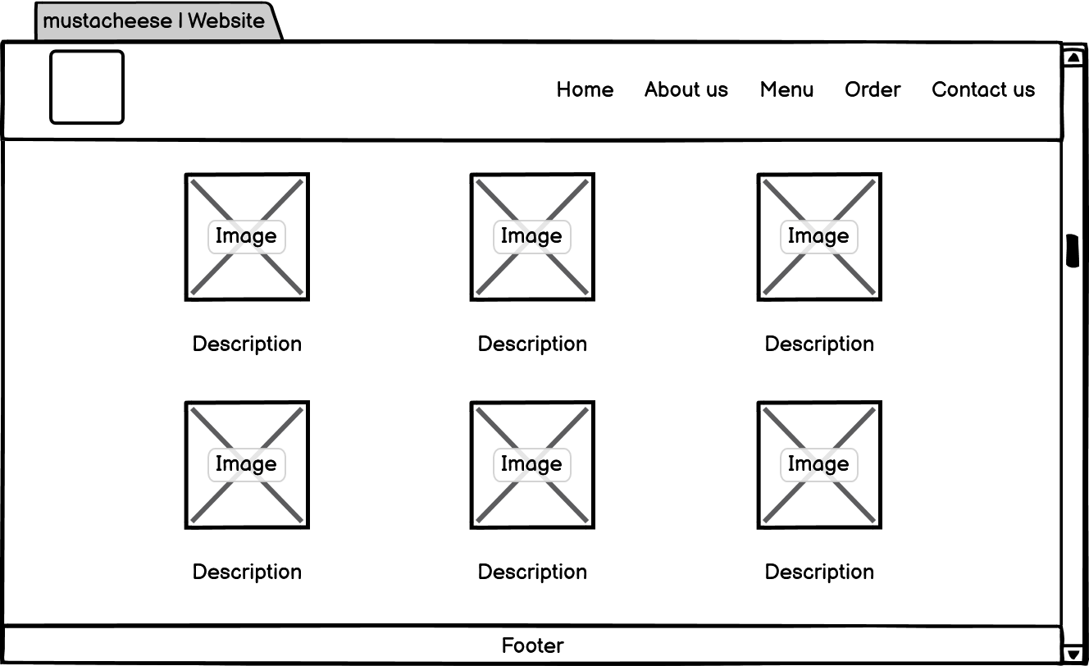
06
Menu (Foods)

Slide 7
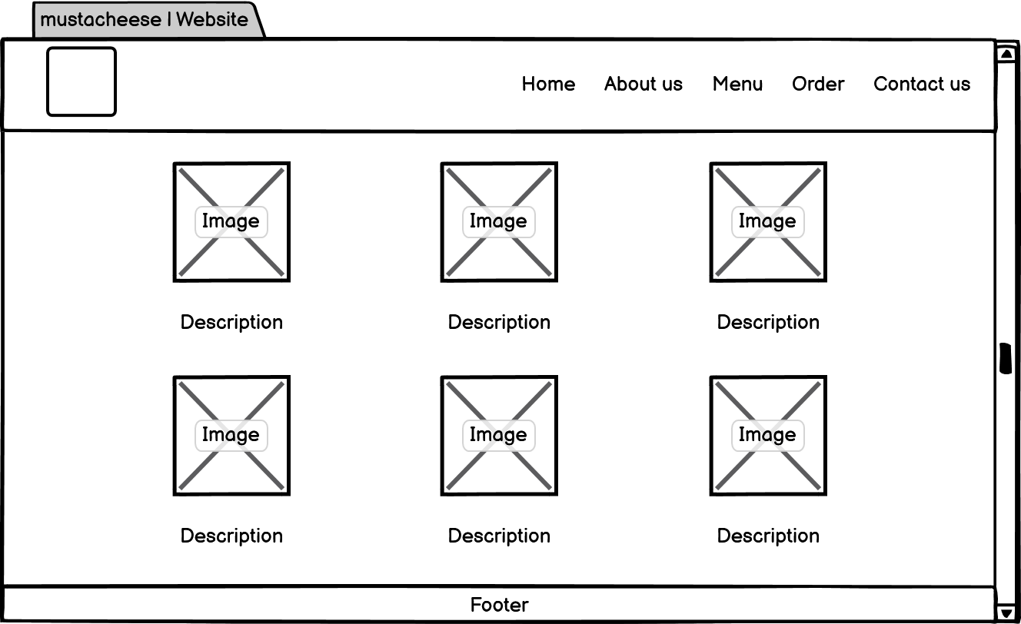
07
Menu (Drinks)

Slide 8
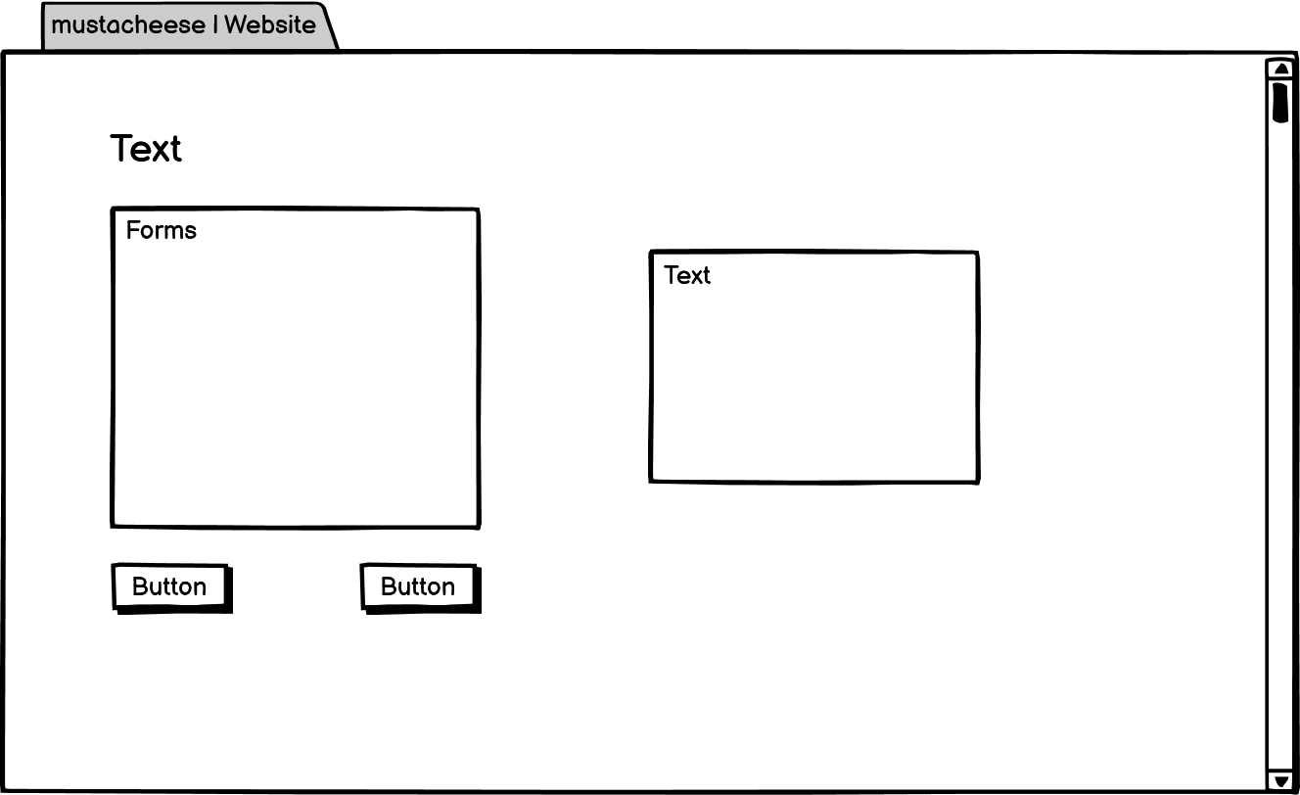
08
Order

Slide 9
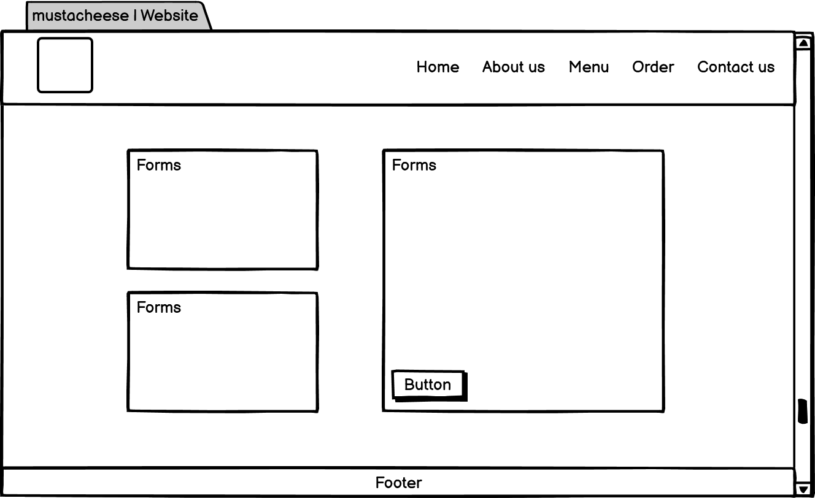
09
Contact Us

Slide 10
10
TERIMA KASIH

