Slide 1

Notes:
It’s Your Job will give you a comprehensive understanding of the whole process of finding a job.

Slide 2


Over 10 units, you can…
Watch videos: Advice Zone
Read ebooks: Career Library
Interactive exercises: Practice Centre
Listen to stories: Story Point
Notes:
Over ten units, each one looking at a key topic, you can read eBooks, watch videos, listen to stories, and test your knowledge with interactive exercises. By the end you will be completely confident you can find the job you are looking for.

Slide 3
Notes:
First, let’s log into your It’s Your Job account. Type in your email address followed by your password. Click Go to start.

Slide 4

My Course

Slide 5
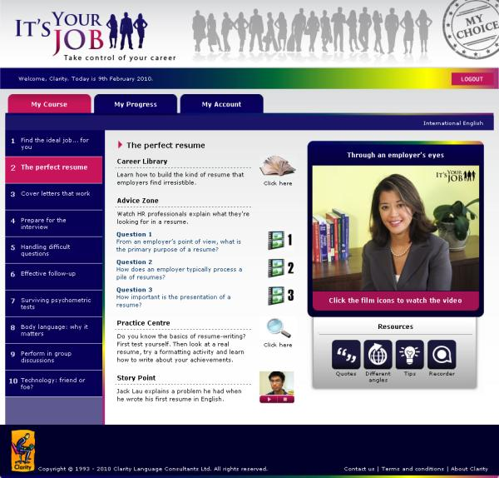

My Course
Notes:
The first thing you’ll see when you log into It’s Your Job is the My Course screen. This is where you will find the content and where you will learn more about finding a job.

Slide 6
My Course
Notes:
The unit you’ve opened now is highlighted pink.

Slide 7
Career Library

Slide 8
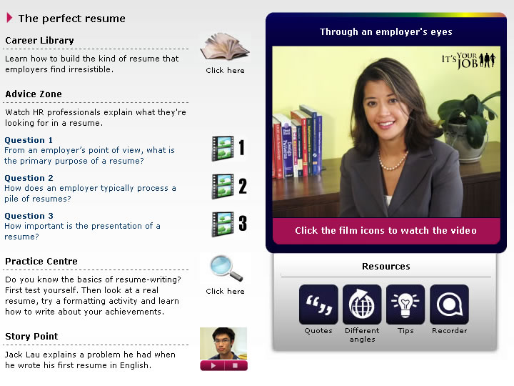
Career Library
Notes:
The Career Library is at the top of the My Course tab in every unit. Click on the book icon to open the Career Library eBook in a new window.

Slide 9
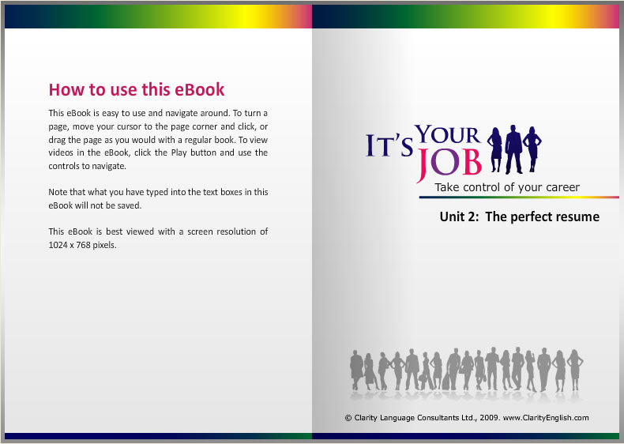
Career Library
Notes:
The Career Library eBook contains a wealth of information focusing on each of the key topics. This eBook is about how to put together the perfect resume.

Slide 10
Career Library
Notes:
Hold down on your left mouse button at a page corner to turn the page forward. At the end of every eBook there is a short video, in which a top HR professional gives a tip on job hunting.

Slide 11
Advice Zone

Slide 12
Advice Zone
Notes:
There are three Advice Zone videos in each unit. Click on a film icon to play a video.

Slide 13






Sample Questions
From an employer’s point of view, what is the primary purpose of a resume?
A lot of students have no idea which job they want to do. What advice would you give to a student who is trying to decide which career to follow?
Do you expect applicants to send a cover letter with their resume, and if so, why?
How important is the way a candidate dresses?
Assuming a candidate is capable of doing the job, what is the next most important information you are trying to find out?
In your experience, what percentage of candidates follows up an interview with a phone call or email?
Do you use aptitude tests, and if so, why?
Which aspects of body language do you particularly look out for in an interview?
How can the Web help a job-seeker?
And More!
Advice Zone
Notes:
In each video a question is posed to a range of HR professionals. These are exactly the kind of people who will be interviewing you, so their advice is invaluable.

Slide 14
Practice Center

Slide 15
Practice Centre
Notes:
The Practice Centre provides a range of interactive activities which help you refresh your memory and activate your skills after reading through the eBooks and watching the Advice Zone videos. You will also find additional information in the form of downloadable worksheets, weblinks and feedback screens. Click on the magnifying glass to open the Practice Centre.

Slide 16
Practice Centre
Notes:
The Practice Centre is highly interactive. After you’ve completed an exercise, you can read feedback and listen to audio. This will help you correct any misunderstandings you might have about the job search – and will help you avoid potentially disastrous mistakes.

Slide 17
Story Point

Slide 18
Story Point
Notes:
Story Point is at the bottom of the screen in every unit. It is a collection of experiences from job-seekers and recruiters. It could be a story of a failed interview attempt, or a recruiter sharing an experience of an exceptional interviewee. You can gain valuable tips from these stories. To listen to Story Point, click the Play button below the thumbnail. You can pause the audio any time while it’s playing.

Slide 19
Story Point
Notes:
Jack Lau, "My story is about when I first came to North Amercian from China, and I was looking for a job..."

Slide 20
Resources

Slide 21
Resources
Notes:
The Resources section is on the right side of the My Course screen. It contains four handy tools offering yet more useful tips.
The Quotes offer inspiring messages from famous people and career experts. Different angles gives you external weblinks as well as interesting books to read up on.
Tips gives simple and easy-to-do pointers you can adopt to increase your chance of being hired.
Lastly, the Recorder allows you to practise your speaking skills. It is a useful tool if you can’t find a friend to help you rehearse your interview.

Slide 22
My Progress

Slide 23
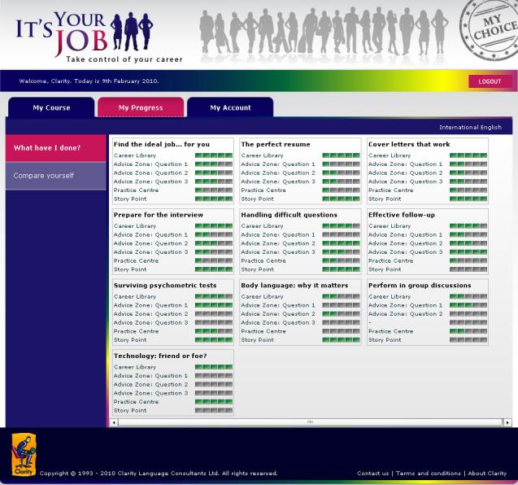
My Progress
Notes:
Click on the My Progress tab at the top of the screen. You will see a record of your activities in It’s Your Job.

Slide 24
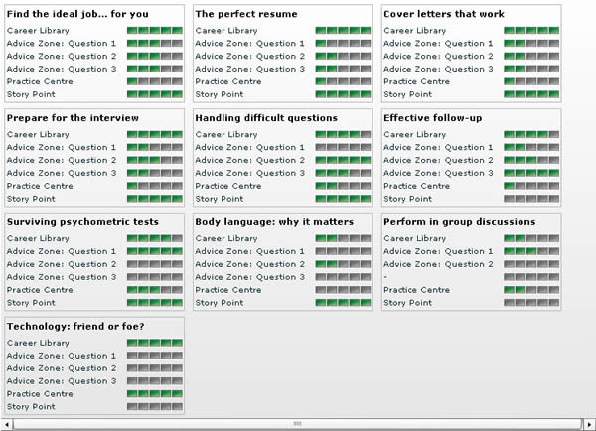
My Progress
Notes:
Every block filled in green means you’ve completed one more portion of the program. This allows you to track your own progress and reminds you where to resume if you haven’t used It’s Your Job in a while.

Slide 25
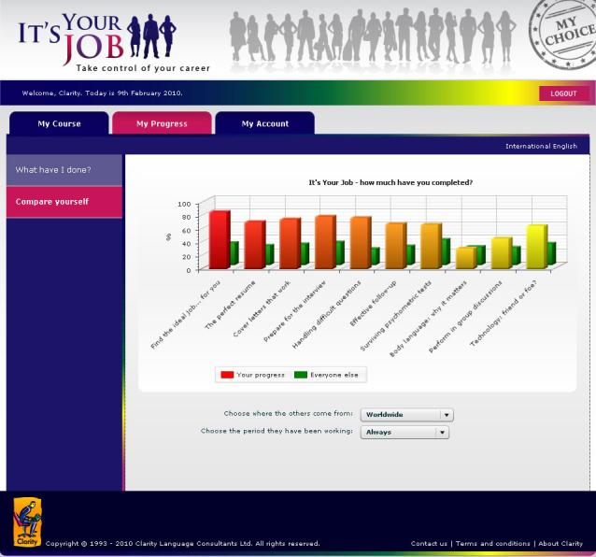
My Progress
Notes:
Click on Compare yourself on the left of the screen. You will see a bar graph comparing your progress with the progress of other It’s Your Job users from around the world. How well are you doing?

Slide 26
My Progress
Notes:
You can refine your comparison by choosing where the other users live in and the time period.

Slide 27
My Account

Slide 28
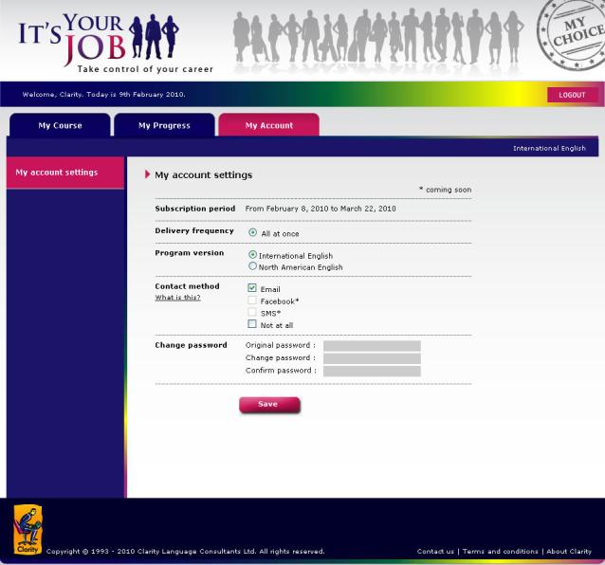
My Account
Notes:
Click on My account at the top of the screen. This tab allows you to change the way you would like to access It’s Your Job.

Slide 29
My Account
Notes:
In My account, you can choose the Program version, how you’d like to be told about changes on It’s Your Job, as well as changing your password. Importantly, it tells you when your subscription period ends, so you can better plan how you are going to use the program.

Slide 30

Notes:
We wish you the best of luck in your job-seeking. Take control of your career – with It’s Your Job.

