Slide 1
Mexico City neighborhood analysis for housing developing.
Submitted by: Adrian rosales

Slide 2
Business Case: Find suitable place for construction companies to establish new housing developments.
Summary
Mexico City is an enormous urban agglomeration which has a severe problem of overpopulation concentrated in few areas, construction companies are always looking for new land to develop new housing developments.
Strategy:
On this project we will be using clustering to determine which areas are suitable for new housing developments based on the amount and type of venues that each of them has

Slide 3
Data
Requirements
List of neighborhoods in Mexico City (CDMX) and their coordinates location.
List of venues for a specific neighborhood area.
Data sources, processing and tools used
To obtain the list of neighborhoods, we will be using a dataset from the local government which are free and public.
To proccess the dataset we will need to use Foursquare API and get venues near 1 km around the neighborhoods, the top ten of venues categories, transform into one hot encoding and merge them with the previous dataset.
There are 1,812 neighborhoods in CDMX, we will add a column to count the total number of venues for each neighborhood.

Slide 4
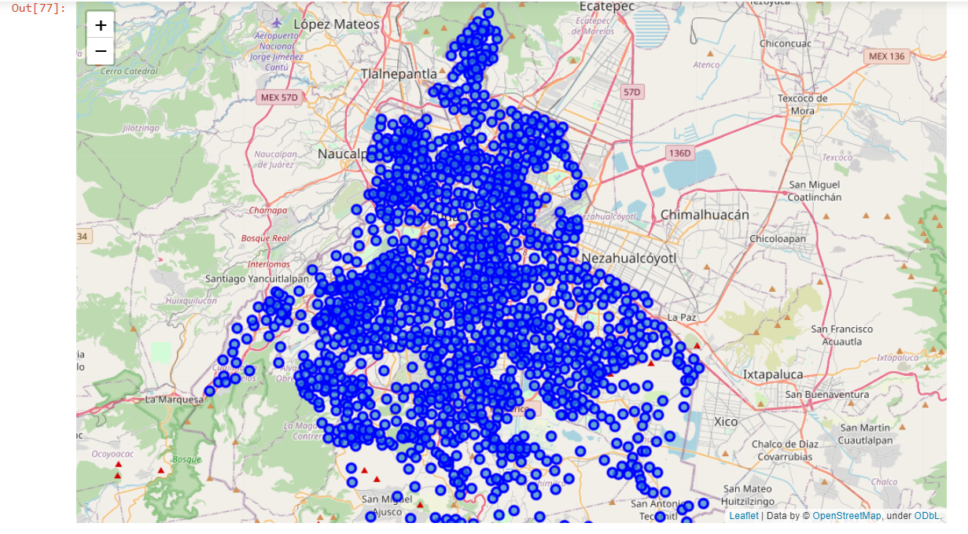
Map of mexico city without clustering

Slide 5
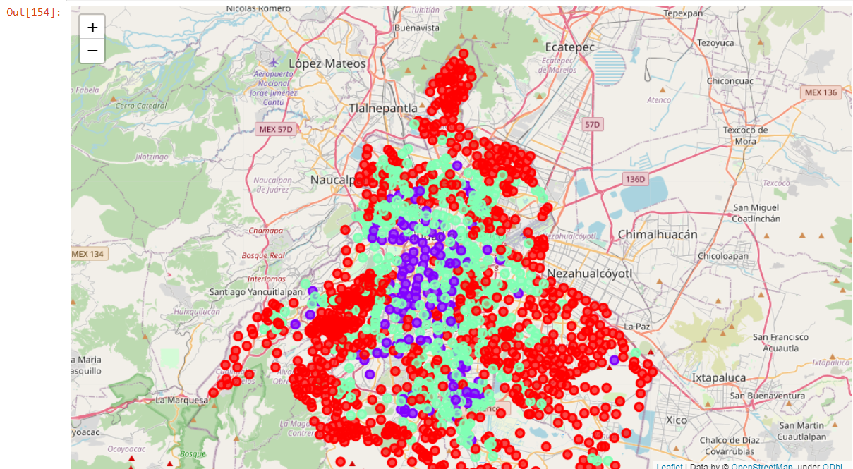
Clustered map
Purple = Cluster Label ‘0’
Green = Cluster Label ‘1’
Red = Cluster Label ‘2’

Slide 6
Discussion
As we may observe there are 3 different types of neighborhoods, the ones that are close to the borders are colored with red, it is obvious that those areas are cheaper lands and have limited number of venues. But the interesting thing occurs analyzing ‘0’ (purple areas) and ‘1’ (green areas) labels, having the background of living in this city and observing some of the pop well know neighborhoods labeled with 0 and 1, the 0’s are for neighborhoods that has certain commodities but are not crowded, this includes exclusive zones for the richest people. Areas labeled with ‘1’ are populated zones which has lot of offices buildings and venues.

Slide 7
Conclusion
It is obvious that if a construction company is looking for cheaper lands they need to locate their buildings into a red zone, but if a company wants to make better profits it needs to concentrate its effort in locate areas in green and red zones, the purple zones are suitable for multifunctional complexes because of their lack of venues and are far from crowded zones and the green ones are suitable just for housing building they are already crowd with offices.

Slide 8
Future work
We could analyze the results of working with a classification paradigm looking for some well know neighborhoods, famous by their good quality of life or by its poor quality an using an expert to label these neighborhoods in order to obtain a train set which could lead us to determine every other neighborhood label into the city and the metropolitan area that includes another boroughs that were not listed in this project.

