Slide 1

Lecturing: planning, preparation and delivery
John Milliken and
Linda Carey

Slide 2
Learning outcomes
By the end of the session you will have:
considered what we understand by lecturing
examined alternative ways to structure a lecture
considered approaches of lecture delivery
Identified the need for feedback
considered alternative ways to deliver a lecture, using video examples

Slide 3



Symbols
Used previously
Workshop
Handouts
1:3
1:3

Slide 4
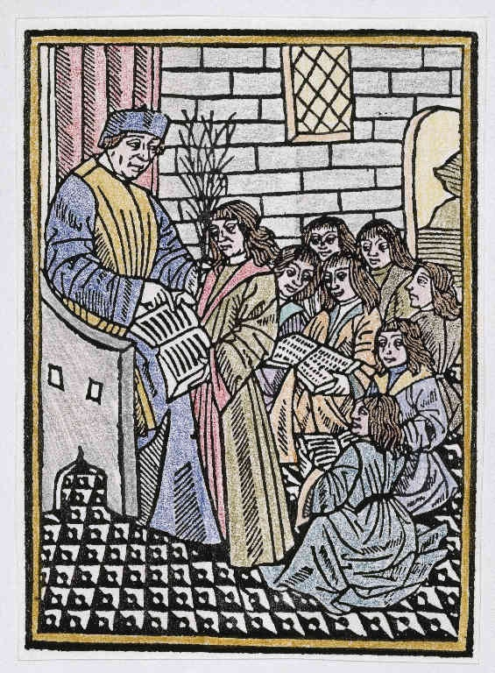
Lecturing in Context
Lectio
Quaestio

Slide 5
Lecturing
I hear, I forget
I see, I remember
I do, I understand

Slide 6
Teaching formats
Lecturer participation and control
Student participation and control
Lecture Small group Research Lab Self instruction Private
teaching supervision work systems study

Slide 7
Lecturing
Think of a lecturer who has impressed you. It might be a colleague or someone who has taught you.
What qualities does this lecturer possess?
Working in pairs, make a list of the characteristics of a good lecturer

Slide 8
Curriculum Model
1:3
Specified
Enacted
Experienced

Slide 9

Definitions of lecturing
1:3
Task 1 - 10 minutes
Read the definitions of lecturing (Brown and Race, 2002).
Which do you agree with and which do you reject?
What does lecturing mean to you?
In pairs, write your own definition.

Slide 10
Lecturers’ Views on Lecturing from: Styles of Lecturing: Brown and Bakhtar, 1983, pp 36-39)
Negative points (top 5)
Uninterested audience who don’t listen, read…
Large groups
Effort and time involved in preparation
Feeling of failure after giving a poor lecture
Lecturing on topics disliked
Positive points (top 5)
Challenge in structuring a lecture
Satisfaction after a good lecture
Students’ responses, questions etc
Arousing interest for subject
Self motivation from having to give a lecture

Slide 11
Criticisms of lectures and lecturers by students
Inaudibility
Incoherence
Level
Not emphasising key points
Poor presentation
Lacking presentational skills,
Not showing sufficient enthusiasm for their subject,
Not encouraging active participation by students and
Not providing quick and detailed feedback to students
Brown and Daines, 1981
Brown and Bakhtar, 1983
Williams & Loader, 1993
Pennington, 1994

Slide 12

Teaching
"... teaching remains one of the few human activities that does not get demonstrably better from one generation to the next"
(Bok,1992, p16).

Slide 13
Preparation: questions to ask yourself
Is the material at the right level?
Am I trying to cover too much?
What difficulties can I anticipate?
Is there any space for student involvement?
Have I got clear learning outcomes?
What audio-visual or other aids am I going to use?
How can I evaluate my lecture?

Slide 14

Five ways to structure a lecture
Classical-hierarchial
Problem-centred
Chaining/Sequential
Comparative
Thesis
Critical review Series No 2
Brown and Atkins 1988
Notes:
Classical –hierarchical is the most common method of structuring. It addresses several broad areas, each of which is sub-divided and is good for giving an overview over a subject area.
The problem-centred method starts with a question or problem and thereafter gives information, arguments and hypotheses as possible solutions
Chaining/sequential consists of a sequence in the same way as telling a story. This method maintains attention well, but, if attention is lost, it is difficult for the student to pick up the thread again.
Comparative –starts with two or more theories, views or perspectives etc. that are compared.
Thesis – a position is taken and then supported with evidence, argument and hypothesis.
The

Slide 15

Structuring the lecture
Signposting
Foci
Links
Frames
Brown (1982)

Slide 16
Signposting
“Today we will examine four approaches to the management of tumours:
Surgery
Radiotherapy
Chemotherapy
Psychological support
We will consider each in turn, identifying their strengths and weaknesses”
Signal the direction structure of the lecture

Slide 17
Foci
These are statements which highlight and emphasise key points.
“The basic pharmacological principle underlying chemotherapy is…..”

Slide 18
Links
These are statements that link the sections of the lecture together.
“From this you can clearly see that chemotherapy is often as aggressive and invasive as the older techniques of excision and radiotherapy”

Slide 19
Frames
These are the statements which delineate the beginning and ending of topics and sub topics and are a subset of links.
“Let’s now consider the uses of chemotherapy”

Slide 20
Openings and Closures
Openings
  Grab and hold attention
  Establish rapport
  Indicate content and structure of lecture (learning outcomes)
  Link with previous lectures and/or reading material
Closures
  Reemphasize key points
  Show links to subsequent lectures, reading materials etc.

Slide 21
The Marketing Process
Analysing Market Opportunities
Lectures 1,2,3
Selecting Target Markets
Lecture 4
Formulating Marketing Programmes
Lectures 5,7,8,9,10
Marketing Planning
Lectures 11 -12

Slide 22
Delivery of a large lecture 1/2
Capturing students’ attention from outset
  relevant examples
  topical references
  controversial statements
  visuals, e.g. cartoons
  humour (?)
Making eye contact round the room (lighthouse)
Checking your audibility
Checking visibility of visuals: font, graphics
Notes:
Capturing students’ attention
relevant examples – from students own experience awareness
topical references – perhaps something from recent press/news (Did you See?)
controversial statements - to stimulate reaction
visuals, e.g. cartoons - I used to include a cartoon at the start of each lecture relevant to the topic
humour (?)

Slide 23
Delivery of a large lecture 2/2
Moving around, e.g. standing in front of lectern, walking up aisle
Pacing delivery appropriately
  How much content is essential?
  Is there time for note-taking?
  Do students have time for reflection?
  Is there time for questions or interaction?

Slide 24
Management of large lectures
Developing “crowd control” strategies
  Managing late comers, phones etc
  Establishing procedural rules, e.g. for starting, stopping, bringing to order
Varying learning experiences
  Interspersing presentation with activities
  Using video, multi-media, models, case studies etc
Notes:
Latecomers – just remember the last person in buys the coffee at the break
Mobile phones – the only rule is that if a phone goes off during the class I answer it
Procedural rules – can often reduce fidgeting, inattention etc.
If you haven’t stuck oil after 20mins – stop boring!

Slide 25
Questions to and from students
Avoid picking on reluctant individuals
Use a method of pre-warning students you will be asking them (e.g. colour of clothing)
Ask questions to students from different parts of the room
Always repeat students’ questions and answers before responding to them
Limit questions per person so no one hogs air time
(adapted from Prof Sally Brown, workshop at Queen’s, 3/2/2006)

Slide 26
Handouts
Providing handouts: when?
  beginning, end, previous week, on QOL?
Types of handout
  PowerPoint outline
  Fuller lecture notes
  Fill in the gap
  Key (skeleton) information only
  Personal research papers
  Selected readings

Slide 27
Alternative ways to use question/answer sessions
Lecturer asks questions; students discuss in groups; lecturer elicits answers from some groups
Students write questions individually; lecturer answers in next lecture
Students develop questions in groups and
  ask lecturer during lecture, or
  give to lecturer in writing for next session, or
  ask each other, while lecturer monitors and takes feedback

Slide 28
Obtaining feedback in large lectures
minute papers
instant questionnaires
informal multiple choice quizzes
show of hands
PRS systems
feedback from tutorial groups
surveys
  On larger classes, see: Biggs 2002, Teaching for Quality Learning at University (2nd Ed)

Slide 29

Lecture Feedback
Subject - Marketing
Lecture size 250-320
Tiered lecture theatre (no desks)
No natural lighting
Second year undergraduate
Several programme cohorts

Slide 30
Feedback on feedback
1. Structure and Organisation of the Material
        Good/Vgoo Average Poor/VPoor
1:1 Clarity of module aims 90.190.5 8.5 9.5 1.4 0.0
1:2 Reinforcement of module structure and linkages 80.479.3 19.0 20.7 0.6 0
1:3 Stated objectives of each lecture 93.0 94.8 6.2 5.2 0.8 0.0
1:4 Structure of the lectures 85.7 87.9 12.6 11.2 1.7 0.9
1:5 Cohesion of the lectures 80.8 83.6 16.1 14.7 3.1 1.7
1:6 Content of lectures 72.1 79.3 22.9 16.4 5.0 4.3
1:7 Presentation of the material in a coherent way 86.4 86.2 11.2 9.5 2.5 4.3
1:8 Use of models/diagrams to explain concepts 87.6 88.8 9.9 10.3 2.5 0.9
1:9 Reinforcement of lecture content in tutorials 61.0 51.7 29.1 31.9 9.9 16.4
Computers and Education

Slide 31
Examples of lecturing
Linda Carey
Notes:
In the last part of this session we are going to look at DVD clips of three colleagues from other universities taking a class.
We will have the opportunity to reflect on their approach and to see how we might conduct peer observation.

Slide 32

Example 1: Catherine Palmer
Teaching Context: Psychology Level 1; 3rd week, term 1
Topic: Research methods in sociology and psychology
Discussion points:
Interaction with the students
Using tasks to break up the lecture
Examples chosen
Other features…

Slide 33
Example 2: Susan Whitten
Teaching Context: Medicine Level1; 6th week of term 1
Topic: Anatomy
Discussion points:
Use of technology
Motivating students
Use of questions and feedback
Other features…

Slide 34
Lecture delivery: summary
Voice: audible, clarity, speed, modulation
Appropriate language for level
Eye contact and body language
Use of questions (open and closed)
Paraphrasing, recapping, summarising
Use of examples
Signposting etc
Interaction with students
Breaks / tasks built in?
Use of technology

Slide 35
And finally,
How do we encourage student engagement with the subject?

