Slide 1
“JETAN” code
Guillermo Contreras Nuno
Mercedes López Noriega
Structure of the code
How to find jets / How to analyze them
What’s done / what’s missing
http://mercedes.home.cern.ch/mercedes/JETAN/JetAnalysis.html

Slide 2
Structure of the code:
Finding jets
In AliRoot/JETAN (everything else removed)
ReaderHeader
  Set cuts for events and tracks
Reader (ESD/MC)
  Choose reader (and set ReaderHeader)
JetHeader
  Set cuts for the jets
Finder (UA1JetFinder/PxconeJetFinder)
  Set Reader, Header, “options” and … Run!

Slide 3
Simple example macro (I)
gSystem->Load("$(ALICE_ROOT)/lib/tgt_$(ALICE_TARGET)/libJETAN");
// define reader header
AliJetESDReaderHeader *jrh = new AliJetESDReaderHeader();
jrh->SetComment("testing");
jrh->SetDirectory("/home/mercedes/alice/jetAnalysis/ESDs/");
jrh->SetPattern("miniesd");
jrh->SetFirstEvent(0);
jrh->SetLastEvent(100);
jrh->SetPtCut(2.);
gSystem->Load("$(ALICE_ROOT)/lib/tgt_$(ALICE_TARGET)/libJETAN");
// define reader header
AliJetESDReaderHeader *jrh = new AliJetESDReaderHeader();
jrh->SetComment("testing");
jrh->SetDirectory("/home/mercedes/alice/jetAnalysis/ESDs/");
jrh->SetPattern("miniesd");
jrh->SetFirstEvent(0);
jrh->SetLastEvent(100);
jrh->SetPtCut(2.);
// define reader and set its header
AliJetESDReader *jr = new AliJetESDReader();
jr->SetReaderHeader(jrh);
gSystem->Load("$(ALICE_ROOT)/lib/tgt_$(ALICE_TARGET)/libJETAN");
// define reader header
AliJetESDReaderHeader *jrh = new AliJetESDReaderHeader();
jrh->SetComment("testing");
jrh->SetDirectory("/home/mercedes/alice/jetAnalysis/ESDs/");
jrh->SetPattern("miniesd");
jrh->SetFirstEvent(0);
jrh->SetLastEvent(100);
jrh->SetPtCut(2.);
// define reader and set its header
AliJetESDReader *jr = new AliJetESDReader();
jr->SetReaderHeader(jrh);
// define jet header
AliUA1JetHeader *jh=new AliUA1JetHeader();
jh->SetComment(“testing jet finder");
gSystem->Load("$(ALICE_ROOT)/lib/tgt_$(ALICE_TARGET)/libJETAN");
// define reader header
AliJetESDReaderHeader *jrh = new AliJetESDReaderHeader();
jrh->SetComment("testing");
jrh->SetDirectory("/home/mercedes/alice/jetAnalysis/ESDs/");
jrh->SetPattern("miniesd");
jrh->SetFirstEvent(0);
jrh->SetLastEvent(100);
jrh->SetPtCut(2.0);
// define reader and set its header
AliJetESDReader *jr = new AliJetESDReader();
jr->SetReaderHeader(jrh);
// define jet header
AliUA1JetHeader *jh=new AliUA1JetHeader();
jh->SetComment(“testing jet finder");
// define jet finder. Set its header and reader
AliUA1JetFinder *jf = new AliUA1JetFinder();
jf->SetJetHeader(jh);
jf->SetJetReader(jr);
jf->SetPlotMode(kTRUE); // if you want “control plots”
jf->SetOutputFile(); // you can change the name of output file
// run
jf->Run();

Slide 4
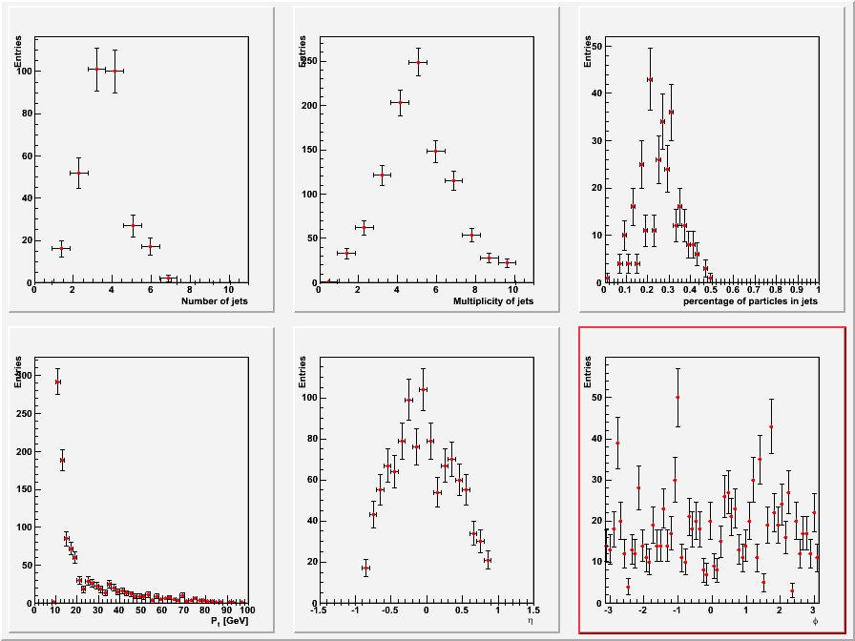
“Control Plots”

Slide 5
Structure of the code:
Analyzing found jets
Open output file from previous macro
  One TTree per event
  get parameters for analysis from headers
Get # of events from (Reader) Header
Loop over events (TTree’s)
  loop over jets (not very useful yet…)
Get control plots

Slide 6
Simple example macro (II)
gSystem->Load("$(ALICE_ROOT)/lib/tgt_$(ALICE_TARGET)/libJETAN");
TFile *jFile = new TFile("jets.root"); // open file
gSystem->Load("$(ALICE_ROOT)/lib/tgt_$(ALICE_TARGET)/libJETAN");
TFile *jFile = new TFile("jets.root"); // open file
// get jet header and display parameters
AliUA1JetHeader* jHeader=(AliUA1JetHeader*) (jFile->Get("AliUA1JetHeader"));
jHeader->PrintParameters();
gSystem->Load("$(ALICE_ROOT)/lib/tgt_$(ALICE_TARGET)/libJETAN");
TFile *jFile = new TFile("jets.root"); // open file
// get jet header and display parameters
AliUA1JetHeader* jHeader=(AliUA1JetHeader*) (jFile->Get("AliUA1JetHeader"));
jHeader->PrintParameters();
// get reader header and # of events to be looped over
AliJetESDReaderHeader *jReaderH =
(AliJetESDReaderHeader*)(jFile->Get("AliJetESDReaderHeader"));
Int_t first = jReaderH->GetFirstEvent();
Int_t last = jReaderH->GetLastEvent();
gSystem->Load("$(ALICE_ROOT)/lib/tgt_$(ALICE_TARGET)/libJETAN");
TFile *jFile = new TFile("jets.root"); // open file
// get jet header and display parameters
AliUA1JetHeader* jHeader=(AliUA1JetHeader*) (jFile->Get("AliUA1JetHeader"));
jHeader->PrintParameters();
// get reader header and # of events to be looped over
AliJetESDReaderHeader *jReaderH =
(AliJetESDReaderHeader*)(jFile->Get("AliJetESDReaderHeader"));
Int_t first = jReaderH->GetFirstEvent();
Int_t last = jReaderH->GetLastEvent();
// loop over events
AliJet *jets = new AliJet();
for (Int_t i=first; i< last; i++) {
char nameT[100];
sprintf(nameT, "TreeJ%d",i);
TTree *jetT =(TTree *)(jFile->Get(nameT));
jetT->SetBranchAddress("AliJet", &jets);
jetT->GetEntry(0);
jets->PrintJets();
}
for(int j;j<nj;j++){ jets->GetPt(j) }
AliJetControlPlots* jPlots=(AliJetControlPlots*)(jFile->Get("AliJetControlPlots"));
jPlots->PlotHistos(); // Get Control Plots

Slide 7
What’s done and what’s still missing (for PPR analysis)
Done:
Code ready to analyze ESD events (and MC events in not “standard” way)
  UA1 Jet Finder with EMCAL dependencies removed
To be done:
by us:
  Add more cuts for tracks
  Defined analysis and plots needed
  Finish writing documentation
by you
  try and send us comments/suggestions

Slide 8
Diagram of classes
AliJetMCReaderHeader
MC selection
AliJeESDReaderHeader
ESD selection
AliJetReaderHeader
AliJetMCHeader
AliJetESDHeader
AliJetControlPlots
AliJetReader
AliJetFinder
Run()
FindJets()
AliJet
Getters, Setters, ClearJets()
AliUA1JetFinder
FindJets()
AliPxconeJetFinder
FindJets()
AliUA1JetHeader
UA1 parameters
AliPxconeJetHeader
Pxcone parameters
AliJetHeader

