Slide 1
Jet Reconstruction Benchmarks
A. Morsch
PWG4 Analysis Meeting
22/6/2005

Slide 2
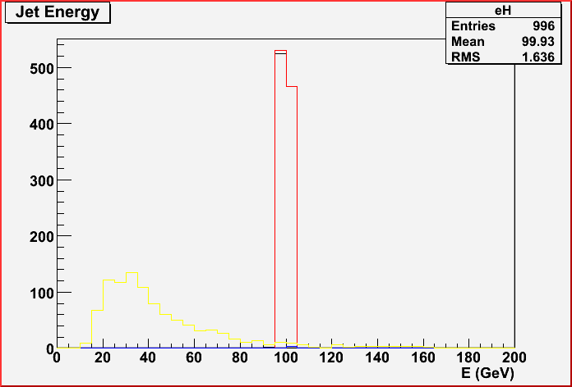
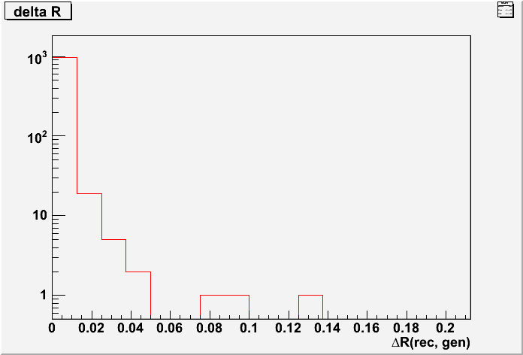
R < 1, No Cuts
Small differences between Pythia jet finder used for trigger
and AliUA1JetFinder.

Slide 3
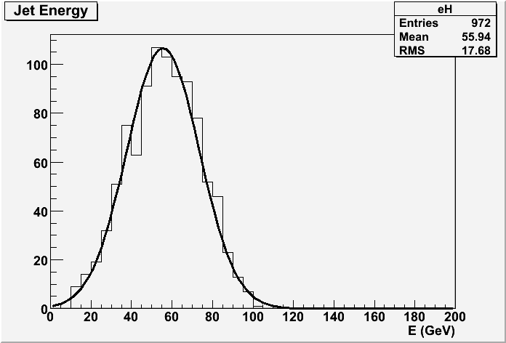
no cuts, TPC acceptance
56 ± 18 GeV

Slide 4
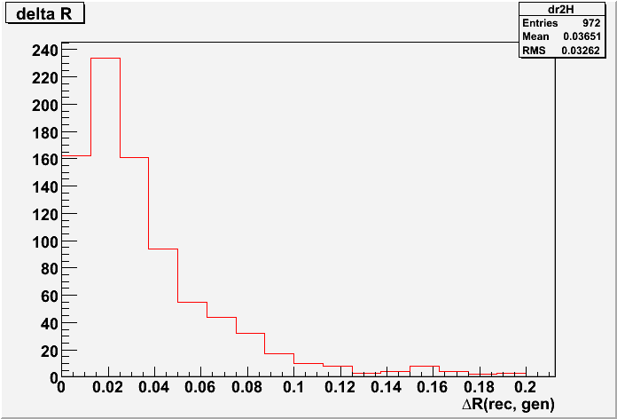
no cuts, TPC acceptance

Slide 5
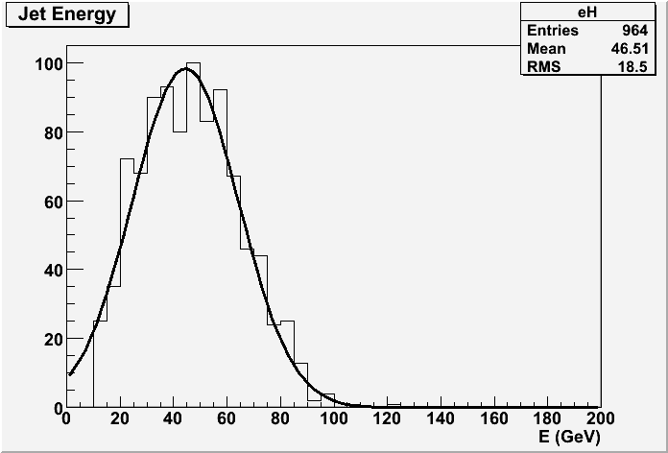
pT > 2 GeV, R < 0.4,
TPC acceptance
46 ± 19 GeV

Slide 6
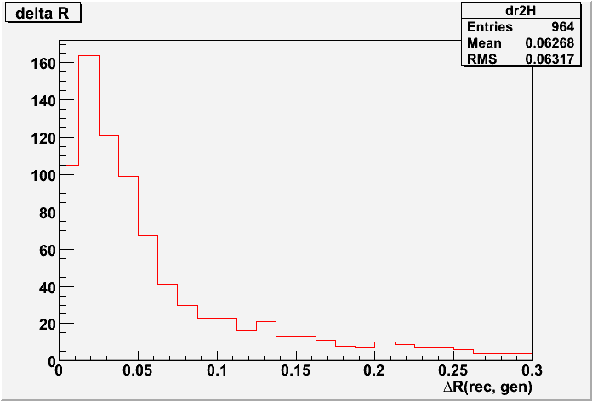
pT > 2 GeV, R < 0.4,
TPC acceptance

Slide 7
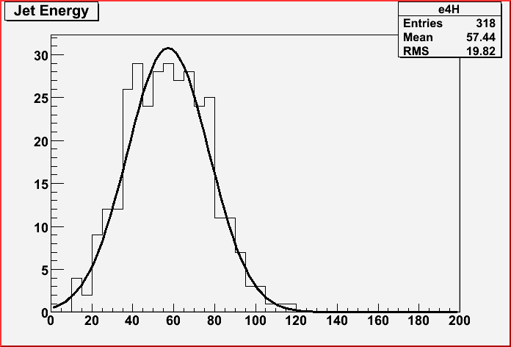
No cuts
Full simulation
105 < Egen < 125 GeV
57 ± 20 GeV

Slide 8
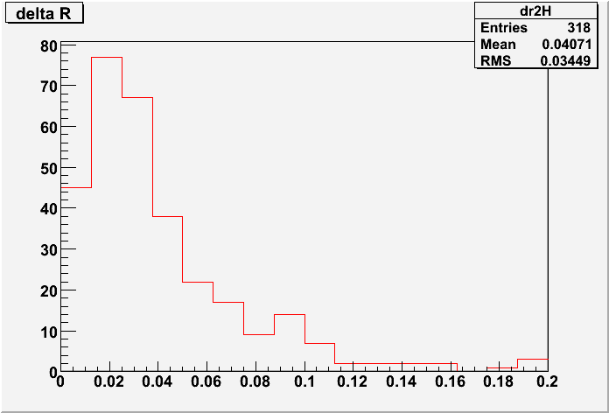
No cuts
Full simulation

Slide 9
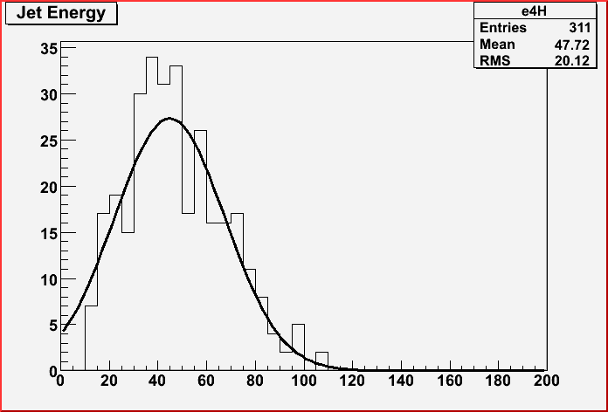
pT > 2 GeV, R < 0.4
Full simulation
47 ± 20 GeV

Slide 10
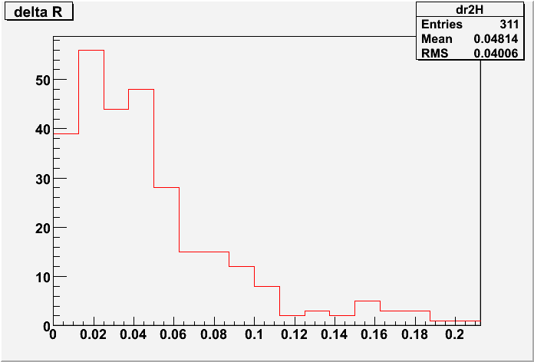
pT > 2 GeV, R < 0.4
Full simulation

Slide 11
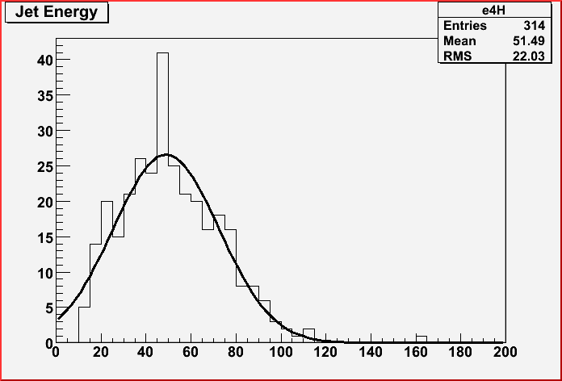
pT > 2 GeV, R < 0.4
Full simulation incl. Background
51 ± 22 GeV

Slide 12
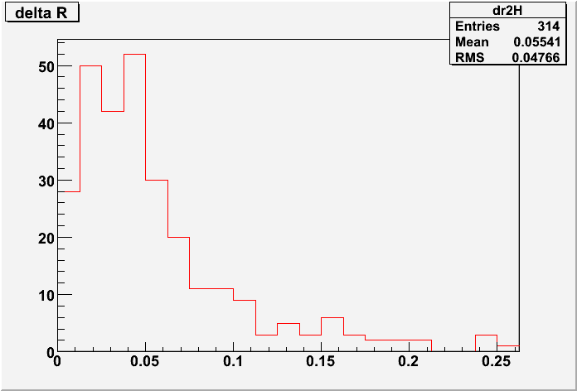
pT > 2 GeV, R < 0.4
Full simulation incl. Background

