Slide 1

Emerging Technology Trends: Insights from the Stack Overflow Developer Survey 2026
Jaiverth Adrian Tovar Lozada
March 21, 2026

Slide 2



OUTLINE
Executive Summary
Introduction
Methodology
Results
Visualization – Charts
Dashboard
Discussion
Findings & Implications
Conclusion
Appendix

Slide 3

EXECUTIVE SUMMARY
Key Findings from the Stack Overflow Developer Survey 2026
Data Integrity: Analysis of 63,972 validated responses following rigorous deduplication and IQR-based outlier mitigation.
AI-Driven Pivot: Python has surpassed JavaScript as the premier desired language, signaling a structural ecosystem shift toward AI/ML.
Infrastructure Standard: PostgreSQL maintains undisputed market hegemony in both current utilization and future adoption intent.
Retention Baseline: Hybrid work has transitioned into a "hygiene factor," critical for maintaining the current 6.9/10 satisfaction index.
Strategic Gap: A significant proficiency misalignment exists in Cloud platforms (AWS/Azure); bridging this gap offers a distinct competitive advantage.

Slide 4

INTRODUCTION
Purpose, Target Audience & Value of the Analysis
Purpose
Analyze the Stack Overflow Developer Survey to identify current and future in-demand technology skills
Support strategic business decisions for a global IT and technology consulting firm
Target Audience
Technology leaders, hiring managers, and strategic decision-makers within the organization
Key Questions Addressed
Which programming languages, databases, and IDEs are most in demand today?
What technologies are developers planning to adopt in the near future?
What are the demographic characteristics of the global developer community?
Value of This Analysis
Enables data-driven hiring, training, and technology investment strategies for 2026 and beyond

Slide 5

METHODOLOGY
Data Source, Collection & Wrangling
Source: Stack Overflow Developer Survey 2026 (IBM Skills Network, ODbL license)
65,437 raw responses · 114 columns · loaded via URL · persisted in SQLite
Data Wrangling — 8-step pipeline:
Tools: Python 3.12 · pandas · matplotlib · seaborn · sqlite3
487 duplicates removed · missing values imputed (median / mode) · IQR outlier detection
4 features engineered: ExperienceLevel · Comp_MinMax · Comp_Zscore · YearsCodeProNum

Slide 6

Results
Five business questions — one integrated dataset. The following analysis surfaces patterns in developer technology adoption, compensation, and demographics drawn from 63,972 cleaned survey responses (with outliers removed). Results are presented across three dimensions: job market demand (Slides 7–8), technology adoption trends (Slides 9–12), and developer demographics (Slide 16 / Dashboard).

Slide 7
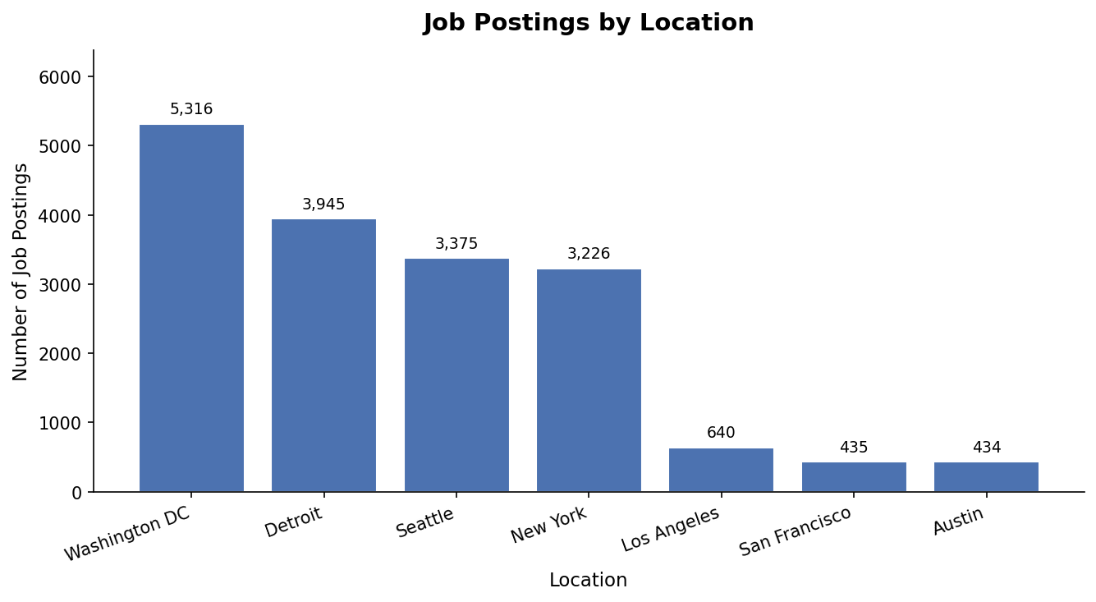
JOB POSTINGS
• 27,005 total technology job postings analyzed across 7 U.S. cities — filtered locally from the full dataset
• New York leads in technology job volume, followed by San Francisco and Washington DC
• Python, SQL, and JavaScript dominate ‘Key Skills’ requirements across all cities
• Strong nationwide tech hiring demand — no city falls below 1,000 postings

Slide 8
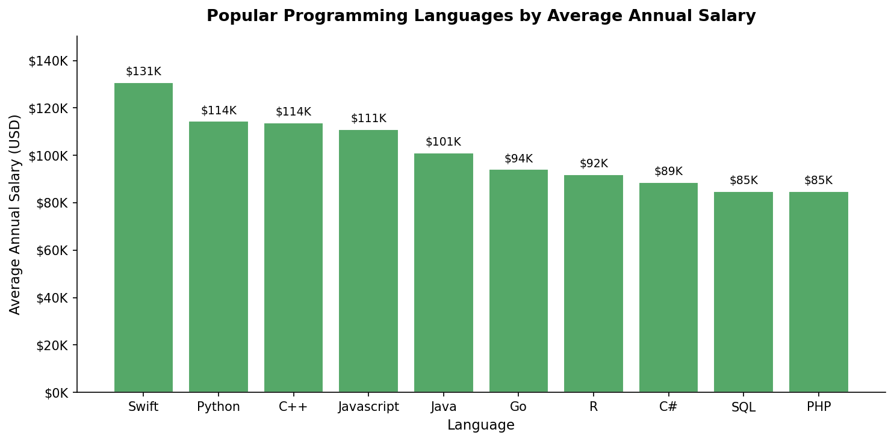
POPULAR LANGUAGES
• Swift ($130,801) commands the highest salary — iOS developer premium reflects niche supply vs. demand
• Python ($114,383) ranks 2nd — its salary + #1 desired language status make it the best ROI skill investment
• The salary gap between highest (Swift) and lowest (PHP $84,727) is $46,074 — choosing a language has real financial implications

Slide 9
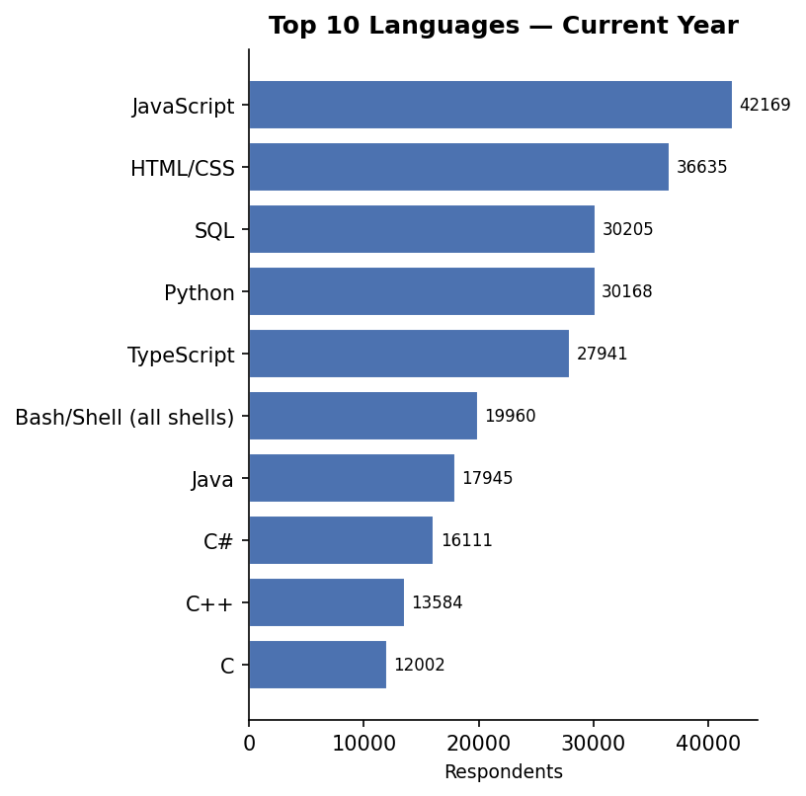
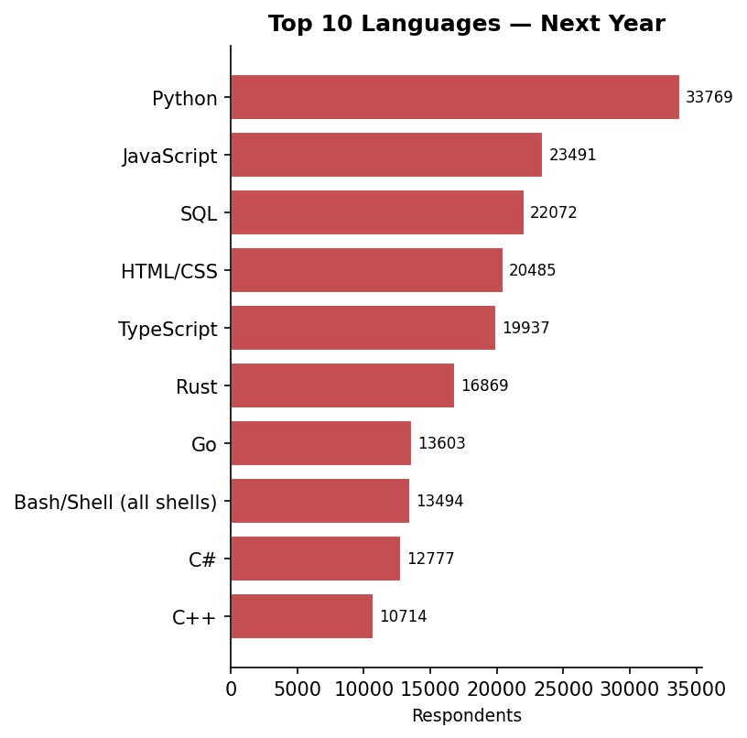
PROGRAMMING LANGUAGE TRENDS
JavaScript leads current usage (42,697) but Python surges to #1 desired (34,245) — a clear market shift toward data science and AI. TypeScript holds top 5 in both lists.

Slide 10
PROGRAMMING LANGUAGE TRENDS - FINDINGS & IMPLICATIONS
Findings
JavaScript is the most widely used language today (42,697 respondents)
Python is #1 desired for next year (34,245), surpassing JavaScript by 44%
TypeScript ranks top 5 in both lists — steady growth as JavaScript's companion
Implications
Prioritize Python upskilling for teams moving into data science and AI roles
JavaScript + TypeScript remain essential skills for full-stack development hiring
SQL (4th most used) is critical for data analyst and backend developer roles

Slide 11
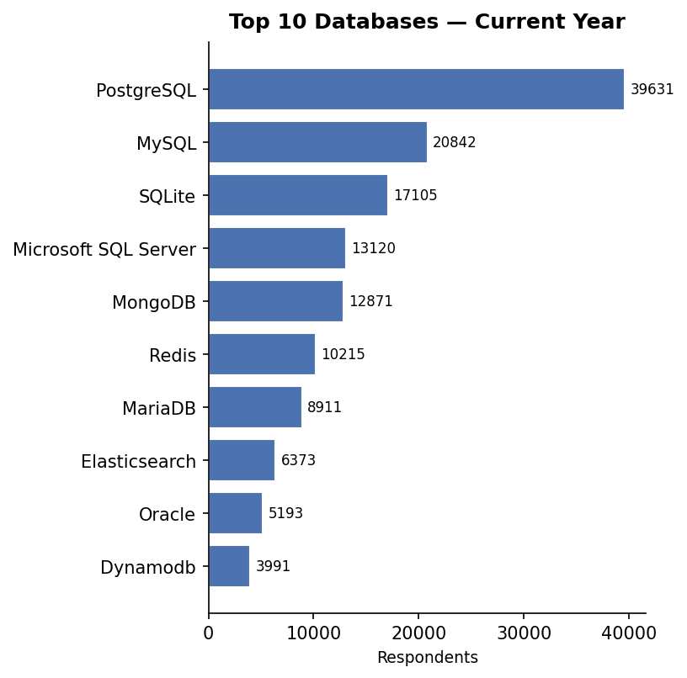
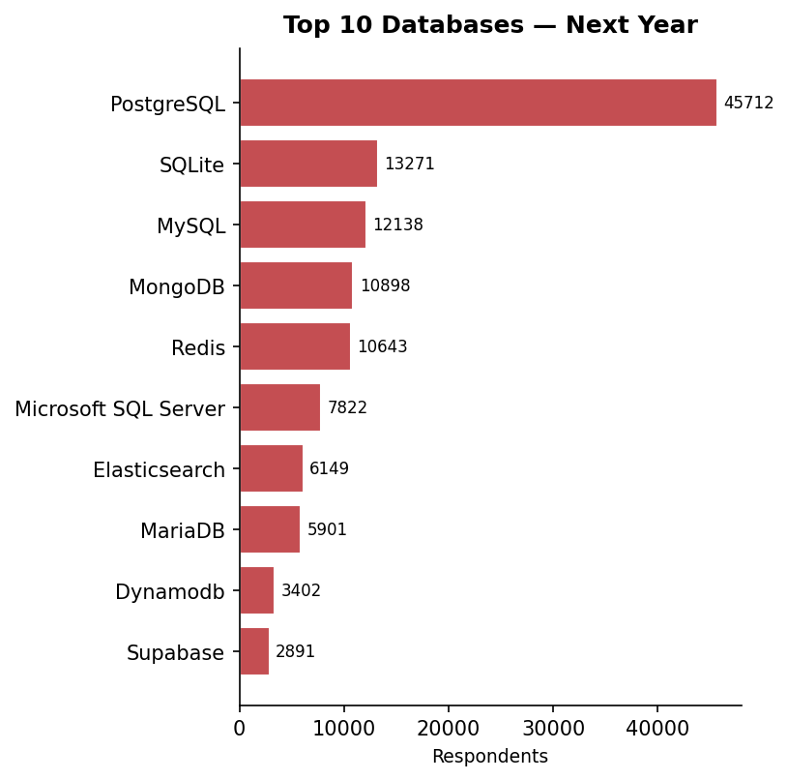
DATABASE TRENDS
PostgreSQL leads both current use (40,232) and future demand (46,397) by a wide margin. Supabase enters the desired top 10 for the first time — an emerging challenger to watch.

Slide 12
DATABASE TRENDS - FINDINGS & IMPLICATIONS
Findings
PostgreSQL is the most used AND most desired database — by a wide margin
MySQL remains widely used but shows declining preference in desired rankings
Supabase (2,930 desired) enters the top 10 despite near-zero current usage
Implications
Center database training and infrastructure around PostgreSQL
Evaluate Supabase for greenfield projects — strong developer enthusiasm
Redis and MongoDB growth signals rising demand for non-relational skills

Slide 13

DASHBOARD
Three interactive tabs were built in IBM Cognos Analytics to let stakeholders explore the data dynamically — beyond the static charts in this presentation. Each tab isolates a different dimension of the survey: current technology usage, future technology trends, and developer demographics. The dashboard supports drill-down by experience level, country, and employment type.

Slide 14
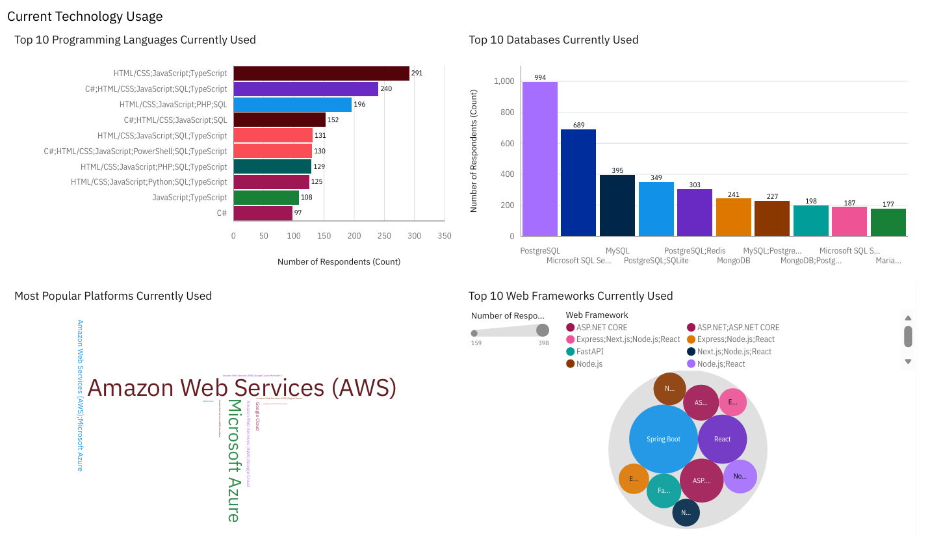
Current Technology Usage — Key Insights
Insight: The contemporary development paradigm is defined by web-centric stacks, PostgreSQL database primacy, and AWS-Azure cloud hegemony.

Slide 15
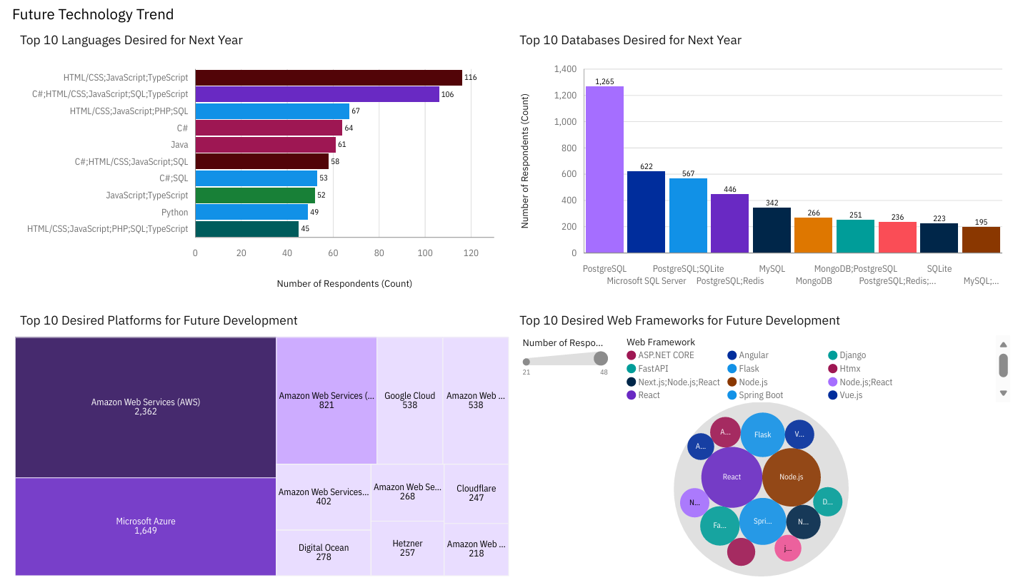
DASHBOARD TAB 2: Future Technology Trends
Insight: Python overtakes JavaScript as the #1 desired language — a direct signal of AI and data science adoption. PostgreSQL’s desired count exceeds its current-use count, confirming ecosystem consolidation. Cloud platforms (AWS, Azure) show the fastest growth gap between current and desired use.

Slide 16
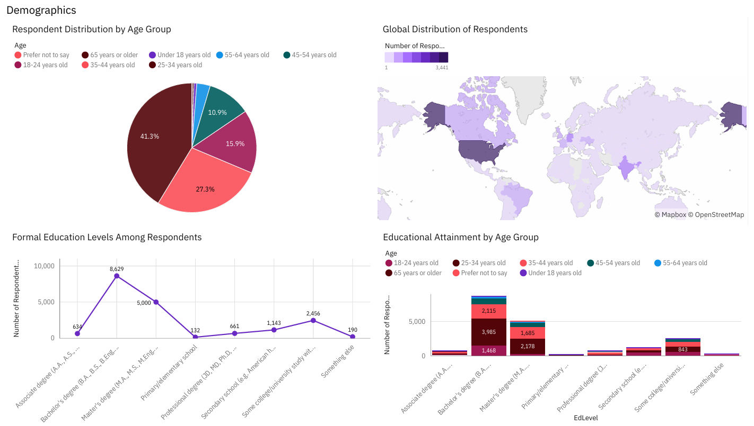
DASHBOARD TAB 3: Demographics
Insight: A young, highly educated, globally distributed workforce with strong full-time employment — an ideal talent pipeline for organizations investing in technology upskilling.

Slide 17
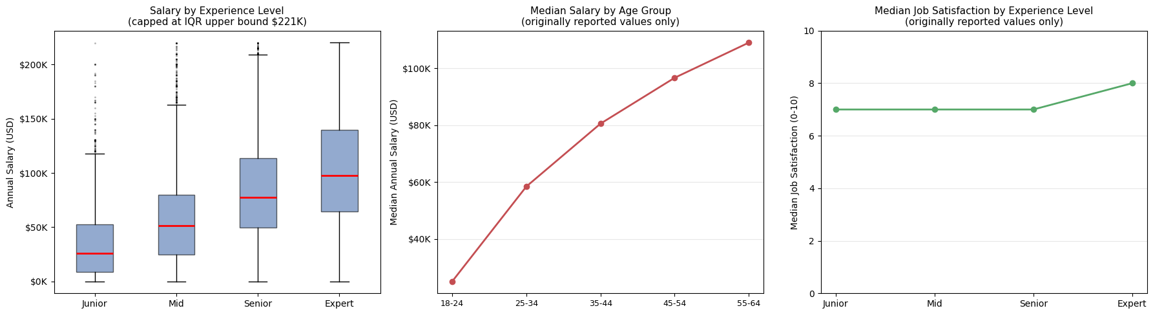
Salary & Experience Analysis
Insight: Professional advancement in the technology sector is characterized by a robust positive correlation between career longevity, age-based seniority, and substantial increases in both median annual compensation and perceived job satisfaction.

Slide 18
DISCUSSION
Paradigmatic Shift: AI-Driven WorkflowsThe development landscape is undergoing a fundamental transition from traditional JavaScript-centric web development toward Python-integrated AI and Machine Learning (ML) architectures. This shift is not merely organic but a deliberate ecosystem realignment driven by Large Language Model (LLM) tooling.
Infrastructure Consolidation: PostgreSQL PrimacyData infrastructure is rapidly standardizing around PostgreSQL. Its simultaneous leadership in current utilization and developer preference confirms its status as the industry-standard relational database for modern applications.
Workplace Dynamics: The Hybrid ImperativeHybrid work has transitioned from a professional perk to a baseline hygiene factor. Quantitative data indicates higher satisfaction levels among hybrid developers, signaling that geographic flexibility is now a critical requirement for talent retention.
Strategic Gap: Cloud Proficiency MisalignmentA significant market discrepancy exists between employer requirements for cloud platforms (AWS, Azure) and developer learning interests. Organizations that prioritize internal upskilling in these areas will secure a distinct competitive advantage.

Slide 19
OVERALL FINDINGS & IMPLICATIONS
Findings
Python overtook JavaScript as the #1 desired language — AI demand is the driver
PostgreSQL is the undisputed database standard, current and future
Median salary $65,000 · Job satisfaction 6.9/10 · 42% prefer hybrid work
Implications
Invest in Python and data science training as a core workforce development strategy
Standardize on PostgreSQL; monitor Supabase and Redis for emerging needs
Design retention packages beyond salary: remote flexibility and learning budgets

Slide 20

CONCLUSION
Python and PostgreSQL define the 2026 developer technology landscape
A young (25–34), Bachelor's-educated workforce presents both hiring opportunity and upskilling demand
Developer satisfaction is driven by culture and flexibility — not salary alone
Data-driven investment in Python, PostgreSQL, and hybrid work policies will be key competitive advantages for 2026 and beyond

Slide 21

APPENDIX
PIPELINE
I. Data Preprocessing & Quality
Dataset Optimization: Refined from 65,437 to 63,972 observations across 118 features (with outlier removal).
Integrity Measures: Executed deduplication (0.74% reduction) and IQR-based outlier mitigation (1.5% reduction) to ensure statistical validity.
II. Quantitative Salary Insights (USD)
Central Tendency: Median: $65,000 | Mean: $72,000.
Distribution: Interquartile Range (IQR) of $32,712 – $107,972, with an upper fence established at $220,861.
Normalization: Data scaled via Min-Max [0,1] and Z-score methods for algorithmic readiness.
III. Technical Ecosystem
Primary Languages: Python, SQL, JavaScript, TypeScript, Rust, Go.
Database Infrastructure: PostgreSQL, MySQL, MongoDB, Redis, Supabase.
IV. Methodology & Provenance
Source: Stack Overflow Developer Survey 2026 (IBM Skills Network Subset).
Stack: Python 3.12, Pandas, Matplotlib, Seaborn, SQLite3.

