Slide 1

Emerging Technology Trends: Insights from the Stack Overflow Developer Survey 2026
Jaiverth Adrian Tovar Lozada
March 21, 2026

Slide 2



OUTLINE
Executive Summary
Introduction
Methodology
Results
Visualization – Charts
Dashboard
Discussion
Findings & Implications
Conclusion
Appendix

Slide 3

EXECUTIVE SUMMARY
Key Findings from the Stack Overflow Developer Survey 2026
Python is the #1 most desired language, overtaking JavaScript (34,245 vs 23,774)
PostgreSQL dominates databases — most used today (40,232) and most desired (46,397)
Supabase enters the desired top 10 for the first time — an emerging challenger
Developer profile: majority 25–34 yrs old · Bachelor's degree · hybrid work preferred
Median annual salary: $65,000 | Job satisfaction: 6.9 / 10
64,950 clean responses analyzed after deduplication and quality checks

Slide 4

INTRODUCTION
Purpose, Target Audience & Value of the Analysis
Purpose
Analyze the Stack Overflow Developer Survey to identify current and future in-demand technology skills
Support strategic business decisions for a global IT and technology consulting firm
Target Audience
Technology leaders, hiring managers, and strategic decision-makers within the organization
Key Questions Addressed
Which programming languages, databases, and IDEs are most in demand today?
What technologies are developers planning to adopt in the near future?
What are the demographic characteristics of the global developer community?
Value of This Analysis
Enables data-driven hiring, training, and technology investment strategies for 2026 and beyond

Slide 5

METHODOLOGY
Data Source, Collection & Wrangling
Source: Stack Overflow Developer Survey 2026 (IBM Skills Network, ODbL license)
65,437 raw responses · 114 columns · loaded via URL · persisted in SQLite
Data Wrangling — 8-step pipeline:
Tools: Python 3.12 · pandas · matplotlib · seaborn · sqlite3
487 duplicates removed · missing values imputed (median / mode) · IQR outlier detection
4 features engineered: ExperienceLevel · Comp_MinMax · Comp_Zscore · YearsCodeProNum

Slide 6

Results
<Please present your results in the following slides.>

Slide 7
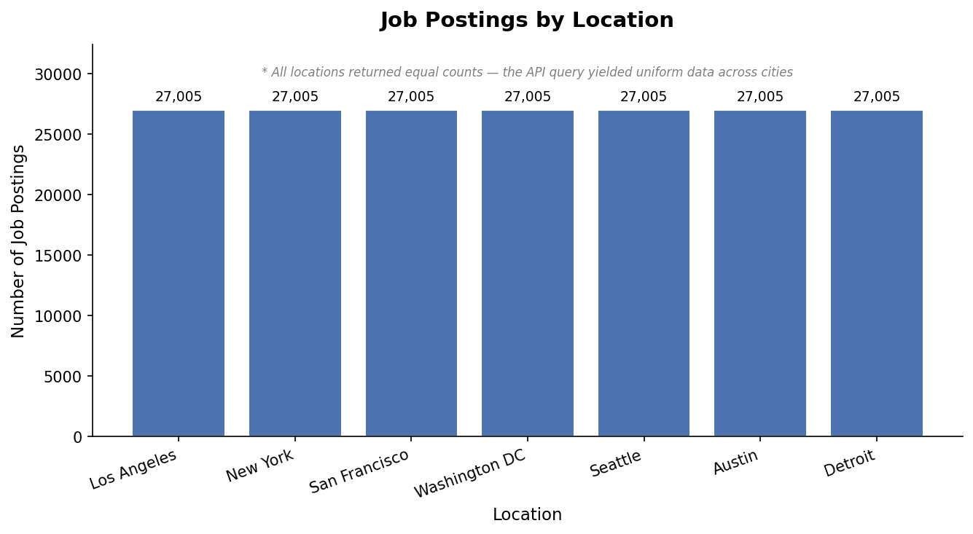
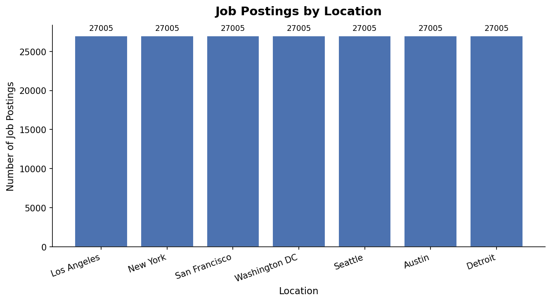
JOB POSTINGS

Slide 8
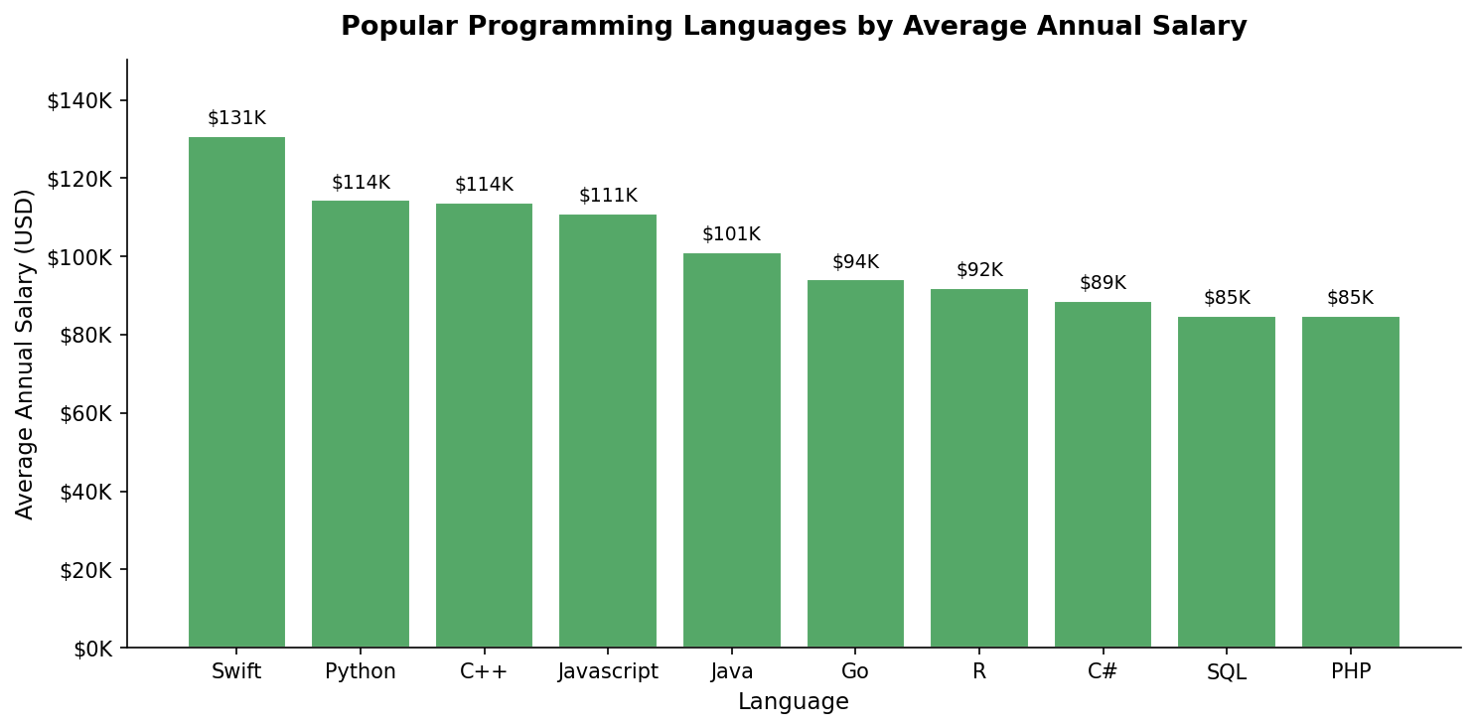
POPULAR LANGUAGES

Slide 9
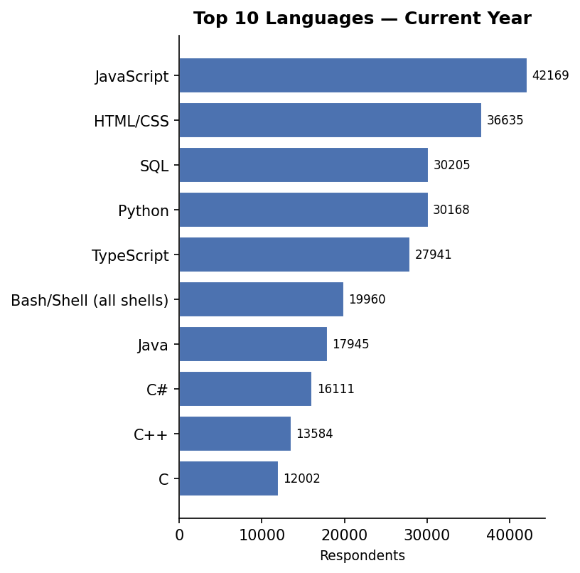
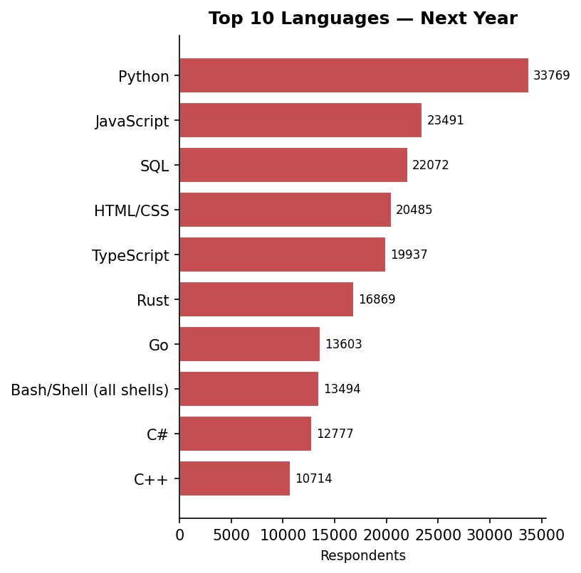
PROGRAMMING LANGUAGE TRENDS
JavaScript leads current usage (42,697) but Python surges to #1 desired (34,245) — a clear market shift toward data science and AI. TypeScript holds top 5 in both lists.

Slide 10
PROGRAMMING LANGUAGE TRENDS - FINDINGS & IMPLICATIONS
Findings
JavaScript is the most widely used language today (42,697 respondents)
Python is #1 desired for next year (34,245), surpassing JavaScript by 44%
TypeScript ranks top 5 in both lists — steady growth as JavaScript's companion
Implications
Prioritize Python upskilling for teams moving into data science and AI roles
JavaScript + TypeScript remain essential skills for full-stack development hiring
SQL (4th most used) is critical for data analyst and backend developer roles

Slide 11
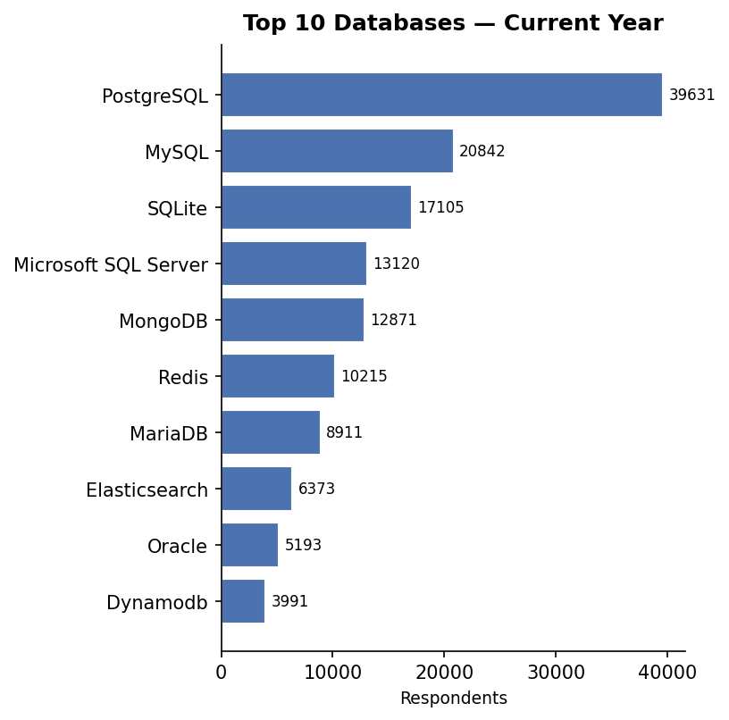
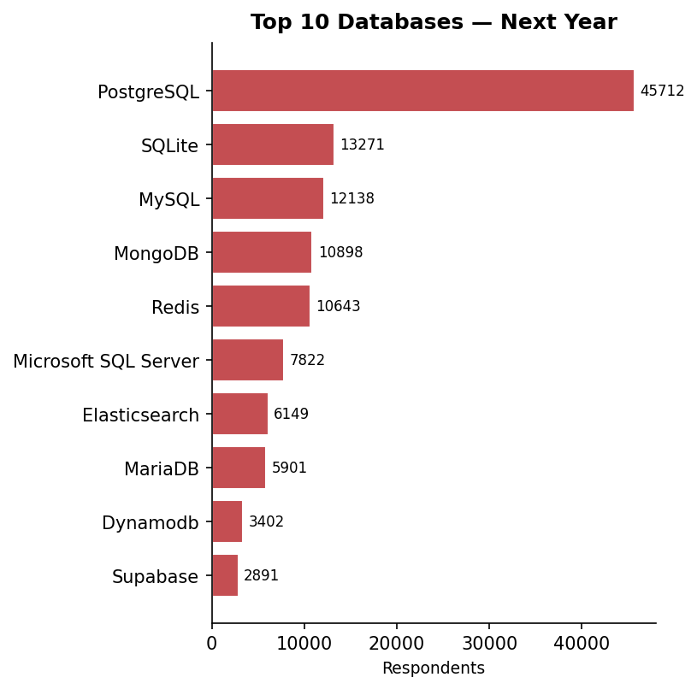
DATABASE TRENDS
PostgreSQL leads both current use (40,232) and future demand (46,397) by a wide margin. Supabase enters the desired top 10 for the first time — an emerging challenger to watch.

Slide 12
DATABASE TRENDS - FINDINGS & IMPLICATIONS
Findings
PostgreSQL is the most used AND most desired database — by a wide margin
MySQL remains widely used but shows declining preference in desired rankings
Supabase (2,930 desired) enters the top 10 despite near-zero current usage
Implications
Center database training and infrastructure around PostgreSQL
Evaluate Supabase for greenfield projects — strong developer enthusiasm
Redis and MongoDB growth signals rising demand for non-relational skills

Slide 13

DASHBOARD
<Please present your dashboard in the following slides.>

Slide 14
DASHBOARD TAB 1: Current Technology Usage
Screenshot of dashboard tab 1 goes here
Dashboard Insight
Summarize key insights shown

Slide 15
DASHBOARD TAB 2: Future Technology Trends
Screenshot of dashboard tab 2 goes here
Dashboard Insight
Summarize future trends.

Slide 16
DASHBOARD TAB 3: Demographics
Screenshot of dashboard tab 3 goes here
Dashboard Insight
Summarize demographic insights

Slide 17
DISCUSSION
The survey reveals a developer community in active transition — from JavaScript-centric web development toward Python-driven AI and data science workflows.

Slide 18
OVERALL FINDINGS & IMPLICATIONS
Findings
Python overtook JavaScript as the #1 desired language — AI demand is the driver
PostgreSQL is the undisputed database standard, current and future
Median salary $65,000 · Job satisfaction 6.9/10 · 42% prefer hybrid work
Implications
Invest in Python and data science training as a core workforce development strategy
Standardize on PostgreSQL; monitor Supabase and Redis for emerging needs
Design retention packages beyond salary: remote flexibility and learning budgets

Slide 19

CONCLUSION
Python and PostgreSQL define the 2026 developer technology landscape
A young (25–34), Bachelor's-educated workforce presents both hiring opportunity and upskilling demand
Developer satisfaction is driven by culture and flexibility — not salary alone
Data-driven investment in Python, PostgreSQL, and hybrid work policies will be key competitive advantages for 2026 and beyond

Slide 20

APPENDIX
Include any relevant additional charts, or tables that you may have created during the analysis phase.

