Slide 1
EDA
Adrian Taggruber

Slide 2
Load Data
import pandas as pd dataset = pd.read_csv("smoker.csv")

Slide 3
Inspect structure
dataset.shape
(10000, 3)
dataset.info()
<class 'pandas.core.frame.DataFrame'> RangeIndex: 10000 entries, 0 to 9999 Data columns (total 3 columns): # Column Non-Null Count Dtype --- ------ -------------- ----- 0 smoker 10000 non-null int64 1 treatment 10000 non-null int64 2 outcome 10000 non-null int64 dtypes: int64(3) memory usage: 234.5 KB

Slide 4
Inspect Value
 | smoker | treatment | outcome
0 | 0 | 0 | 0
1 | 1 | 1 | 1
2 | 2 | 1 | 5
3 | 3 | 1 | 67
4 | 4 | 0 | 8
dataset.head()

Slide 5
 | smoker | treatment | outcome
9995 | 1 | 1 | 0
9996 | 0 | 0 | 1
9997 | 0 | 0 | 0
9998 | 1 | 1 | 0
9999 | 1 | 1 | 0
dataset.tail()

Slide 6
Statistics
 | smoker | treatment | outcome
count | 10000.00 | 10000.00 | 10000.00
mean | 0.31 | 0.30 | 0.28
std | 0.47 | 0.48 | 0.82
min | 0.00 | 0.00 | 0.00
25% | 0.00 | 0.00 | 0.00
50% | 0.00 | 0.00 | 0.00
75% | 1.00 | 1.00 | 1.00
max | 5.00 | 8.00 | 67.00
round(dataset.describe(), 2)

Slide 7
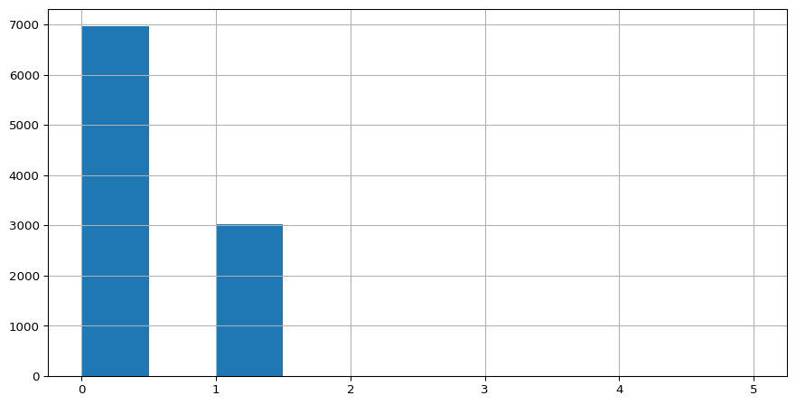
Histogram
import matplotlib.pyplot as plt dataset["smoker"].hist() plt.show()

