Slide 1

EVOLVING MODELS WITH ESTIMATION OF DISTRIBUTION ALGORITHMS
Scientific coordinator:
Prof. dr. Henri Luchian
Graduate student:
Adrian Tiron

Slide 2
PRESENTATION OVERVIEW
MOTIVATIONS
RESEARCH OBJECTIVES
DESIGNING THE RESEARCH
PRACTICAL PART
RESULTS
CONCLUSIONS

Slide 3
MOTIVATIONS
My passion for evolutionary computing stems from an optional subject in the 2nd year, Genetic Algorithms, which I just happened to choose, not knowing how much I’d be fascinated by it…
When the moment of finding a coordinator came, I could think of none other than the coordinator of the aforementioned course!

Slide 4
research objectives
Devising a fair comparison between EDA¹ and other EA² by:
Making all algorithms as independent as possible.
Creating similar experiment conditions.
Compiling the results into intuitive plots.
¹Estimation of Distribution Algorithms
²Evolutionary Algorithms

Slide 5
DESIGNING THE RESEARCH
Getting accustomed to this new type of algorithms…
Settling on UMDA¹ as the representative of EDA.
Implementing the adversary algorithms.
Running all the algorithms on benchmark functions.
¹Univariate Marginal Distribution Algorithm

Slide 6
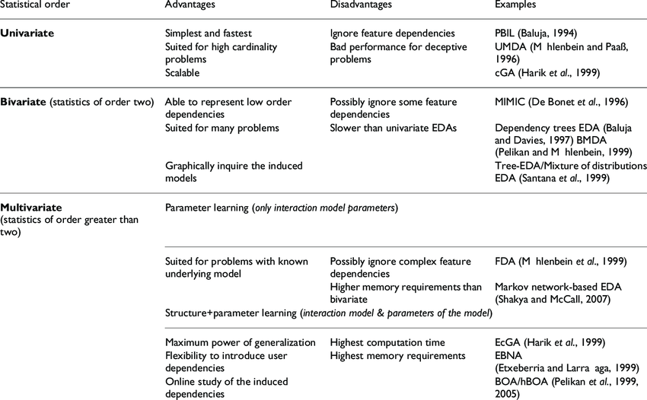
Fig. 1 Types of EDA¹
¹ Source: https://www.researchgate.net/publication/23288894_A_review_of_estimation_of_distribution_algorithms_in_bioinformatics

Slide 7
PRACTICAL PART
4 algorithms:
A classic Genetic Algorithm
Hill Climbing (ITS¹)
Simulated Annealing (ITS¹)
Univariate Marginal Distribution (EDA)
¹Iterative Local Search

Slide 8
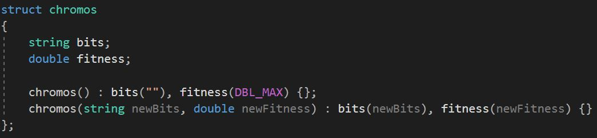
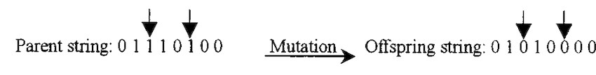
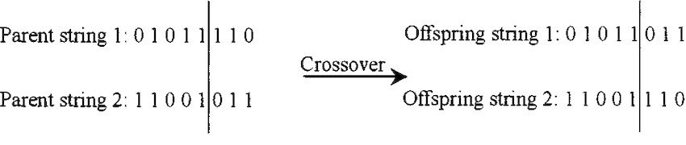
Fig. 2
Structure of a chromosome
Fig. 3 Mutation
Fig. 4 Crossover

Slide 9
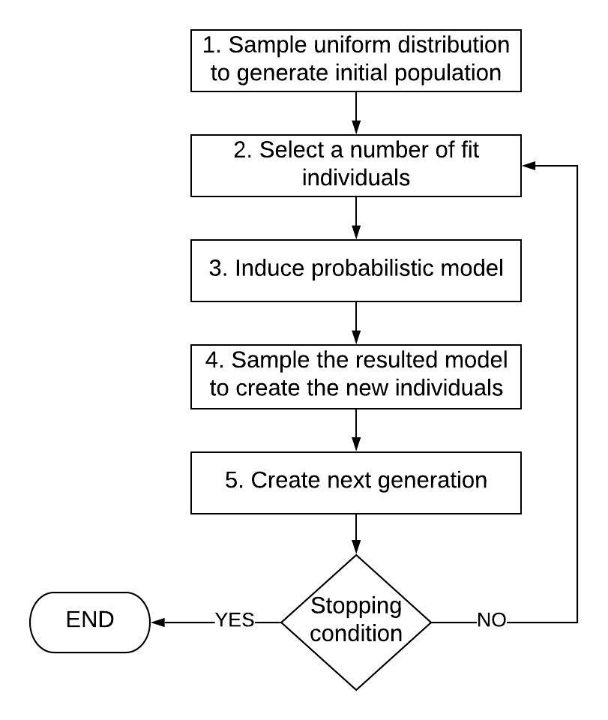
Fig. 5 EDA algorithm flow chart

Slide 10
RESULTS
3 whole runs for each algorithm to show consistency.
Max. 400 generations per run.
Initial necessary parameters (no. of variables, length etc.) are the same for each function.
The plots show the attained optimum AND the road to it.

Slide 11
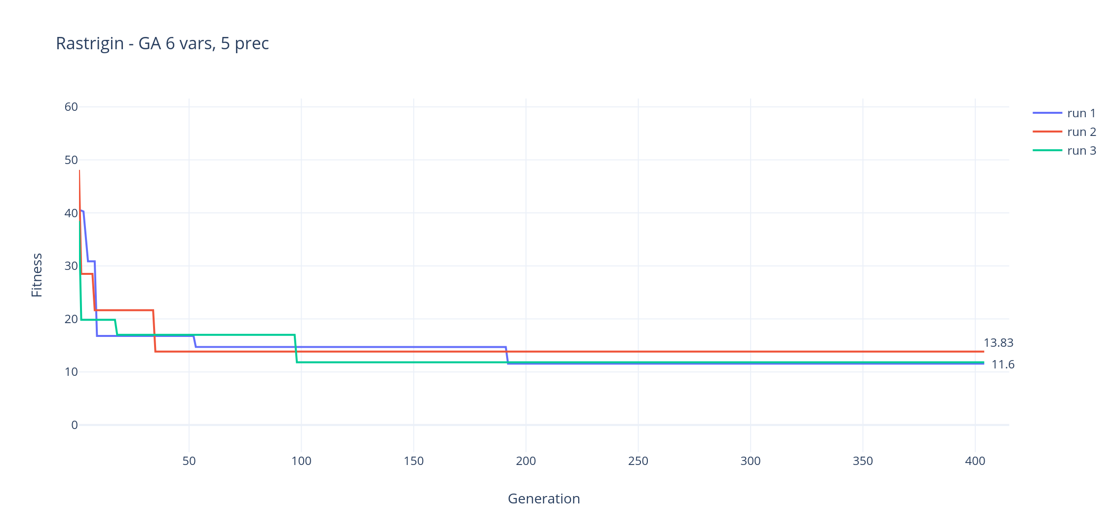
Example – Genetic Algorithm

Slide 12
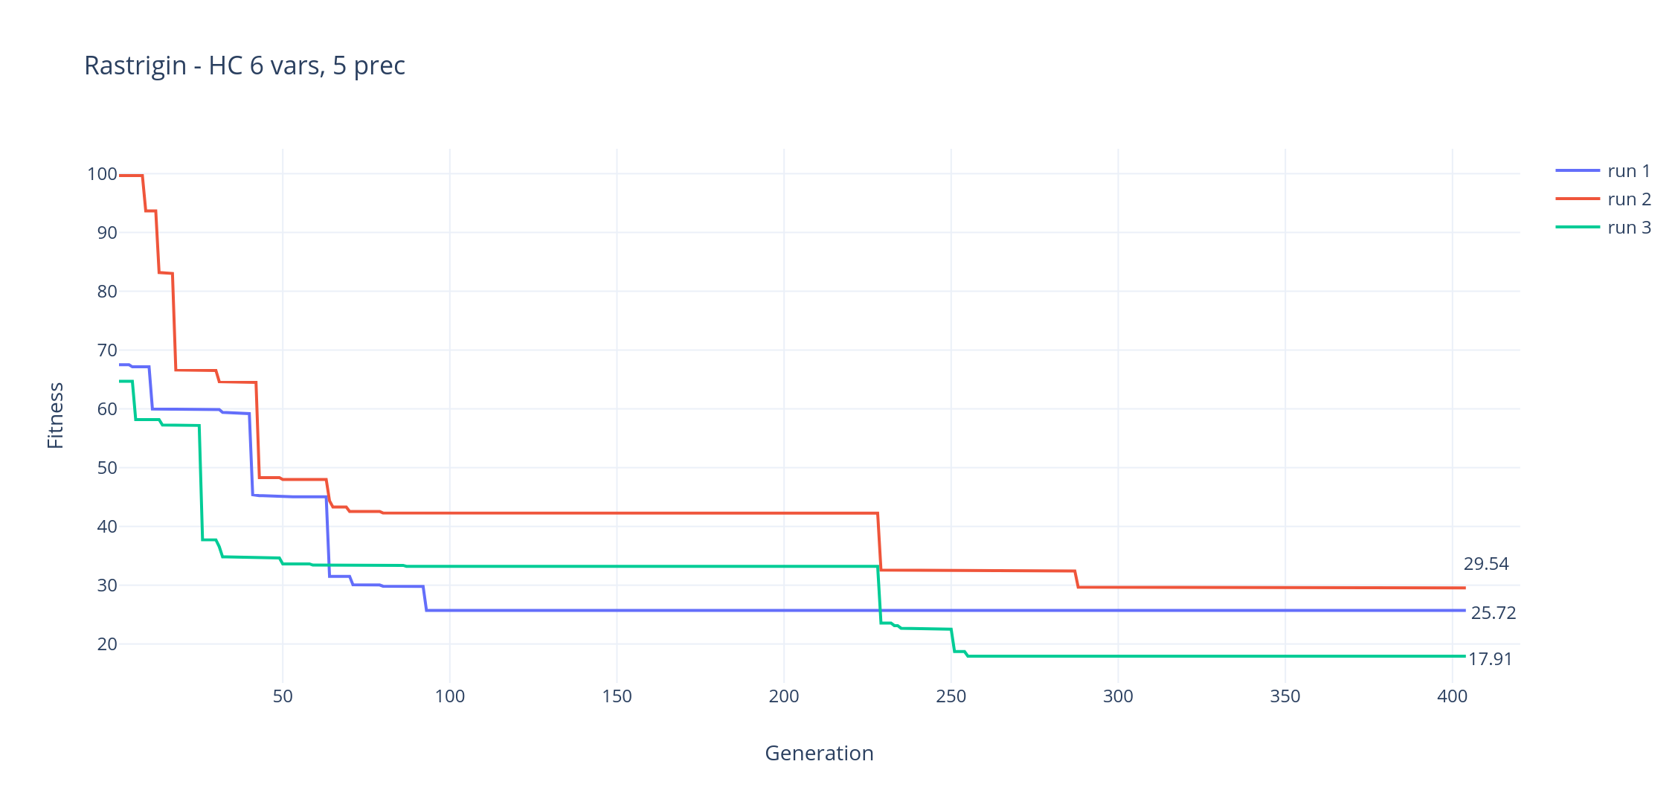
Example – Hill Climbing

Slide 13
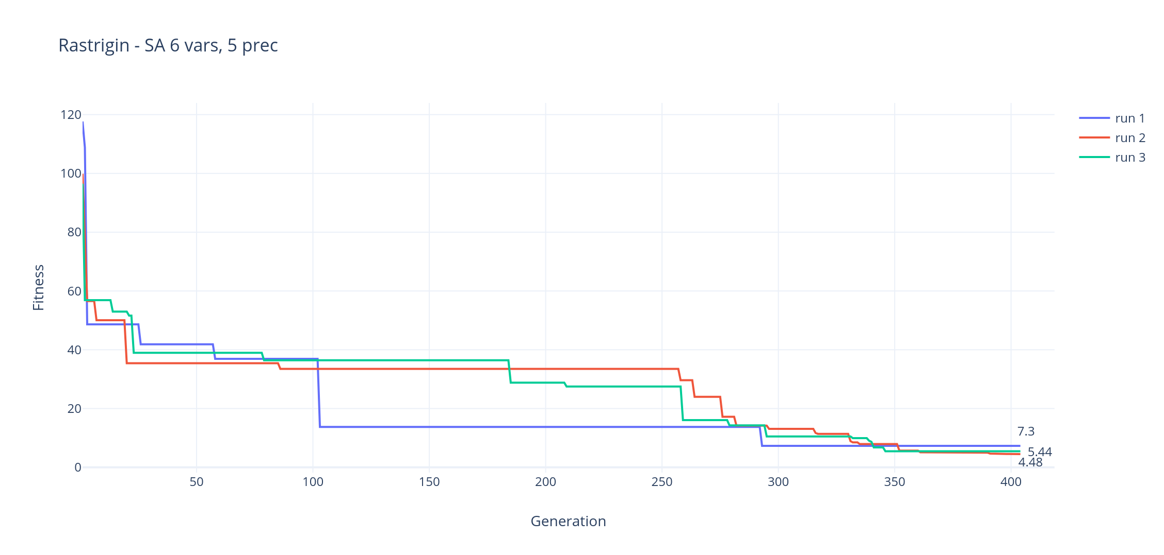
Example – Simulated Annealing

Slide 14
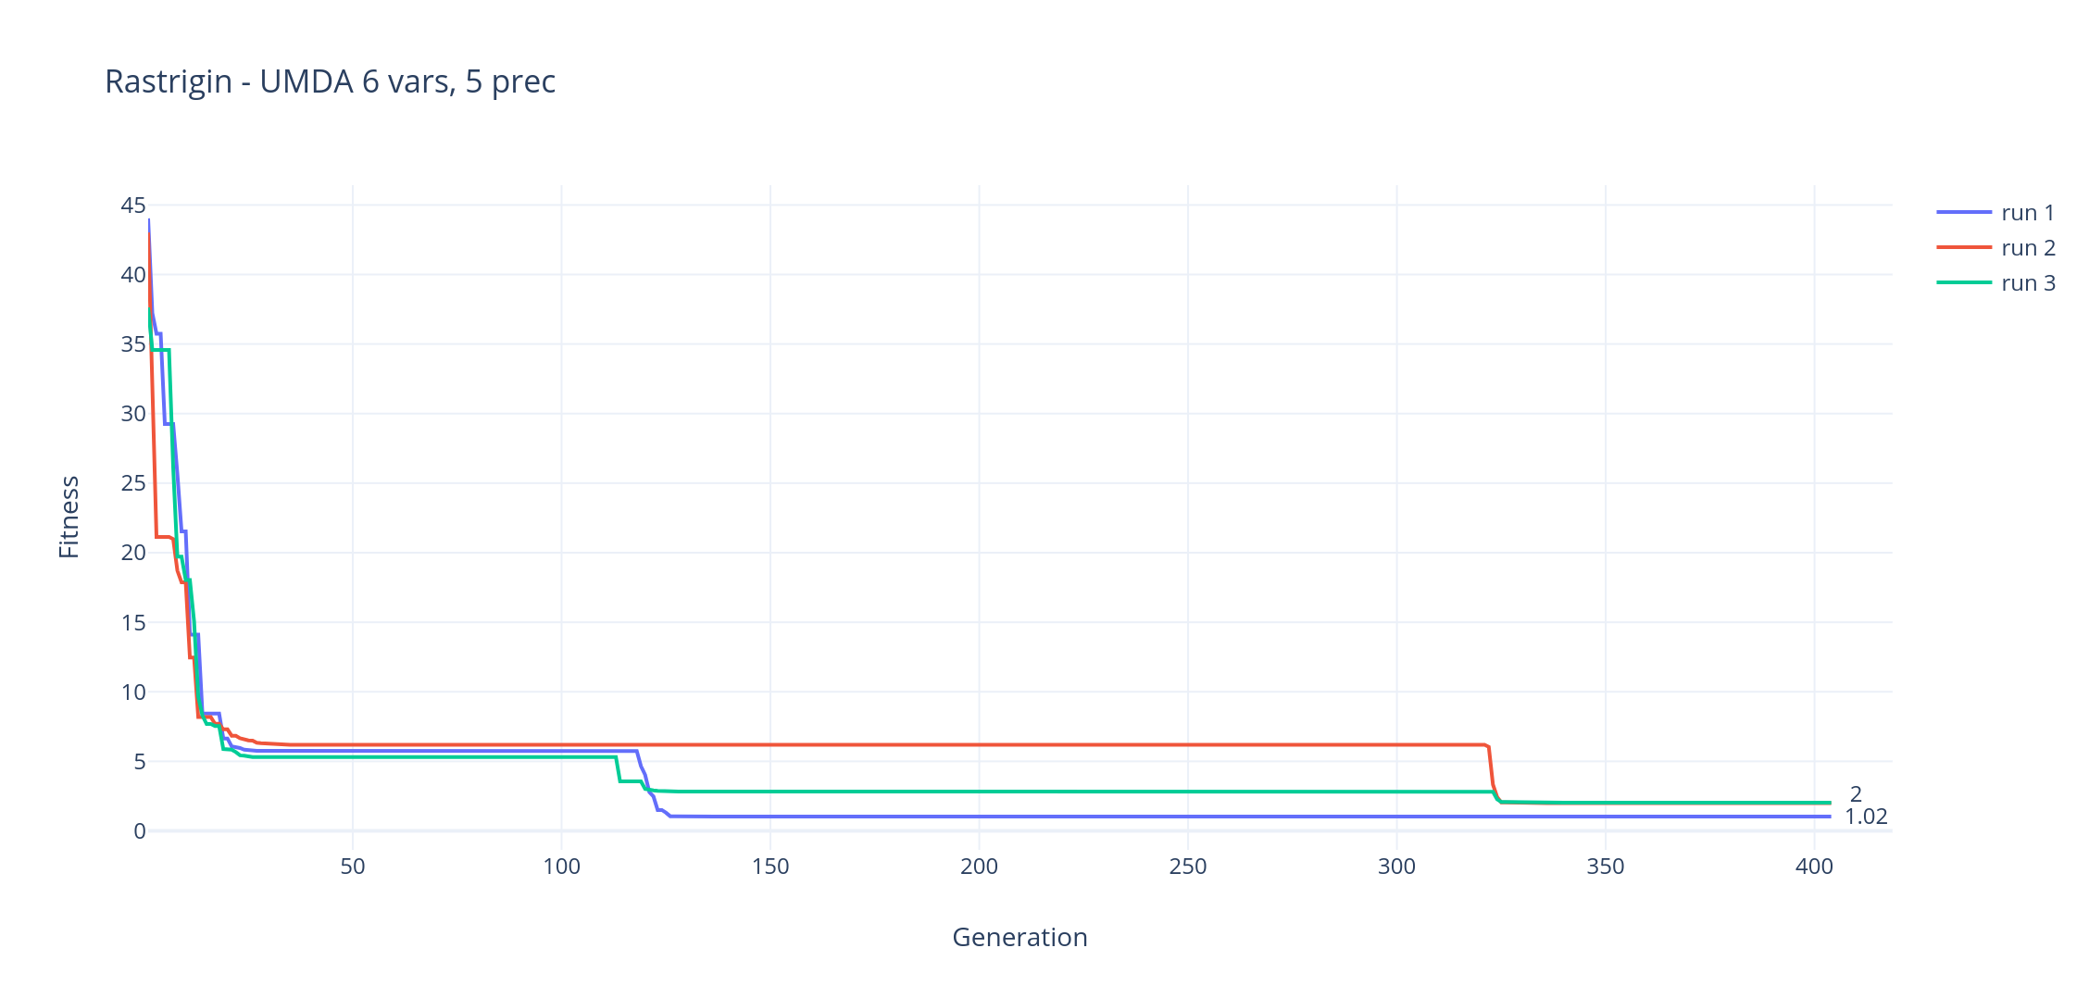
Example – Univariate Marginal Distribution

Slide 15
CONCLUSIONS
EDA are at least as good as the other algorithms.
They are easier to implement and depend on less parameters.
It takes them less generations to reach an acceptable solution.
EDA have a lot of potential and that should not be rejected.

