Slide 1
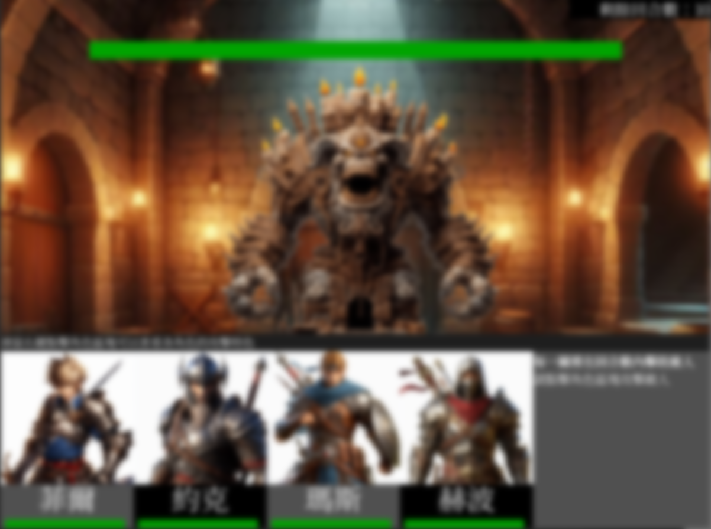
必須在剩餘回合數歸零前打敗敵人
敵人生命值
敵人顯示在此
↓ ↓點擊底下想要發動攻擊的角色圖片即可攻擊↓ ↓
其餘說明顯示在此
戰鬥狀態更新在此
玩家角色生命值

Slide 2
Defeat enemy in the remaining rounds
Enemy Health
Enemy
↓ ↓Click on the image of the character to attack↓ ↓
Other Details
Battle Status Update
Player Character Health

