Slide 1
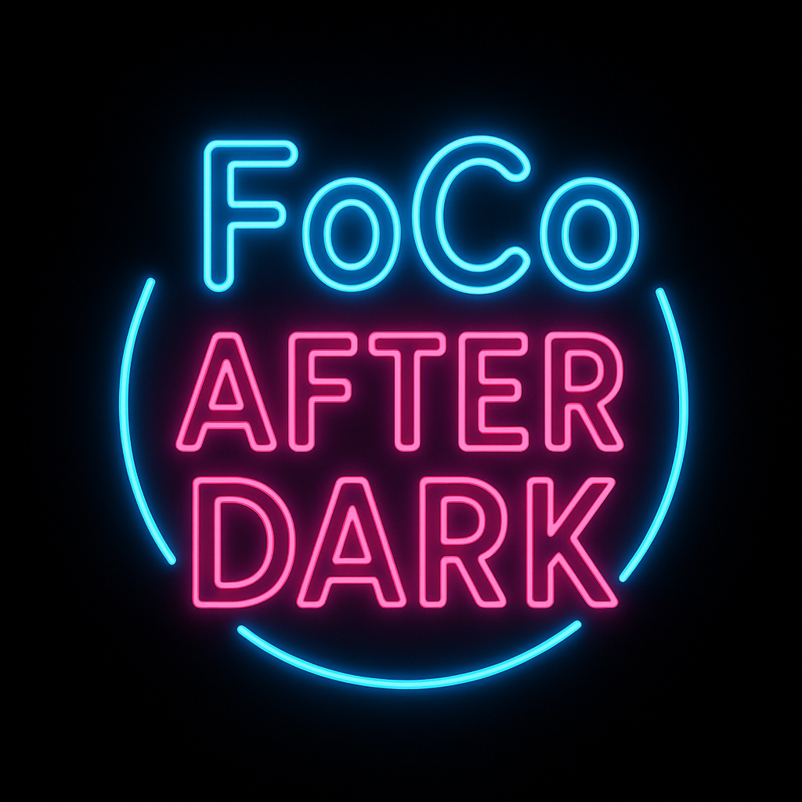
FoCo After Dark
Nightlife membership • VIP vibes • Real customers delivered to your venue.

Slide 2
Who We Are
Neon-branded nightlife tech.
Designed for Fort Collins.
Verified 21+ members.
High‑spend crowd.

Slide 3
Current Value Proposition
✔ Free for bars
✔ Guaranteed foot traffic
✔ Trackable redemptions
✔ Featured in-app placement
✔ Nightlife-targeted audience

Slide 4
How It Works
1. Member shows QR
2. Staff verifies
3. Voucher redeems
4. Dashboard updates
5. FoCo promotes your venue

Slide 5
The App in Action
Digital pass
Live QR codes
Wallet integration
Skip-line logic
Age verification

Slide 6
Analytics Dashboard Mockups
Heat map: peak hours
Redemption totals
User return rate
Top perks
ROI metrics

Slide 7
Branding Power
Neon visuals
High-energy marketing
College + young professional focus
FoCo-wide exposure

Slide 8
Premium Visibility
Featured Venue banner
Top search results
Push notifications
Event priority placement

Slide 9
Monetization Roadmap
Phase 1: Free for all bars
Phase 2: Premium placement
Phase 3: Analytics PRO
Phase 4: Redemption fees
Phase 5: Venue wallet
Phase 6: Sponsored events
Phase 7: Enterprise tier

Slide 10
Pricing Breakdown
Premium Placement: $49–$199
Analytics Pro: $79–$149
Redemption Fees: $0.10–$1
Events: $200–$500
Enterprise: $199–$499

Slide 11
Why Bars Will Pay
They already get customers
Proof of value
Recurring traffic
Competitive advantage
Early partner pricing guaranteed

Slide 12
Old Town Targeting
Designed specifically for:
College bars
High-volume dance floors
Craft cocktail lounges
Late-night food spots

Slide 13
Founding Venue Perks
Permanent discounted pricing
Lifetime featured eligibility
Exclusive city‑launch promotions

Slide 14
Expansion Vision
Denver After Dark
Boulder After Dark
Greeley After Dark
CSU/CU passes
National rollout

Slide 15
Join the Launch
Become a founding venue.
No cost. No contract.
Day-one traffic boost.
VIP branding exposure.

