Slide 1
Advanced data testing with go

Slide 2
DATA validation vs data verification
Data validation is the process of comparing data with a set of rules ensuring data is meeting quality requirements.
Data verification is the process of checking that the target data matches the original source.

Slide 3
APPLICATION DATA FLOW
input
business rules
output

Slide 4
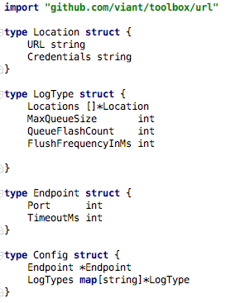

Logger config use case
https://github.com/adrianwit/golang-data-testing/tree/master/config_use_case

Slide 5
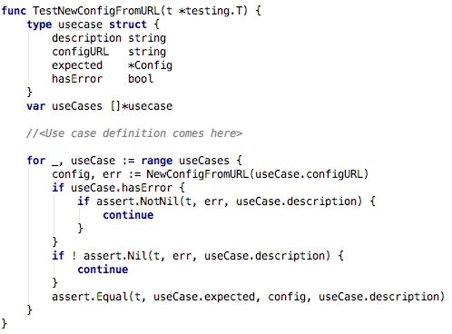
Data driven test organization
github.com/stretchr/testify/assert

Slide 6
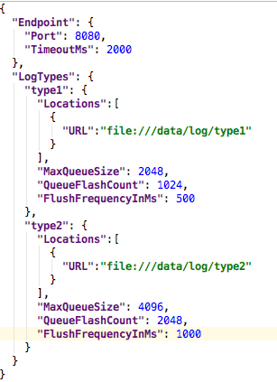
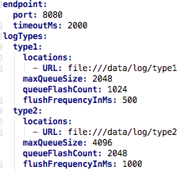
TEST USE CASE data

Slide 7
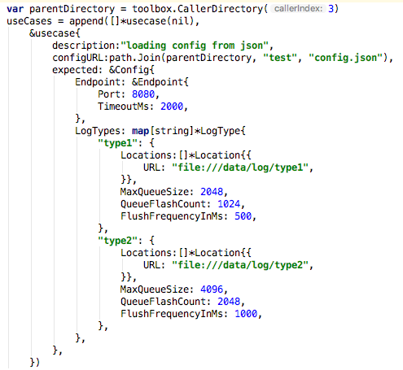
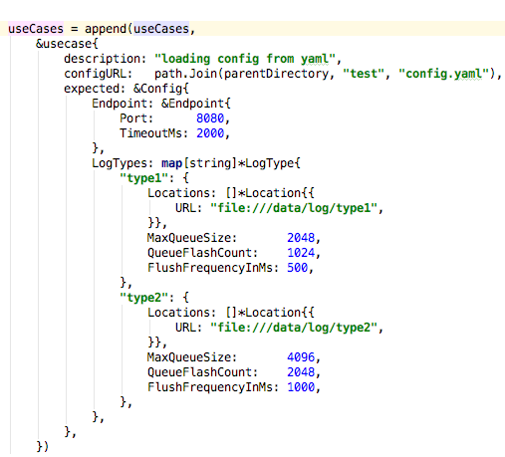
TEST Use case DEFINITION

Slide 8
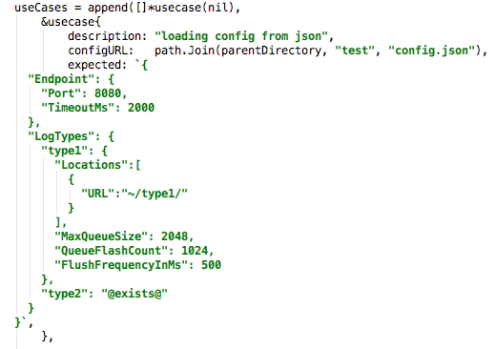
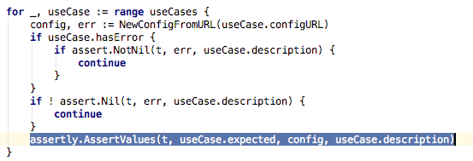
PARTIAL VERIFICATION WITH VALIDATION
https://github.com/viant/assertly

Slide 9
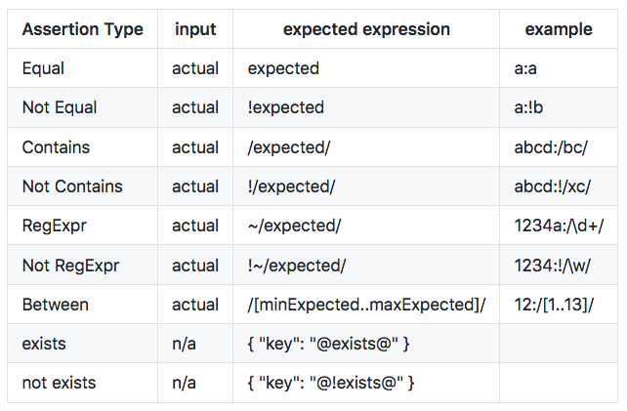
AssertLy - assertion type
https://github.com/viant/assertly

Slide 10
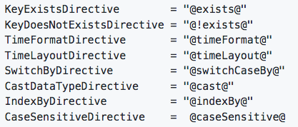
AssertLy - DirectivE
Notes:
Directive is piece of information instructing validator to either convert data just before validation takes place or to validate a date according to provided rules.

Slide 11
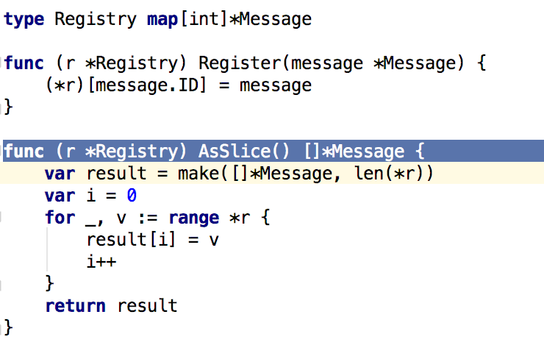
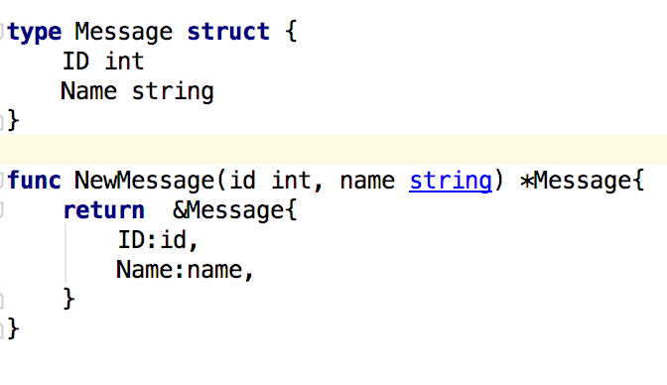
Unordered COLLECTION use case

Slide 12
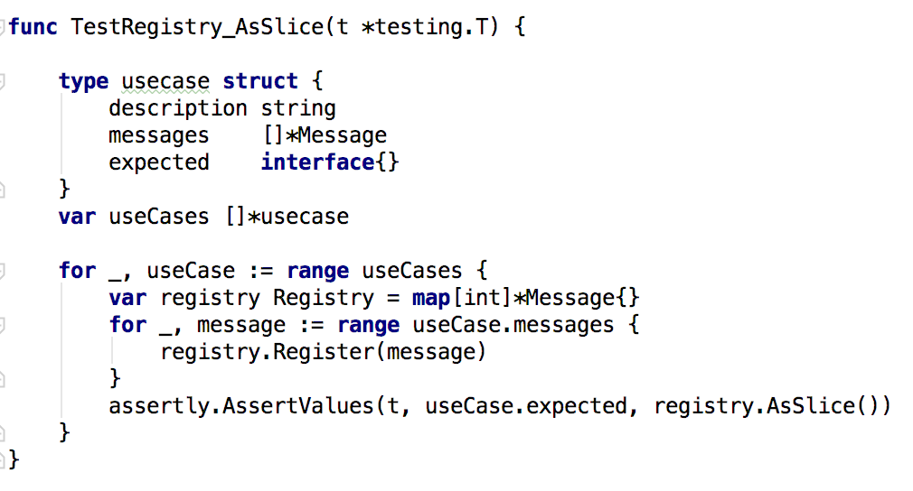
Unordered COLLECTION USE CASE TEST DESIGN

Slide 13
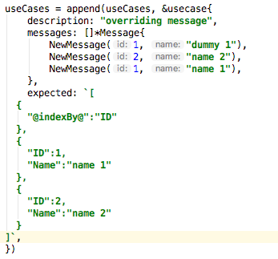
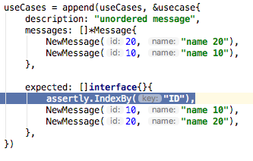
Unordered COLLECTION USE case definition

Slide 14
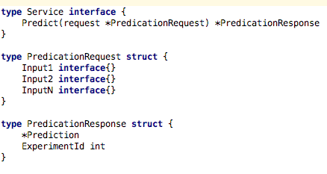
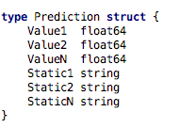
AB testing use case

Slide 15
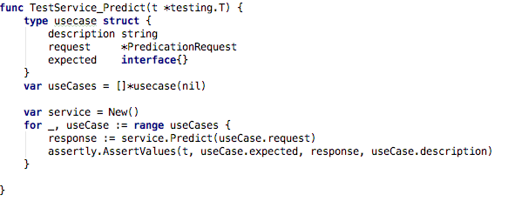
AB testing use case test design

Slide 16
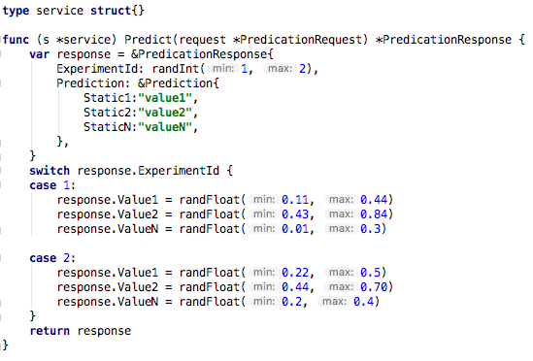
AB testing dummy SERVICE implementation

Slide 17
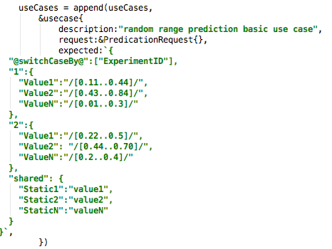
Ab testing use case definition

Slide 18
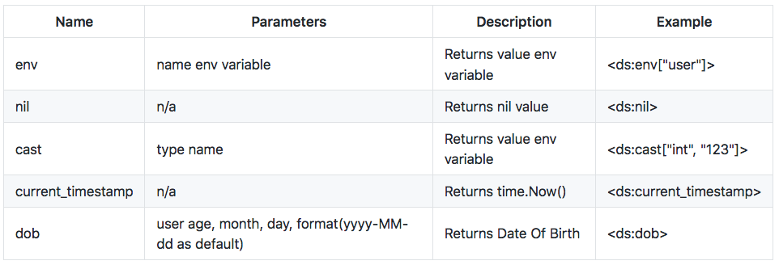
AssertLy - MACRO
Notes:
viant/toolbox/value_provider.go

Slide 19
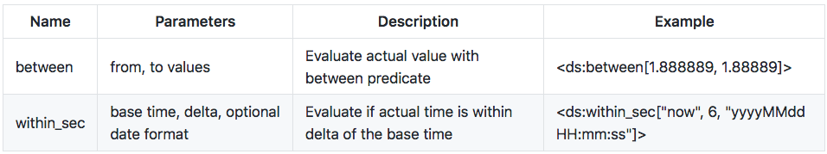

AssertLy - Predicate

Slide 20
DATA ACCESS API
Storage API - https://github.com/viant/toolbox/tree/master/storage
Database API - database/sql
Datastore API - https://github.com/viant/dsc/

Slide 21
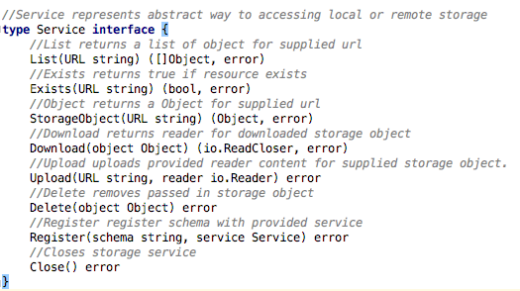
DATA ACCESS API – STORAGE API
https://github.com/viant/toolbox/tree/master/storage

Slide 22
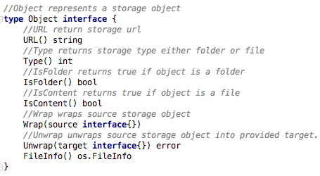
DATA ACCESS API – STORAGE API
https://github.com/viant/toolbox/tree/master/storage

Slide 23
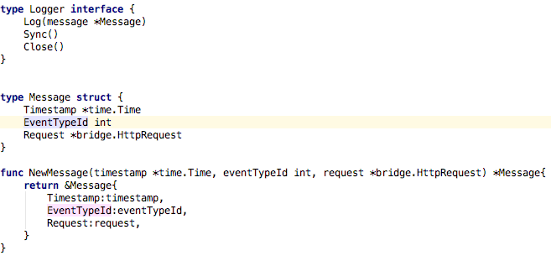
Structured log use case

Slide 24
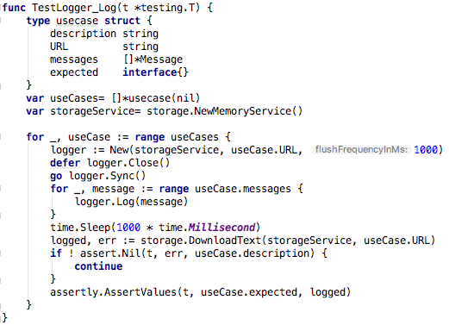
Structured log use case TEST DESIGN

Slide 25
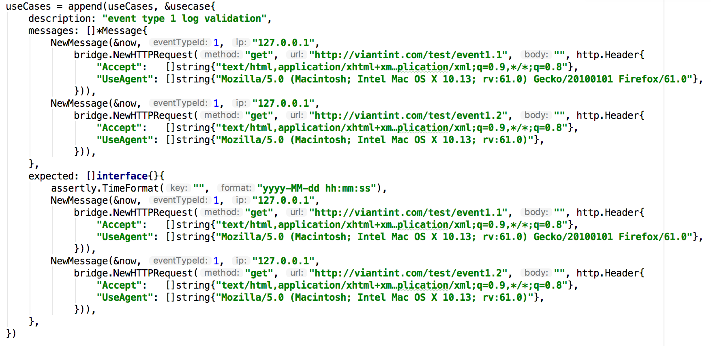
Structured log use case TEST DEFINITION

Slide 26
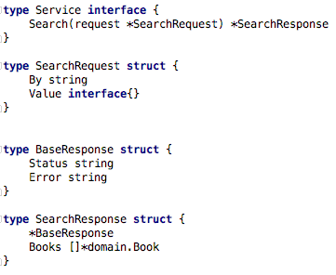
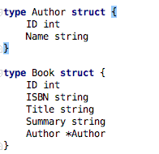
DATABASe use case

Slide 27
DSUNIT – datastore testibility framework
https://github.com/viant/dsunit
Manages test databases
Seed database with test data
Validates data in database
Simplifies multi table data organization with table mapping

Slide 28
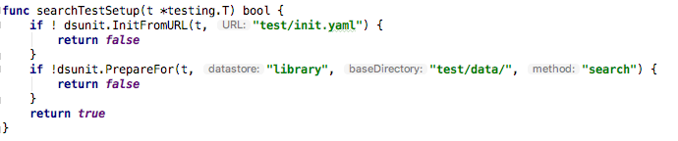
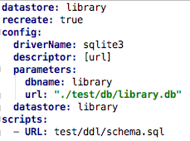
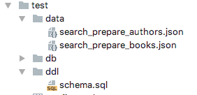
DATABASe use case TEST SETUP

Slide 29
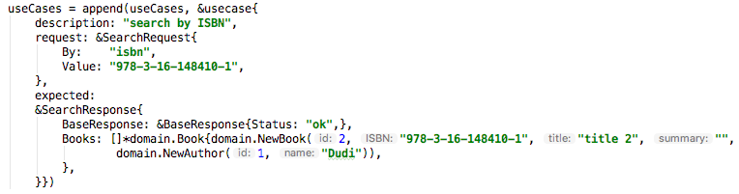
DATABASe use case TEST DEFINITION

Slide 30
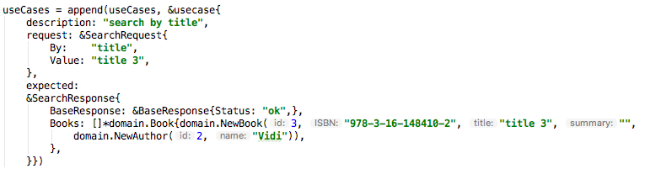
DATABASe use case TEST DEFINITION

Slide 31
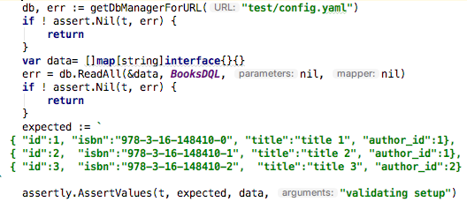
Data setup verification

Slide 32
Q & A

