Slide 1
Neatly workshop
By Adrian Witas
https://github.com/viant/neatly

Slide 2
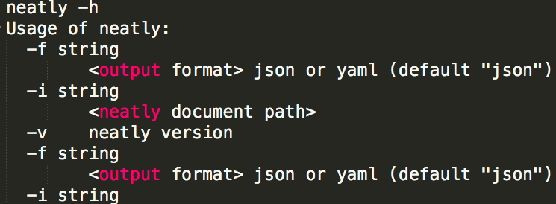
What is neatly
Neatly is tabular based document format for representing complex and large object structure
Neatly comes with converter written in go LANG producing JSON, YAML or actual domain model object tree from neatly document

Slide 3
motivation
Format addressing json, yaml, xml maintaining complexity in representing large objects
Power of UI/datastore without it
Simple, readable and intuitive
Able to manage and organize hundred thousand+ objects
Cohesive
Extendable
reusable

Slide 4
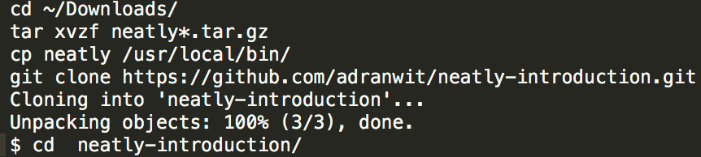
Prerequisites
Download neatly
https://github.com/viant/neatly/releases/
Clone neatly workshop
https://github.com/adranwit/neatly-introduction

Slide 5
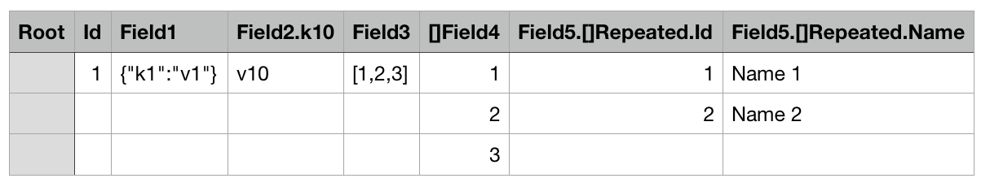

Neatly document – object tag

Slide 6
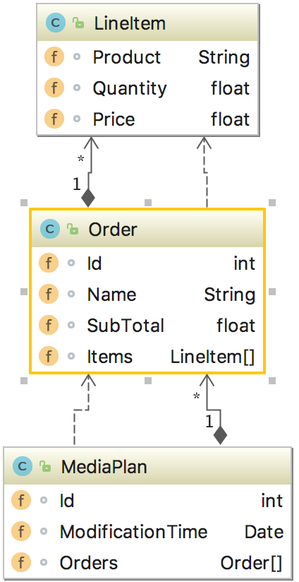
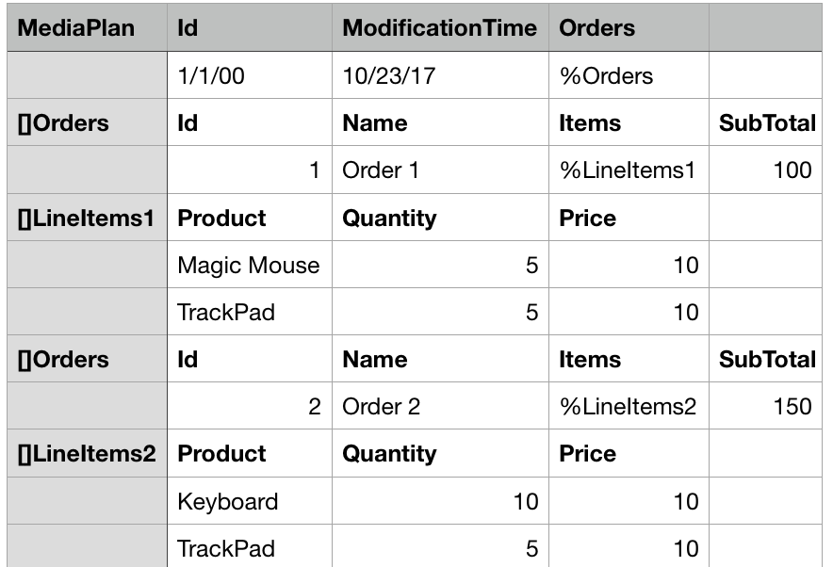
Neatly – object tree

Slide 7
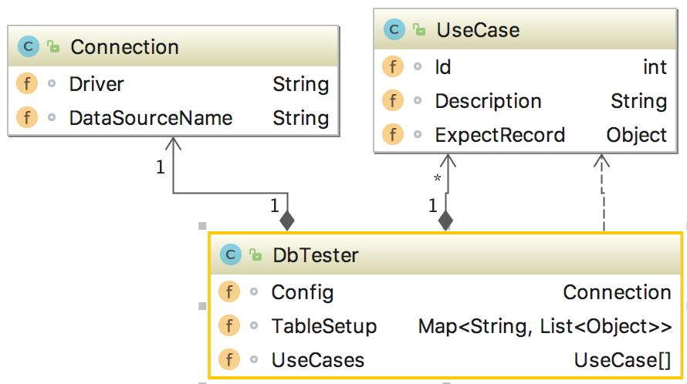
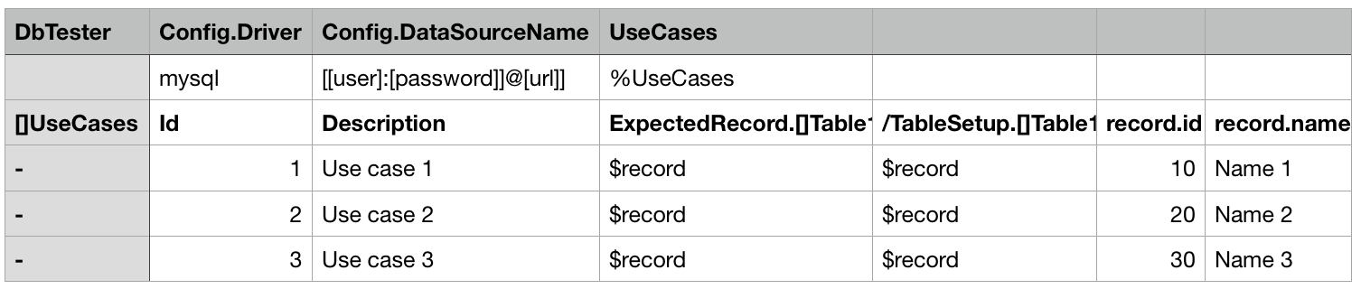
Neatly – root object

Slide 8
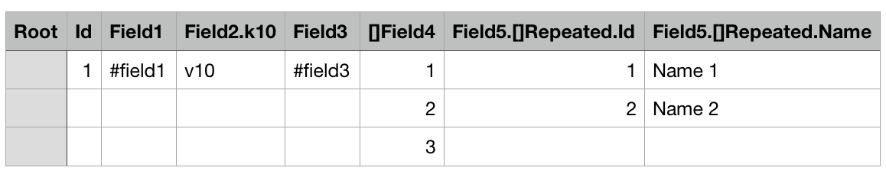

Neatly - external Resource

Slide 9
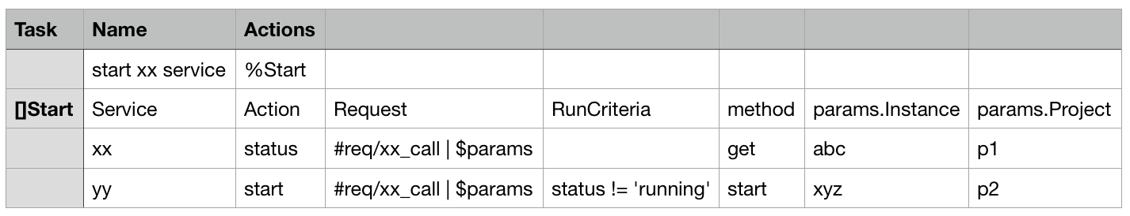
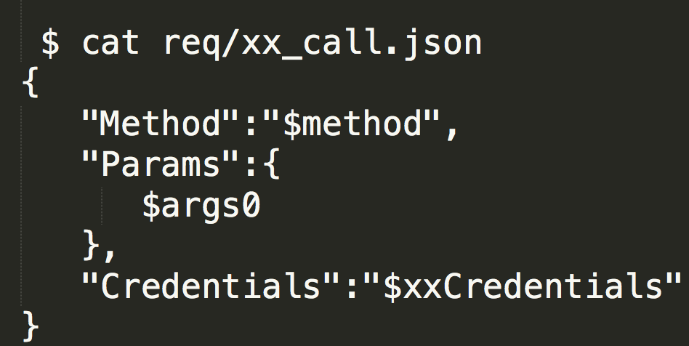
Neatly– data substitution

Slide 10
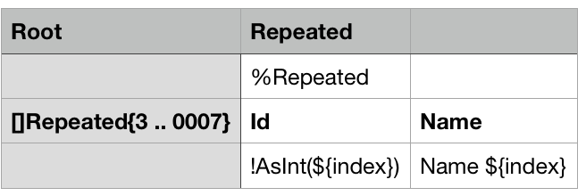

Neatly– Tag range/iterator

Slide 11
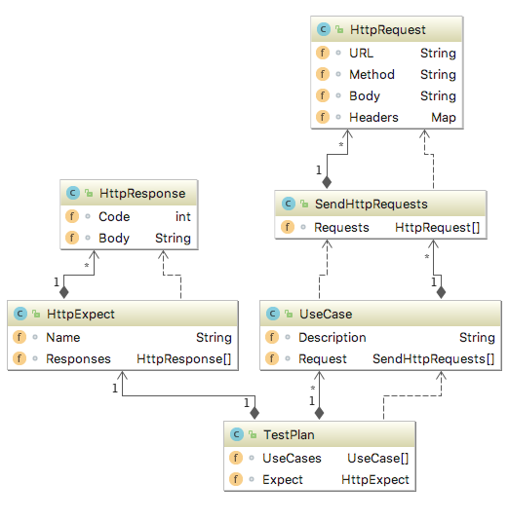
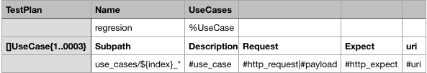
Neatly– sub path discovery

Slide 12
External resource lookup
1. Subpath directory if subpath specified 2. neatly document path 3. Local/Remote repository is specified

Slide 13
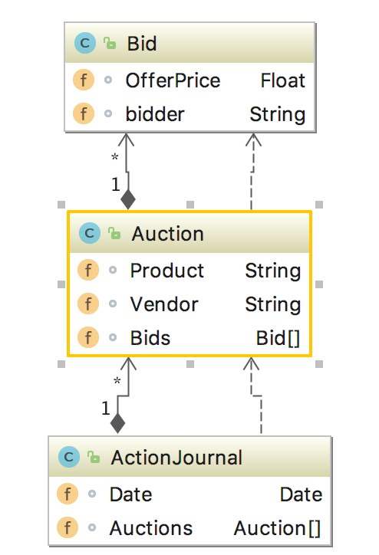
Exercise – define neatly document

Slide 14
Neatly – User Defined Function
AsMap
AsBool
Length
AsFloat
AsInt
HasResource
WorkingDirectory

Slide 15
Neatly – User Defined Function …
LoadNeatly
FormatTime
Zip
Unzip
UnzipText
Markdown
Cat

Slide 16
Reserved substitution keywords
$index / ${index}
$tag expands to the current object tag.
$tagId expands to current root object Name if specified, followed by object tag, object tag index, and subpath if specified.
$subPath expands to current subPath if specified for the tag
$path expands to current path if sub path is specified for the tag

Slide 17
Neatly Q & A

