Slide 1

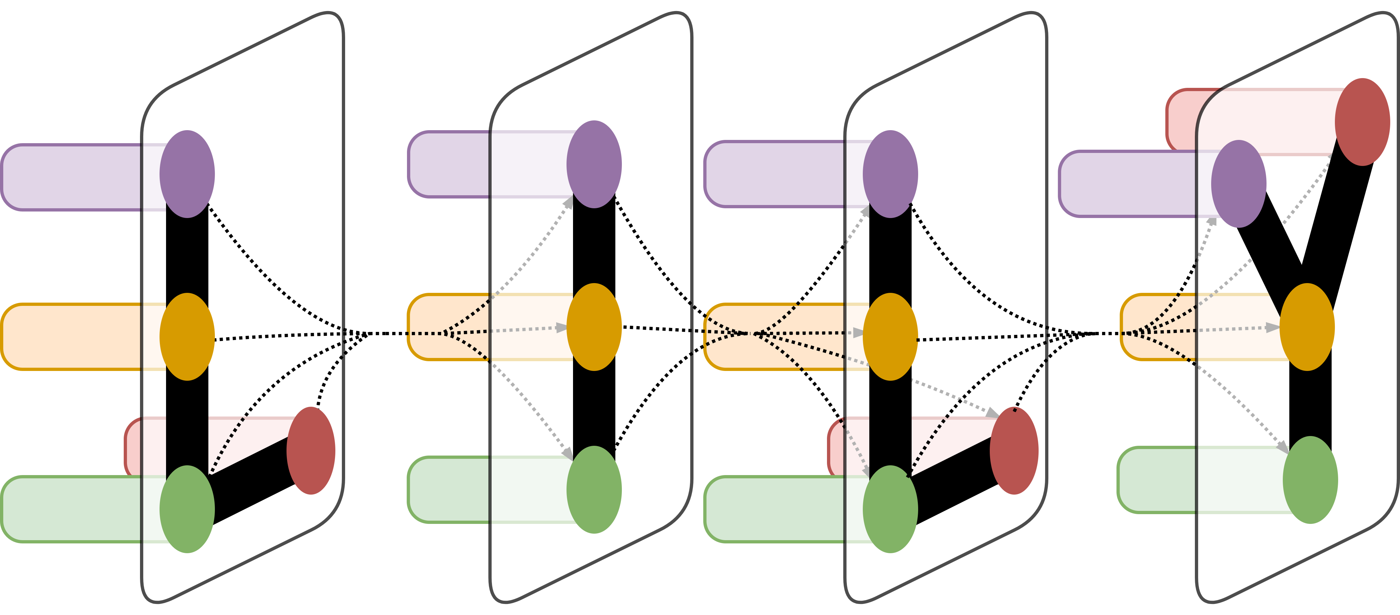
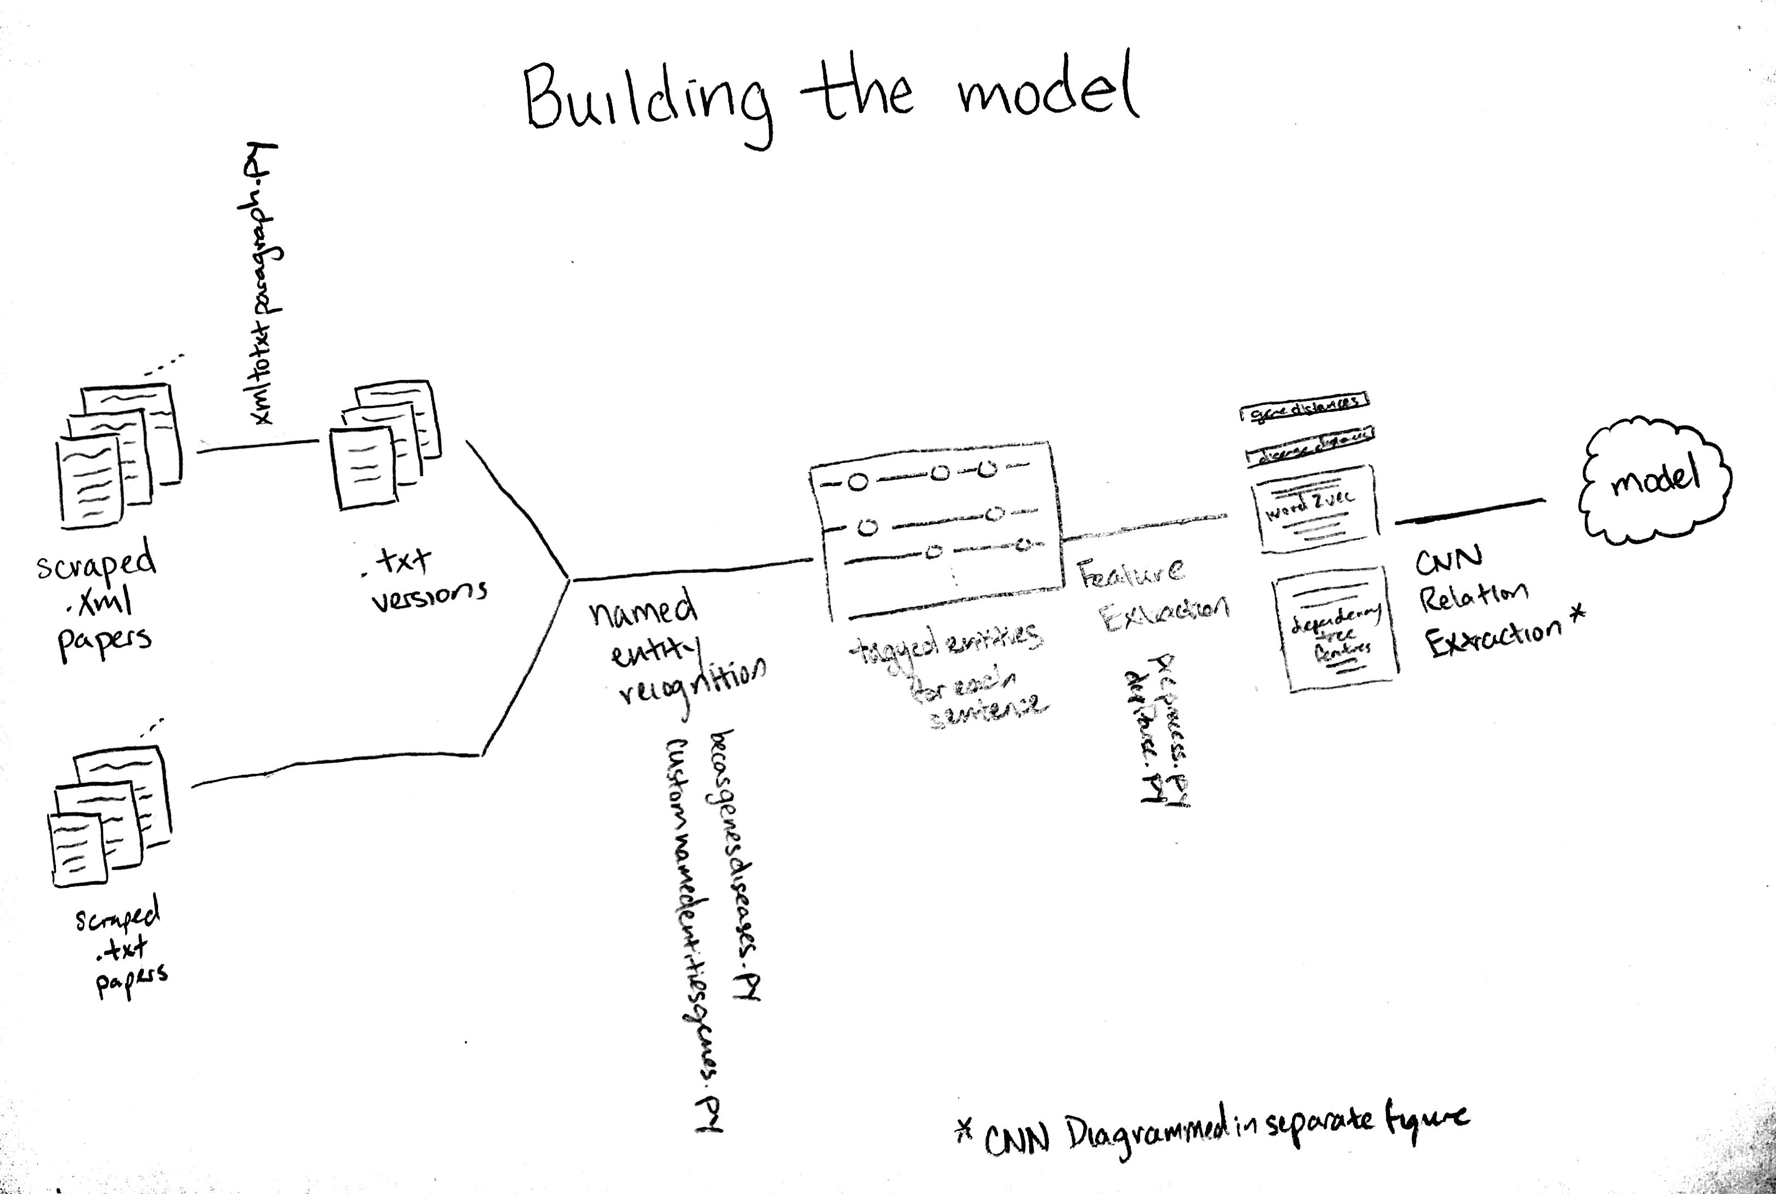
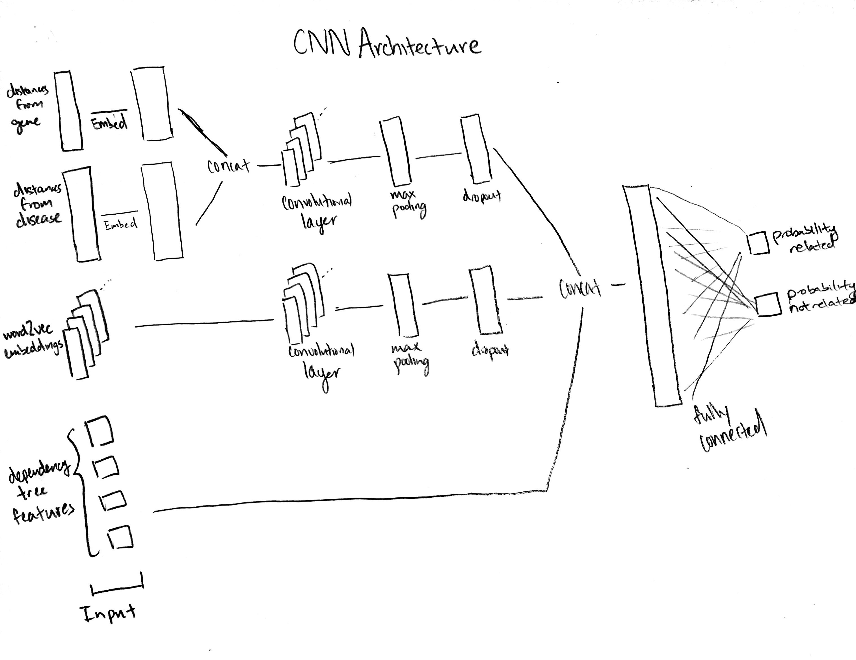
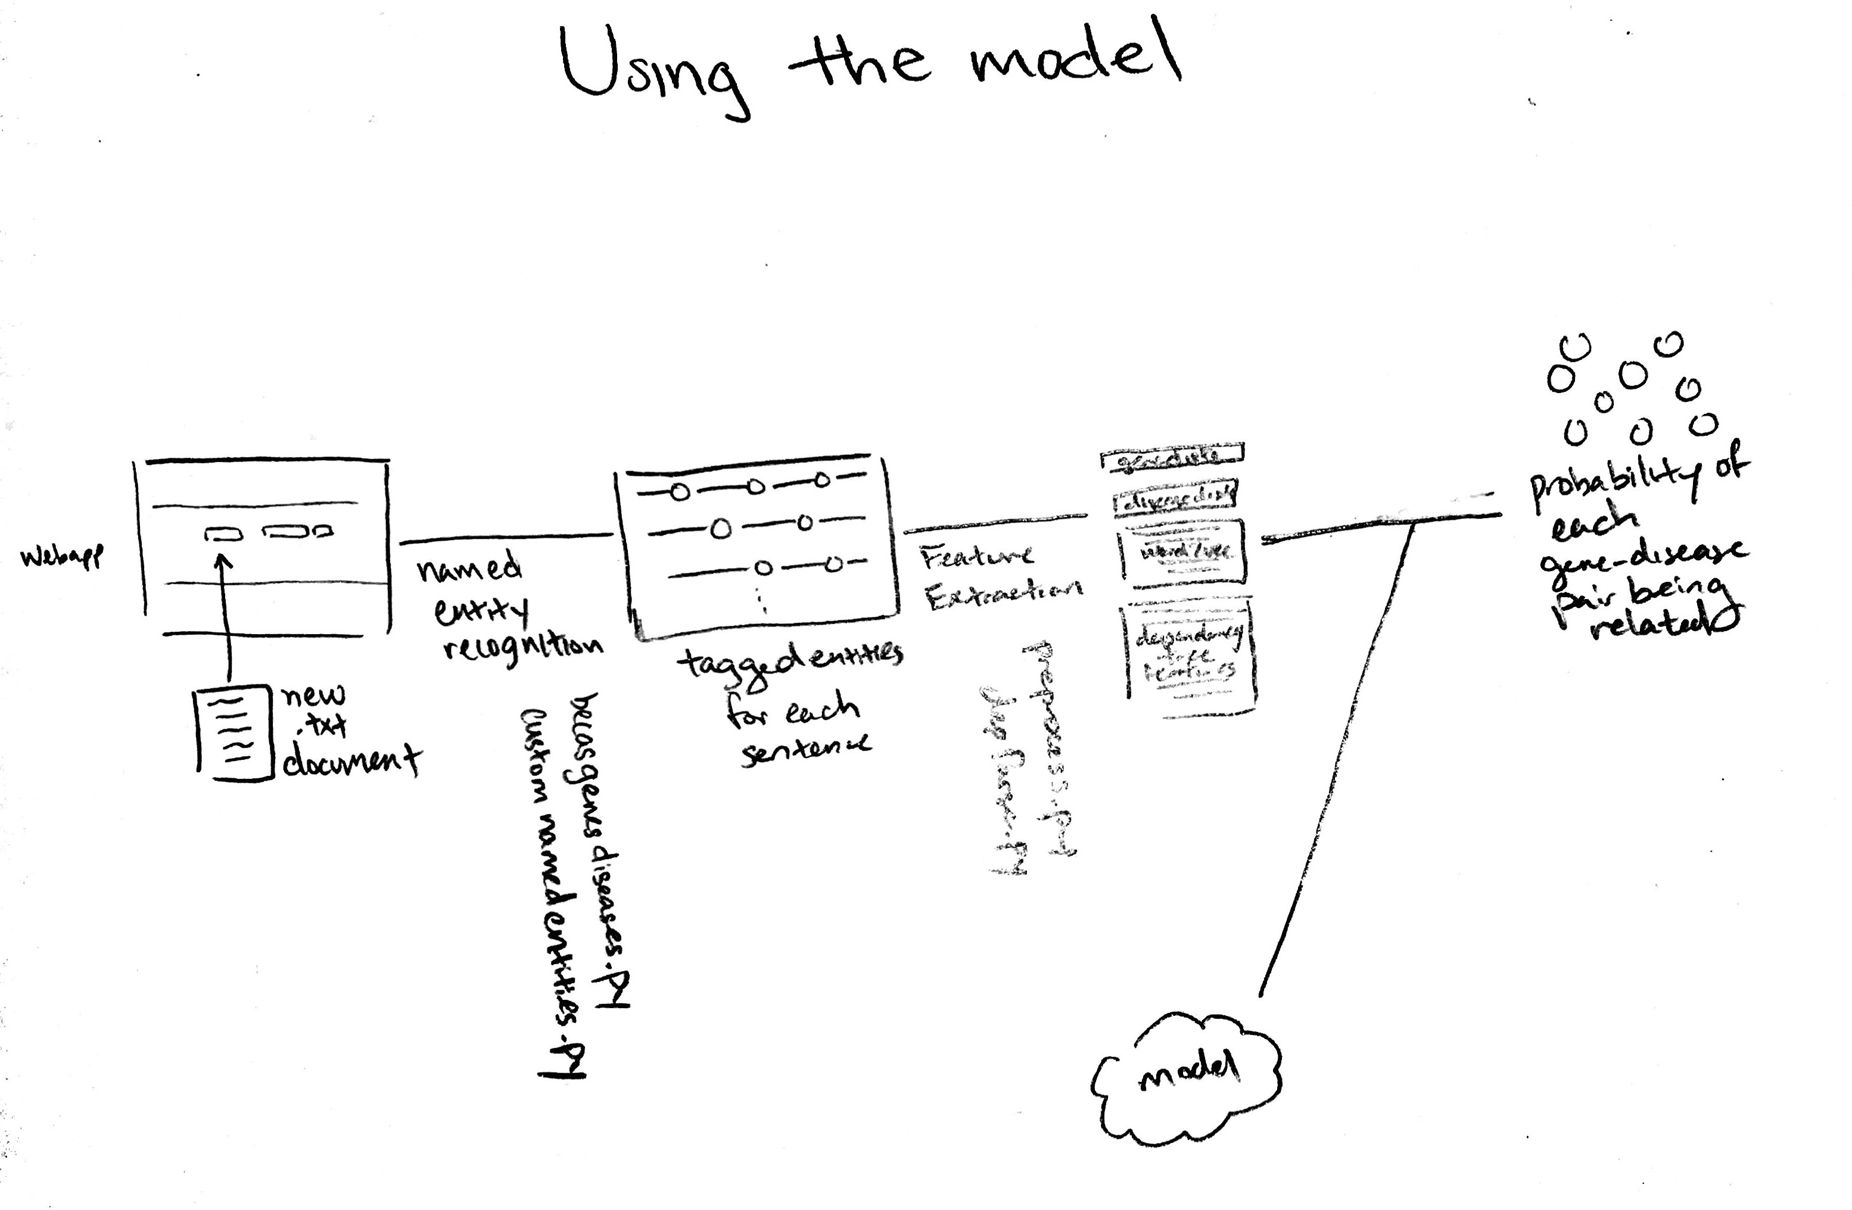
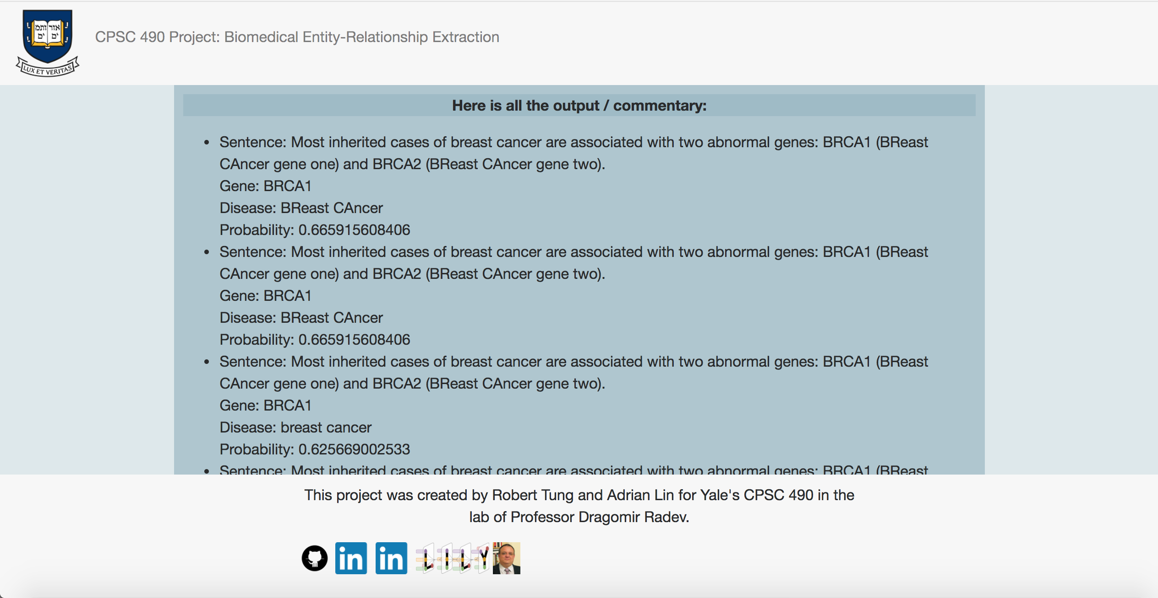
Biomedical Entity-Relationship Extraction
Robert Tung¹ and Adrian Lin¹
¹Department of Computer Science, Yale University, New Haven, CT
LILY Lab
Introduction
Pipeline Description (cont’d.)
This project seeks to use natural language processing methodologies to create a pipeline that ultimately determines the probability that each pair of genes and diseases in a paper is related. This project also includes a web application that can take in a new biomedical paper, use the model trained by the pipeline, and in turn determine the probability that each pair of genes and diseases in a sentence in that paper is related.
This project next required the construction of a relationship-extractor; for this we built a convolutional neural network, described in Figure 3 below.
For some of the data, dependency parse features failed to be extracted due to bad or incorrect parses of the sentence. As a result, we trained two different models, one with dependency parse inputs and one without. Embeddings are initialized for the distance features and passed through a convolution layer with max pooling and dropout. The word embeddings are also passed through a separate convolution layer.
These outputs are then concatenated (with the optional dependency parse features) into a fully connected layer with a binary softmax classifier output layer.
Previous Work / Background
Ensembl has a corpus of 60000 gene names
Becas is a library for biomedical text annotation
Sunil Sahu and Ashish Anand created RNN models for disease name recognition
Abner is a biomedical named-entity recognizer with a Java API
The best general Named-Entity Recognizers to date "reach an F-measure around 85 per cent”
The Convolutional Neural Network in our paper is an adaptation and extension of that of Zeng et. al
Analysis
The syntactically-based gene named-entity recognition was tested in isolation and labeled a corpus of genes with 95% accuracy and a text without genes with 99% accuracy.
For disease-recognition, which relies on the becas library, our results achieved an average of 85% accuracy.
Our relationship extractor, run on 25 iterations with 8 epochs each, achieved a 57% accuracy and 0.5174 F1 measure without dependency-tree features. It achieved a 49% accuracy and 0.4826 F1 measure with dependency-tree features
Pipeline Description
Figure 1. Design of Pipeline for Building the Model.
Figure 3. Convolutional Neural Network Architecture for Relationship Extraction.
The overall pipeline created in this paper is shown in Figures 1 and 2.
The project began with the development of a suitable corpus of text from biomedical literature from the DISEASES database, and the conversion of these papers into a usable format.
This project then required us to build a named-entity extractor; this extractor was built upon that of becas, and we also incorporated our own syntactic gene named-entity extraction as an optional way to differentiate the proteins and genes.
The pipeline then required the extraction of features from each sentence and gene-disease pair. These features, for each gene-disease pair in a sentence, included the distance from each word in the sentence to the relevant gene, the distance from each word in the sentence to the relevant disease, the word2vec embedding of each word in the sentence, and features pertaining to the dependency tree of the sentence.
Future Research
Implement and compare multiple implementations of Named-Entity Recognition, in particular that of Sahu and Ashish Anand and that of Abner.
Determine a confidence measure on each relationship extracted and determine what the relationship is between two entities rather than just the existence of a relationship between the two.
Code
The code for this project can be found at:
https://github.com/adrianwlin/cpsc-senior-project
Figure 2. Design of Pipeline for Using the Model on New Data.
Figure 4. Screenshot of WebApp after taking in Sample Text.
Acknowledgement
Thanks so much to our advisor, Professor Dragomir Radev, as well as CPSC 490 course instructor Professor James Aspnes.

