Slide 1

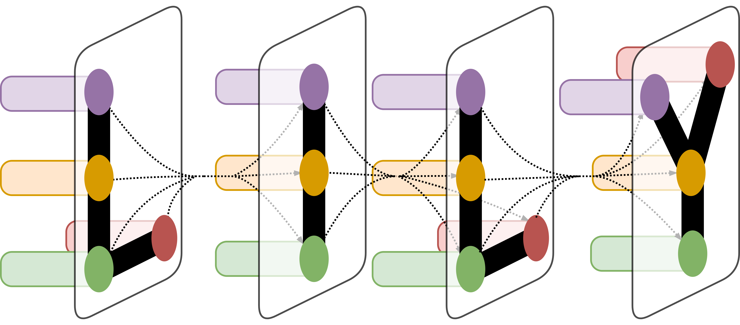

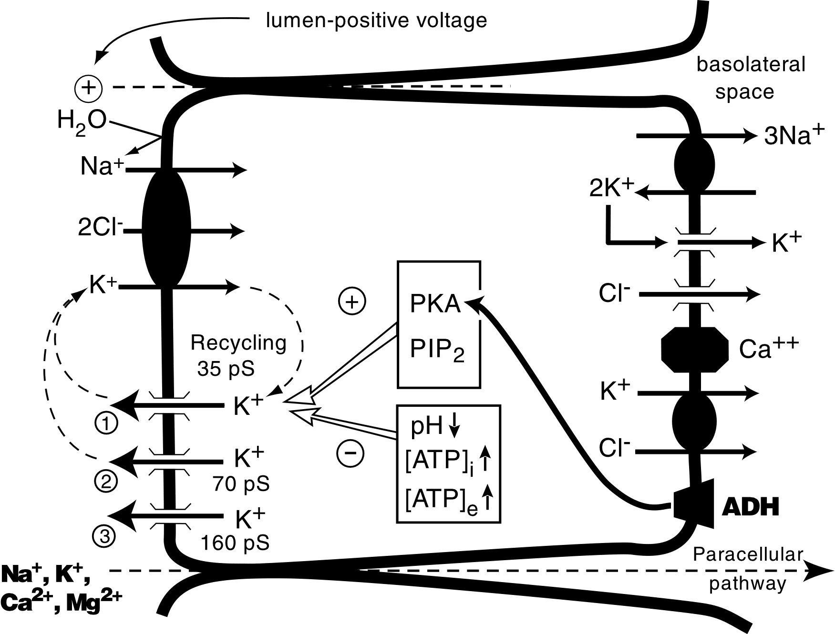
The Title of This Poster Was Typed in Powerpoint and Sits Here
Me Author MD,¹ You Author PhD,² and She Author DMD²
¹Department of Research, Yale School of Medicine, New Haven, CT and ²Another Department, Dottirsson University, Iceland
LILY Lab
Introduction
This is a body of text that will repeat over and over until it fills up the page. It requires little thought but says a great deal about layout design for the purpose of this discussion. This is a body of text that will repeat over and over until it fills up the page. It requires little thought but says a great deal about layout design for the purpose of this discussion. This is a body of text that will repeat over and over until it fills up the page. It requires little thought but says a great deal about layout design for the purpose of this discussion. This is a body of text that will repeat over and over until it fills up the page. It requires little thought but says a great deal about layout design for the purpose of this discussion. This is a body of text that will repeat over and over until it fills up the page. It requires little thought but says a great deal about layout design for the purpose of this discussion. This is a body of text that will repeat over and over until it fills up the page. It requires little thought but says a great deal about layout design for the purpose of this
Table 1. Made in PPT
120
Results
1745
3754
195
543
1745
3754
195
543
100
This is a body of text that will repeat over and over until it fills up the page. It requires little thought but says a great deal about layout design for the purpose of this discussion. This is a body of text that will repeat over and over until it fills up the page. It requires little thought but says a great deal about layout design for the purpose of this discussion. This is a body of text that will repeat over and over until it fills up the page. It requires little thought but says a great deal about layout design for the purpose of this discussion. This is a body of text that will repeat over and over until it fills up the page. It requires little thought but says a great deal about layout design for the purpose of this discussion. This is a body of text that will repeat over and over until it fills up the page. It requires little thought but says a great deal about layout design for the purpose of this discussion. This is a body of text that will repeat over and over until it fills up the page. It requires little thought but says a great deal about layout design for the purpose of this discussion. This is a body of text that will repeat over and over until it fills up the page. It requires little thought but says a great deal about layout
3622
1765
57
5743
3622
1765
57
5743
80
Series1
1200
3465
435
480
1200
3465
435
480
Whatever
60
Series2
40
Series3
436
658
8343
4555
436
658
8343
4555
20
0
100
120
90
100
80
80
70
Whatever
60
Series1
Series2
60
40
Series3
50
20
40
0
30
1
2
3
4
5
6
7
8
9
10
Materials and Methods
20
Things
This is a body of text that will repeat over and over until it fills up the page. It requires little thought but says a great deal about layout design for the purpose of this discussion. This is a body of text that will repeat over and over until it fills up the page. It requires little thought but says a great deal about layout design for the purpose of this discussion. This is a body of text that will repeat over and over until it fills up the page. It requires little thought but says a great deal about layout design for the purpose of this discussion. This is a body of text that will repeat over and over until it fills up the page. It requires little thought but says a great deal about layout design for the purpose of this discussion. This is a body of text that will repeat over and over until it fills up the page. It requires little thought but says a great deal about layout design for the purpose of this discussion. This is a body of text that will repeat over and over until it fills up the page. It requires little thought but says a great deal about layout design for the purpose of this discussion. This is a body of text that will
10
Figure 3. Two more graphs that show something. These might include a small legend to explain the results.
0
First
Second
Third
Fourth
Figure 1. A graph that shows something.
Conclusion
This is a body of text that will repeat over and over until it fills up the page. It requires little thought but says a great deal about layout design for the purpose of this discussion. This is a body of text that will repeat over and over until it fills up the page. It requires little thought but says a great deal about layout design for the purpose of this discussion. This is a body of text that will repeat over and over until it fills up the page. It requires little thought but says a great deal about layout design
Acknowledgement
Figure 4. Another imported image.
This is a body of text that will repeat over and over until it fills up the page. It requires little thought but says a great deal about layout design.
Figure 2. An importedi image.

