Slide 1
Roles & Responsibilities
Admin/Ops
Monitor & update enquiries
Fertility Coach
Monitor & update leads
Marketing
Planning of marketing events, promotion & program launch
Arrange & ensure on time product delivery
Stocks management
Other administrative matters
Couple consultation
Planning of program schedule for couple
Coordinate blood test & program schedule with respective associate
Monitor & ensure associate performance meet program requirement
Website maintenance
Sourcing of event venues, speakers & practitioners
Design marketing collateral
Accounting/Finance
Monitor & update payable & receivable
Associate or partners that based on demand:-
Product delivery
Yoga trainer
Workout trainer
Nutritionist
Speakers/ Practioner

Slide 2
Work flow for BeNatural Fertility Program enquiry
Incoming leads via online portal (refer to Appendix A)
Admin/Op update chat group within 24 hrs
Fertility coach message client within 24 hrs (after working hrs @ ACRM) using standard template(Appendix A1) & update word file
Send repeated message every alternate day for 1 wk
Fertility coach to provide address to client upon appointment fixed
Give a missed call if no response after 1 wk msg
No response from client
Communication with client can only be done after working hours at ACRM. Possibility of losing some leads?
Record file to ensure all incoming leads are follow-up?

Slide 3
Workflow for BeNatural Free consultation program
Meet couple at Oasis Hotel & bring them to level 7 office
Fertility coach self introduction & explanation on fertility assessment
Fertility coach to take BMI & blood pressure of couple. Couple are to fill in questionnaire (Appendix B)
Fertility coach go through questionnnaire & introduce activity of fertility program accordingly
Fertility coach to provide fertility program brochure & showcase level 6 facility area where activities are host
3 days later, Fertility coach to send “Thank you” message to couple
To provide Fertility program details within 1 week due to customisation
Couple who are interested with the program
Record file to ensure all leads are follow-up?
Record file for sending updates on program & events?

Slide 4
Workflow for Fertility program
1st meeting with couple after 1wk from free consultation
Fertility coach explain 4 wks & 12 wks program in details to couple
Couple make deposit upon confirming the program & sign consent form (Appendix C)
Fertility coach to check couple’s availability for coordinating the session dates with relevant associates
Fertility coach to coordinate couple’s schedule with nutritionist, yoga & workout trainer
2nd meeting with couple to present prog schedule and blood test date
Start of program on 3rd meeting. Fertility coach to follow-up with couple & respective associate after every session
Meetings are currently scheduled 1 week apart, chances of shortening this process to keep the excitement for couple?
KPI for associates?
Shared drive to upload program schedule for easy follow-up?
Backup for unforeseen situation?
Cancellation or no show policy?
Process for trainer no show?

Slide 5
Work flow for HealthTree product order for client self pickup
Order received via email (Appendix D)
Admin/op check stock @ RICE
Contact client within 24hrs to arrange pickup date & time
Contact vendor (ACRM) to place order
Stock received
Client to sign off on proof of pickup sheet
Stock avail
No stock
Stock record update in shared drive?

Slide 6
Workflow for HealthTree product sales - Delivery
Order received via email
Admin/op contact Vendor(ACRM) within 24hrs place order & request delivery
Admin/Fin provide details to Fertility coach to arrange delivery
Delivery done by driver when he is avail
Admin/op will follow up with vendor within 48 hours on delivery status. There are time that delivery can’t be fulfilled within 48 hours due to driver availability

Slide 7
Workflow for SA
Incoming order via online portal
(Appendix E)
Admin/op update group chat
Vendor (ACRM) contact client to schedule appointment
Update of incoming leads generated by portal?
Update on the commission earned for each lead?
Follow-up with lead if there is possibility in promoting BN fertility program?

Slide 8
Workflow for Staycation
2 months before event, Marketing (Rachel) to source & nego for venue, speakers, relevant associates & practitioners
RICE to design and launch online campaign once confirmation of relevant info, eg: venue, speakers, etc.
RICE to contact prospects from different source of referral
Receive registration & payment via online portal
2 weeks before event, RICE to confirm with respective speakers & practitioners on their slots & any other matters
1 week before event, RICE to send out email confirmation to signed up couples
Standard requirements for venue, speaker, associate & practitioner?
Record on signed-up couple for future follow-up to promote BN program?
List of venues, speakers, associates & practitioners for consideration?
Contract/agreement for current venue, associates & practitioners?

Slide 9
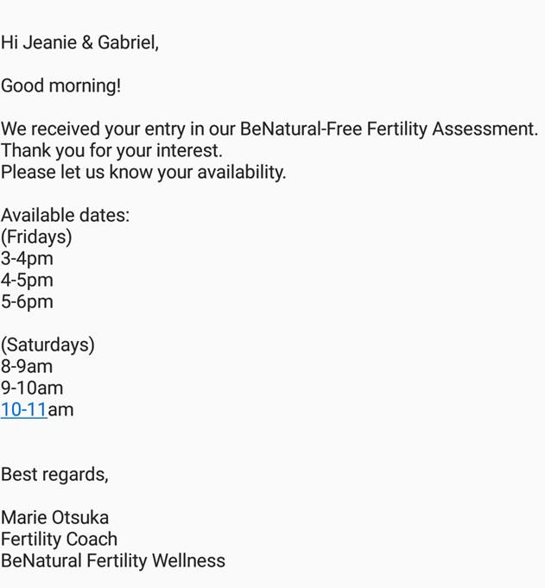
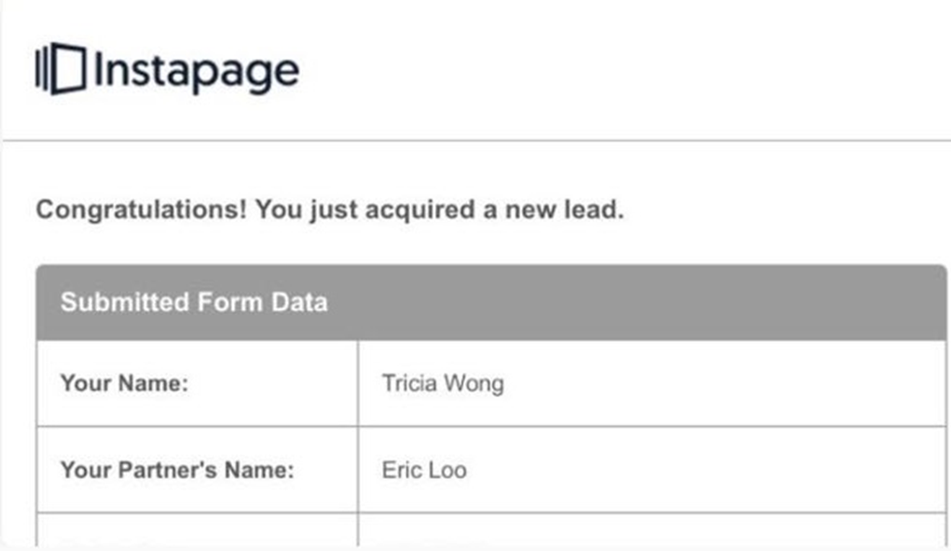
Appendix A
Appendix A1

Slide 10
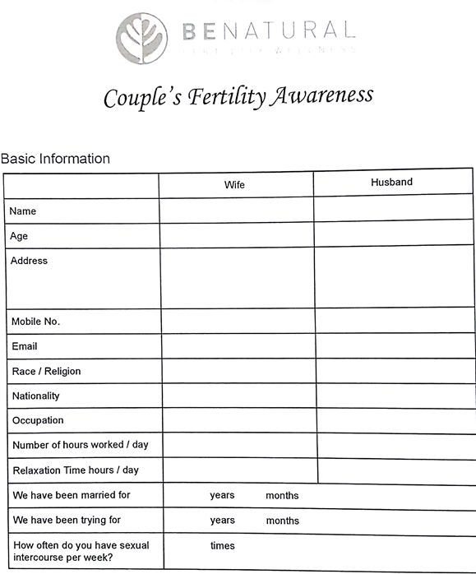
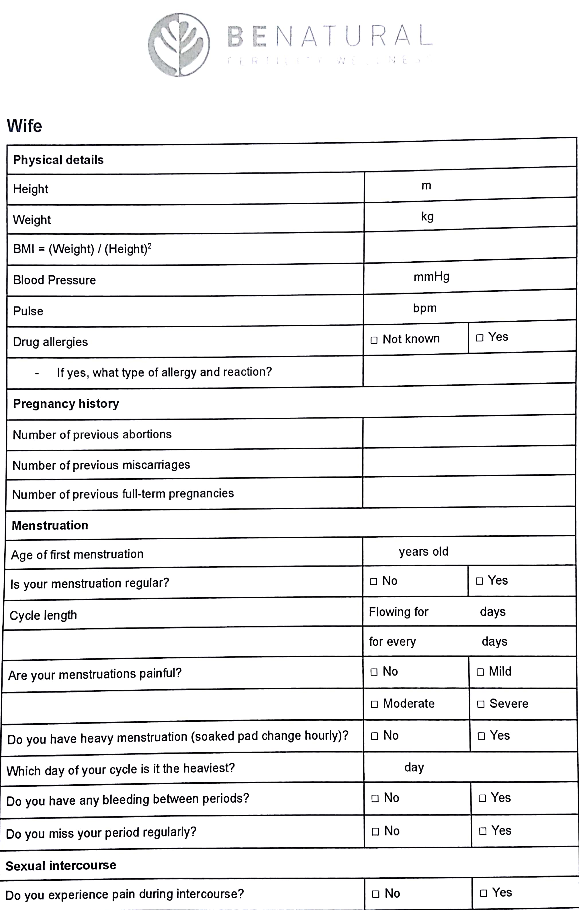
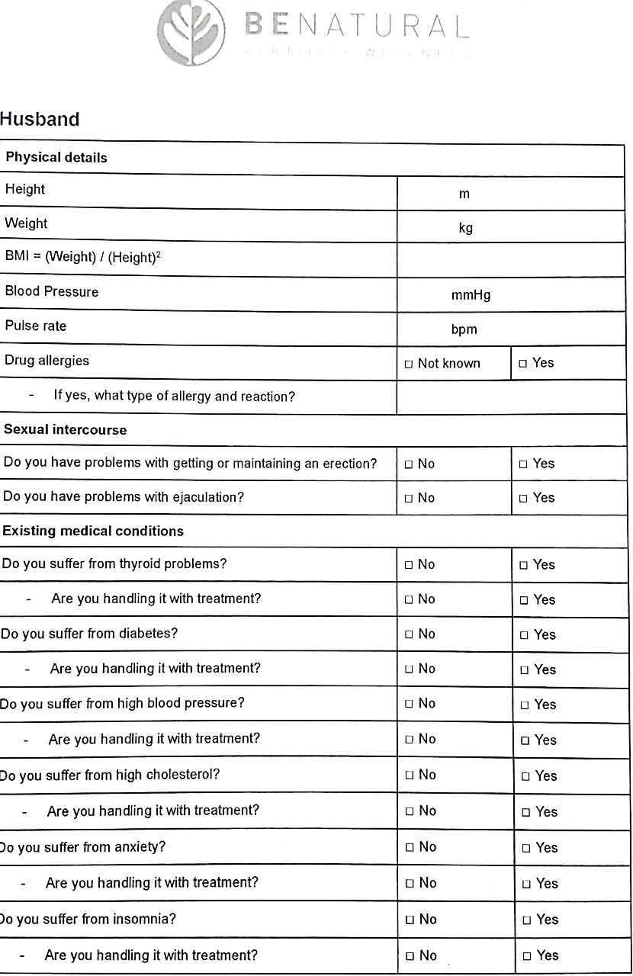
Appendix B

Slide 11
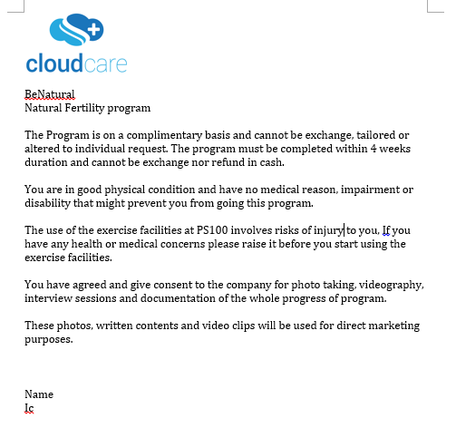
Appendix C

Slide 12
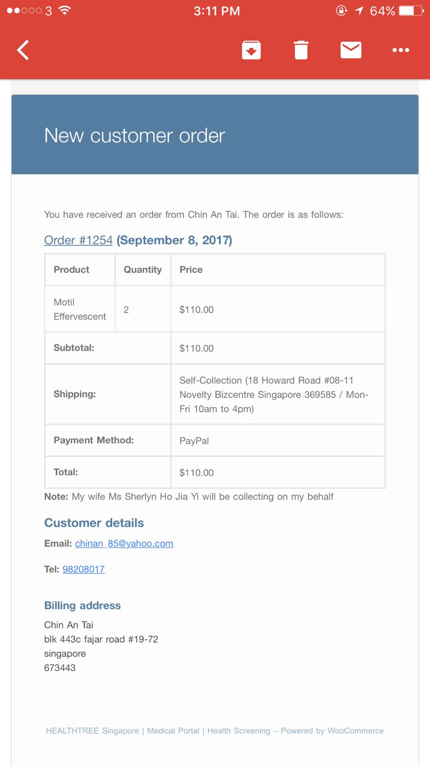
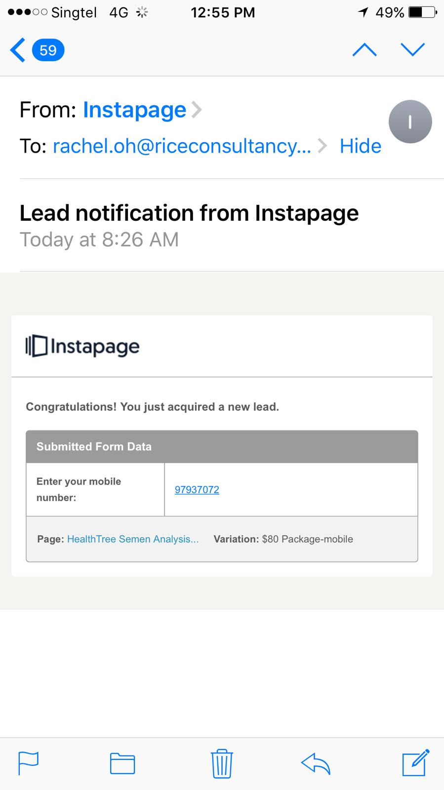
Appendix D
Appendix E

