Slide 1
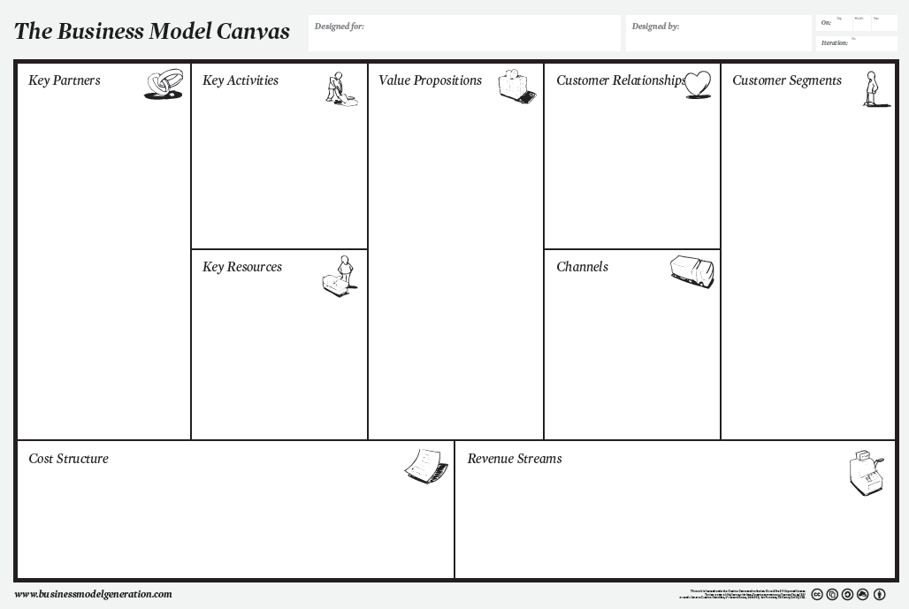

Preconception Care
Fertility & pregnancy trained practitioners:
Nutritionist
Yoga Teacher
Personal Trainer
Acupuncture
Fertility Coaching
Therapies
Promotion
Management
($100? /year) DIY
online course => “Freemium” education and self-assessment
Fertility Coach
DIY online course
($2,500) 4 week
=> IVF/FET preparation
MyGen supplements?
Prof Book
Website
Social Media
Brochures for doctors?
Fertility Coach
Patient Database
($3,600) 12 week
=> best chance of pregnancy and super healthy start for baby
1st year
Expense = $233,760
1st year (does not include DIY online course)
4-week package: 1,2,3,4,5,6,7,8,9,10,11,12
12-week package: 0,0,0,1,1,1,2,2,2,3,3,3
Revenue = $258,000

Slide 2
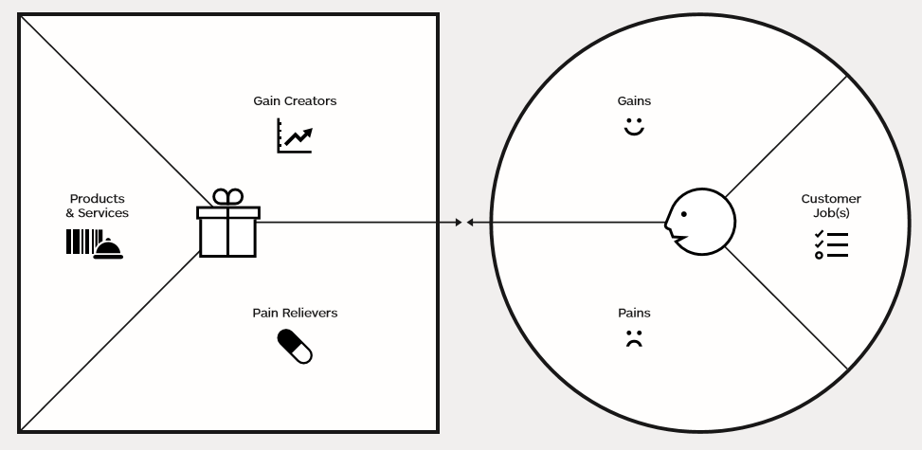
Value Proposition: Preconception Care (Women)
Best possible eggs
Positive mindset
Healthy reproductive system
=> Natural conception?
Pregnancy success
Proud mum-to-be
Happy relatives
3 month program:
Medical tests
Diet plan
Exercise
Acupuncture
Visualisation
Get pregnant:
Lose weight
Eat well
Feel good
Make love
Woman
Optional
Fertility Food
Supplements
Fertility Yoga
Hypnotherapy
Surgery (e.g. fibroids, endometriosis, PCOS)
We take away the hassle of you having to organise your fertility preparation
Anxiety
Tiredness
Disappointment
Relationship strain

Slide 3
Value Proposition: Preconception Care (Men)
Best sperm
Healthy body
Positive mindset
=> Natural conception?
Healthy love life
Proud dad-to- be
Pregnant wife
12 week program:
Medical tests
Diet plan
Exercise
Acupuncture*
Visualisation
Be virile & fertile:
Lose weight
Eat well
Feel good
Make love
Man
Optional
Fertility Food
Supplements
Surgery (e.g. varicocele)
We take away the hassle of you having to organise your fertility preparation
Anxiety
Disappointment
Relationship strain
* http://www.acupuncture.org.uk/a-to-z-of-conditions/a-to-z-of-conditions/male-infertility.html

Slide 4
DIY online course
1 program for MEN, and 1 program for WOMEN
Purpose: Self-help for couples who have mild fertility issues, and entry point for those with more serious conditions which require practitioner help
Content includes text and video footage from our panel of experts (doctor, fertility coach, yoga teacher)
FREE registration with email address
Lead generation funnel:
0$: Access to introductory content
$100: Access to deep content => book COMPLIMENTARY fertility coaching session
$500: Medical tests
Upgrade to 4-week, or 12-week program
Lessons:
Basics of fertility
Assess your fertility
Your reproductive system
Your partner’s reproductive system
Woman’s monthly cycle
Medical tests for you
Medical tests for your partner
Nutrition plan
Supplements
Exercise plan

Slide 5
DIY online course (cont’d)
Lessons (cont’d):
Stress and its effects
Meditation (e.g. mindfulness and breathing)
Visualisation (e.g. Be Fertile download)
Fertility yoga sequence (beginner)
Work environment
Relationship dynamics
Detox your home
Need help?
Fertility Readiness Score (0 – 100): There are quizzes embedded in the lessons which give you points to help you gauge if you’re doing the right things to remove the obstacles to your fertility

Slide 6
Preconception Care program
Initial 90 minute consultation with our Fertility coach to get to know you better:
Nutrition and eating habits
Exercise habits
Emotional baseline and lifestyle factors – personal, work, relationship, stress
Medical history
At the end of the consult, coach will come up with a customised fertility action plan
Medical tests to check the fertility status of the couple before commencement of program
Woman - Pelvic Ultrasound and optional hormone and ovarian reserve tests
Man – Semen Analysis
Optional consultations with doctor if issues are found
The results will help us tailor the right program for you
Diet & Exercise plan to attain ideal Body Mass Index and enhance fertility and vitality
10 day detox to clear the body of toxins and enhance liver function for hormonal balance
Customised diet of nutritious, fertility-enhancing foods will be recommended e.g. vitamin A for sex hormones, vitamin B for hormone balance, amino and folic acids for developing eggs and sperm, iron and magnesium for protection against miscarriage, selenium/manganese/zinc for healthy sperm
Moderate exercise program to lose weight, boost the immune system, raise energy levels, reduce stress, and reduce the chance of constipation, haemorrhoids, and morning sickness
Fertility Yoga sessions to “reset” and nurture the reproductive and endocrine system, restore balance to emotions and hormones, create a mind/body environment of clarity and relaxation

Slide 7
Preconception Care program (continued)
Acupuncture
Optimise the flow of qi (or vital life force) through the meridian system, especially those associated with fertility such as kidneys, spleen and liver
Women: Relieve menstrual pain, encourage healthy blood flow, replenish energy, boost ovulation, encourage implantation
Men: Improve sperm quality and potency
Recent studies at Homerton University Hospital in London indicate that acupuncture can even double the chances of IVF success
Visualisation
Recent advances in biology and epigenetics indicate that our thoughts and beliefs control our cells, our genes, our behavior and ultimately the life we experience
Olympic athletes apply this principle by cultivating a mindset of ‘peak performance’ i.e. repeatedly visualising the steps they will take to win an event and the positive emotions of success that will follow
Our visualisation CD’s and exercises will provide you mental preparation for your fertility journey, and a greater sense of well-being and appreciation for all that you might experience along the way
Continuous support
Face-to-face, phone and email catch-ups with our Fertility Coach to track your progress and provide all the support and encouragement you need
Fertility Coach coordinates appointments with medical specialists and holistic practitioners
You will feel looked after every step of the way

