Slide 1
Convolutional neural network for Image recognition
Reference
http://cs231n.github.io/convolutional-networks/

Slide 2
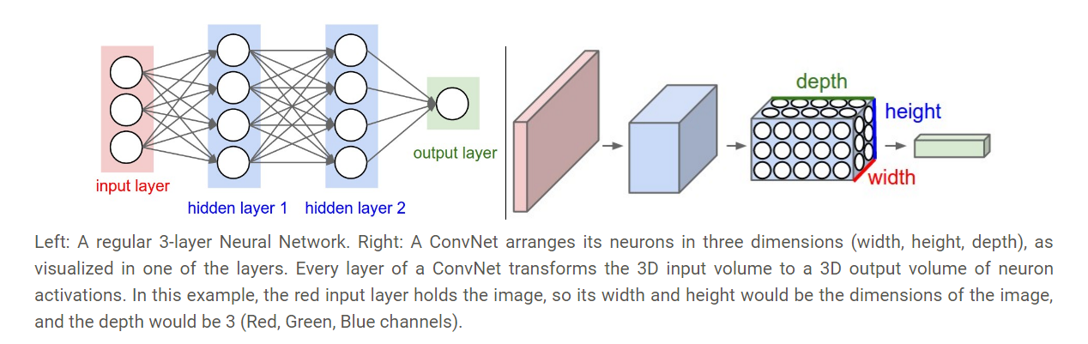
Dense neural network and Convolutional neural network

Slide 3
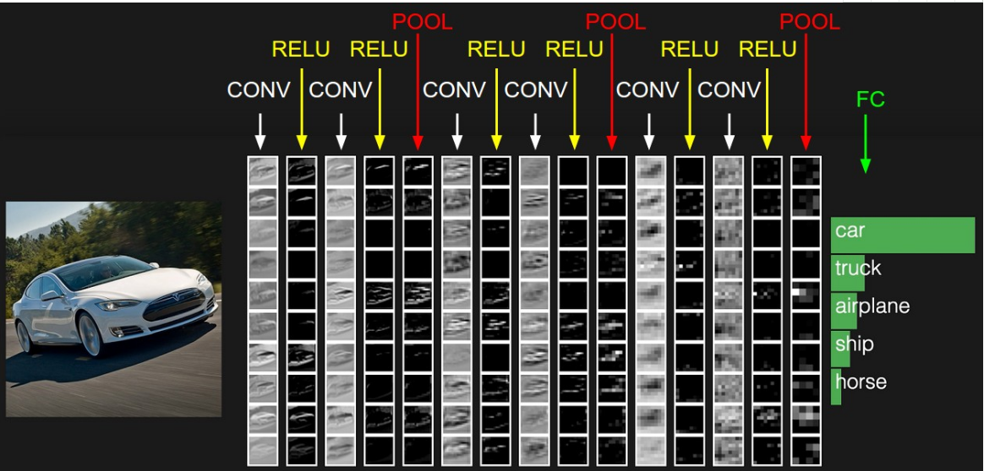
A simple CNN structure
CONV: Convolutional kernel layer
RELU: Activation function
POOL: Dimension reduction layer
FC: Fully connection layer

Slide 4
Convolutional kernel
This is a gif image

Slide 5
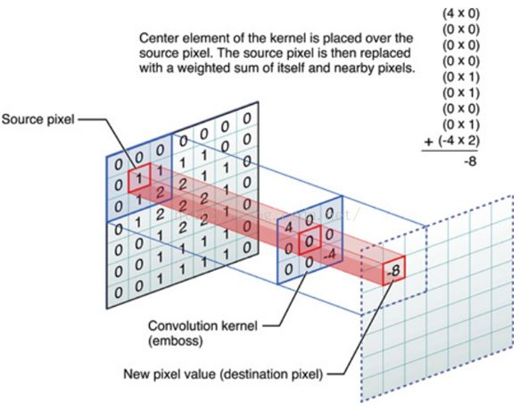
Convolutional kernel
Padding on the input volume with zeros in such way that the conv layer does not alter the spatial dimensions of the input

Slide 6
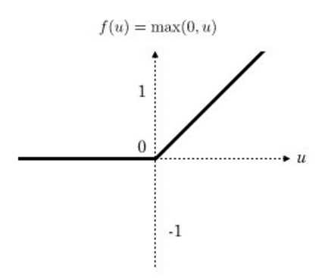
Rectified linear unit，ReLU

Slide 7
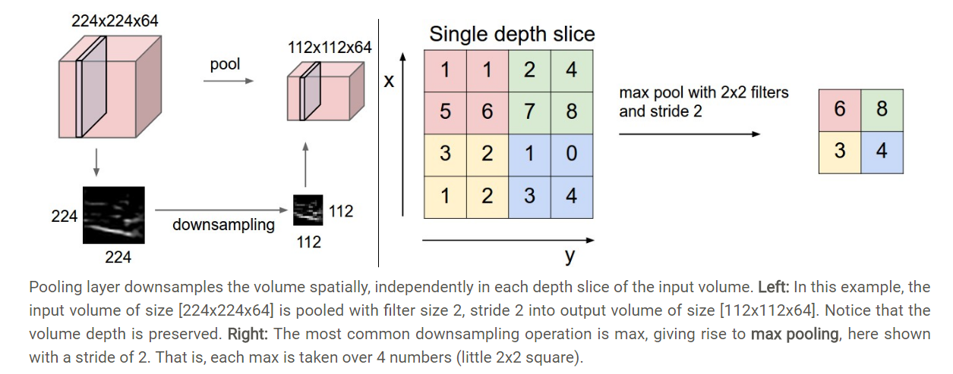
Pooling layer

Slide 8
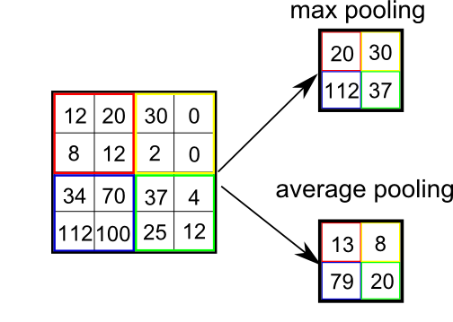
Pooling

Slide 9
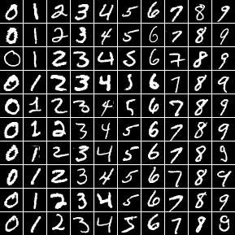
MNIST dataset
The MNIST database of handwritten digits,
available from this page,
has a training set of 60,000 examples, and a test set of 10,000 examples.
It is a subset of a larger set available from NIST.
The digits have been size-normalized and centered in a fixed-size image.

Slide 10
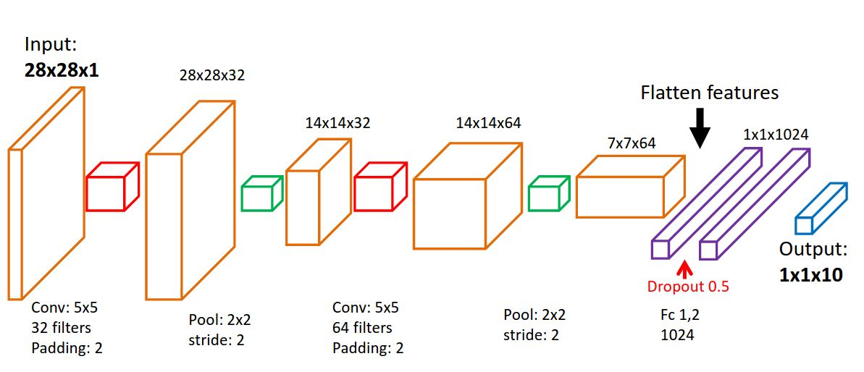
LeNet-5 for MNIST

Slide 11
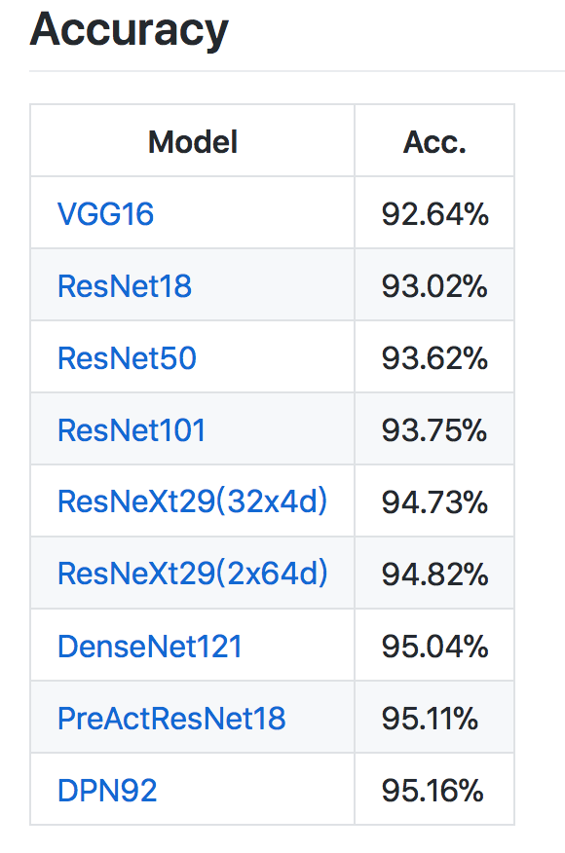
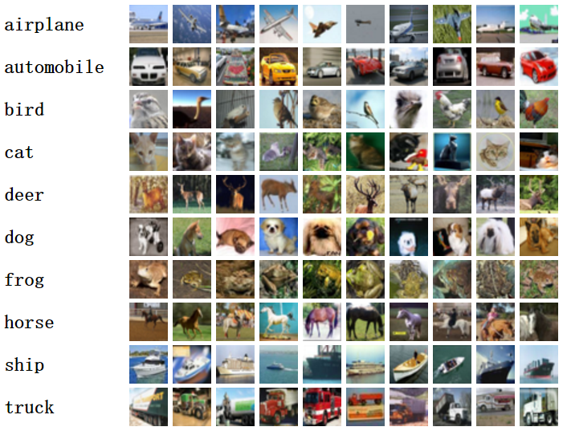
CIFAR10 dataset and state of the art
The CIFAR-10 dataset consists of 60000 32x32 color images in 10 classes,
with 6000 images per class. There are 50000 training images and 10000 test images.

Slide 12
ImageNet
The ImageNet project is a large visual database designed for use in visual object recognition software research. As of 2016, over ten million URLs of images have been hand-annotated by ImageNet to indicate what objects are pictured; in at least one million of the images, bounding boxes are also provided.^{[1]} The database of annotations of third-party image URL's is freely available directly from ImageNet; however, the actual images are not owned by ImageNet.^{[2]} Since 2010, the ImageNet project runs an annual software contest, the ImageNet Large Scale Visual Recognition Challenge (ILSVRC), where software programs compete to correctly classify and detect objects and scenes.

Slide 13
Case studies
LeNet. The first successful applications of Convolutional Networks were developed by Yann LeCun in 1990’s. Of these, the best known is the LeNet architecture that was used to read zip codes, digits, etc.
AlexNet. The first work that popularized Convolutional Networks in Computer Vision was the AlexNet, developed by Alex Krizhevsky, Ilya Sutskever and Geoff Hinton. The AlexNet was submitted to the ImageNet ILSVRC challenge in 2012 and significantly outperformed the second runner-up (top 5 error of 16% compared to runner-up with 26% error). The Network had a very similar architecture to LeNet, but was deeper, bigger, and featured Convolutional Layers stacked on top of each other (previously it was common to only have a single CONV layer always immediately followed by a POOL layer).

Slide 14
Case studies
GoogLeNet. The ILSVRC 2014 winner was a Convolutional Network from Szegedy et al. from Google. Its main contribution was the development of an Inception Module that dramatically reduced the number of parameters in the network (4M, compared to AlexNet with 60M). Additionally, this paper uses Average Pooling instead of Fully Connected layers at the top of the ConvNet, eliminating a large amount of parameters that do not seem to matter much. There are also several followup versions to the GoogLeNet, most recently Inception-v4.

Slide 15
Case studies
VGGNet. The runner-up in ILSVRC 2014 was the network from Karen Simonyan and Andrew Zisserman that became known as the VGGNet. Its main contribution was in showing that the depth of the network is a critical component for good performance. Their final best network contains 16 CONV/FC layers and, appealingly, features an extremely homogeneous architecture that only performs 3x3 convolutions and 2x2 pooling from the beginning to the end. Their pretrained model is available for plug and play use in Caffe. A downside of the VGGNet is that it is more expensive to evaluate and uses a lot more memory and parameters (140M). Most of these parameters are in the first fully connected layer, and it was since found that these FC layers can be removed with no performance downgrade, significantly reducing the number of necessary parameters.

Slide 16
Case studies
ResNet. Residual Network developed by Kaiming He et al. was the winner of ILSVRC 2015. It features special skip connections and a heavy use of batch normalization. The architecture is also missing fully connected layers at the end of the network. The reader is also referred to Kaiming’s presentation (video, slides), and some recent experiments that reproduce these networks in Torch. ResNets are currently by far state of the art Convolutional Neural Network models and are the default choice for using ConvNets in practice (as of May 10, 2016). In particular, also see more recent developments that tweak the original architecture from Kaiming He et al. Identity Mappings in Deep Residual Networks (published March 2016).

Slide 17
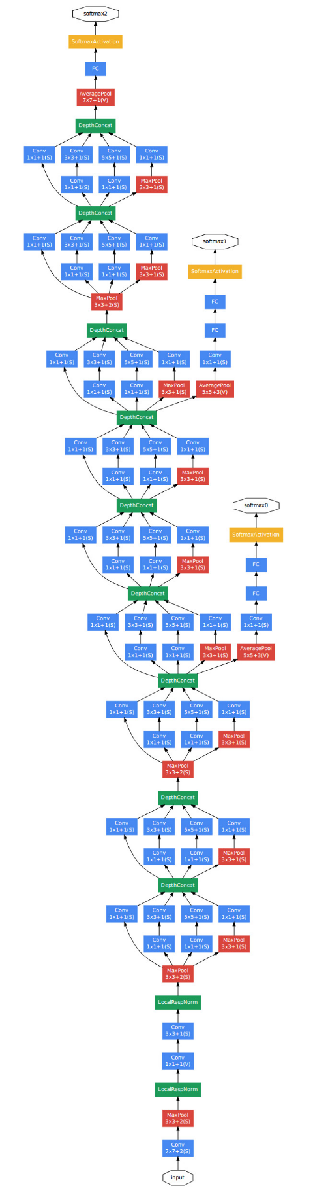
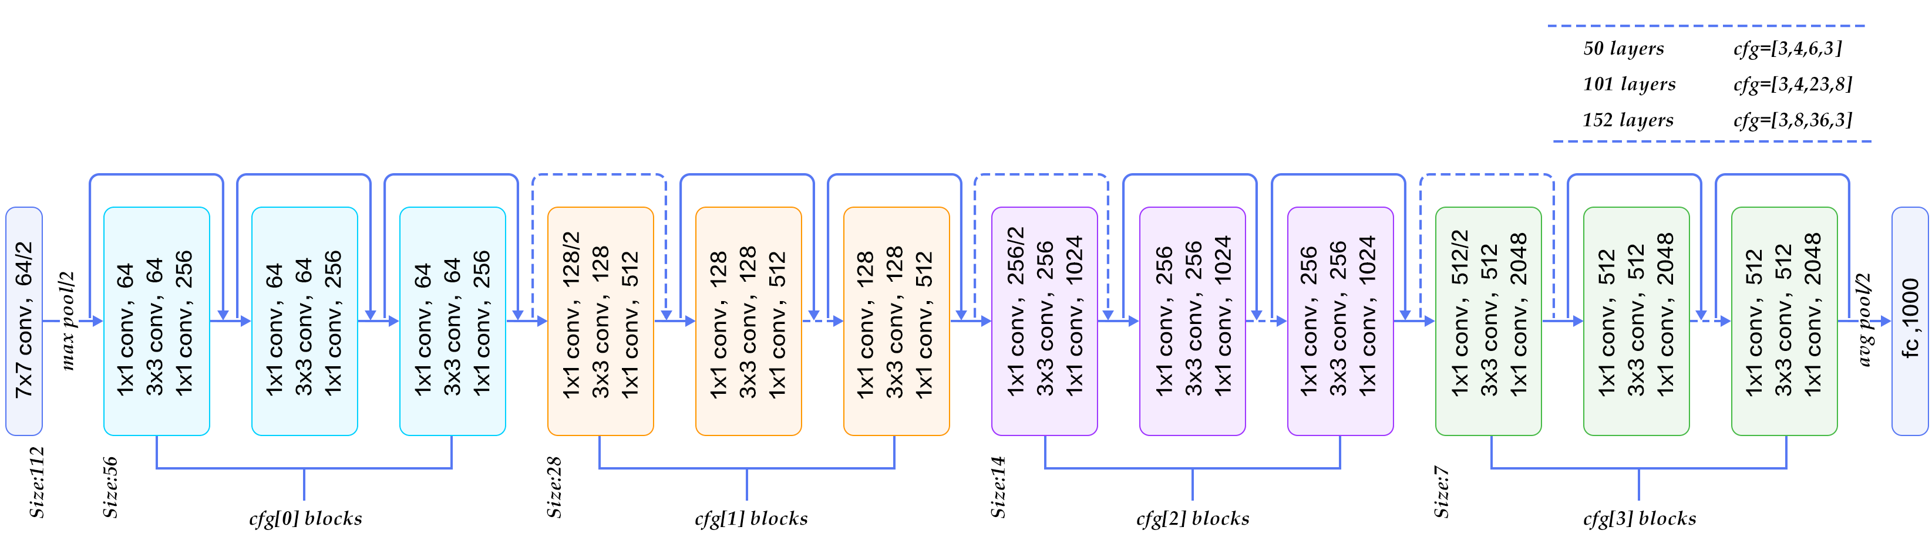
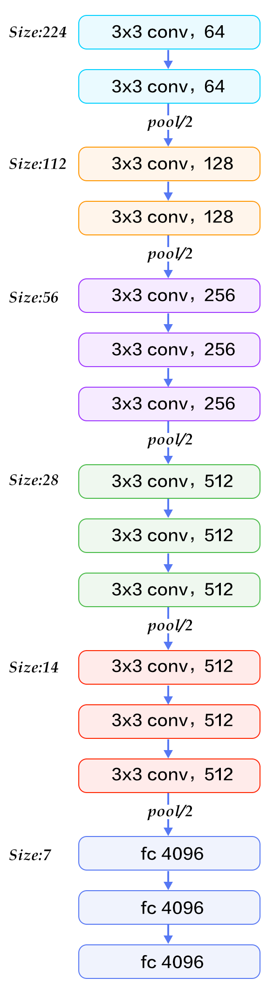
VGG-16
GoogleNet
ResNet

