Slide 1
卷积神经网络

Slide 2
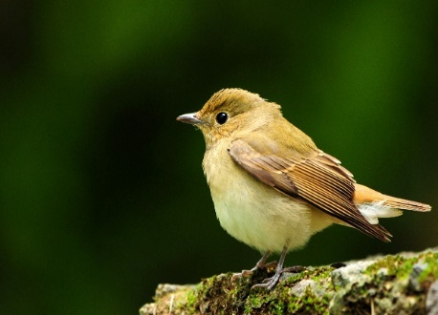

Observation 1
只关注于部分区域
也有可能人类也是如此
Notes:
https://www.dcard.tw/f/funny/p/233833012

Slide 3
Observation 1
Input
Layer 1
Layer 2
Bird？
……
……
100*100 => 25*25+ 25*25+ 25*25+ 25*25
Notes:
https://www.dcard.tw/f/funny/p/233833012

Slide 4
Deep Neural Network -CNN
3 x 3 x 3 weights
3 x 3
…...
bias
1
Receptive field
1 | 0 | 0 | 0 | 0 | 1
0 | 1 | 0 | 0 | 1 | 0
0 | 0 | 1 | 1 | 0 | 0
1 | 0 | 0 | 0 | 1 | 0
0 | 1 | 0 | 0 | 1 | 0
0 | 0 | 1 | 0 | 1 | 0
3 x 3
…...
1 | 0 | 0 | 0 | 0 | 1
0 | 1 | 0 | 0 | 1 | 0
0 | 0 | 1 | 1 | 0 | 0
1 | 0 | 0 | 0 | 1 | 0
0 | 1 | 0 | 0 | 1 | 0
0 | 0 | 1 | 0 | 1 | 0
1 | 0 | 0 | 0 | 0 | 1
0 | 1 | 0 | 0 | 1 | 0
0 | 0 | 1 | 1 | 0 | 0
1 | 0 | 0 | 0 | 1 | 0
0 | 1 | 0 | 0 | 1 | 0
0 | 0 | 1 | 0 | 1 | 0
3 x 3
…...

Slide 5
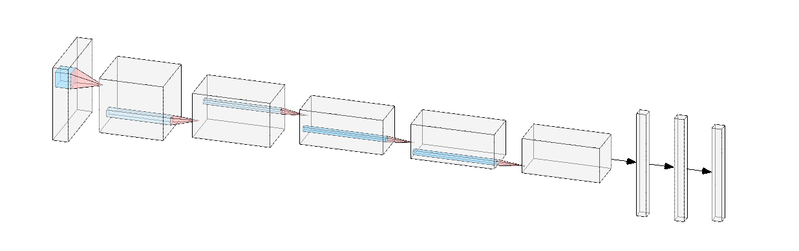
Deep Neural Network -CNN

Slide 6
Playground
https://cs.stanford.edu/people/karpathy/convnetjs/demo/cifar10.html
Weight (filter) 权重、过滤器

Slide 7
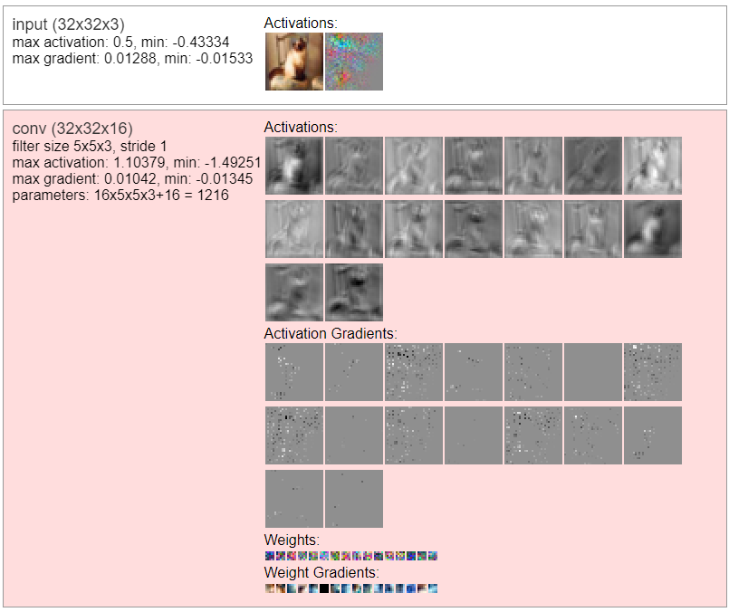
CNN

