Slide 1
影像组学分析肺结节良恶性

Slide 2
背景
Lung cancer is the leading cause of cancer-related death worldwide
1.8 million new lung cancer cases (2012) ○
18.4% of the total cancer deaths
Early detection is crucial
Survival rates can get up to 70-90% for stage I tumours ○
But only 15-19% for tumours detected in advanced stage

Slide 3
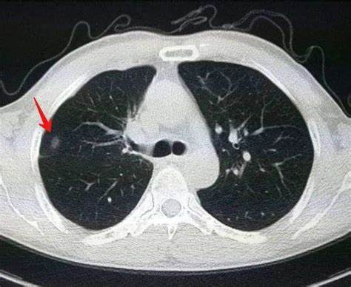
CT的作用

Slide 5
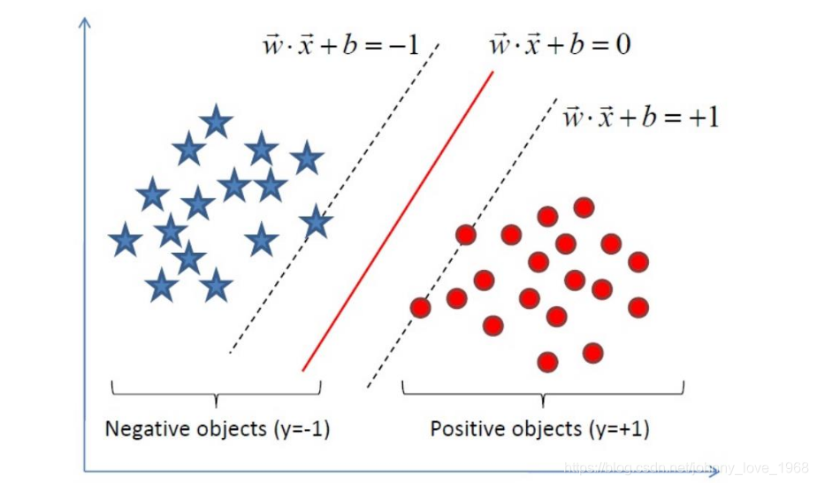
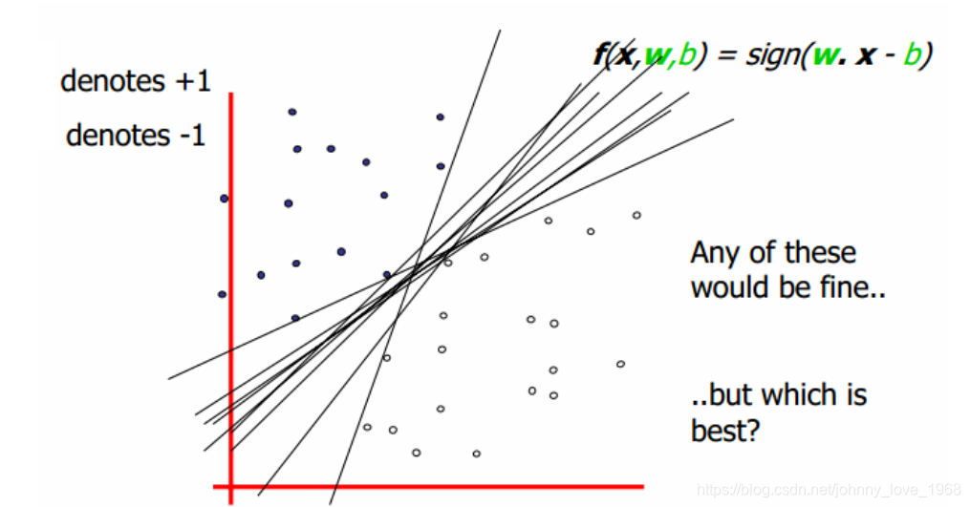
SVM

Slide 6
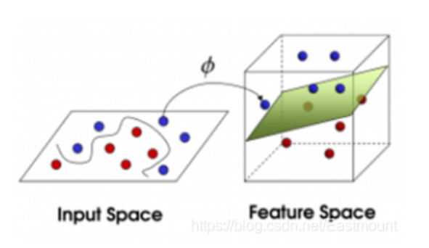
SVM

Slide 7
额外增加神经网络

