Slide 1
Spatial Sound

Slide 2
Quick intro
What?
Why?
When?
Who?
How?
Trying to simulate real sound behaviour
Game-feel, immersion, realism...
1950, film industry. Multiple speakers on theaters
Not clerar: it was an organic progression
More than one sound output
    Which leads me to...

Slide 3
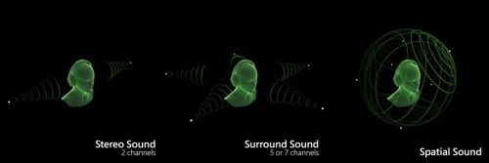
Common misconceptions
It's not only left / right
It's still a work in progress
Human hearing is surprisingly accurate

Slide 4
Spatial audio in videogames
Headphones are mandatory! They give us 2 sound outputs
As of today, pretty much a standard in the industry
Specially relevant in 3D games. Mandatory in VR
So, we got it figured out... right?

Slide 5
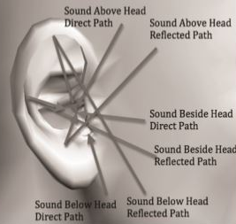

The Future of Spatial Audio
Headphone progression
Tech progression
(Tomb Raider, anyone?)

Slide 6
Spatial Sound in 2D RTS
What can we play with?
Propagation Yes:
Loudness Yes:
Absorption No:
Intelligibility No:
Noise Yesn't:
Ambient Yes:
Inverse Square Law
Perception Thresholds
We got God view
Only makes sense in FP
We can, we don't want to
Indoor / outdoor

Slide 7
Spatial Sound in 2D RTS
Propagation
  Dispersion is the 2nd power of the distance: don't make it lineal!
Loudness ratio (db)
  Conversation = 1ud
  Street noise = 4 ud
  Artillery = 128 ud
Ambient
  Indoors: Include 2nd and 3rd multiples due to rever
  Outdoors: Atmospheric conditions. Fog? Heat?
Noise
  Inevitable: mutiple audios playing at once. Get your priorities right.

Slide 8
Resources
Please use this
https://www.libsdl.org/projects/SDL_mixer/docs/index.html
Nice informative article
https://www.gamasutra.com/blogs/RobBridgett/20190619/344991/The_Positive_Future_of_Spatial_Audio_for_Games.php
Fun related videos. Don't look for answers to your bugs here, but they are interessant
https://www.youtube.com/watch?v=L2Kckjq0Gcs
https://www.youtube.com/watch?v=M-MhP2T3Adw
If you feel lost, start here
https://lazyfoo.net/tutorials/SDL/21_sound_effects_and_music/index.php
In this topic, some flaws of SDL are exposed. Useful to know, saves time
https://www.gamedev.net/forums/topic/188112-3d-sound-with-sdl
https://discourse.libsdl.org/t/surround-multichannel-sound/8639
These are technical. Unless you're into sound design and/or sound engineering, you have nothing to see (or hear lmao) here
https://www.semanticscholar.org/paper/Game-Sound-Technology-and-Player-Interaction%3A-and-Grimshaw/93a979a7af230e4ca00a13dfca6f4b2abd3aa4bf
https://www.acousticalsurfaces.com/acoustic_IOI/101home.htm

Slide 9
TODO

Slide 10
Todo 1:
Music plays on loop
You already should
know how to do this
If not... check the SDL documentation

Slide 11
Todo 2:
Music changes on keypress back and forth between track 1 and 2
Remember to add fadeout (SDL makes it easy to do so)

Slide 12
Todo 3:
Change keypress logic to instead check camera position
Congratulations, you can implement battle music now. Just mess with the checks (pressence of enemy in camera. It'll be clear once we know about FOW)

Slide 13
Todo 4 (last mandatory Todo):
Use Mix_SetPosition to reproduce a sfx with variations of channel and volume
With this function and a little imagination, you have all you need for the RTS

Slide 14
Todo 5 (if you want to know more):
What if we want to do it manually?
Make it so F5 Plays the sfx in channel 5. Don't configure (yet) said channel.

Slide 15
Todo 6:
Volume of FX changes depending of distance to origin of camera {0,0}
Remember the inverse square law!

Slide 16
Todo 7:
Improve upon Todo 6. Change the angle depending of relative position according to origin of camera
You might wanna check Mix_SetPanning
Congratulations, you have achieved Stereo+ Status

Slide 17
Todo 8:
Change % of volume in channel depending on both
Relative position and distance
Basically, just merge Todo 6 and 7.
Congratulations! You have made a custom version of the Mix_SetPosition function! Now you can tweak it at your pleasure.

