Slide 1

OpenTutor
OPEN SOURCE · OFFLINE · FREE
An AI tutor that goes to the student, instead of asking the student to connect to the AI.
273M out of school · 2.2B offline · One laptop, any phone, no internet
Photo: Humla, Karnali, Nepal · Wang Lama Humla, CC BY-SA 4.0, Wikimedia Commons
Notes:
Opening. OpenTutor puts a patient tutor on any phone, in places where there is no school nearby, no teacher for the subject and no internet.

Slide 2
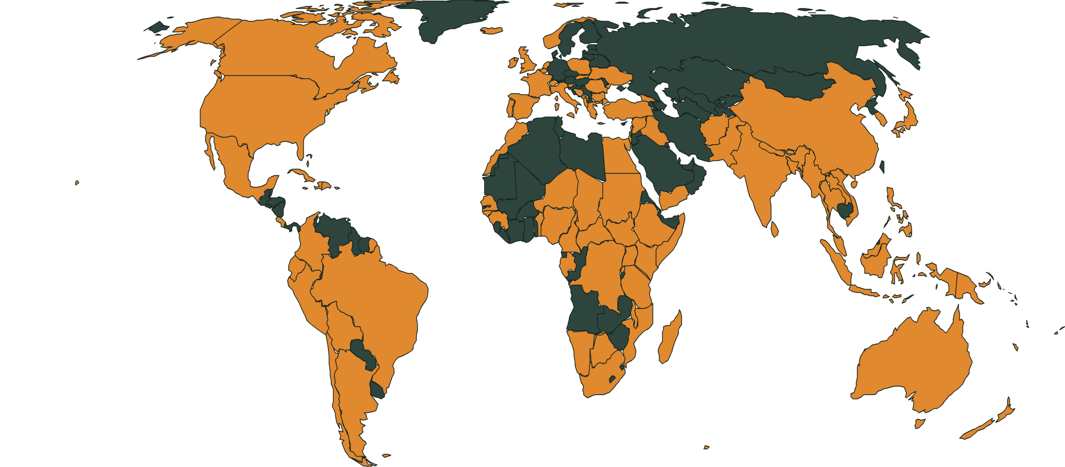
A global problem, with unequal consequences
THE PROBLEM
273 million
out of school worldwide (2024)
70%
of 10-year-olds in low- and middle-income countries cannot read a simple text (2022)
2.2 billion
people still offline (2025)
171M+ · 75%
Orange: countries and territories with reported climate disruptions to schooling in 2025 (UNICEF). Grey means no report, not no disruption.
students hit by climate disruption in 2025; 75% live in low- or lower-middle-income countries
Sources: UNESCO (2026) · World Bank (2022) · ITU (2025) · UNICEF (2026). Different populations and dates: do not add the figures together.
Notes:
Four numbers frame the problem. The map shows where climate hazards disrupted schooling in 2025. These are education problems, not only connectivity problems: the students who need support most are often the ones who can least depend on traditional digital education. The +0.31 SD from the Nigeria study (World Bank, 2025) is an effect size for teacher-guided AI tutoring, not a 31% gain, and it did not test this app.

Slide 3



We’re bringing the AI tutor to the student, instead of requiring the student to connect to the AI.
OUR ANSWER
Their school may close and their internet may disappear, but their ability to keep learning doesn’t have to.
On-device AI
Open-weight model
Gemma 4 runs on one laptop
Free to inspect and reuse
Offline practice
Data stays local
Works with the internet off
Nothing leaves the hub
Background: Hill Tracts village, Bangladesh · S.H. Tanim, CC BY 4.0, Wikimedia Commons · Insets: Magnific stock photos
Notes:
When introducing the solution, say it in these words. The photos show children learning with a laptop: on the right, the kind of study corner and shared device the hub is built for.

Slide 4
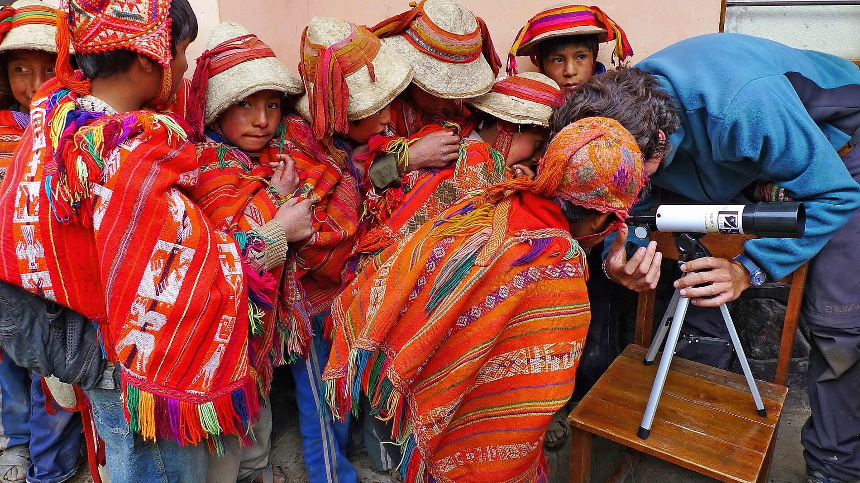
See OpenTutor in action
DEMO
Watch the demo on YouTube
Full walkthrough, internet off
Code: github.com/adricasi/opentutor
Open source · MIT licence · Photo: GalileoMobile/ESO, CC BY 4.0, Wikimedia Commons
Notes:
Close by playing the demo video. The link on this slide takes the audience to YouTube.

Slide 5
What it asks for, and what we have done
THE HACKATHON MINIMUM STANDARD
In the repo
In the README
Open-source licence
What it is and who it is for
MIT, LICENSE file in the repo
Free offline tutor for students without data or tutoring
Keys only in .env
How to run it
No API keys needed; .env git-ignored; gitleaks pre-commit
uv sync, opentutor setup, opentutor start; operator guide
No real personal data
Expertise inside, and its source
Invented data in tests and examples; photos never stored
Hint ladder, 3 subject tutors, sympy maths checker, safety set
Pinned dependencies
The model and its licence
Locked in uv.lock; pip-audit set up. Fresh audit result still to add
Gemma 4 via Ollama; Apache 2.0 confirmed on Google's model card
Clear model error, rate limit
Proof it works better
"Please try again" message; 15 sessions, 2 per device, 10 joins/min
Targets set in evals; results with real Gemma 4 still to run
Disclaimer
"AI can make mistakes, check with your teacher" on every page
Also built: phone hub plus iPad handwriting tutor, 18 requirements, 8 decision records, 185 tests (88% coverage).
Filled circle: done. Open circle: still to do. Checked against github.com/adricasi/opentutor (main) on 24 Oct 2026.
Notes:
This is the organisers' minimum standard, checked against our GitHub documentation. Everything with a filled circle is backed by a file in the repo. Two items are honestly still open: a fresh pip-audit result, and the measured comparison with real Gemma 4, which needs a run on the hub laptop. The Gemma 4 licence is now confirmed as Apache 2.0 on Google's model card on Hugging Face. GitHub Actions runs on main currently show as failed, so we do not claim a green CI.

