Slide 1
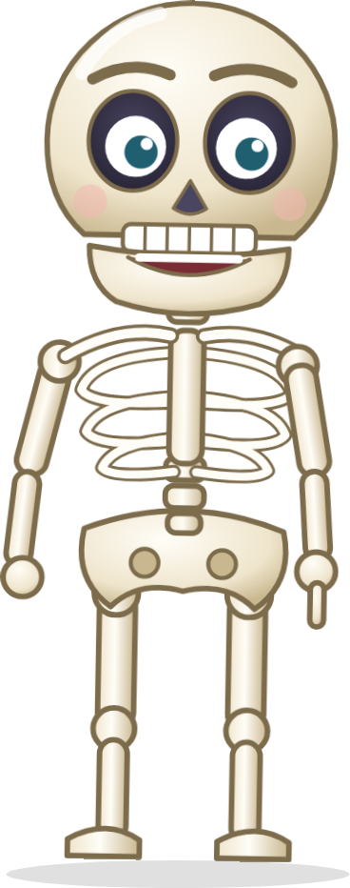

AT2 presentation: three aged care scenarios
CHCCCS041 Recognise healthy body systems
Your name:
Student number:
Date:
Notes:
Type your name, student number and the date on this slide.

Slide 2
How to use this template
1
Read each scenario.
There are three aged care scenarios: Beth, Albert and Margie.
Remember
2
Do your own research.
Use trusted health websites, your Learner Guide and the lesson pages. Write in your own words.
The Scenario 1 slides are your information sheet for Misha. You use them when you give the handover.
Explain every medical word in simple words.
Every scenario has a References slide. Fill it in.
Your assessor asks you three questions after you present.
Check the final slide before you present.
3
Fill in each slide.
Each slide has a GUIDE box. It tells you what the slide must show. Delete the GUIDE box when you finish the slide.
4
Add your own pictures.
Use labelled diagrams. Write where each picture came from on the References slide.
5
Present and upload.
Present your slides to your assessor. Then upload this PowerPoint and your progress note in Connect.
Notes:
You can delete this slide before you present.

Slide 3
Scenario 1: Beth Brown, handover to Misha
Beth is 84. She has osteoarthritis and her knees are very painful.
She walks slowly with a wheelie walker. She needs help with showering, some housework, appointments and shopping.
Misha is a new support worker. Misha will take over some of Beth's support.
Your job: make an information sheet for Misha (the next slides). Use it to give Misha a handover.
Notes:
Keep this slide. It tells your assessor which scenario you are presenting.

Slide 4
Osteoarthritis
What it is:
Causes:
Signs (what you can see):
Symptoms (what Beth feels):
Add a labelled picture of a joint with osteoarthritis
Insert > Pictures. Then delete this box.
GUIDE
What is osteoarthritis?
☐ What osteoarthritis is, in your own words
☐ The cause or causes
☐ Signs: what you can see
☐ Symptoms: what Beth feels
☐ A labelled picture of a joint
☐ Medical words explained in simple words
Delete this guide box before you present.
Notes:
Explain osteoarthritis to Misha. Use simple words. Point to the picture when you talk.

Slide 5
Body system 1: (name of the system)
Structure (anatomy): the main parts
Function (physiology): what it does
How osteoarthritis affects this system
Add a labelled diagram that shows where the parts are in the body
Insert > Pictures. Then delete this box.
GUIDE
The first body system
☐ The name of the body system
☐ Structure (anatomy): the main parts
☐ Function (physiology): the jobs it does
☐ A labelled diagram that shows where the parts are
☐ How osteoarthritis affects this system
☐ The source of the diagram on the References slide
Delete this guide box before you present.
Notes:
Name one of the two main body systems affected by osteoarthritis. Tell Misha its parts and its jobs. Point to the labels on your diagram.

Slide 6
Body system 2: (name of the system)
Structure (anatomy): the main parts
Function (physiology): what it does
How osteoarthritis affects this system
Add a labelled diagram that shows where the parts are in the body
Insert > Pictures. Then delete this box.
GUIDE
The second body system
☐ The name of the body system
☐ Structure (anatomy): the main parts
☐ Function (physiology): the jobs it does
☐ A labelled diagram that shows where the parts are
☐ How osteoarthritis affects this system
☐ The source of the diagram on the References slide
Delete this guide box before you present.
Notes:
Name one of the two main body systems affected by osteoarthritis. Tell Misha its parts and its jobs. Point to the labels on your diagram.

Slide 7
How the two systems work together
Body system 1: (name)
Body system 2: (name)
GUIDE
Working together
☐ How the two systems are connected
☐ How each system supports the other
☐ How they work together to keep the body working well
☐ What goes wrong for both when Beth has osteoarthritis
☐ A picture or arrows can help
How system 1 helps system 2:
How system 2 helps system 1:
What happens to both systems with osteoarthritis:
Delete this guide box before you present.
Notes:
Tell Misha how the two body systems need each other. Replace the words in the boxes with your own words.

Slide 8
Support for Beth
Aids and equipment
What does Beth use? How does it help her body?
Services and health workers
Who else supports Beth? How do they help?
GUIDE
Support for Beth
☐ The support Beth gets: services, aids and other support
☐ How each one helps her body work well
☐ What Misha needs to do on each visit
☐ A picture of an aid or service (optional)
Support from you and Misha
What do you do on each visit? How does it help her body work well?
Her choices and wellbeing
How do you respect Beth's choices and keep her active and happy?
Delete this guide box before you present.
Notes:
Write under each heading. Explain to Misha how each kind of support helps Beth stay well and safe.

Slide 9
Medical words on my information sheet
Medical word | What it means (simple words) | Where I checked it
GUIDE
Medical words
☐ The medical words you used on your slides
☐ What each word means, in simple words
☐ Where you checked the meaning
☐ Use trusted sources only
☐ Your assessor may ask: what did you use to understand the medical words?
Delete this guide box before you present.
Notes:
This slide helps Misha understand your sheet. It also helps you answer your assessor's question about how you understood the medical words.

Slide 10
References: Scenario 1
Click to add your references
GUIDE
References
☐ Every website, book or video you used
☐ Every picture and diagram you used
☐ For each one, write:
who made it (a person or organisation)
the title
the year
the link (for a website)
☐ Use trusted sources
Delete this guide box before you present.
Notes:
List every source you used for this scenario. Do not copy and paste text from websites. Write in your own words.

Slide 11
Scenario 2: Albert Parker, a healthy lifestyle
Albert is 75. You help him with personal care after a broken hip.
He smokes a few cigarettes a day. He put on 10 kg after his hip operation.
His doctor says he has diabetes type 2 and should change some things, like smoking and his diet.
Albert asks you what he can do to be healthier, and how stopping smoking will help.
Your job: plan a friendly, respectful conversation with Albert.

Slide 12
Plan your conversation with Albert
Topic | What I will share with Albert | How it helps his body
Healthy food
Exercise and moving
Smoking
Weight
Water and alcohol
Friends and feeling good
GUIDE
A respectful conversation
☐ How you start: greet Albert, ask if he wants to talk, listen
☐ Simple words, no lectures
☐ Each lifestyle factor in the table
☐ How each factor helps his body systems work well
☐ His choice: Albert decides what he will change
☐ Be ready: what will you do if Albert does not want to talk about his lifestyle?
Delete this guide box before you present.
Notes:
Fill in the table in your own words. When you present, explain how you would talk with Albert. Show respect for his choices.

Slide 13
References: Scenario 2
Click to add your references
GUIDE
References
☐ Every website, book or video you used
☐ Every picture and diagram you used
☐ For each one, write:
who made it (a person or organisation)
the title
the year
the link (for a website)
☐ Use trusted sources
Delete this guide box before you present.
Notes:
List every source you used for this scenario. Do not copy and paste text from websites. Write in your own words.

Slide 14
Scenario 3: Margie Compton, a change in health
Margie is 88. She lives alone. She has arthritis and walks with a walking stick.
Today she is limping on her left leg. She bumped it on a footstool a couple of days ago.
Under the bandage there is a skin tear, about 2 cm. The skin around it is red, hot and a little swollen, with a small amount of creamy ooze. It hurts when she walks.
Your job: plan what you will notice, say and do. You will phone your supervisor (your assessor) and write a progress note.

Slide 15
Plan: what I will notice, say and do
Step | My plan
1 Notice the changes | What changes can I see in Margie's health and body?
2 Talk with Margie | What will I say to Margie about the changes?
3 Ask more questions | When did it happen? What did she put on it? How much pain?
4 Phone my supervisor | What will I tell my supervisor? How will I check the next step?
5 Write a progress note | What facts go in the note?
GUIDE
Notice, ask, report, record
☐ The changes you noticed in Margie
☐ How you talk with Margie about them
☐ Your extra questions: when, what she put on it, how much pain
☐ Your phone call: what you report, and the next step your supervisor gives you (repeat it back)
☐ What goes in your progress note
☐ Be ready: name three changes in a person that need medical help straight away
Delete this guide box before you present.
Notes:
Write your plan over the grey questions. Your assessor plays the supervisor on the phone. After the call, write the progress note and upload it with this PowerPoint.

Slide 16
References: Scenario 3
Click to add your references
GUIDE
References
☐ Every website, book or video you used
☐ Every picture and diagram you used
☐ For each one, write:
who made it (a person or organisation)
the title
the year
the link (for a website)
☐ Use trusted sources
Delete this guide box before you present.
Notes:
List every source you used for this scenario. Do not copy and paste text from websites. Write in your own words.

Slide 17
Final check before you present
Scenario 1: Beth and Misha
Scenario 2: Albert
Scenario 3: Margie
☐ What osteoarthritis is, its causes, signs and symptoms
☐ Two main body systems it affects
☐ Structure and function of both systems
☐ Labelled diagrams
☐ How the two systems support each other
☐ The support Beth gets and how it helps her body
☐ Medical words explained
☐ References
☐ A respectful way to start and keep the conversation going
☐ Lifestyle factors: food, exercise, smoking, weight, water and alcohol, friends and feeling good
☐ How each factor helps his body
☐ References
☐ The changes you noticed
☐ What you say to Margie
☐ Your extra questions about the injury and the pain
☐ Your phone call to the supervisor and the next step
☐ Your progress note
☐ References
After you present, upload:
☐ this PowerPoint (all GUIDE boxes deleted)
☐ your progress note for Margie
Be ready for 3 questions:
How did you understand the medical words?
What if Albert does not want to talk about his lifestyle?
Three changes that need medical help straight away
Notes:
Tick every box before you present. You can delete this slide before you upload.

