Slide 1
Labmeeting
20120703

Slide 2
Schematic illustrate the signaling events after the angiotensin stimulation

Slide 3
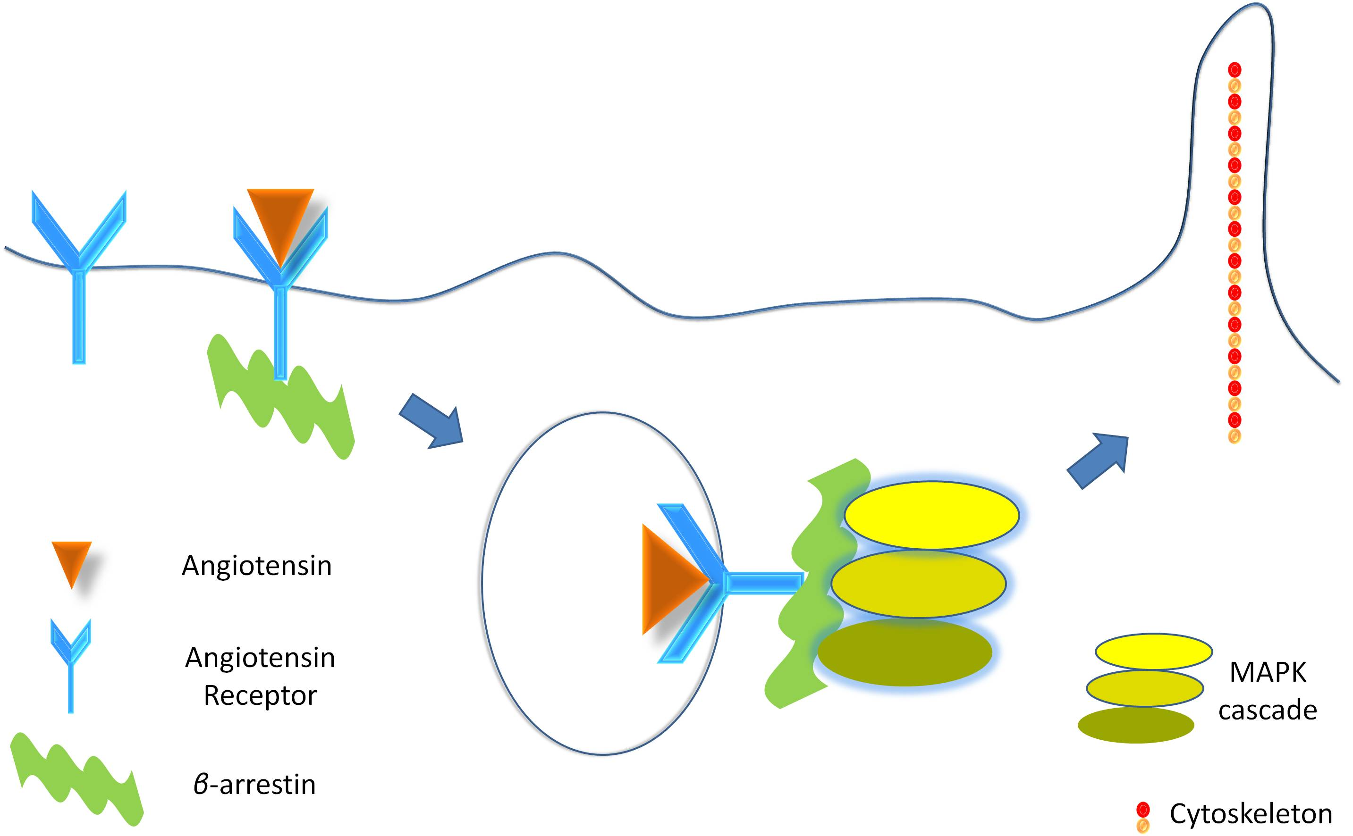

Slide 6
Cell chemotaxis to angiotensin gradient is depand on the gradient, arrestin concentration and the ligands

Slide 10
During the signal transduction, the polarizations of signals are amplified step-by-step.

Slide 15
Actin effect on arrestin translocation

Slide 16
Control
Nocodazole treat

Slide 17
Nocodazole inhibit the microtubule and arrestin polarization

Slide 18
Highly expressed arrestin

Slide 20
Thanks

Slide 21

pERK
Tubulin
KD Native OE1 OE2 OE3

Slide 22
pERK
Tubulin
0.016ng 0.05ng 0.16ng 0.5ng 1.6ng 5ng 16ng 50ng 160ng

