Slide 1

Global Renewable Electricity: Trends, Forecasts to 2050, and Country Clusters
Scientific Visualization - Università degli Studi di Milano, 2025
Daniyar Abdrakhmanov
Francesco Morgigno
Madizhan Islambek
Adrien Houdoux

Slide 2
Motivation
Renewables are growing, but the pace and the mix differ a lot across countries
How did renewable electricity evolve since 1985?
What might change by 2050 (if trends continue)?
Can we group countries with similar transition patterns?

Slide 3
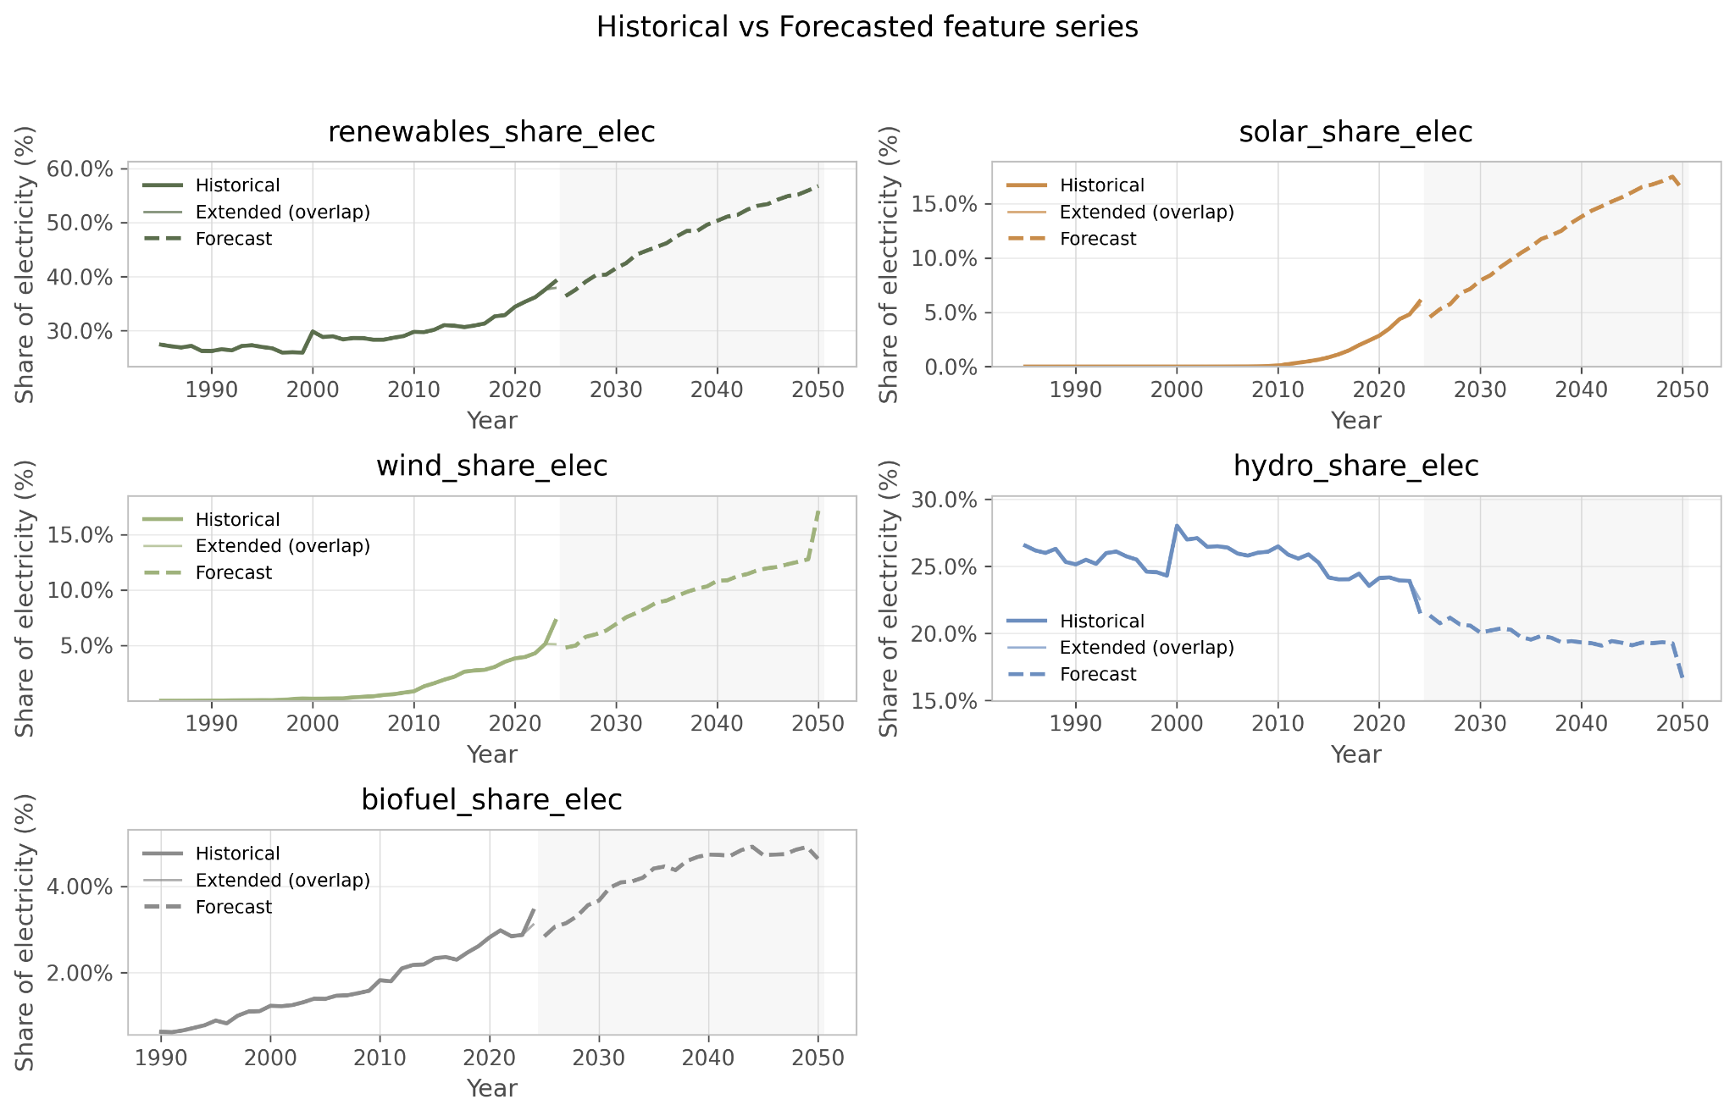
By source: different growth patterns
Hydro is stable, while wind and solar drive most of the recent increase.
Dashed area = forecast (model-based).

Slide 4
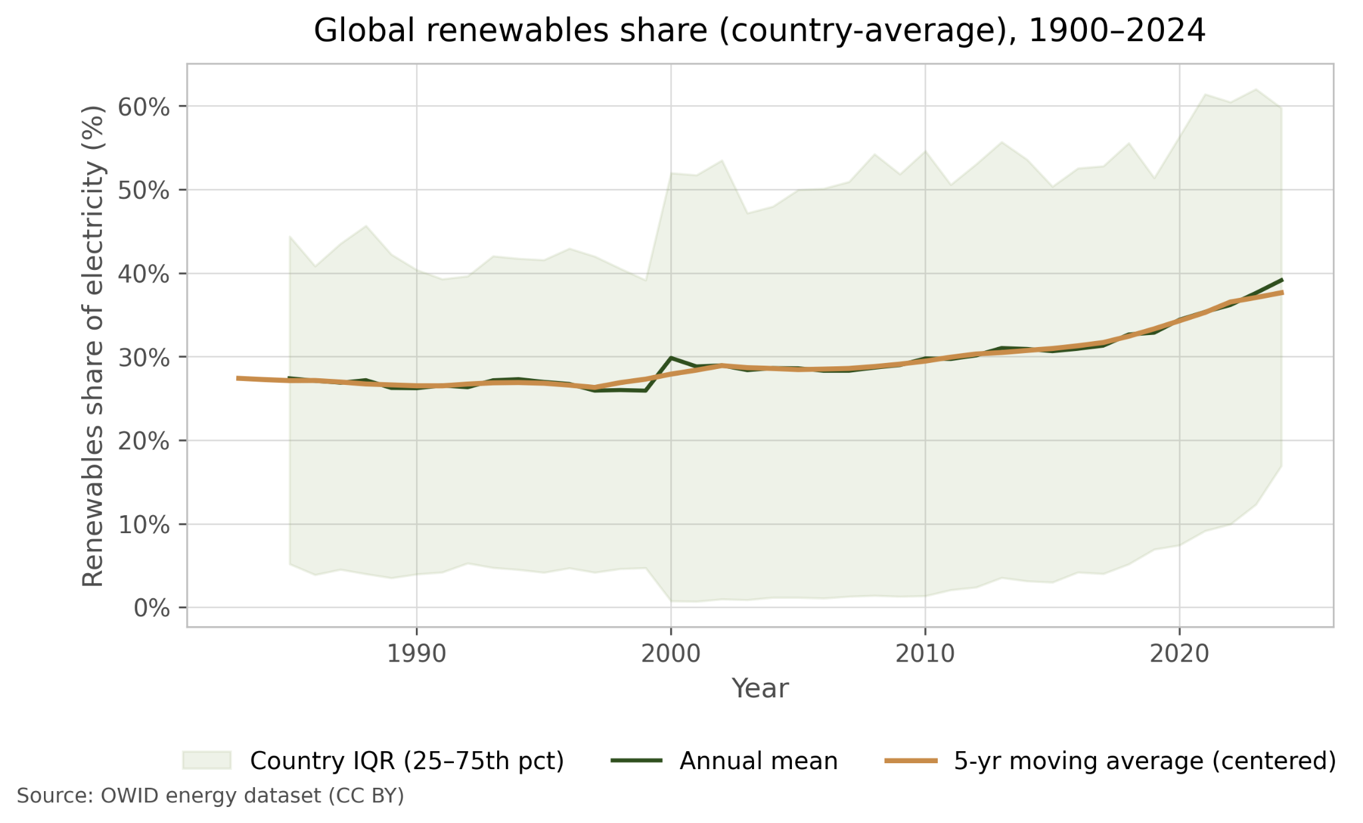
Global renewables: median + spread across countries
The typical country increases renewables, but the global spread remains large.

Slide 5
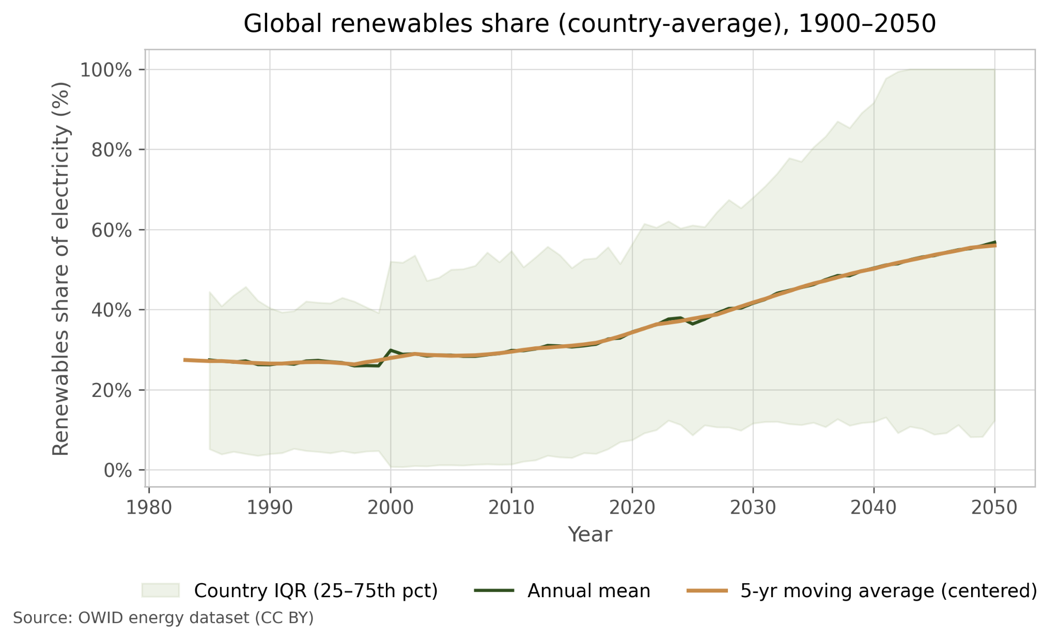
Forecast to 2050: trend continuation (with uncertainty)
If historical trends continue, the median country keeps rising, but outcomes vary widely.

Slide 6
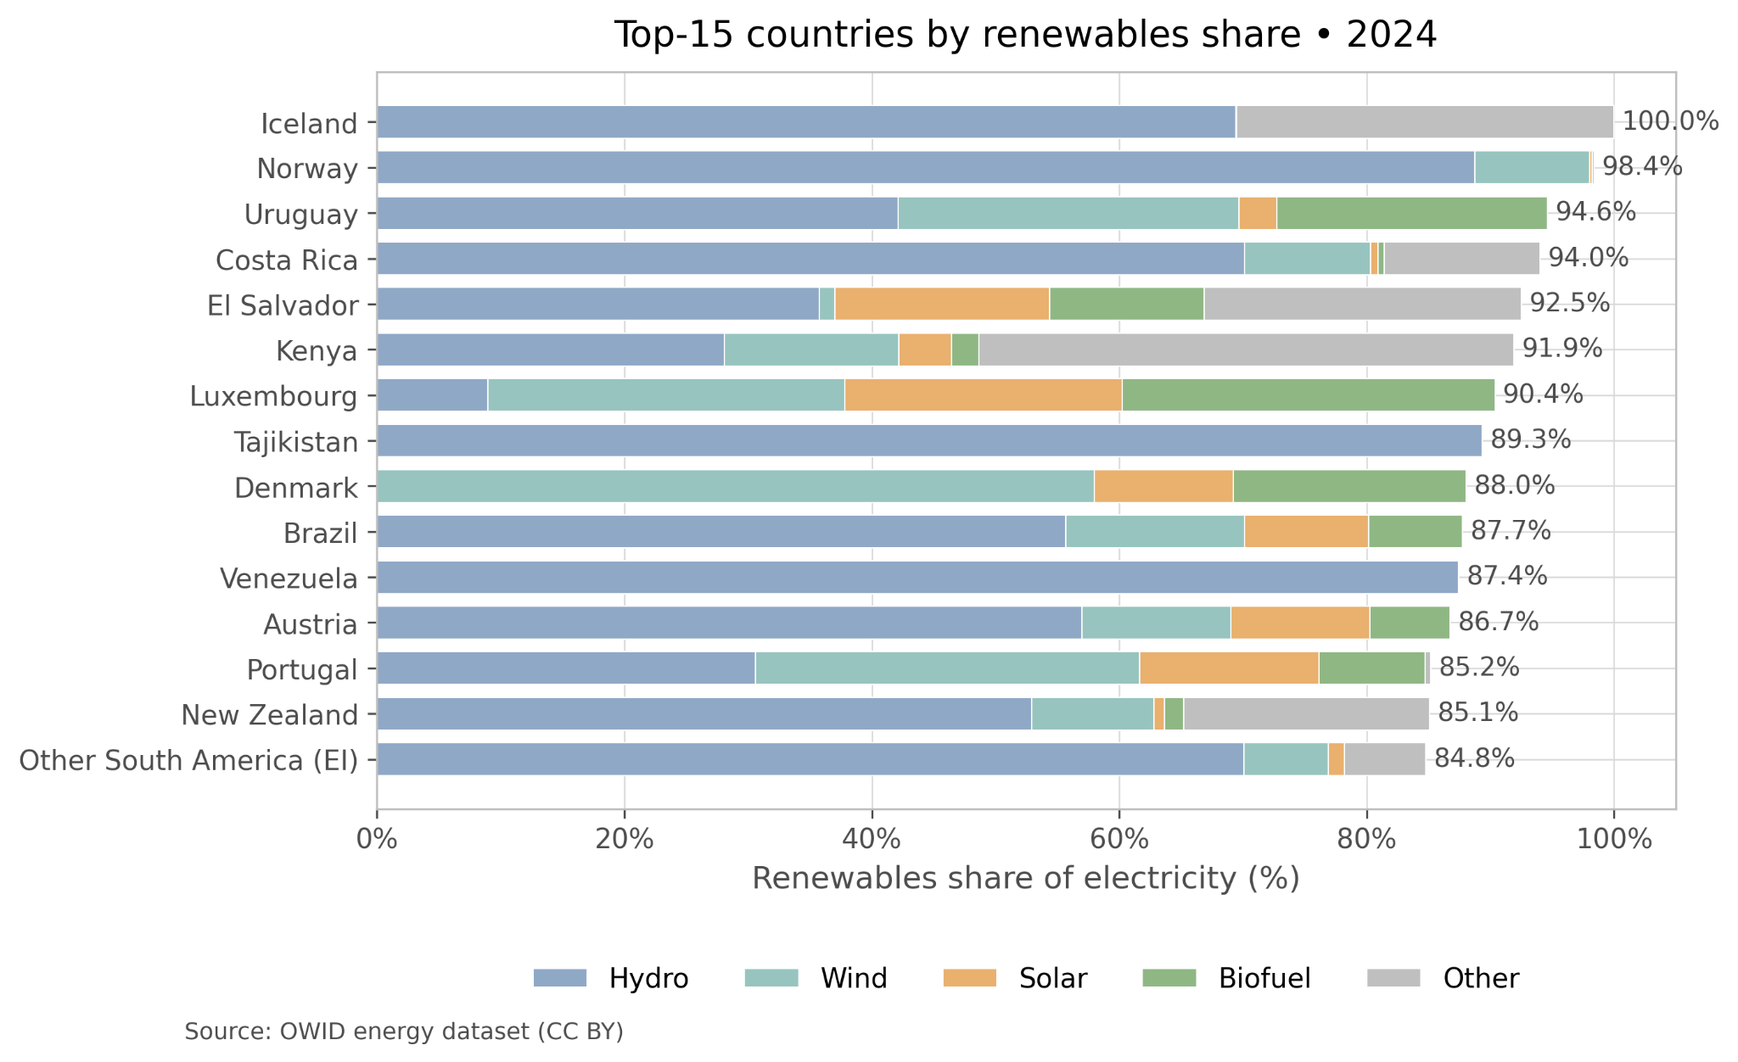
Top renewable electricity shares (latest year)
High-renewables leaders are often hydro-heavy, but some show diversified mixes.

Slide 7
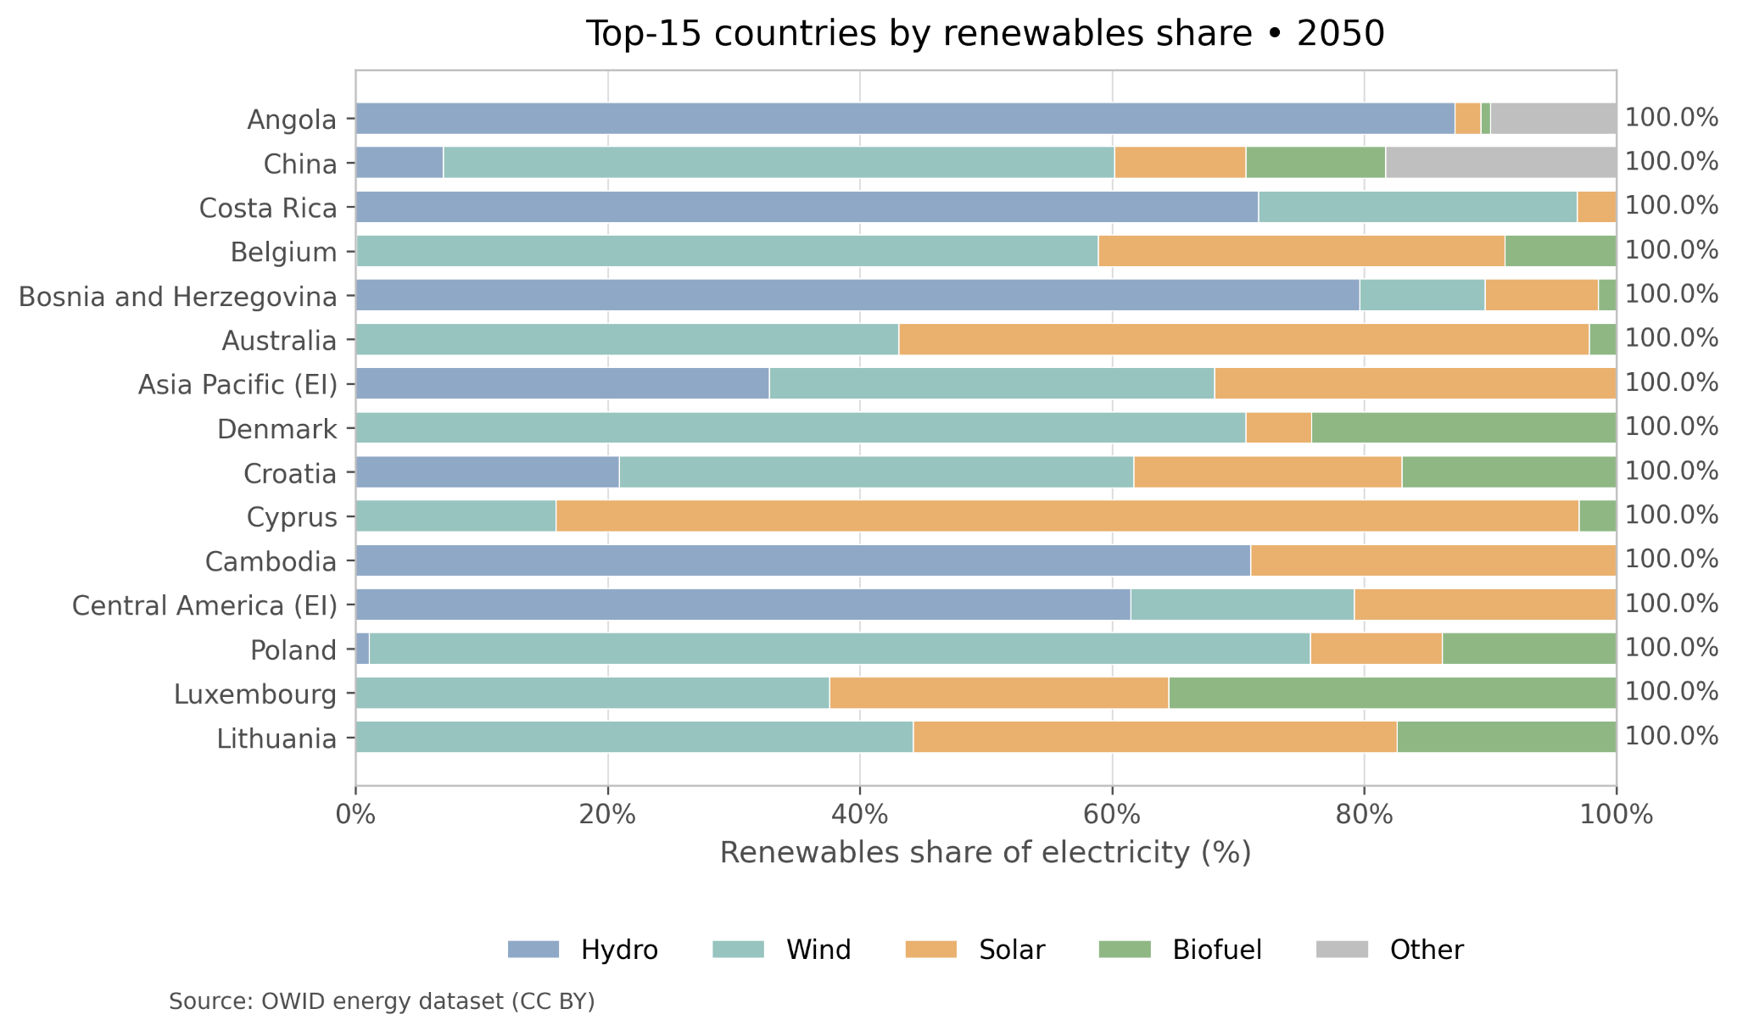
Countries projected to reach ~100% renewables by 2050
Even among leaders, the mix can be very different: hydro-only vs wind/solar-driven systems.

Slide 8
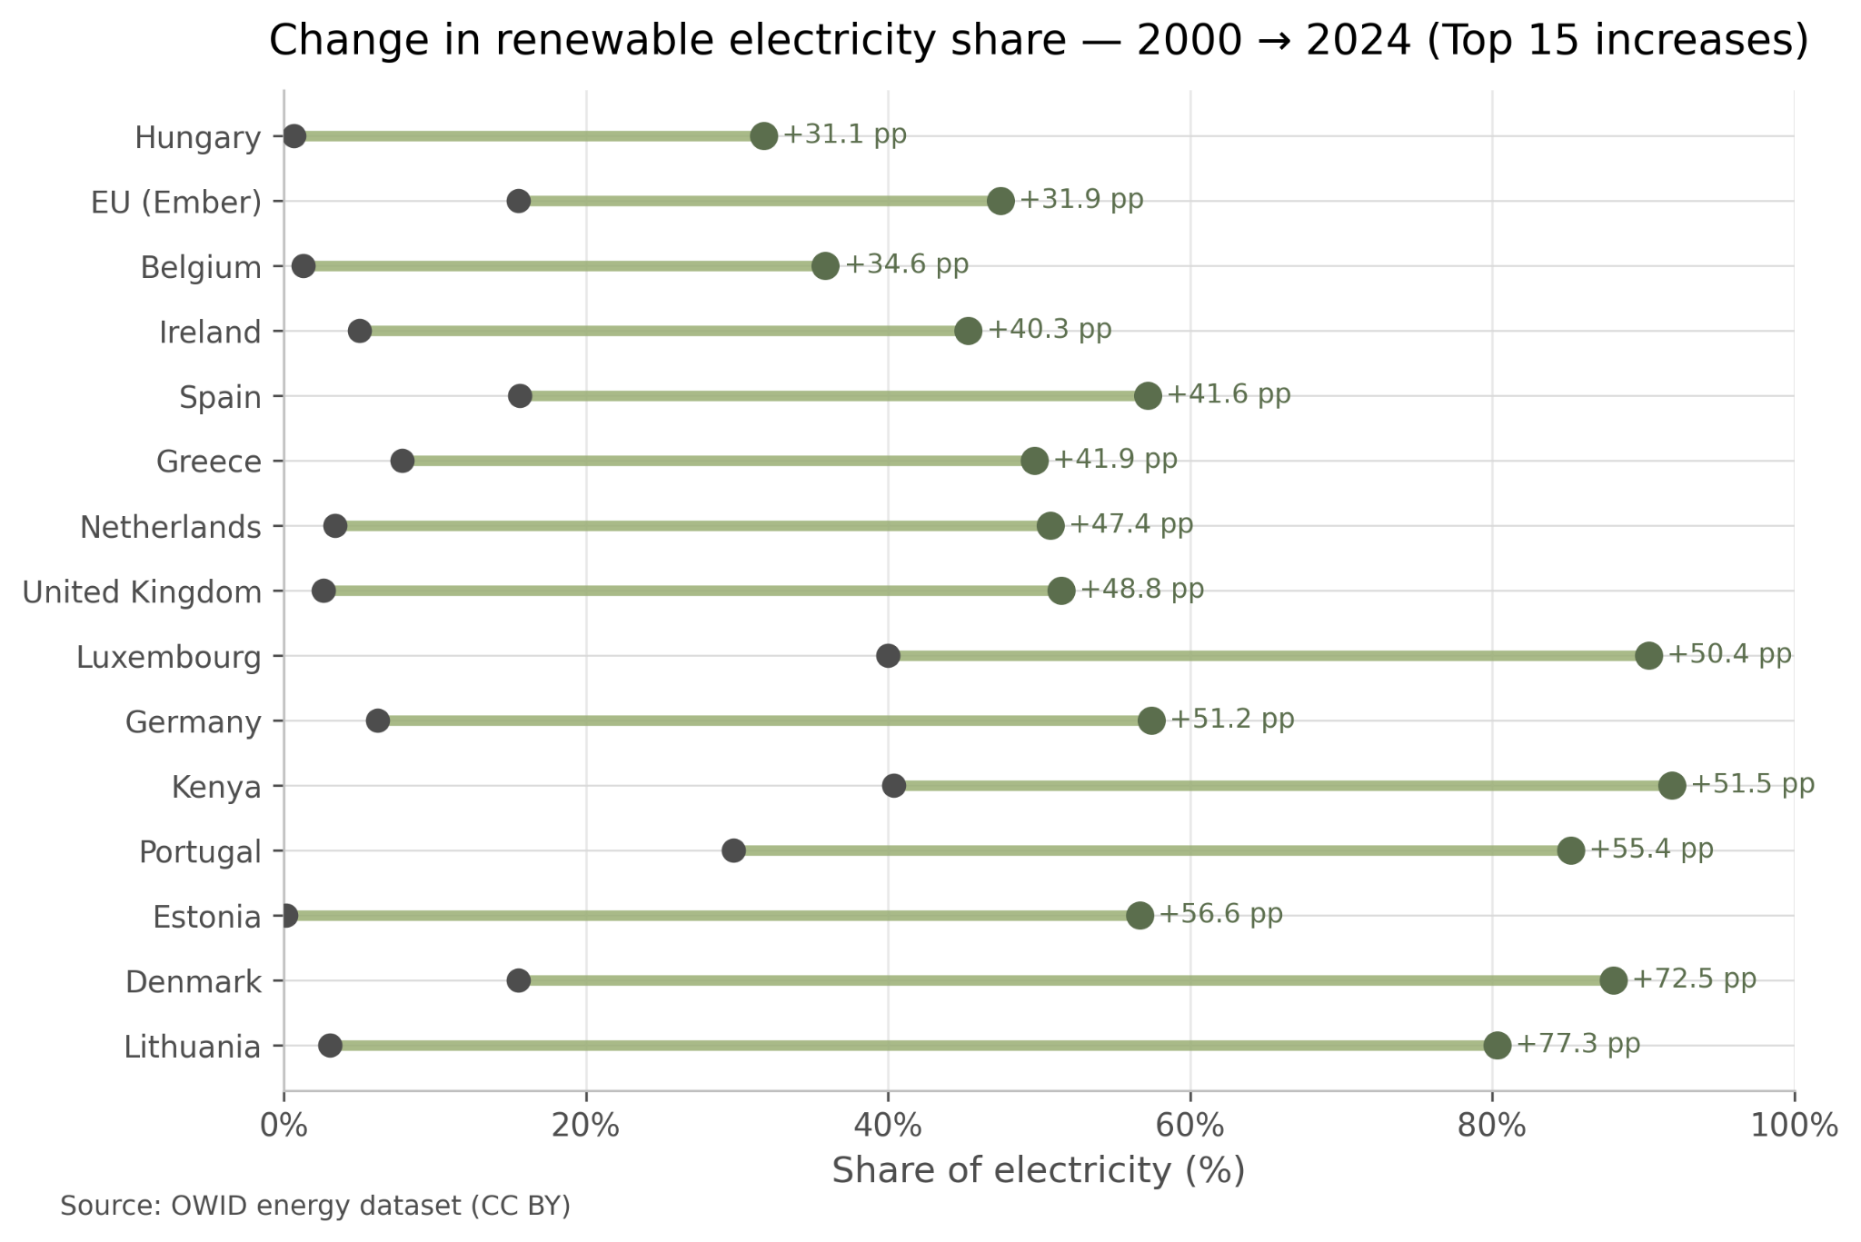
Biggest risers (recent years)
Some countries gained +40–80 percentage points, but there is no single “EU-only” pattern.

Slide 9
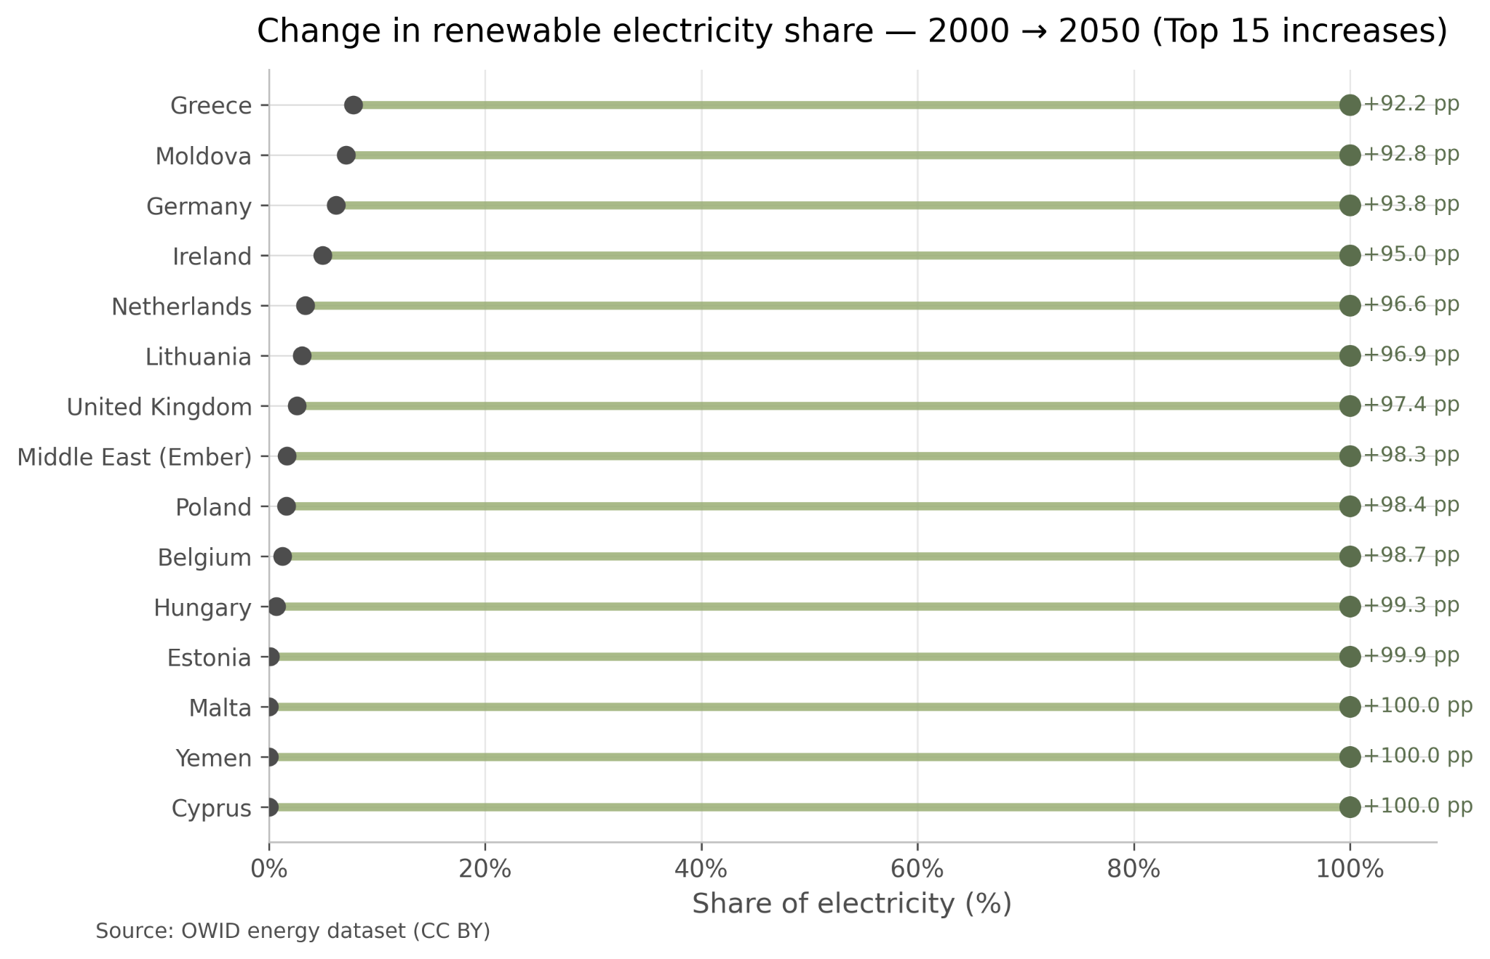
Biggest risers by 2050
the projection illustrates a common long-term transition toward renewable energy adoption.

Slide 10
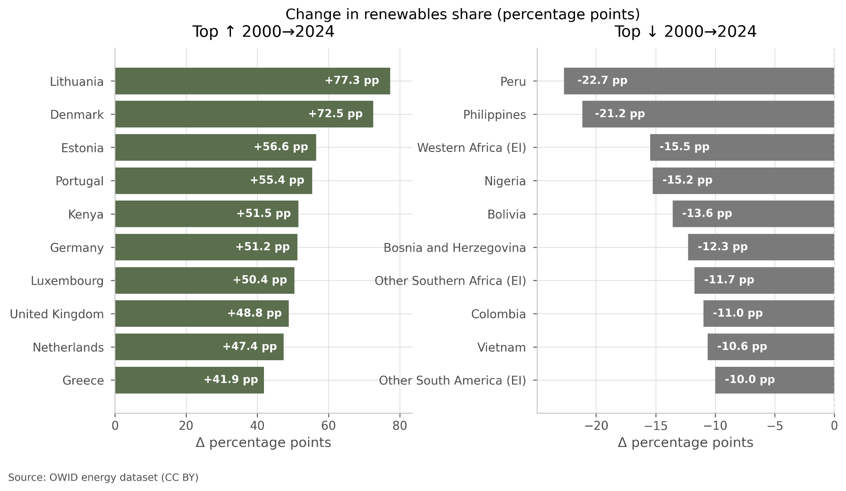
Winners and losers: change in renewable share
Most top changes are positive, but some countries lose share due to demand growth or fossil expansion.

Slide 11
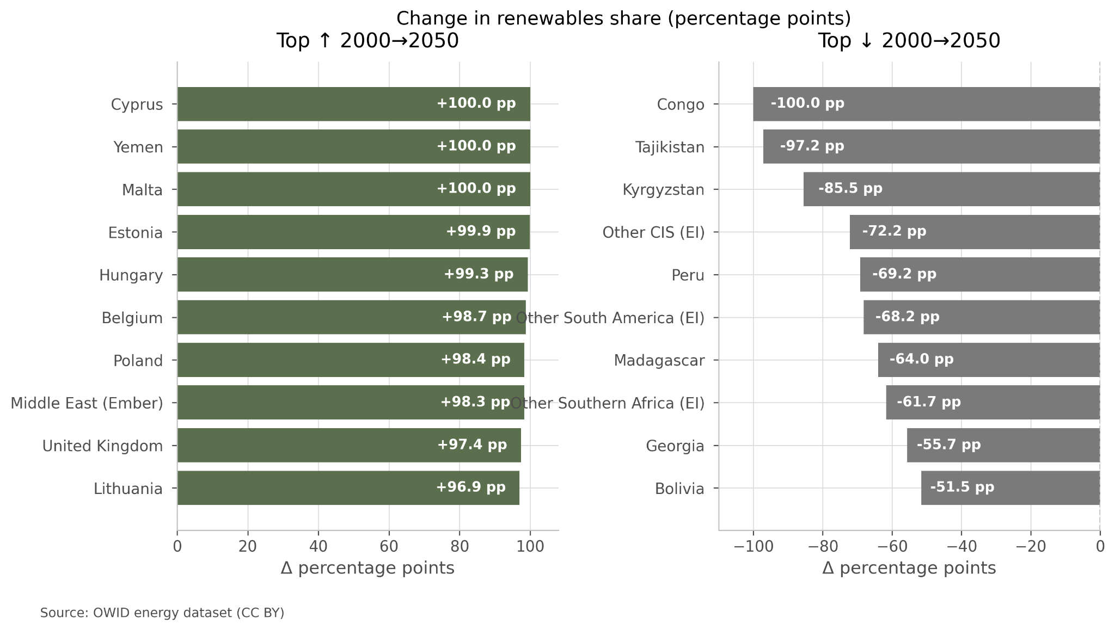
Extreme change in renewable share
Countries with low initial renewable shares show large gains due to saturation effects, while fast-growing energy systems may see declining renewable shares despite continued deployment.

Slide 12
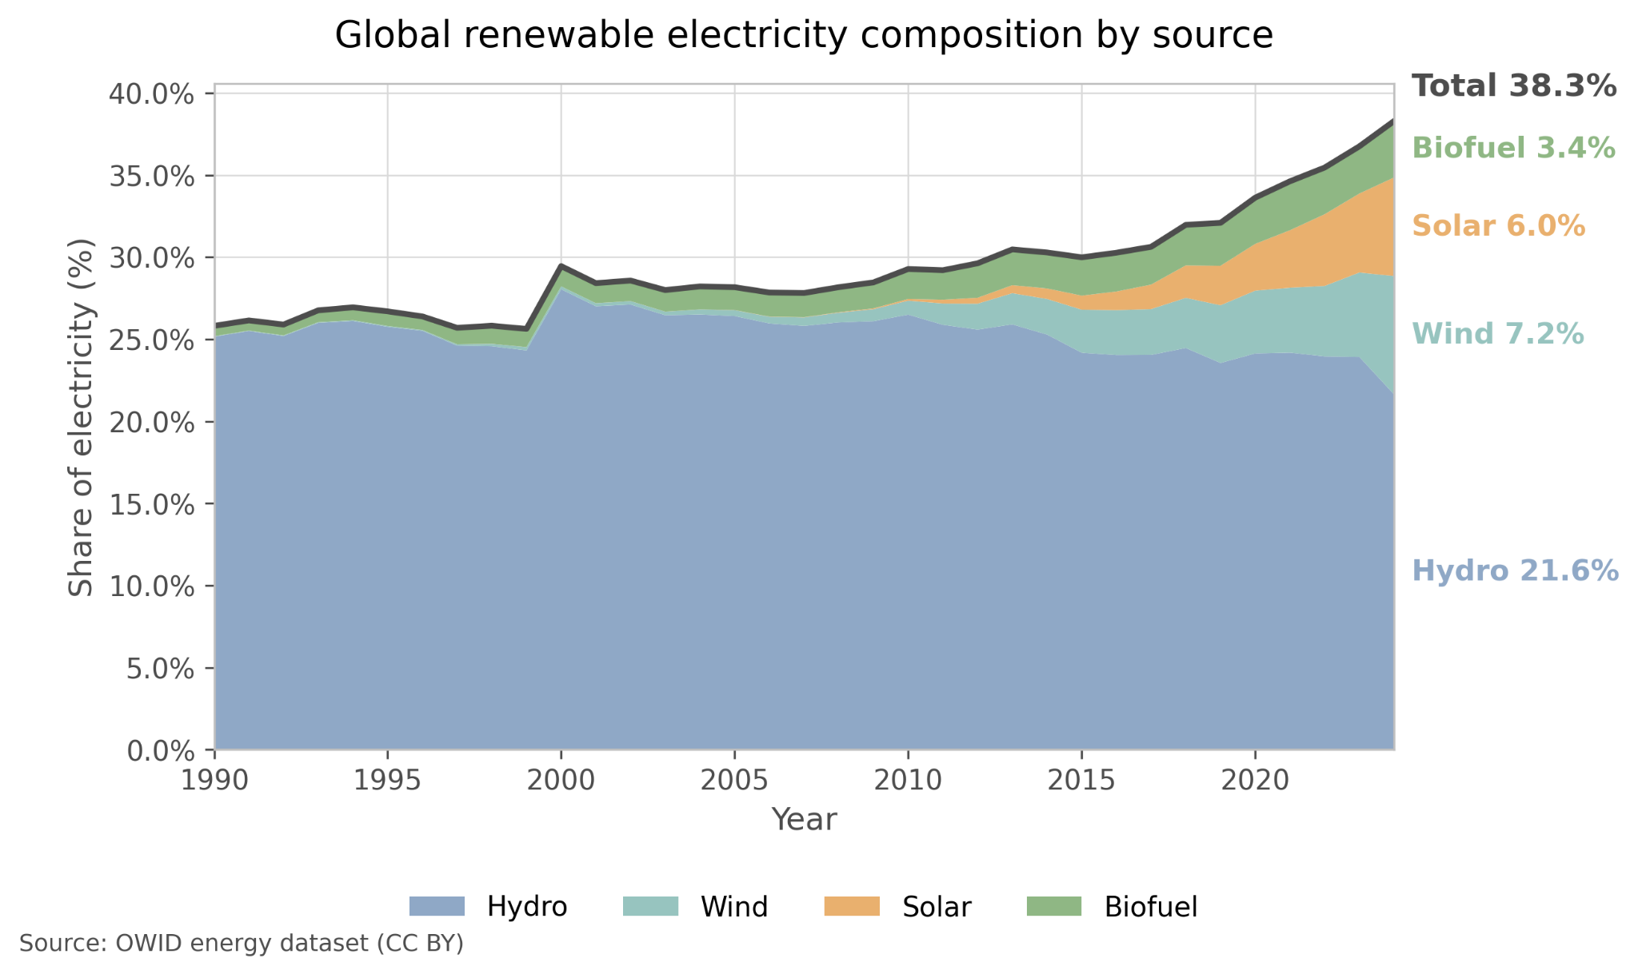
Global mix
Total renewables rise mainly because wind and solar grow on top of stable hydro.

Slide 13
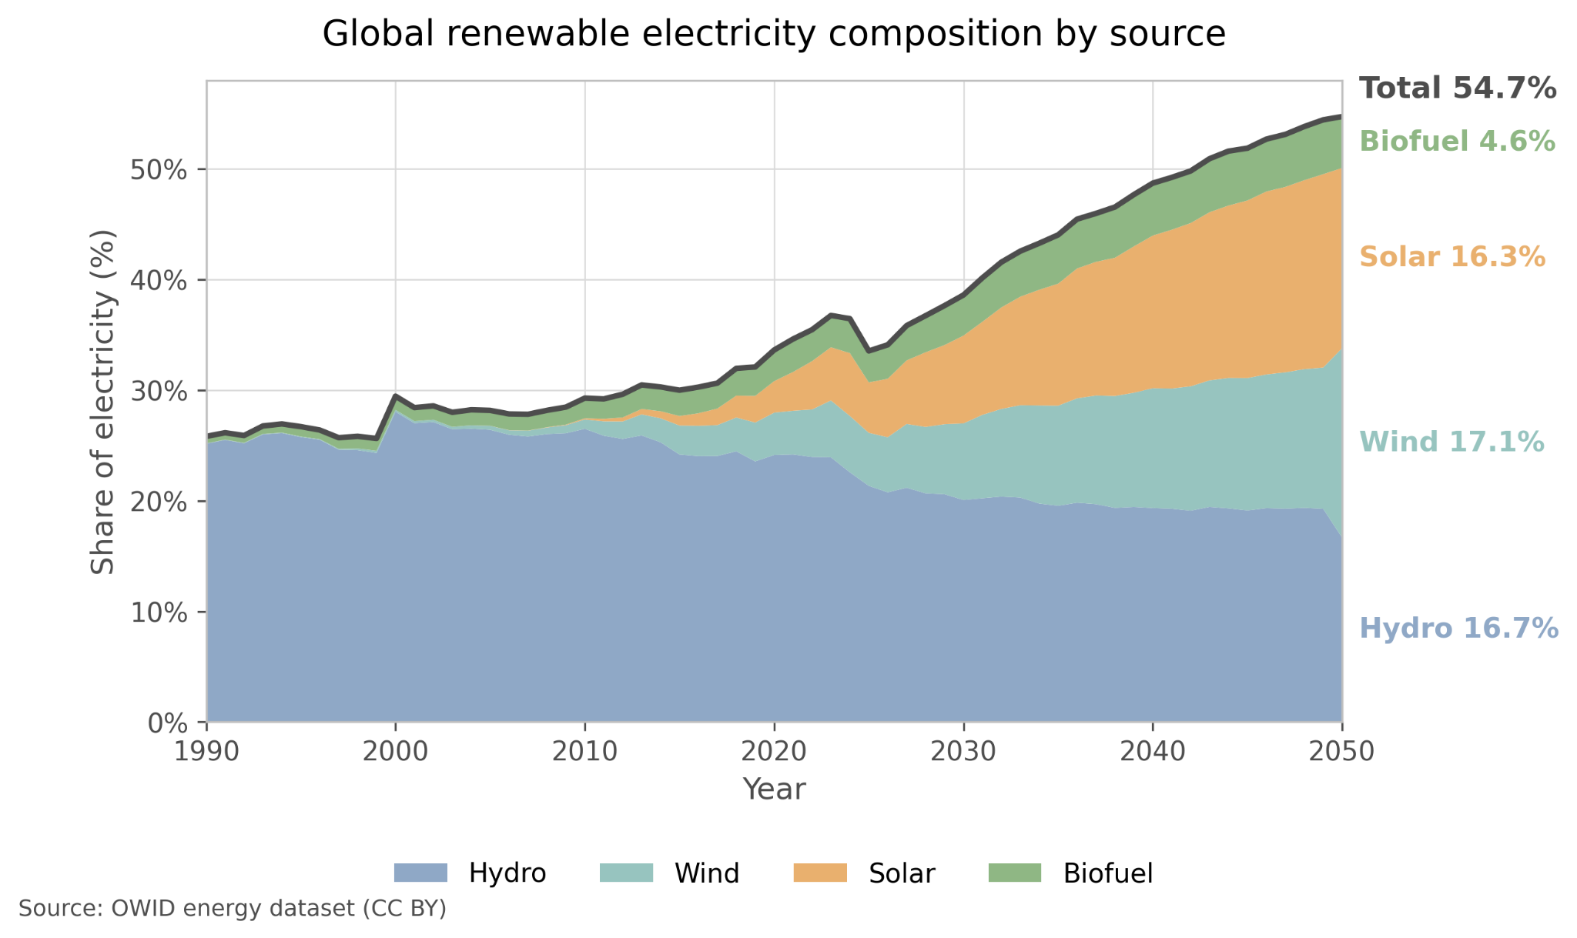
By 2050, the mix shifts toward wind and solar
In the projection, hydro becomes relatively smaller while wind/solar expand strongly.

Slide 14
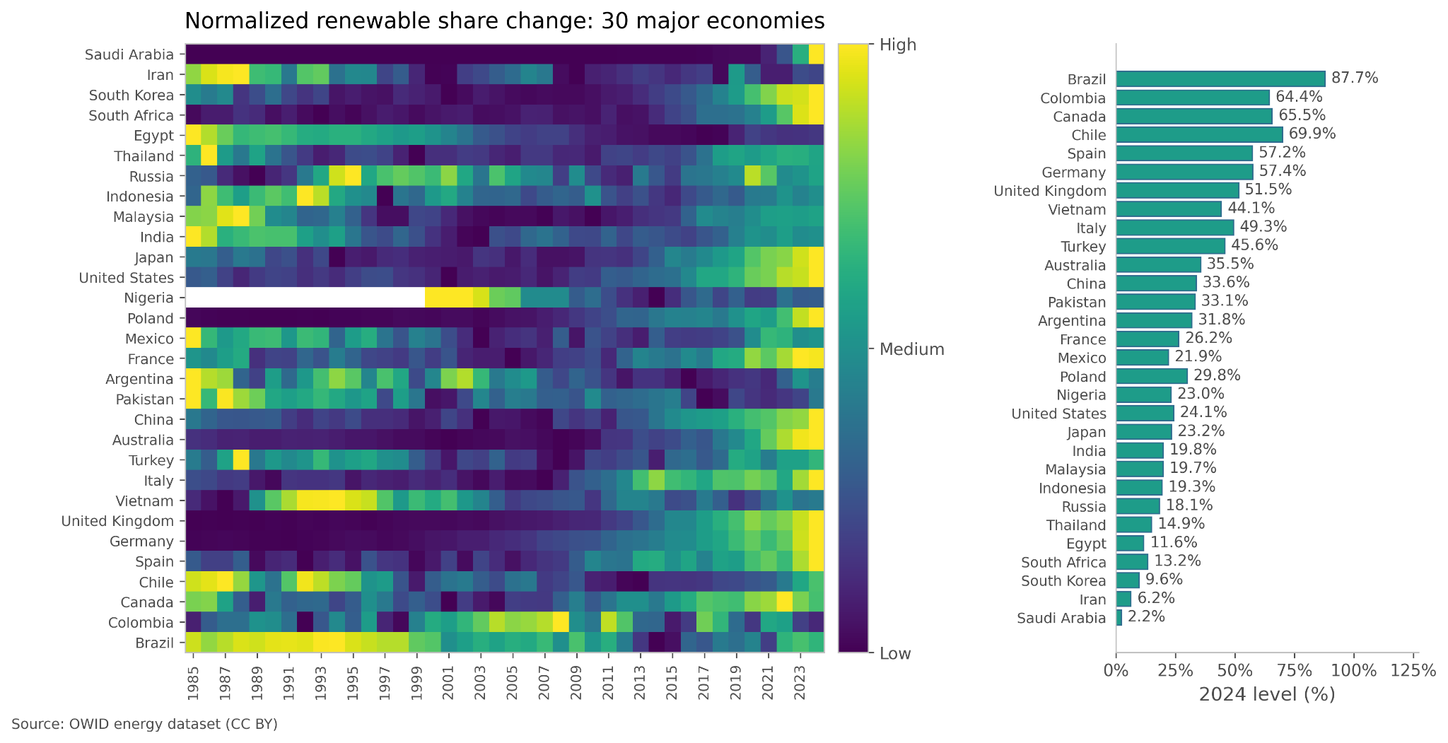
Major economies: historical patterns (1985–2024)

Slide 15
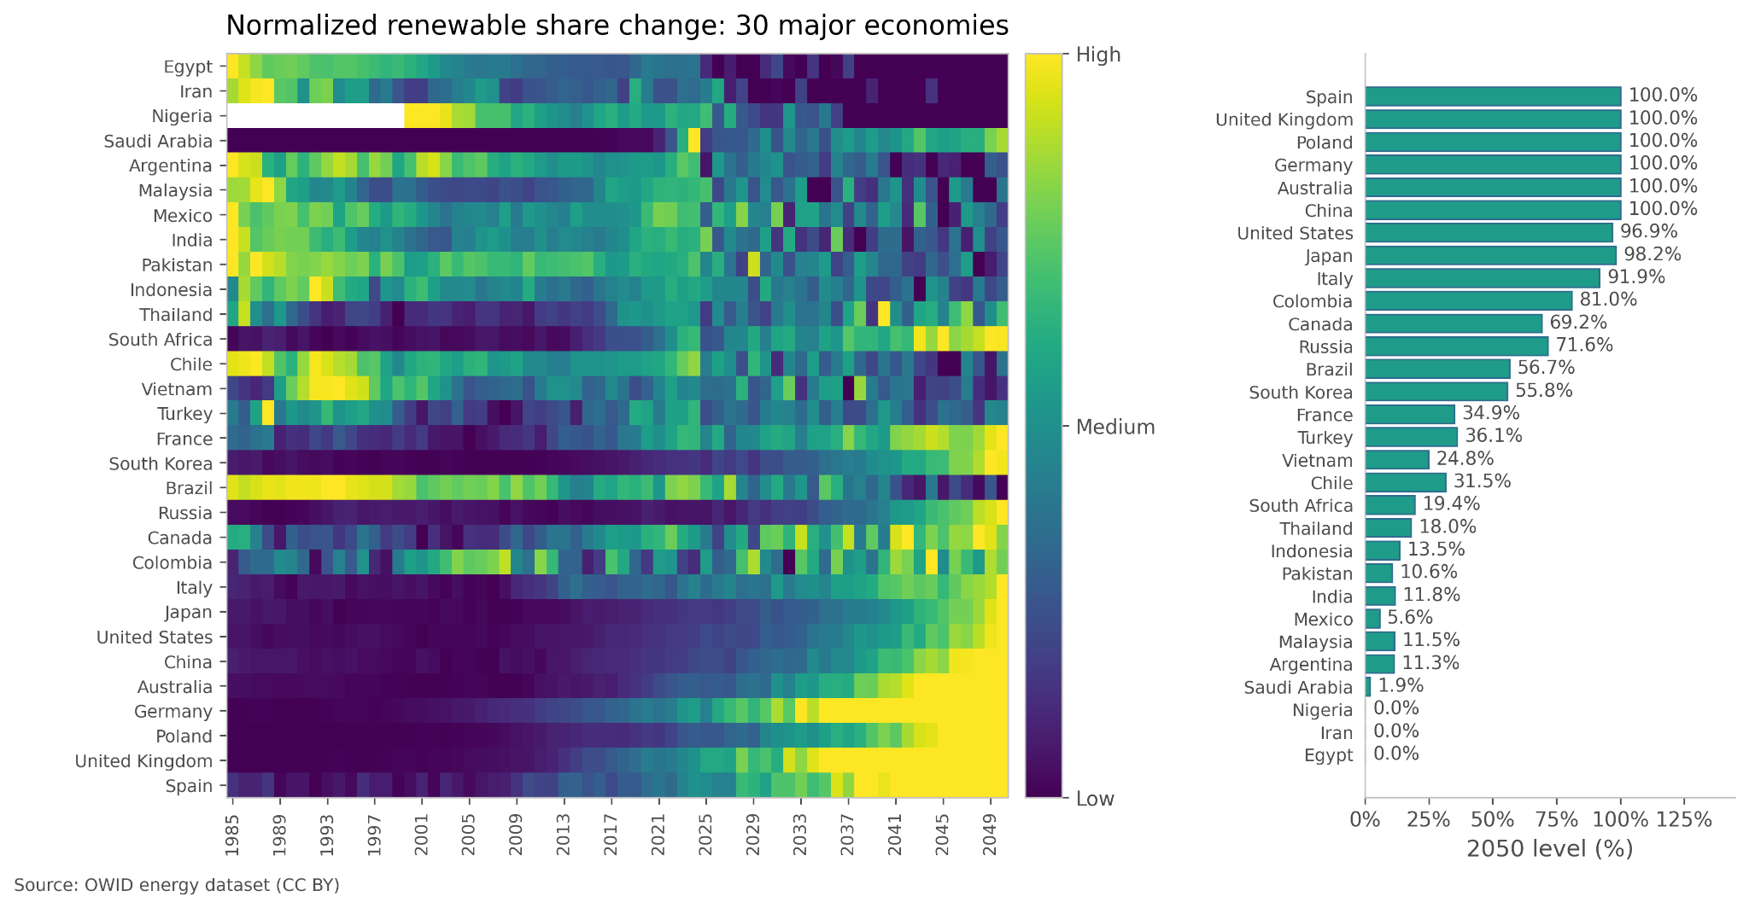
Major economies: trajectories to 2050

Slide 16
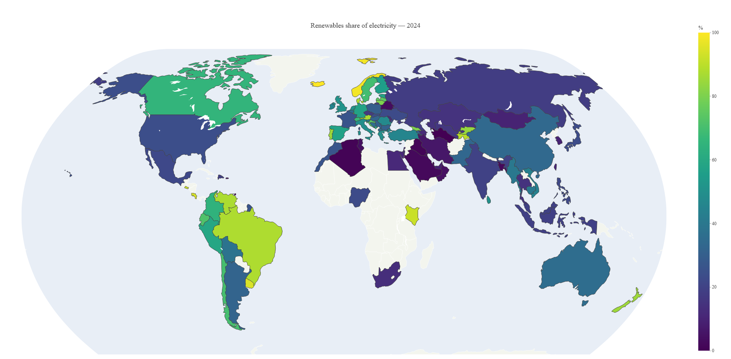
countries % of renewable share (2024)

Slide 17
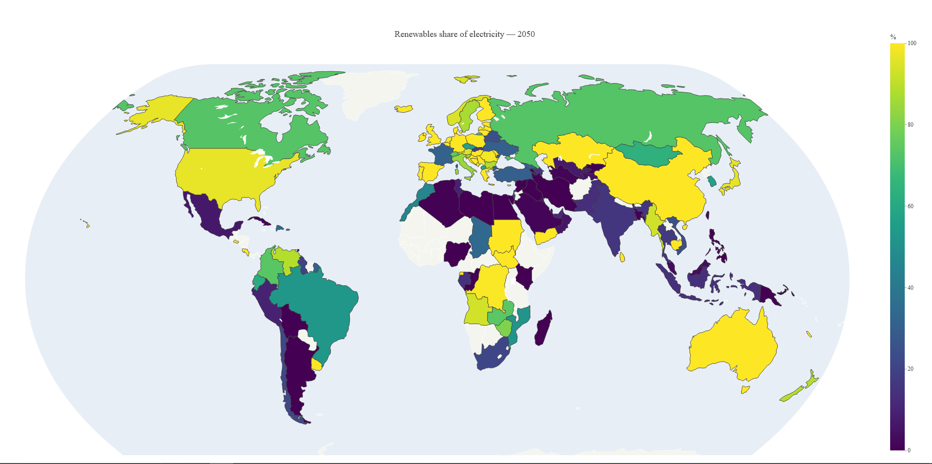
countries % of renewable share (2050)

Slide 18
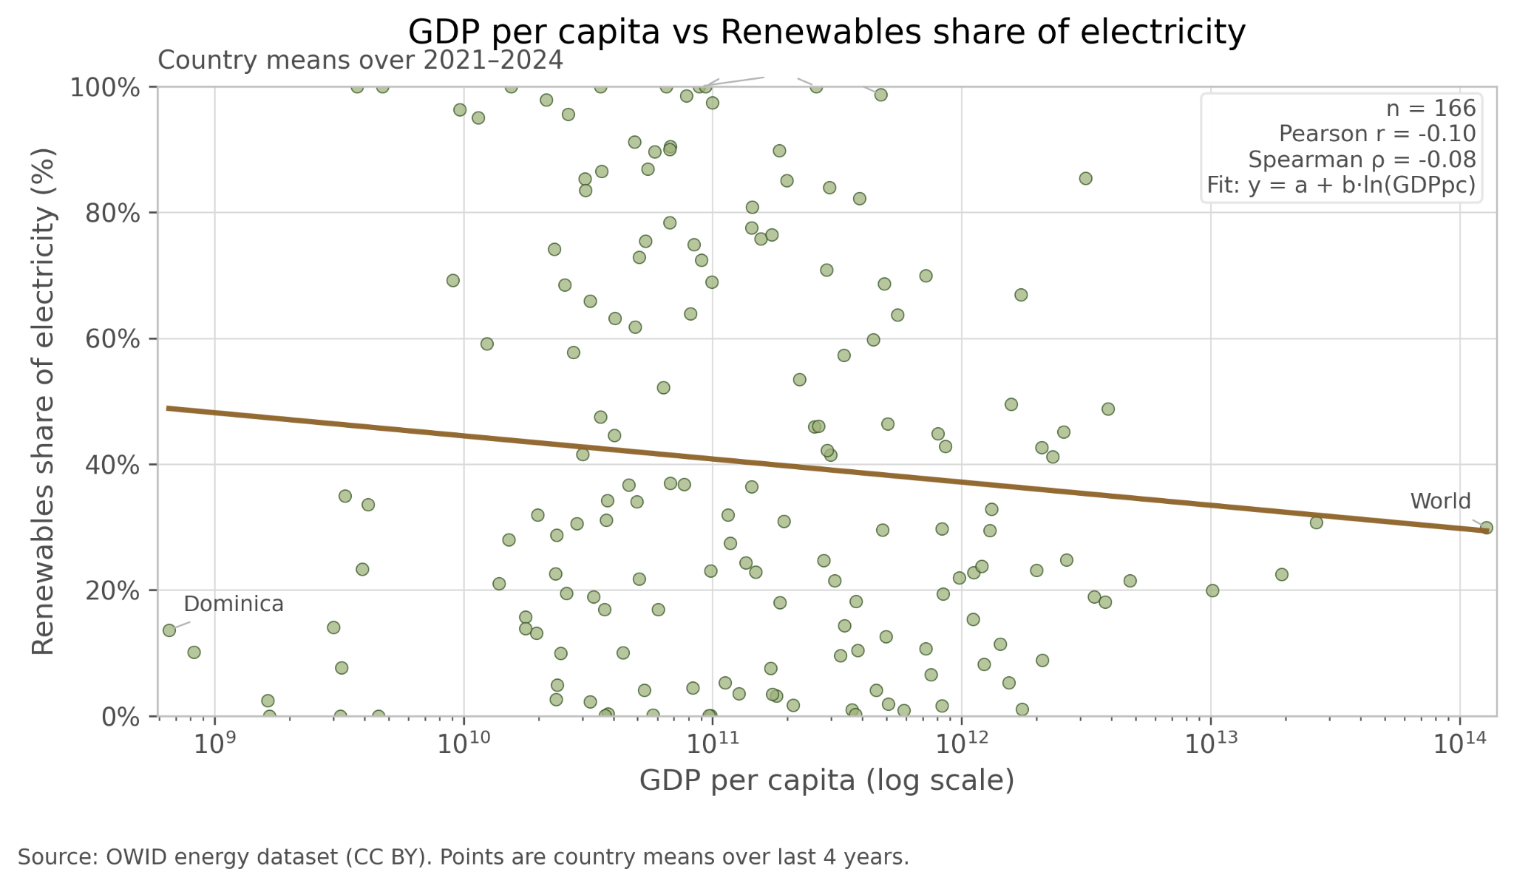
Is wealth associated with renewables? (recent years)
We find only a weak relationship: high-renewables countries exist at many income levels.

Slide 19
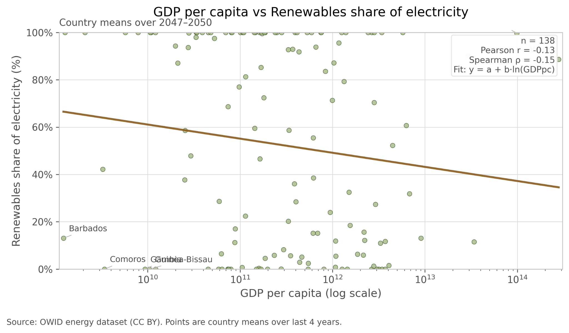
Projected relationship by 2050
Even in the forecast, GDP alone does not explain renewable adoption.

Slide 20
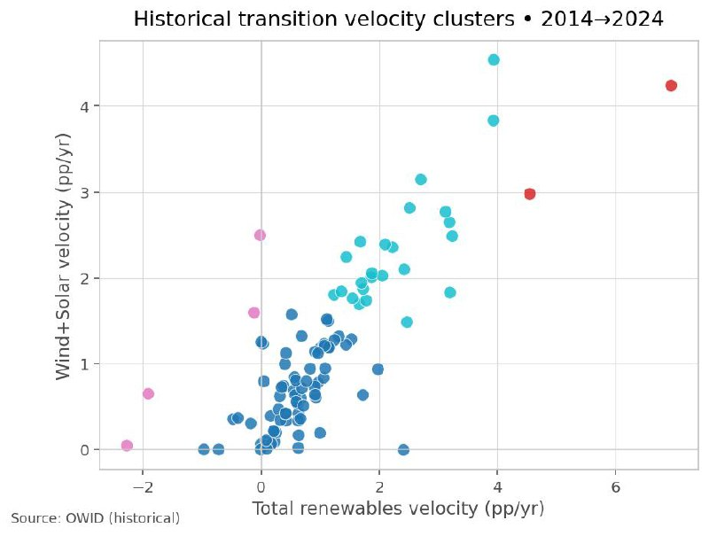
Clustering by transition speed (2014–2024)
We identify groups from slow movers to fast transitioners, driven mostly by wind+solar.

Slide 21
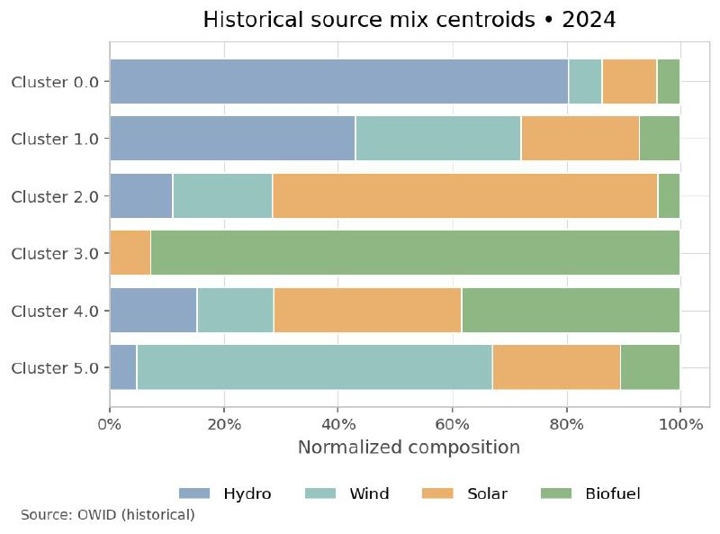
Clustering by transition speed (2014–2024)
We identify groups from slow movers to fast transitioners, driven mostly by wind+solar.

Slide 22
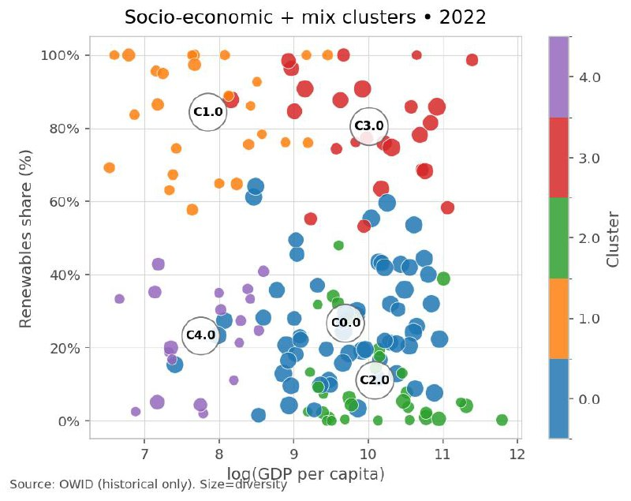
Socio-economic + mix clustering (2022)
Clusters separate both by renewable share and by income level, with different diversity profiles.

Slide 23
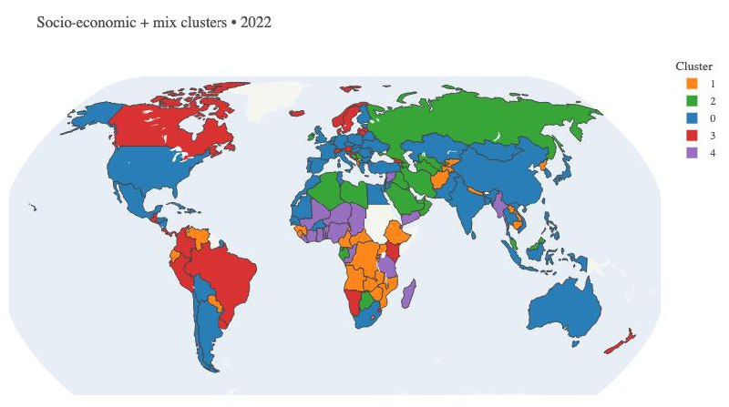
Socio-economic + mix clustering (2022)
Clusters are geographically structured: similar mixes often appear in the same regions.

Slide 24
Thank you!

