Slide 1






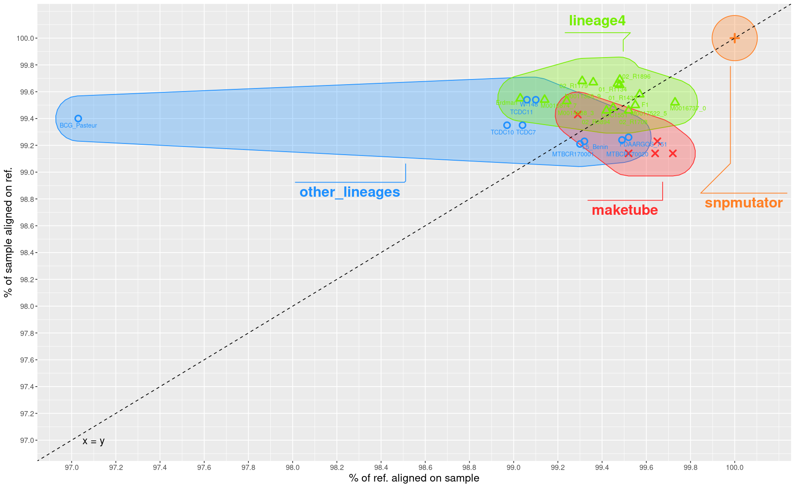
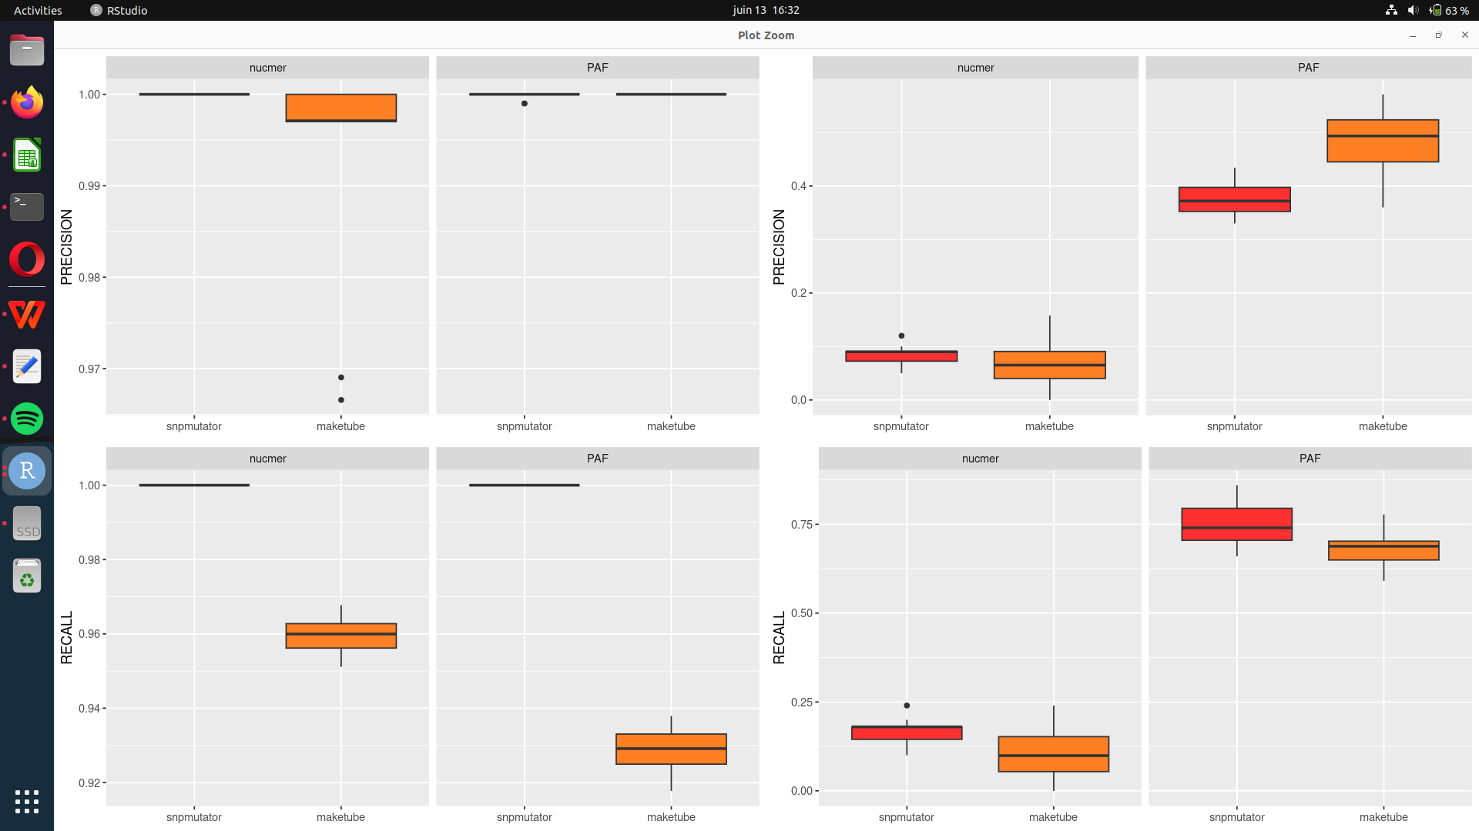
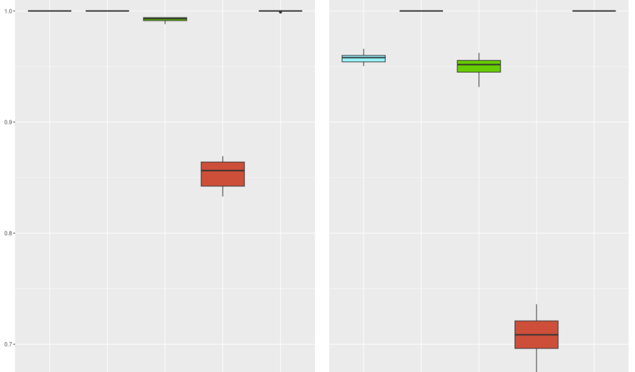
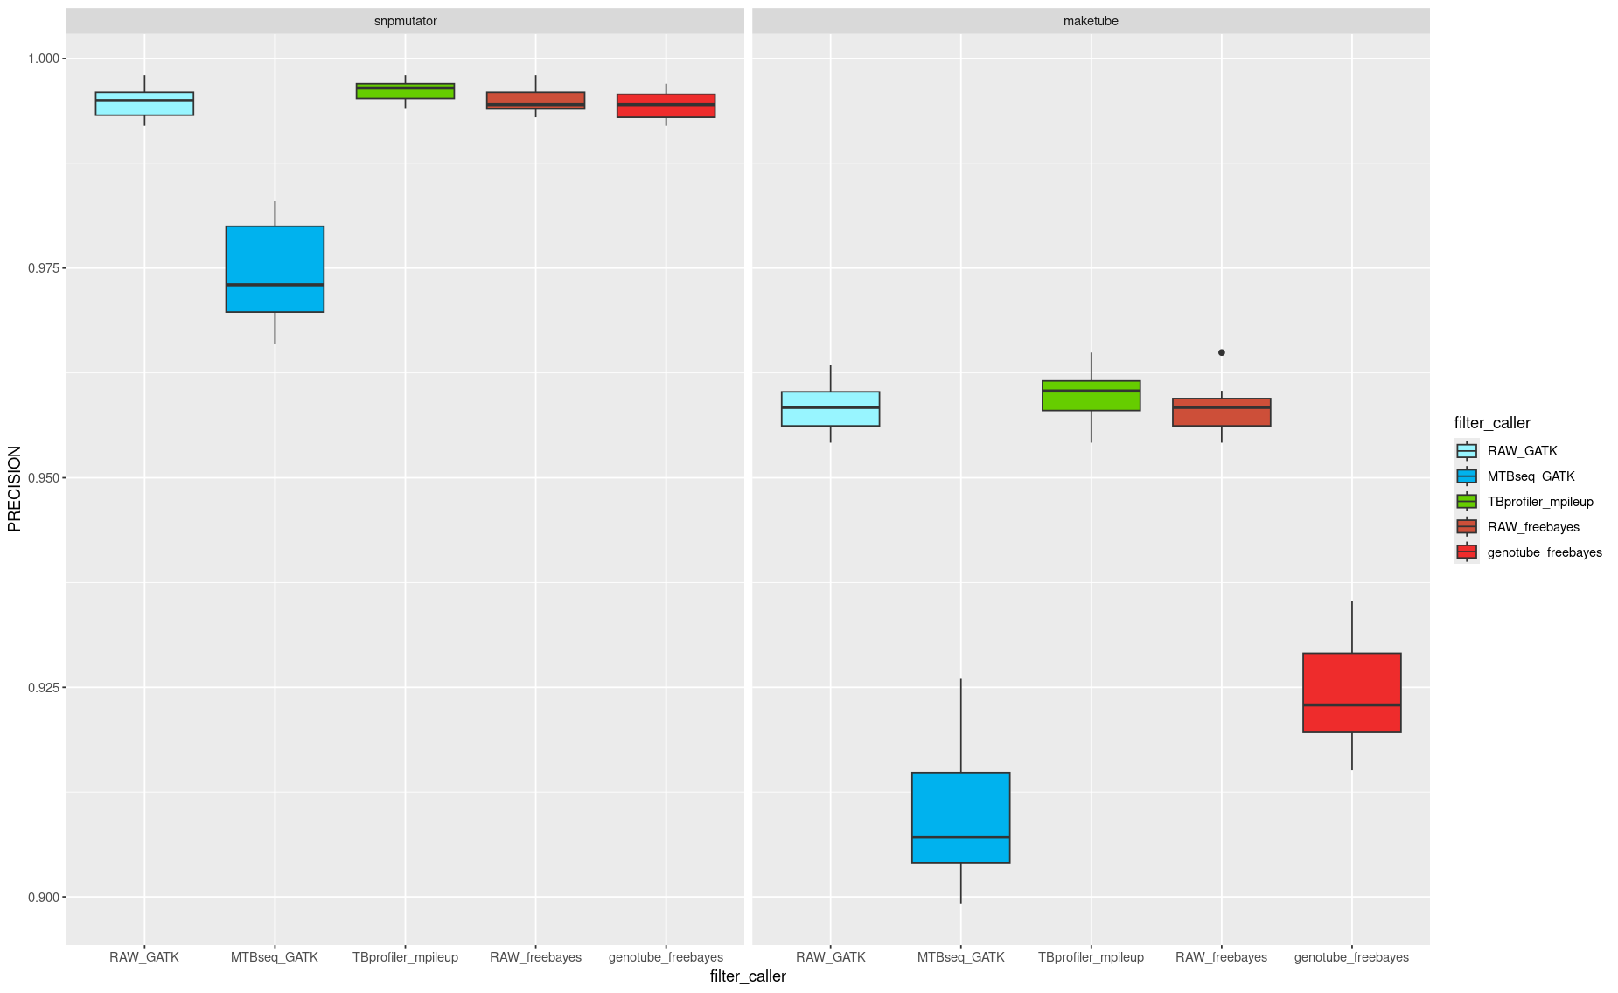
A systematic evaluation of tools and benchmarks used for short read sequencing of Mycobacterium tuberculosis using genome evolved in silico
Adrien Le Meur¹, Guislaine Refregier¹
Introduction : The evaluation of tools and methods (or benchmark) is an important step in the validation of bioinformatics protocoles. Regarding Mycobacterium tuberculosis, researchers and clinicians are interested in identifying as many variants as possible while limiting the number of false positives. The most common, completely in silico, way of evaluating the performance of variant calling strategies is adding variants (SNP and indels) to the reference genome, generate short reads, align these reads on the same reference genome, and count the number of variant recovered. As such the test genome is extremely close to the reference genome. In reality, the distance between a contemporary genome of M. tuberculosis and the reference strain H37Rv is greater, as both genome underwent parrallel, independent evolution. In M. tuberculosis, these evolutionnary events have been extensively studied and catalogued. Here we describe maketube, a tool designed to mimick the evolution of M. tuberculosis from natural data. We show that these genomes are much closer to real natural genome, while retaining the cost effectiveness of in silico genomes. We compared maketube genomes to genomes with only SNP and indels generated with SNP mutator as a controle. We first compared the distance to the reference from these artificial genome with a large set of real natural genomes of different lineages. Then, we compared the metrics given by SNP mutator and maketube genomes for genome wide aligner used for extracting variant from natural genomes. At last, we evaluated the performance of three different strategies used for calling variant in M. tuberculosis.
Material & method
Experimental design
Maketube
Description of Maketube
M. tuberculosis
assembly
SNP mutator
Reference genome
IS6110
FASTA
FASTA
FASTA
Pseudo-evolution
Backtrack
nucmer
art-illumina
Benchmark genome
IS6110
FASTQ
Moving regions
Region equivalence
Nucmer
Minimap
bwa-mem
Transposon Jump
Bordering regions of interest
BAM
Deleted regions
IS scar
mpileup
+ filter
Freebayes
+ filter
GATK
+ filter
Deletion Region
Deletion scar
Regions with no equivalence
IS-disrupted region
A
Pairwise ANI
B
Genome alignement performance
C
Variant calling performance
Duplication Region
Short variant
Equivalent on the reference
Non-homologuous regions
Short variant with no equivalent
All IS6110 were moved once across the genome
Deletion size and number were chosen from a gamma distribution inspired from
Non-homologuous regions are taken from a pool of 31-mer found in the 20 natural genomes but not in H37Rv
A large portion of 350kbp is duplicated and inserted at the end of the newly constructed genome
Dataset of 20 natural genome built from long read + short read polishing or Sanger (A)
20 maketube genomes from 5 independant run (A, B, C)
20 SNP mutator genomes from 5 independant run (A, B, C)
Results
A. The ANI from maketube genomes to H37Rv is similar to natural genomes
B. Maketube genomes can help compare genome wide aligners
A
Nucmer Minimap
B
Nucmer Minimap
Precision
Recall
SNP mutator
Maketube
SNP mutator
Maketube
SNP mutator
Maketube
SNP mutator
Maketube
Near perfect precision and recall of nucmer and minimap2 for finding SNP in SNP mutator genomes
Performance drop for maketube genome & especially recall (1 > 0.94)
Genome wide aligners miss a significant number of variants
SNP mutator genomes have almost 100% identity with the reference with no diversity
Maketube genomes are more distant to the reference (equivalent to real genomes)
C. Maketube genomes give more insightful performance metrics to distinguish variant callers
A
SNP mutator
maketube
B
SNP mutator
maketube
The most conservative strategy is MTBseq (GATK)
The less conservative strategy is TBprofiler (mpileup)
The middle ground with the best precision is Genotube (freebayes)
Precision
Recall
GATK (unfiltered call)
MTBseq (GATK)
TBprofiler (mpileup)
Freebayes (unfiltered call)
Genotube (freebayes)
Discussion
What is next :
Study the performance of variant calling in the vicinity of structural variants
Compare a more tools
Maketube genomes retain the cost effectiveness of in silico generated genomes
Like natural genomes, these genome underwent several structural rearrangement
Their genetic distance to the reference and their diversity is closer to real genomes
They provide insightful metrics for the evaluation of bioinformatics tools
TBprofiler variant strategy captures more variant to the cost of a few false positives
Genotube variant strategy have the best precision to the cost of a few false negative
Although they are more complex, genome built with maketube are still simplistic representation
Some features such as region of duplication are rare and only appear in a few sublineages
1 Université Paris-Saclay–AgroParisTech, Gif-sur-Yvette, France
This work was supported by the French Bioinformatics Society (SFBI)
Contact information :
Adrien Le Meur : adrien.le-meur@universite-paris-saclay.fr
Guislaine Refrégier : guislaine.refregier@universite-paris-saclay.fr

