Slide 1
Index
ADT's:
      Stack
      Queue
UML diagrams:
      Use cases
      Classes
Program's functionality

Slide 2
ADT's: Stack
Stack
Top

Slide 3
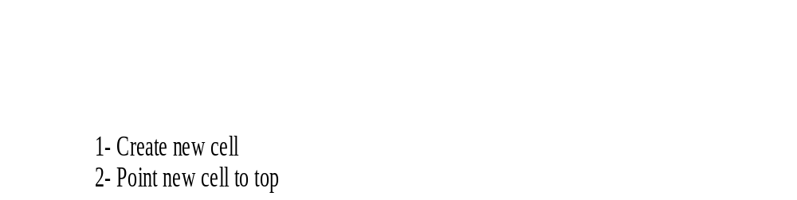
Push operation
1
2
Top
3
Pop operation
4
aux
Top
1- Create aux pointing to top
2- Change top
3- Get aux value
4- Dispose aux
5- Return aux value
1
3
2

Slide 4
Makenull operation
Top
Empty operation
true
Yes
Top equals NULL?
false

Slide 5
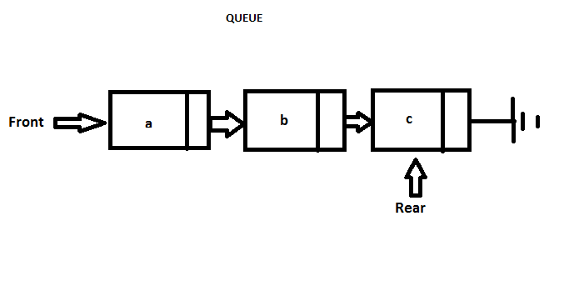
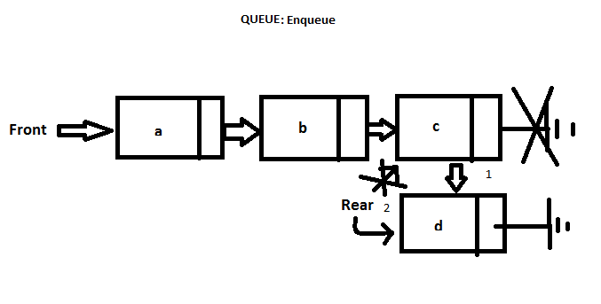
ADT's: Queue

Slide 6
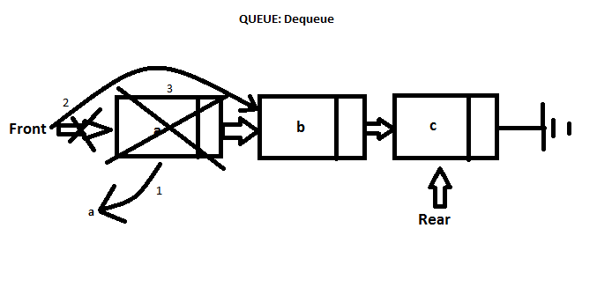
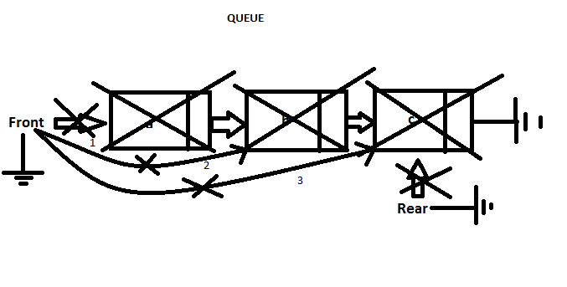

Slide 7
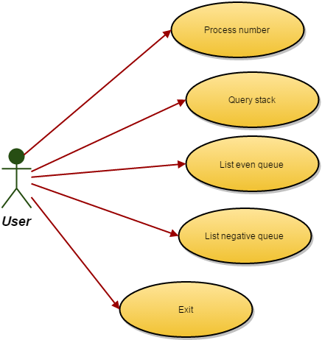
UML: Use cases diagram

Slide 8
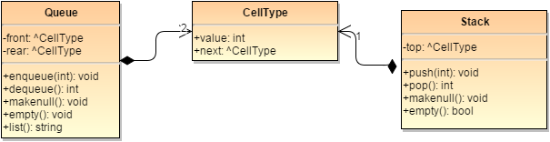
UML: Classes diagram

Slide 9
