Slide 1
Index
ADT's:
      DList
      DCList
UML diagrams:
      Use cases
      Classes
Program's functionality
Running times

Slide 2
ADT's: DList
spec DLIST[NATURAL]
genres dlist, position, natural
operations
insert: dlist position natural -> dlist
extract: dlist postion -> natural
swap: dlist -> dlist
empty: dlist -> boolean
makenull: dlist -> dlist
list: dlist -> string
cut: dlist position -> dlist
locate: dlist natural -> position
endspec

Slide 3
Doubly-linked list
Head
Last
Swapped :Boolean

Slide 4
Insert
1)If Swapped == False
Last
Head
4
2
1
3
1)Allocate new cell
2)Make Last cell pointer next point to new cell
3)Make new cell pointer previous point to Last cell
4)Make Last point to the new cell

Slide 5
2) If Swapped == true
Head
1
2
Last
3
2
3
1)Allocate new cell
2)Make new cell next pointer point to the next pointer of head and new cell previous pointer point to head.
3)Make new cell point to next pointer of head, and make next pointer of head point to new cell

Slide 6
Extract
1)If Swapped ==True
Head
Aux
1
2
Last
4
3
1- Create Aux pointer, pointing to Head.
2- Change Head
3- Make new first element previous pointer point to NULL
4- Return Aux and dispose it.

Slide 7
2) If swapped == False
Last
1
Aux
Head
2
3
4
1) Cre Aux pointer, pointing to Last
2) Change Last
3) Make new Last next pointer point to NULL
4) Return Aux and dispose it.

Slide 8
Makenull
Head
1
Last
1) Perform extract until Empty()
Empty
Yes
Head and Last == NULL?
No

Slide 9
ADT's: DCList
spec DCLIST[NATURAL]
genres dclist, position, natural
operations
insert: dclist position natural -> dclist
extract: dclist position -> natural
swap: dclist -> dclist
makenull: dclist -> dclist
list: dclist -> string
cut: dclist position -> dclist
locate: dclist natural -> position
endspec

Slide 10
Doubly-linked circular list
Head
Last
Swapped :Boolean

Slide 11
Insert
1)If Swapped == False
Head
Last
4
2
3
1
1)Allocate new cell
2)Make Last cell pointer next point to new cell, and Head previous pointer point to Last
3)Make new cell pointer previous point to Last cell, and next pointer point to Head
4)Make Last point to the new cell

Slide 12
2) If Swapped == true
Head
1
2
Last
3
2
3
1)Allocate new cell
2)Make new cell next pointer point to the next pointer of head and new cell previous pointer point to head.
3)Make new cell point to next pointer of head, and make next pointer of head point to new cell

Slide 13
Extract
1)If Swapped ==True
Head
Aux
1
2
Last
4
3
1- Create Aux pointer, pointing to Head.
2- Change Head
3- Make new first element previous pointer point to NULL
4- Return Aux and dispose it.

Slide 14
2) If swapped == False
Last
1
Aux
Head
2
3
4
1) Create Aux pointer, pointing to Last
2) Change Last
3) Make new Last next pointer point to NULL
4) Return Aux and dispose it.

Slide 15
Makenull
Head
1
Last
1) Perform extract until Empty()
Empty
Yes
Head and Last == NULL?
No

Slide 16
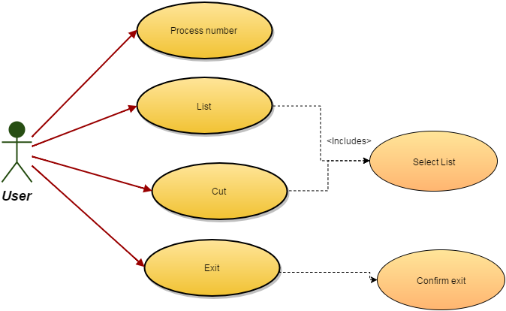
UML: Use cases diagram

Slide 17
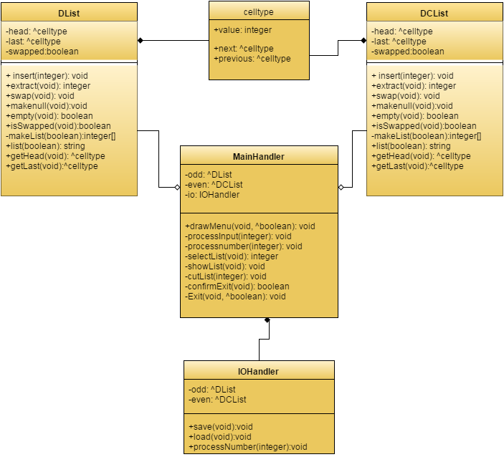
UML: Classes diagram

Slide 18
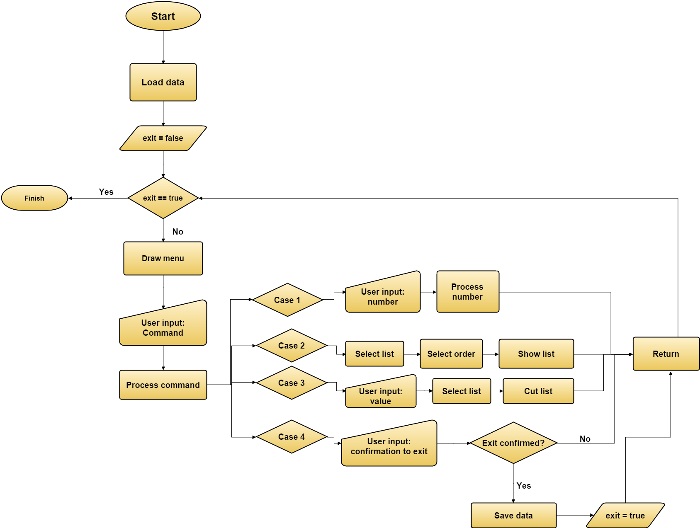

Slide 19
Running times
- celltype methods:
celltype(int, celltype*, celltype*): disjoint simple statements. O(1).
~celltype(): nothing. O(1)
int getValue(): simple statement. O(1)
celltype* getNext(): simple statement. O(1)
celltype* getPrevious(): simple statement. O(1)
void setNext(celltype*): simple statement. O(1)
void setPrevious(celltype*): simple statement. O(1)
void setValue(int): simple statement. O(1)

Slide 20
-Lists' methods:
int makeList(int*): this method has to iterate through all elements in the list. Its running time is O(N), with N being the number of elements in the list.
Dlist(): simple disjoint statements. O(1).
~Dlist(): empty. O(1).
void insert(int): simple conditionals and simple statements. O(1).
int extract(void): simple conditionals and simple statements. O(1).
void swap(void): one simple statement. O(1).
void makenull(void): this method has to iterate through all elements in the list. Its running time is O(N), with N being the number of elements in the list.
bool empty(void): one simple statement. O(1).
bool isSwapped(void): one simple statement. O(1).

Slide 21
std::string list(bool): this method uses makeList. It does not use it in nested loops, nor has any loop larger than makeList, so its running time is O(N), with N being the number of elements in the list..
void cut(int): this method uses locate (analyzed below) and may call makenull. In the worst case, its running time is O(N), with N being the number of elements in the list..
celltype* getHead(void): one simple statement. O(1).
celltype* getLast(void): one simple statement. O(1).
celltype* locate(int): in the worst case, this method has to iterate through all elements in the list. Its running time is O(N), with N being the number of elements in the list.

Slide 22
-IOHandler:
IOHandler(DList*, DCList*): disjoint simple statements. O(1).
~IOHandler(): nothing. O(1).
void save(): this method calls list in both lists. Its running time is O(N), with N being the number of elements in the largest list.
void load(): this method has to read and interpret a whole file. Its running time is O(N), with N being the length of the file.
void processNumber(int): this method is composed of simple conditionals and simple statements. It calls inserts and swap in both lists. Its running time will be O(1).

Slide 23
-mainHandler:
void processInput(int, bool*): simple conditionals, and statements of varying running time. Its running time can be O(1) or O(N), so, in the worst case, running time is O(N).
void processnumber(): simple statement. Calls IOHandler's processNumber. Its running time is O(1).
int selectList(void): simple statements and simple conditional. Running time of O(1).
bool selectOrder(void): simple statements and simple conditional. Running time of O(1).
void showList(void): calls selectList, selectOrder and corresponding's list list method. Its running time is O(N).
void cutList(int): calls selectList and corresponding list's cut method. Running time of O(N).
bool confirmExit(void): simple conditionals and statements. Its running time is O(1).

Slide 24
void Exit(bool*): calls confirmExit and IOHandler's save method. Running time of O(N).
void drawMenu(bool*): simple statements and calls processInput. Its running time can be O(1) or O(N), so, in the worst case, running time is O(N).

