Slide 1
Index
ADT's:
      BST's boxes diagram
      simpleBST
      complexBST
UML diagrams:
      Use cases
      Classes
Program's functionality
Running time of the solution

Slide 2
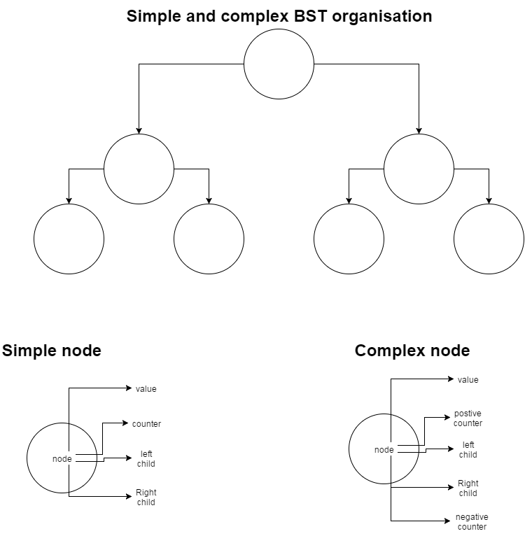
BST's boxes diagrams

Slide 3
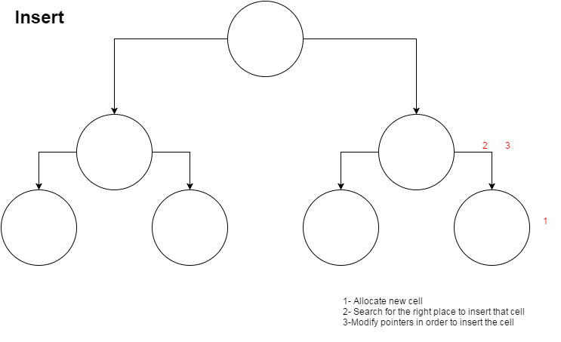

Slide 4
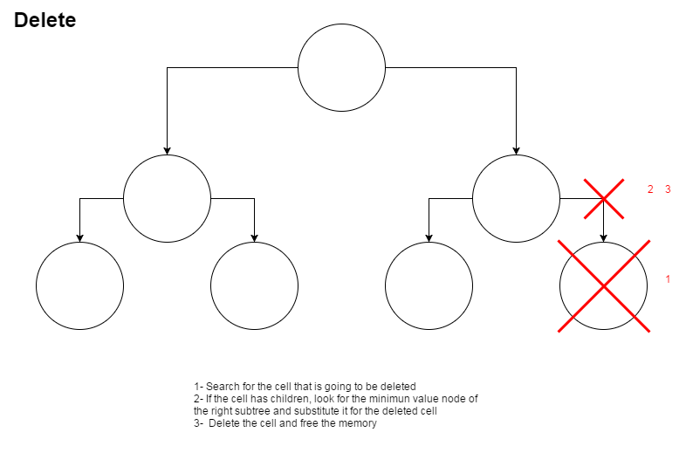

Slide 5
simpleBST
spec simpleBST
genres simpleBST, simpleNode, integer
operations
insert: simpleBST integer simpleNode -> simpleBST
delete: simpleBST integer simpleNode -> simpleBST
search: simpleBST integer -> boolean
list: simpleBST -> string
endspec

Slide 6
complexBST
spec complexBST
genres complexBST, complexNode, integer
operations
insert: complexBST integer complexNode -> complexBST
search: complexBST complexNode -> complexNode
delete: complexBST integer -> boolean
list: complexBST -> string
endspec

Slide 7
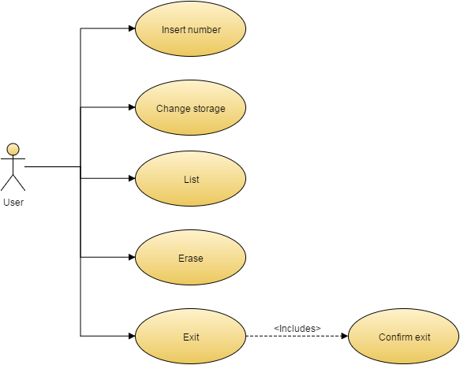
Use cases

Slide 8
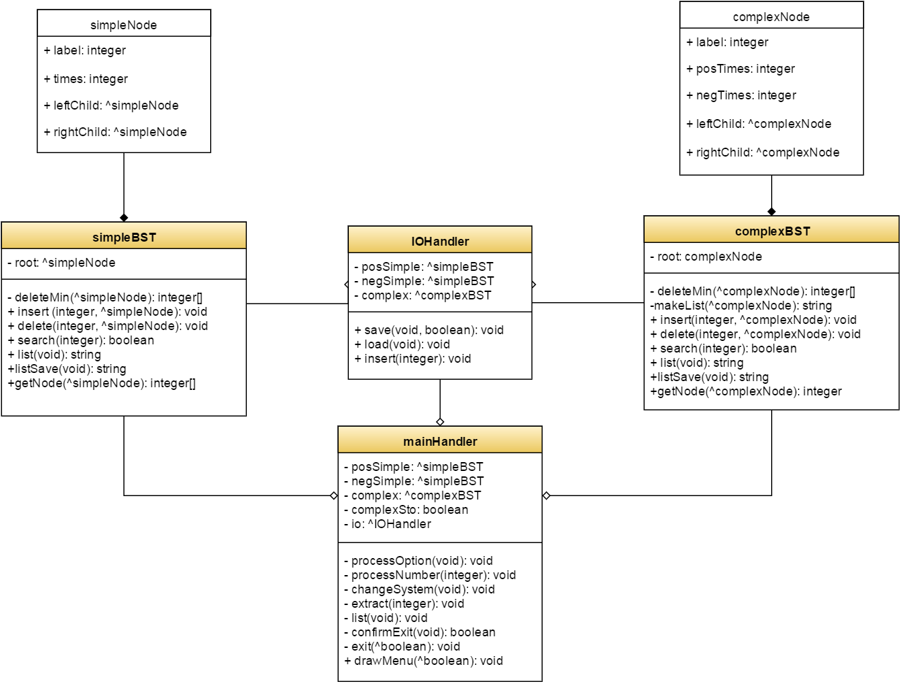
Classes

Slide 9
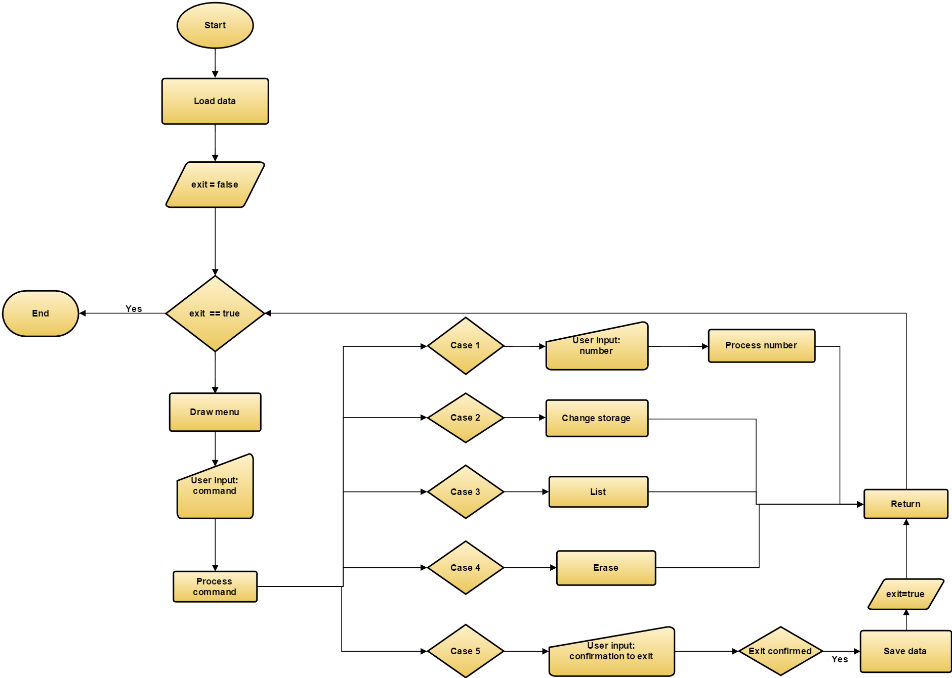

Slide 10
Running time of the solution
Most methods found on the BST's work on O(N).
Exceptions: Getters and Setters -> O(1)
From IOHandler, Save and processNumber work on O(N).
Load works on O(N^2)
From MainHandler, all methods except drawMenu, processInput, changeStorage and Exit work on O(N). These methods work on O(N^2)
The solution, as a whole, has a running time of O(N^2).

