Slide 1
OPEN-ENDED EDA PROJECT

Slide 2
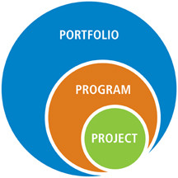
Open-Ended Project Purpose
Expose you to a realistic data analysis project prior to diving into machine learning
Implement many of the concepts you have been learning for the past weeks
Self-identify strengths, weaknesses, likes and dislikes of the process
Organize code well and prepare findings in a proper deliverable

Slide 3
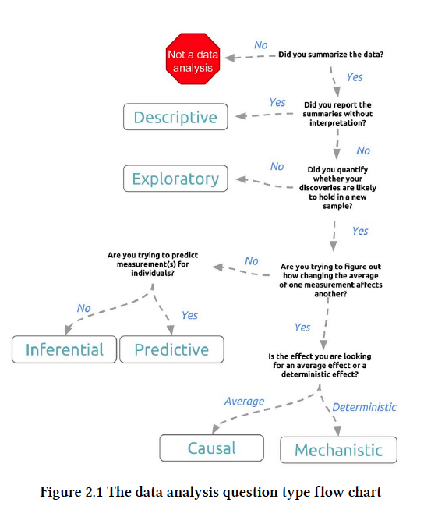
Elements of Data Analysis Project
The Question
Cleaning Data
Exploring Data
Statistical Modeling and Inference
Prediction and Machine Learning
Causality
Written Analysis
Creating Figures
Presenting Data
Reproducibility

Slide 4
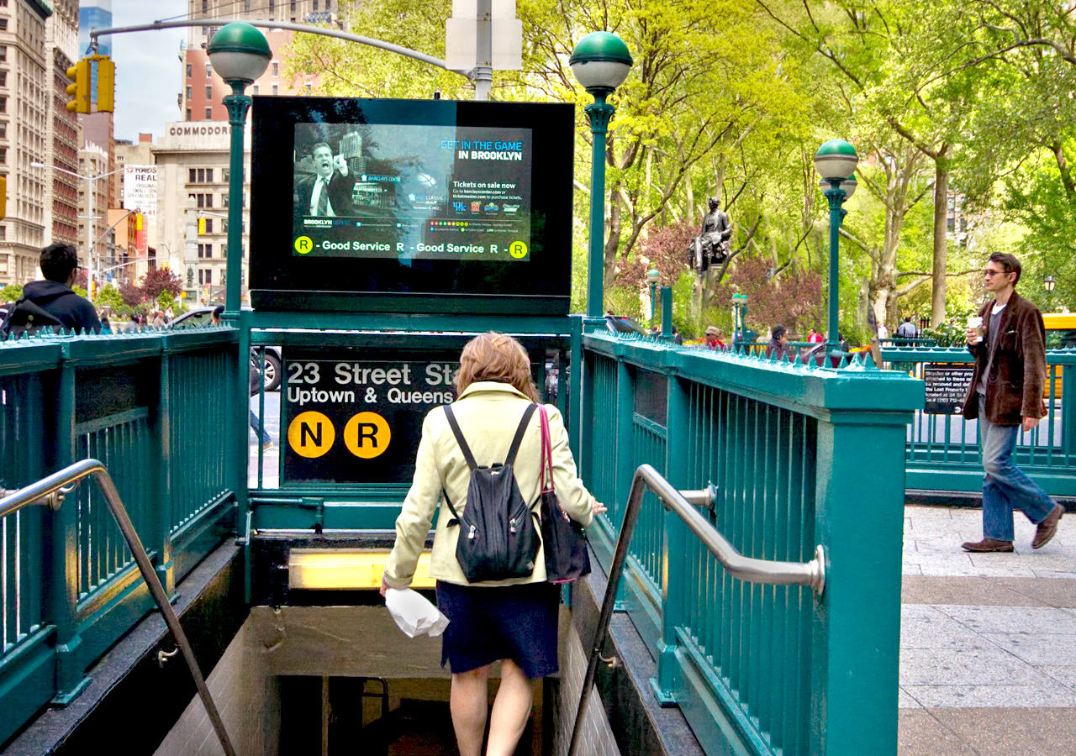
Project Prompt
Question
Using NYC MTA data, can you identify the best areas to canvas for signatures?
Background
You are working with a non-profit organization. They are trying to raise awareness about women in technology. They want you to identify the best areas to canvas during the day. They will place street teams at the entrances to various subway stations to collect email addresses. You need to help them optimize the placement of street teams.

Slide 5

EDA Project Workflow
Define Question
Get Data / Clean Data
Initial Exploration
Conduct Research
Initial Minimum Viable Project (MVP)
Refine Question
Deeper Exploration
Organize Code / Repository
Prepare Presentation

Slide 6
Project Components
“Spend Equal Time Thinking as Coding”
Jupyter Notebook or Python Scripts
GitHub Repository with README
MVP Write-Up
Final Presentation (PDF)

