Slide 1
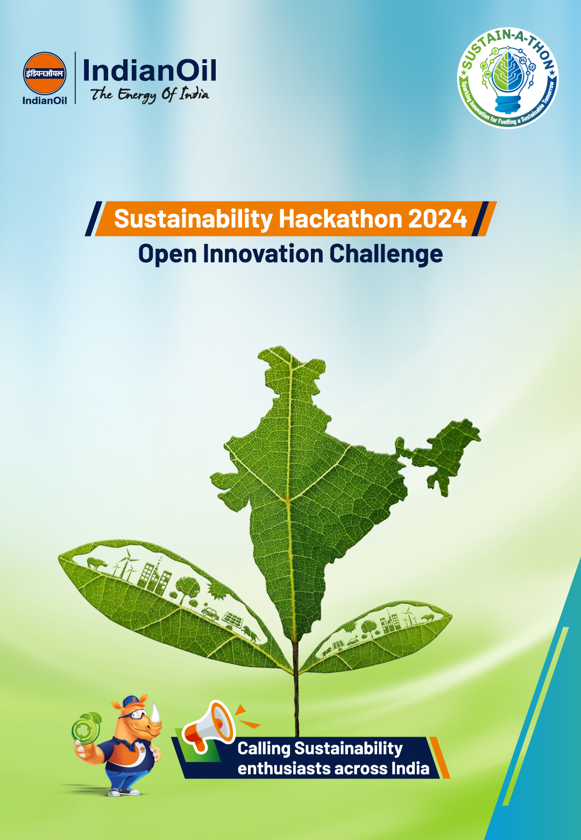

Slide 2


SUSTAIN-A-THON 2024: Round 1 Submission
Guidelines for the Executive Summary Round
Window to make your submission ends: Sunday, 28th April 2024, 11:59 PM IST. Kindly mention your Sub-Theme name in the given “Chosen Sub-Theme Name” section (in the next slide). Only one submission per Team is allowed. In case more than one entry is submitted, the team shall be disqualified and will debar participation in further rounds. Please note that you have to prepare your idea on any one of the given 19 sub-themes. Any violations of Terms & Conditions published on the official website will debar them from the Hackathon. Any drawings, concept plan or prototype details can be attached as Annexure (limit to 1 page only). You need to submit a 2-page summary in a PDF document (excluding Cover and Annexure pages) explaining their problem statement and its details. Kindly rename your submission as “Team Name_Your Name” before making your submission. Please note that you will be evaluated basis the following parameters: Technical feasibility Innovation Commercial Impact Strategy for Commercialization Business feasibility Risk Relevance to IndianOil Please make your submission in the prescribed format: Font size - 12 Font Style - Times New Roman Line Spacing - 1.5 Text alignment - Justified

Slide 3
SUSTAIN-A-THON 2024: Round 1 Submission
Energy-efficient logistics solution
1. Problem Solution/Proposition
1.Standardized book-and-claim framework (Refer to Annexure Figure 2), Digital tools to track emissions reduction from green transport choices.
Green Premium: Buyers pay extra for green transport and receive credits. Credits can be used by: Asset owners to claim lower direct emissions (Scope 1) & Others in the supply chain (forwarders, shippers, consumers) to claim lower indirect emissions (Scope 3) associated with transportation. Credit Reliability: Credits are backed by trusted industry sources. Premium Flow: The green premium increases as it moves up the supply chain. It's reinvested to: Increase access to green transport options, Lower the cost of green transport, Fund "insetting" projects that directly reduce emissions within the transport sector.
2. Green supply-chain demand coalitions (Refer to Annexure Figure 3) : Aggregate and amplify demand for green transportation options. Promote insetting, Engagement and education, Demand scaling. These would create a positive cycle (Refer to Annexure Figure 1). For additional steps that can be taken by Shipper and Carriers refer to Annexure.
Road Freight: Fleet Mix: 1. Gradually replace ICEs with HEVs and BEV & Prioritize decarbonization for heavy trucks. 2. Adopt PHEVs as a mid-term solution:, to facilitate the transition towards a decarbonized pathway for light trucks. Fuel Mix and CO2 Emissions: 1. Transition to electricity and hydrogen as key fuels 2. Promote the adoption of ZEVs, leading to a 36% reduction in CO2 emissions by 2050. Operational Parameters: Improve cargo capacity and recharging time: This can increase the adoption of BEVs and reduce the total number of vehicles needed to meet demand. Policy Instruments: 1. Introduce carbon budget constraints to accelerate the transition to ZEVs and reduce emissions. 2. Offer incentives that target operational expenditure parameters to promote the adoption of ZEVs. 3. Early adoption of ZEVs can prevent lock-in effects and achieve cumulative emissions reductions.
AUGMECON is a model to optimize India's petroleum supply chain. It considers costs, profits, and the environment by factoring in refineries, products, and transportation. It uses mathematical formulas to find the best strategies and balance efficiency, profit, & reducing pollution. We can optimize the model by combining them into a single objective function, utilizing existing optimization software, running simulations with different weights & analysing the output for cost-saving opportunities.(Annexure)

Slide 4
SUSTAIN-A-THON 2024: Round 1 Submission
2. Strategy for Business Development
Unlocking a New Market Opportunity: By investing in green energy, IOC can capitalize on the emerging market segment of alternative fuels, including biofuels, hydrogen, ethanol-blended fuels, and electricity. As the energy landscape continues to evolve, this strategic move can position IOC as a leader in the low-carbon economy by 2050, with the First mover advantage. Future-proofing: The world is moving towards electrification and cleaner fuels. By investing in these areas is utmost important for IOC for long-term relevance and profitability. Enhanced Brand Image: By actively promoting decarbonization, IOC can build a strong reputation as a responsible and environmentally conscious company. This can attract investors, partners, and talent who value sustainability. Improved operational efficiency: Investing in infrastructure for BEVs and hydrogen, like charging stations and refuelling points, can increase efficiency and attract customers looking for faster turnaround times. Enhanced Supply Chain Resilience: Green supply-chain coalitions facilitate collaboration among stakeholders, which can improve supply chain resilience. By working together to accelerate the adoption of green transportation options, companies can reduce dependency on fossil fuels, minimize supply chain disruptions associated with environmental issues, and ensure continuity of operations. Cost Savings: While the initial investment in green technologies and practices might be high, they can lead to significant cost savings in the long run. For example, electric vehicles have lower operating costs compared to traditional internal combustion engines. Similarly, improving operational efficiency can reduce fuel consumption and maintenance costs. Standardized book-and-claim framework: This system allows Indian Oil to earn revenue by issuing carbon credits to companies that utilize their green solutions. Green premium: Indian Oil can partner with shippers and forwarders to develop a green premium model. This allows shippers to offer eco-friendly options to their customers and Indian Oil can earn a share of the premium. Regulatory Compliance: Governments around the world are implementing stricter regulations to reduce carbon emissions. By proactively adopting green practices, Indian Oil can ensure compliance with these regulations, avoiding potential fines and penalties.

Slide 5
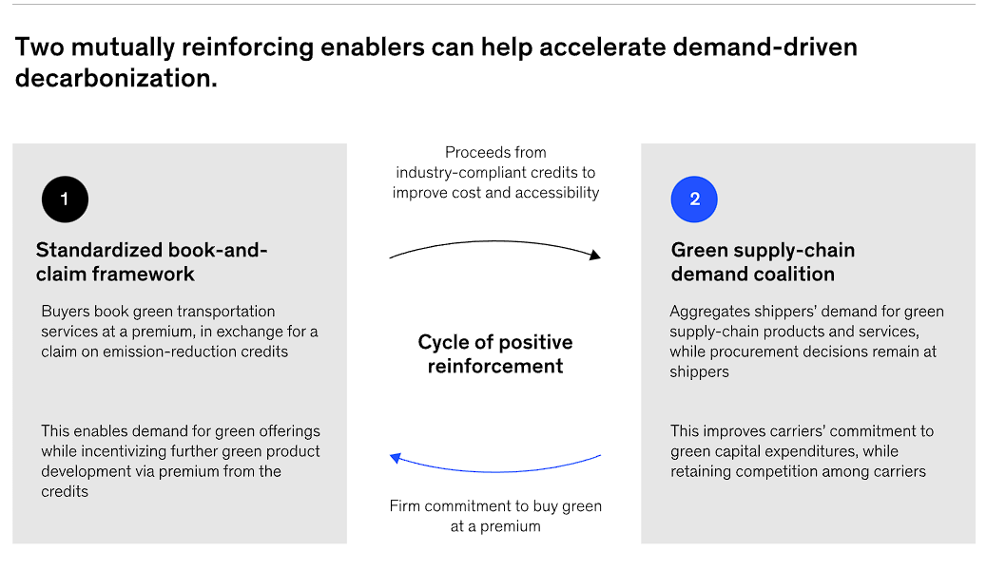
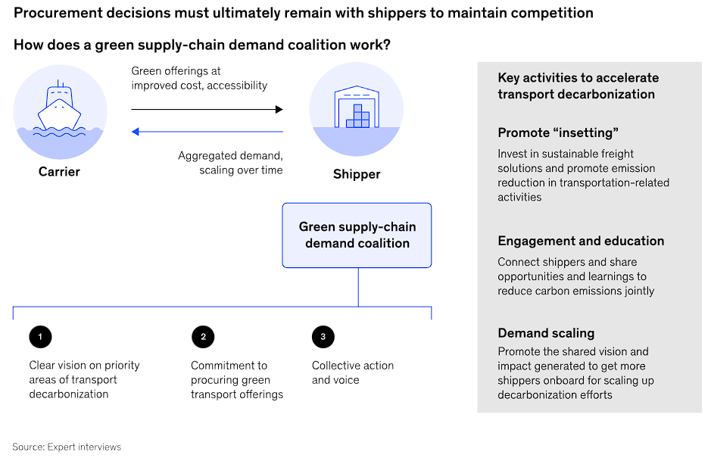
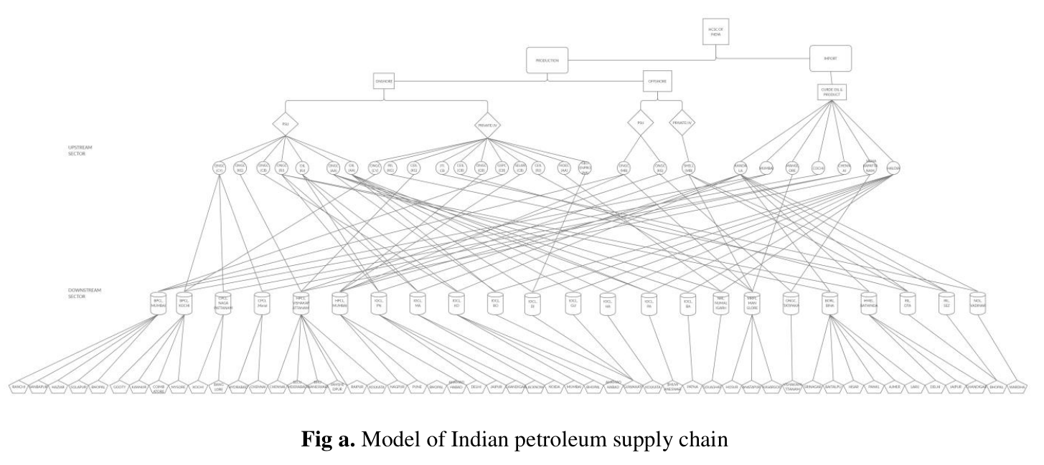
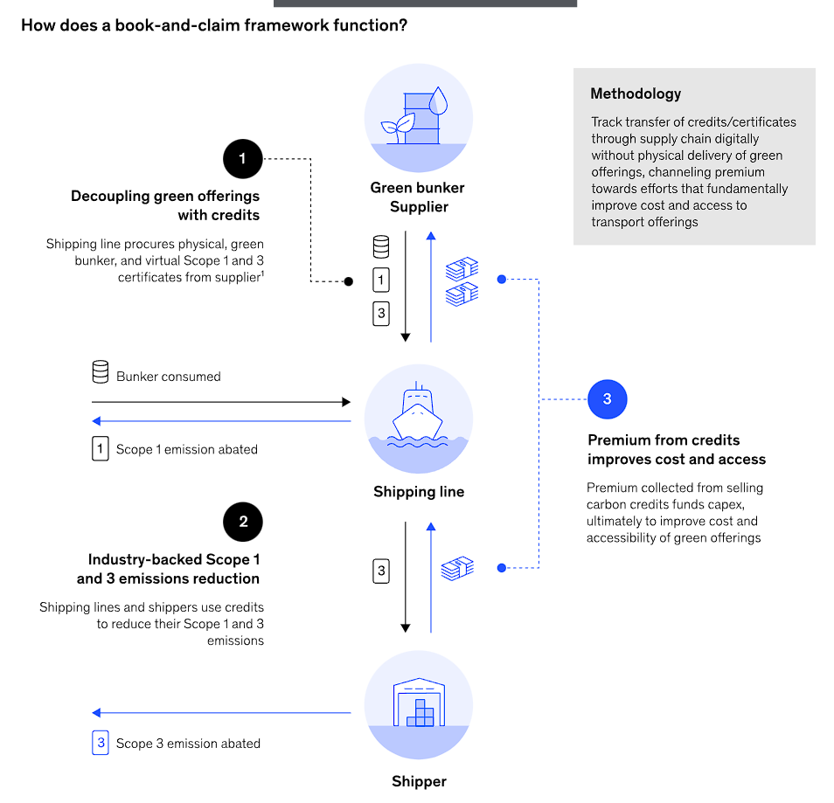
SUSTAIN-A-THON 2024: Round 1 Submission
Annexure
Figure 1
Figure 3
AUGMECON model (Janijo, K J, and Dr. Jayasree N. "Mathematical Modeling of Indian Petroleum Supply Chain." International Research Journal of Modernization in Engineering Technology and Science 2.7 (July 2020)): We have refineries (r) like IOC Digboi, IOC Haldia etc. Distribution centers (j) are in Guwahati, Mumbai, Kolkata etc. We also have crude oil supply nodes (m and n), with m representing the importing crude oil supply node (Kandala, Mumbai, Bangalore) and n representing the indigenous crude oil supply node (Cavery, Mumbai, Krishna, Godavari, etc.). We deal with different types of crude oil products (o) such as LPG, NAPHTHA, MS, ATF, SKO, and others, over a time period (t) of 1 to 6 months. The mathematical model includes the following formulas:
Minimizing Cost (F1) = (TRANSPORTATION COST + HOLDING COST + BACK-ORDERING COST + PRODUCTION COST)∑ TCorjt*Zorjt + ∑Xojt*INAojt + ∑Yojt*INSojt + ∑Wrt*PCrt –(i)
Maximizing Profit (F2) = SELLING PRICE * QUANTITY OF OIL SHIPPED FROM NODE R TO J∑SPojt * Zorjt –(ii)
Figure 2
Minimizing Environmental Impact (F3) = QUANTITY OF OIL SHIPPED FROM NODE R TO J * ENVIRONMENTAL IMPACT OF SHIPPED OIL PRODUCT + QUANTITY OF OIL PRODUCED AT NODE R * ENVIRONMENTAL IMPACT OF PRODUCED OIL PRODUCT∑Zorjt * ETorjt + ∑Wrt * EPrt–(iii)
Abbreviations:
Internal Combustion Engines (ICEs)
Hybrid Electric Vehicles (HEVs)
Battery Electric Vehicles (BEVs)
Plug-in Hybrid Electric Vehicles (PHEVs)
Zero Emission Vehicles (ZEVs)

