Slide 1
Variant Calling based on binomial distribution
School of Electrical Engineering, University of Belgrade
13M111GI Computational Genomics
Adrijana Ilić, 19/3134
Suzana Mandić, 19/3120

Slide 2
Task summary
In Python implement Variant Calling algorithm based on binomial distribution.
Algorithm should have Pileup file as an input, and file in VCF4.2 format as an output.
As test samples use merged-normal.BAM file and referent genome human_g1k_v37_decoy.fasta.

Slide 3
From DNA sequencing to Variant Calling
Human genome: 23 pairs of chromosomes, too many nucleotides
DNA sequencing, reference genome and alignment
PileUp
Variant calling is the process of finding differences between reference genome and observed sample.
We need aligned reads to the reference genome so we can find “call” variants.

Slide 4
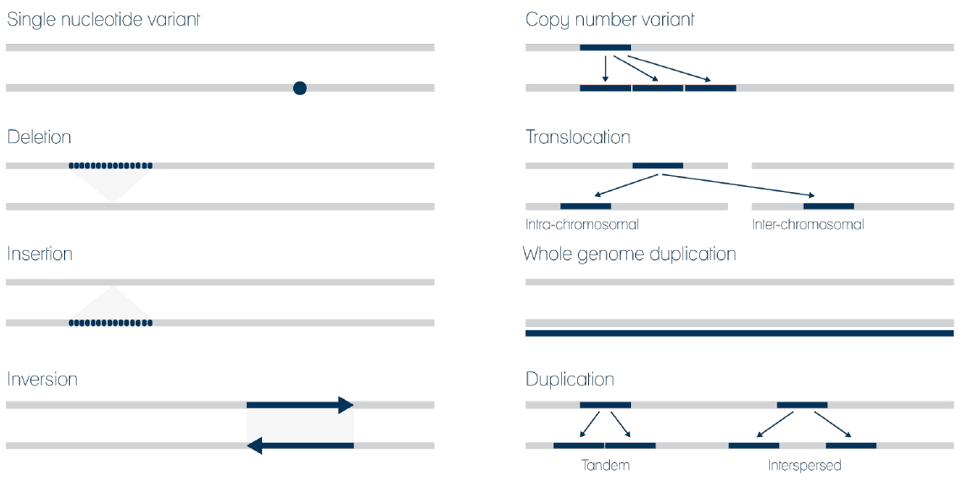
Genomic Variants

Slide 5
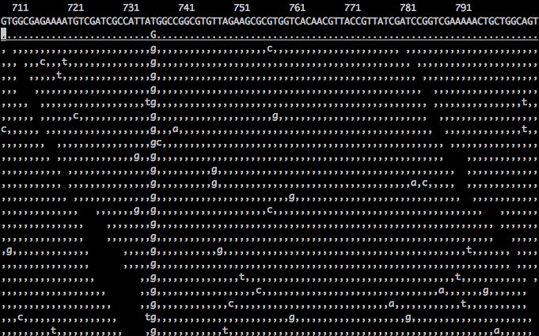
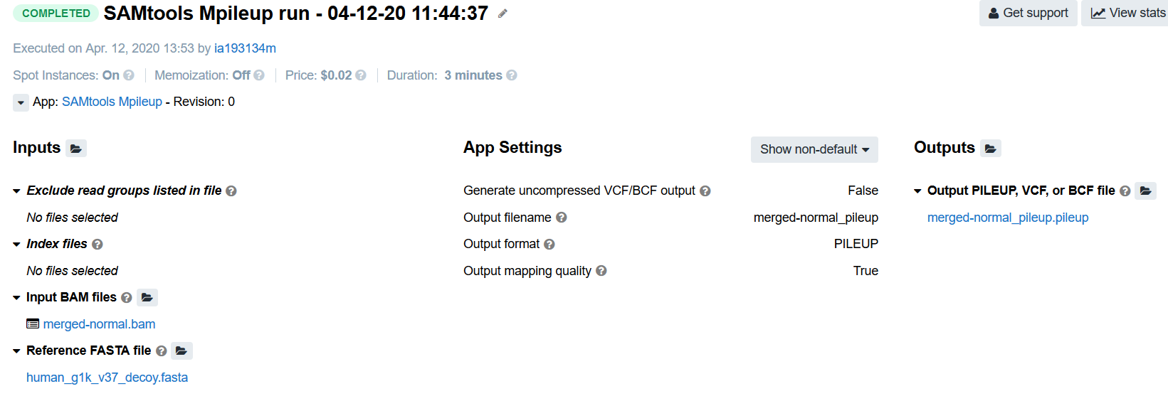
Pileup file
Pileup is the set of bases aligned to a single position on the genome.
Pileup file can be made out of a BAM file using the tool SAMtools Mpileup.

Slide 6
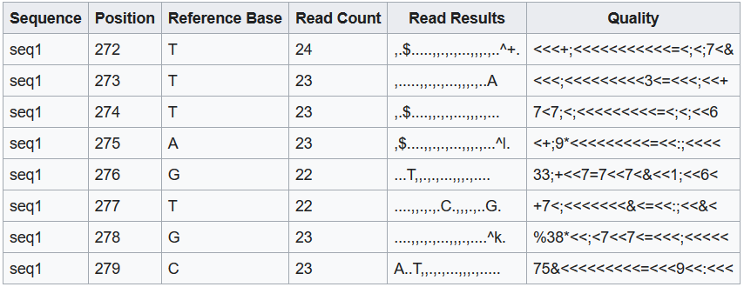
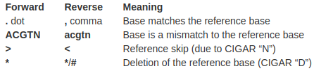
Pileup file format

Slide 7
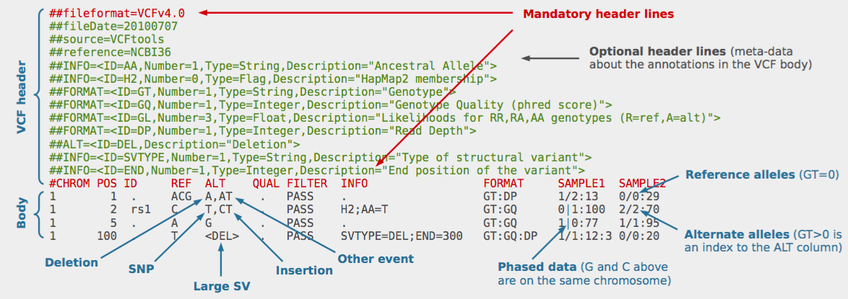
VCF file format

Slide 8
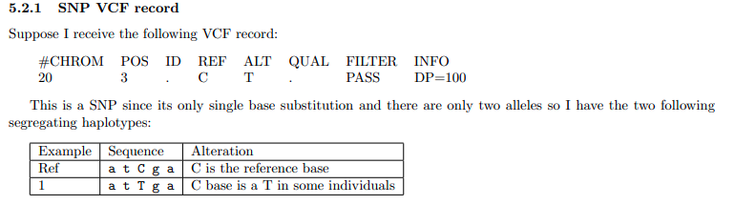
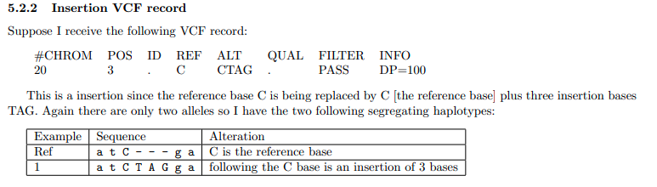
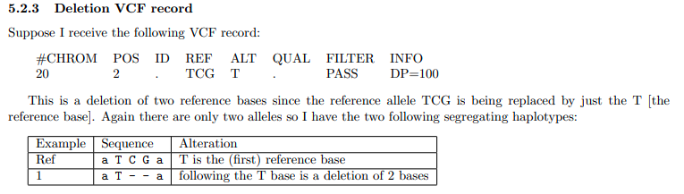
How are variants represented in VCF?

Slide 9
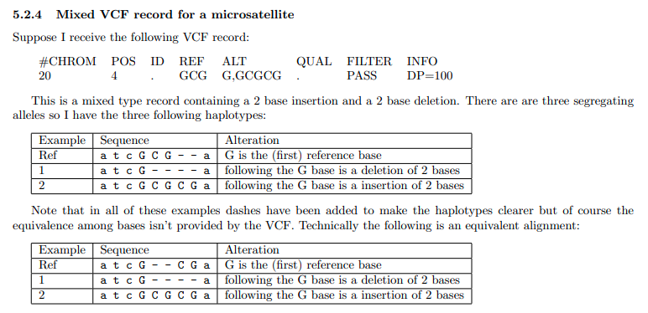
Microsatellites
A microsatellite is a tract of repetitive DNA in which certain DNA motifs (ranging in length from one to six or more base pairs) are repeated, typically 5–50 times.
These are represented differently in VCF when it comes to insertions and deletions

Slide 10
How to do variant calling?
Two possible cases:
  All of the bases in pileup are the same nucleotide [A,T,C,G]
  Different nucleotides exist in the pileup
  In the simplest case, assume diploidy. There can be only two alleles at a site.
  If there are more than two different letters in the pileup we will only consider the most common two (assume others are errors and discard them)

Slide 11
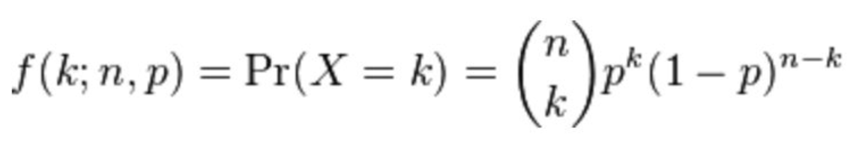
Binomial distribution
Models the number of successes in a sequence of yes/no experiments
Parameters:
  n - number of trials
  p - probability of a success in a single trial

Slide 12
Variant calling based on binomial distribution
So, when we have two letters in the pileup, what should we call?
  Let’s call the two “letters” b and b’ (b, b’ ∈ [A, C, T, G])
  Let n be the total number of bases, and k number of b’ bases
  Three possible explanations for the pileup:
    Genotype is bb; k bases are errors, n-k are correct
    Genotype is b’b’; n-k bases are errors, k are correct
    Genotype is bb’; all n bases are correct
  Now we need to find the probabilities of these three cases. Will pick the most probable one!

Slide 13
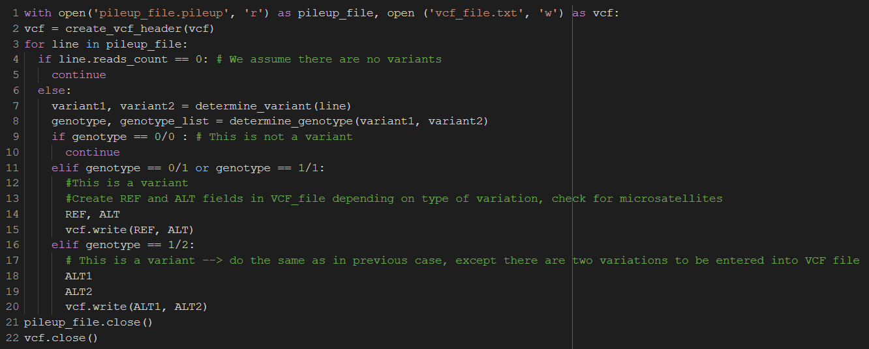
Pseudocode

Slide 14
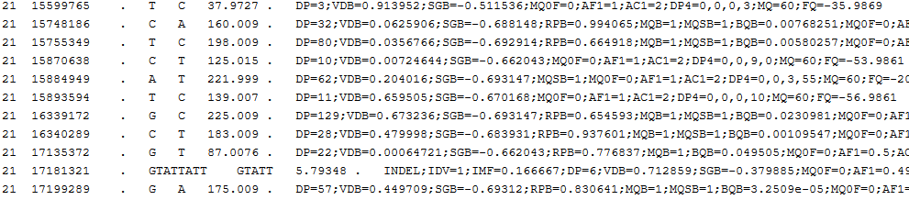
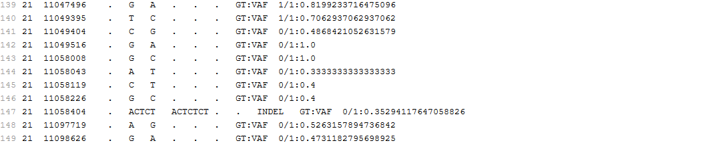
Referent and implemented VCF
Referent Variant Calling File
Implemented Variant Calling File

Slide 15
Metrics calculation
Counting TP, FP and FN in two ways:
  TP, FP and FN are determined based only on the presence of variation positions in VCF files
  TP, FP and FN are determined based both on the presence of variation positions in VCF and whether they are completely the same (REF, ALT and genotype)

Slide 16
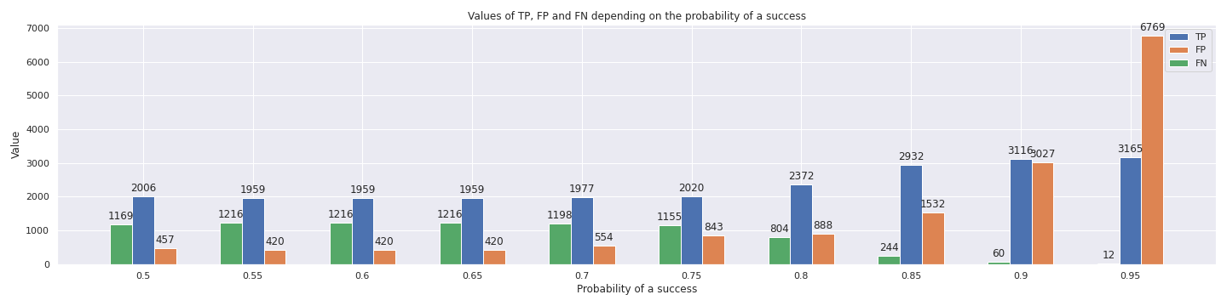
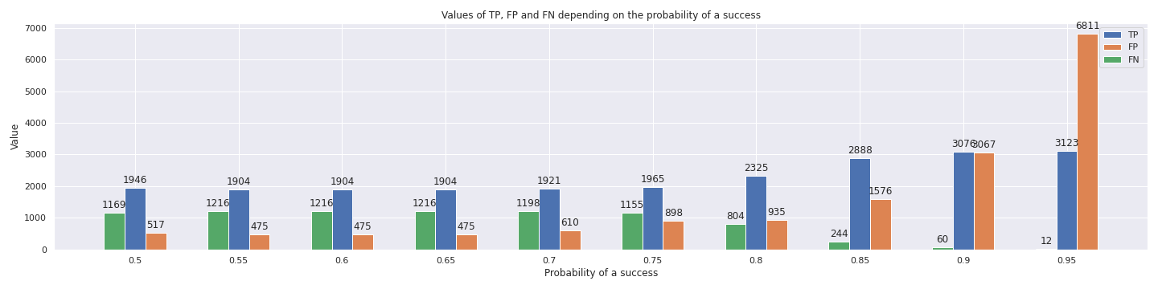
TP, FP and FN

Slide 17
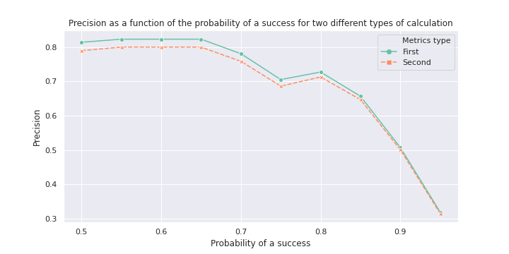
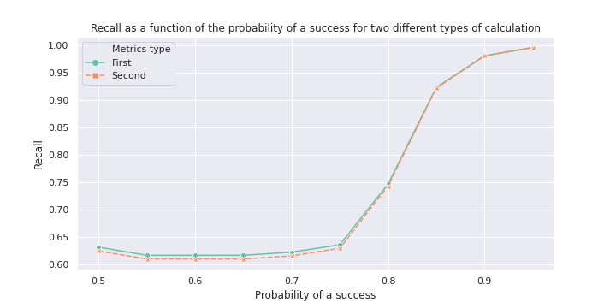
Precision and Recall

Slide 18
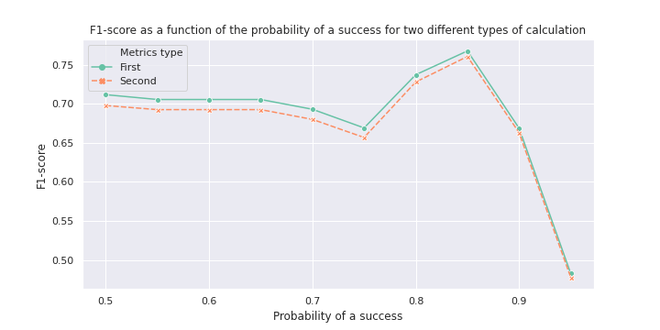
F1-score

Slide 19
Possible improvements
Taking into account mapping qualities could improve performance of our algorithm, mainly because mapping errors are a big source of errors
Taking into account base qualities - we assumed that bases are of the same quality with fixed probability of success which is not the case

Slide 20
Have questions? Send us an e-mail!
Adrijana Ilic: ia193134m@student.etf.bg.ac.rs
Suzana Mandic: ms193120m@student.etf.bg.ac.rs
Github/Adrijana: www.github.com/adrijanailic
Github/Suzana: www.github.com/SuzanaM

