Slide 1
Public Service and Governments
Group (6) Consultancy
Adrian Septiandry Sendjaja, student number: b8039737
Anna Kosheleva, student number: b7031412
Jiawen Zhou, student number: b8041005
Kingsley Ezeanochie, student number: b6039183
Tenzin Nyima Tenzin, student number: b8030432

Slide 2
Business question 2
Provide a month by month breakdown of crime types by district of Sheffield for 2015 – 2018
14 type of crimes
28 areas in Sheffield
12 months

Slide 3
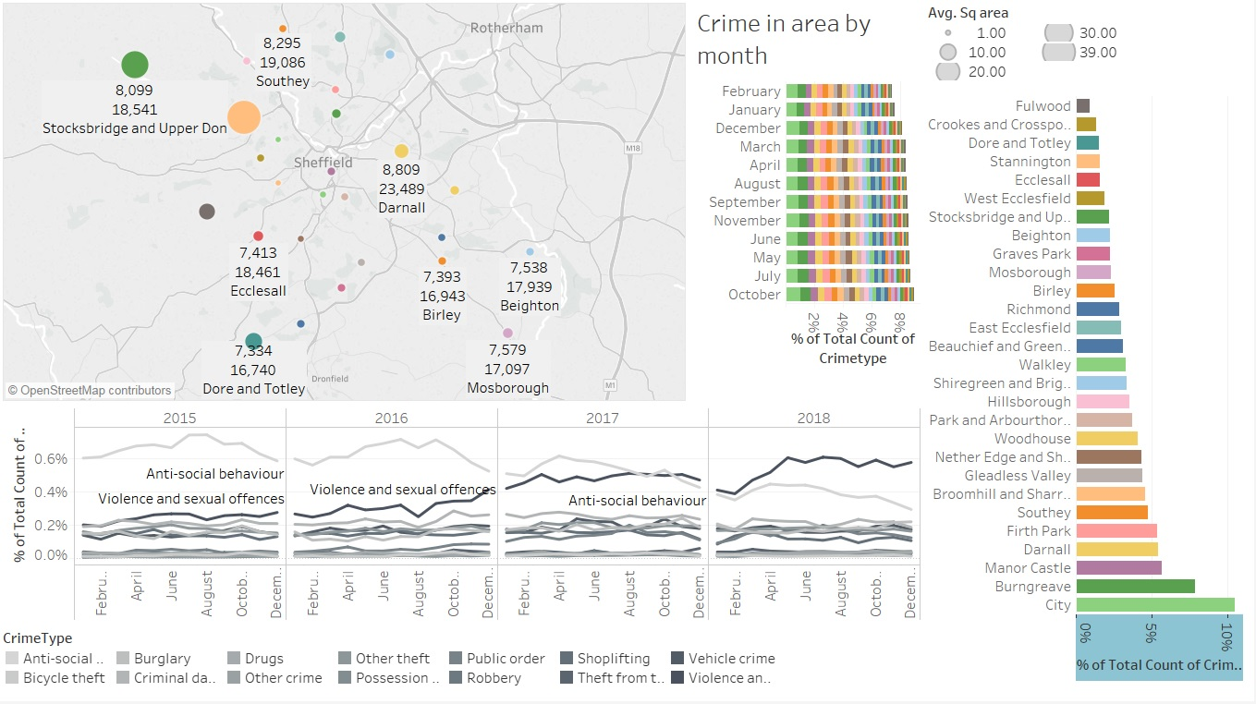
Business question 2: demographic/crime information

