Slide 1

Clemens Neudecker
How to read a million books
@pydataberlin
github.com/pydataberlin/meetup-slides

Slide 2
PyData Berlin 2017 conference 🎉
July 1.7. - 2.7. (tutorials 30.6.)
Accepted papers are out!
http://pydata.org/berlin2017/
40 accepted (acceptance rate ~42%)
Price: 200€ individual, 115€ student
Non-profit: All proceeds go to NumFocus
Keynote speakers:
Barbara Plank
Veronika Valeros
Toby Walsh

Slide 3
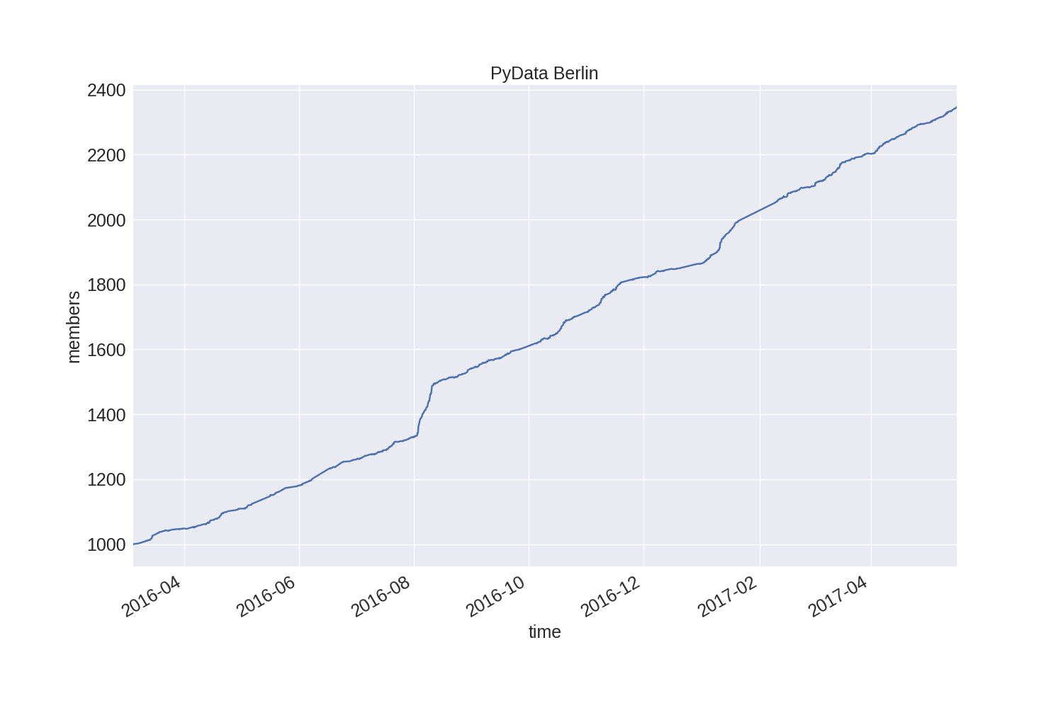

Slide 4
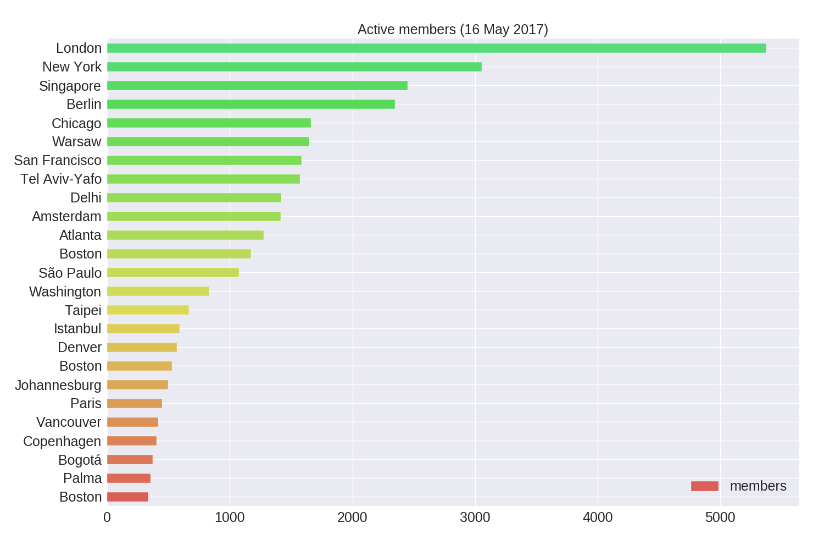

Slide 5
TODAY
Intro
Infosys
Clemens Neudecker: How to read a million books
Katarzyna Marszałek-Kowalewska: Pitch for Berlin NLP Meetup

Slide 6
Thank you all for coming, and thank you to Infosys!
@pydataberlin
github.com/pydataberlin/meetup-slides

