Slide 1
Text Preprocessing
IF6082 Pemrosesan Bahasa Alami Lanjut
Ayu Purwarianti

Slide 2
Basic Tools of NLU (Natural Language Understanding)
Lexical (word level)
Syntactic (sentence level)
Semantic (sentence level)
Pragmatic (paragraph level)

Slide 3
General Framework of NLU
John runs.
Lexical Processing
John run+s.
P-N V 3-pre
N plu
S
Syntactic Analysis
NP
VP
P-N
V
Semantic Analysis
Pred: RUN
Agent:John
John
run
Pragmatic
Processing
John is a student.
He runs.

Slide 4
Tools Dasar pada CL
Tokenisasi
Pemisahan kalimat
Stemming
Lemmatisasi
POS Tagger
Pemrosesan
Leksikal
Named Entity Tagger
Phrase Tagger
Parser
Syntactic Analysis
Semantic Analysis
Word Sense Disambiguation
Semantic Analysis
Semantic Role Labeling
reference resolution
Pemrosesan
Pragmatik

Slide 5
NLP Toolkit
NLTK
Tokenizer, POS Tagger, Named Entity Tagger, Parser, Stemming, Semantic Analyzer, Sentiment Analyzer, machine translation, text classification, clustering, collocation
OpenNLP
Sentence detection, tokenization, named entity tagger, part of speech tagger, document categorizer, chunker, parser, coreference resolution
Stanford CoreNLP
Sentence splitter, tokenization, POS tagger, lemmatization, named entity tagger, parser, coreference resolution, sentiment analysis, mention detection, open IE

Slide 6
NLTK

Slide 7
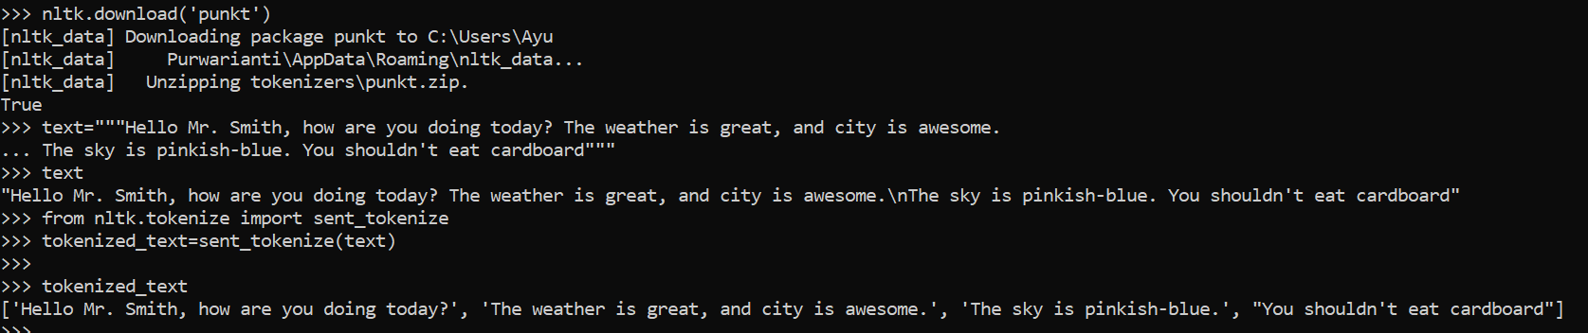
Tokenization
sent_tokenize : to split text into sentences
word_tokenize : to split text into words

Slide 8
Exercise on Tokenization
Write a program to tokenize words for each sentence in a list
Given an input of tokenized_text such as below
Make a program to give sword output such as below

Slide 9
Token, Bigram, Trigram, Ngram
Input: Hello Mr Smith, how are you doing today?
Token: Hello – Mr – Smith – , – how – are – you – doing – today – ?
Bigram: Hello Mr – Mr Smith – Smith , – , how – how are – are you – you doing – doing today – today ?
Trigram: Hello Mr Smith – Mr Smith , – Smith , how – , how are – how are you – are you doing – you doing today – doing today ?
Ngram: n can be defined

Slide 10
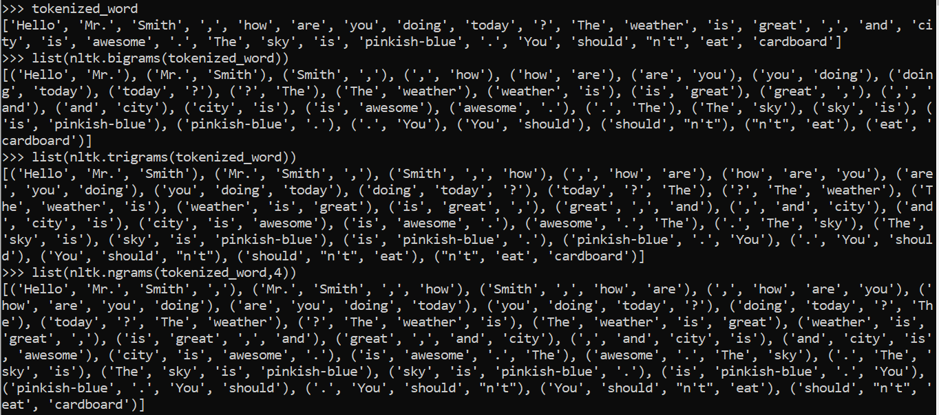

Slide 11
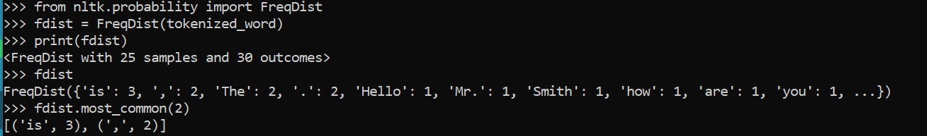
Frequency Distribution
To calculate the frequency of each word in a list of words
What if we use if for the tokenized_text ? Please try

Slide 12

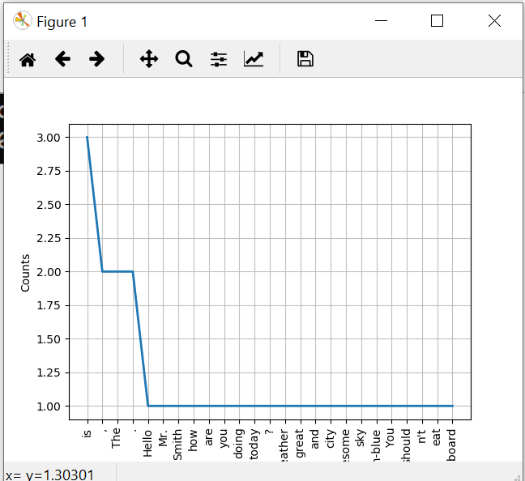
matplotlib

Slide 13
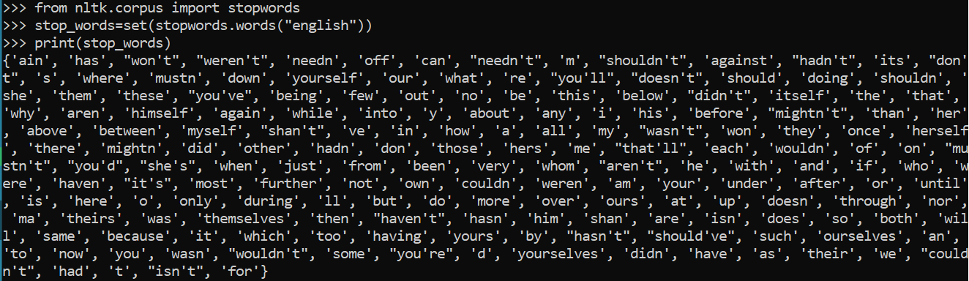
Stop words
Stop words are assumed as unimportant words in the given text, which words can’t differentiate sentences and occur in most sentences. Usually function words such as preposition or conjunction words.
Stop words for Information Retrieval might be different with the one for Sentiment Classification
Please try “indonesian”, check the word size

Slide 14
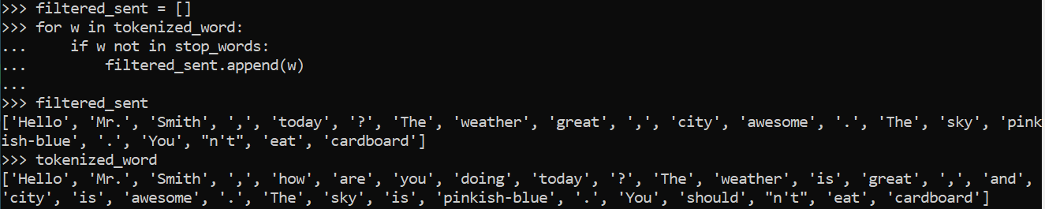
Stop words Filtering
Compare the filtered_sent and tokenized_word

Slide 15
Exercise on Stop Word Filtering
Write a program to do stop word filtering for sentences.
Given an input of tokenized_text such as below
Make a program to filter the stop word for each sentence in the list of tokenized_text and give filtered_sent2 output such as below

Slide 16
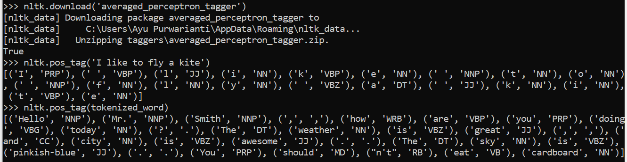
NLTK POS Tagger
POS (Part of Speech) Tagger is a tool to tag POS of each word in the input text

Slide 17
Exercise on POS Tagger
Write a program to filter words in the tokenized_text by only using POS tags of: NN, NNP, VBP, VBZ, VBG, JJ
Given input of tokenized_text such as below:
Give output such as below:

Slide 18
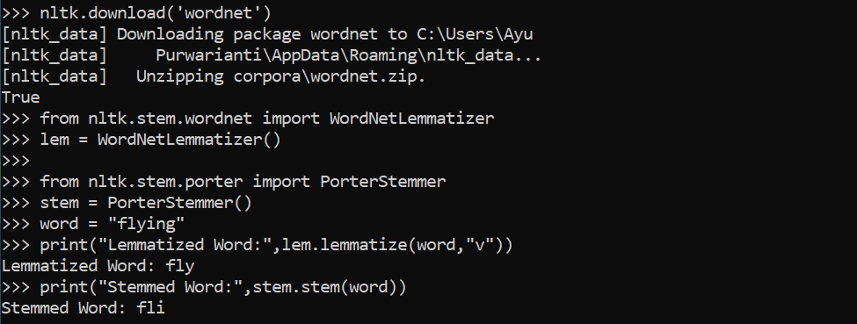
NLTK Stemmer & Lemmatizer
Lemmatizer: to lemmatize a word into its basic word form
Stemmer: to stem a word into a common form

Slide 19
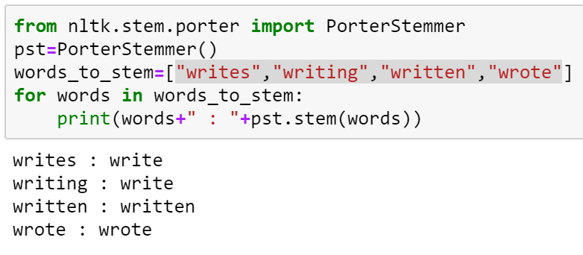
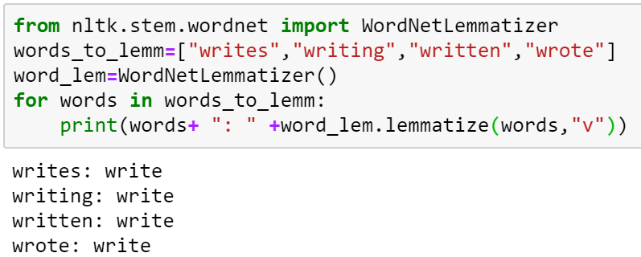

Slide 20
Flow of Text Classification Task
Preprocessing
Feature Extraction (Indexing)
Classification (Model Execution)
Input Text
(ex: email, sms)
Class labels
Word List (optional)
Classification Model

Slide 21
PreProcessing
Preprocessing
Input Text
(ex: email, sms)
List of token
Tokenization: Text is tokenized into tokens such as words, bi-grams, tri-grams, n-grams
Lemmatization: Word is lemmatized into its lemma form
Stemming: Word is stemmed into its stemmed form
Lowercase: all words are lowercased
Stopword elimination: words are filtered by a stop word list
POS Tagger and stopword elimination: conduct POS Tagger and filter words based on its POS Tag
Spelling correction: incorrect words (including informal) are corrected
Entity masking: words fulfilling certain patterns are masked

Slide 22
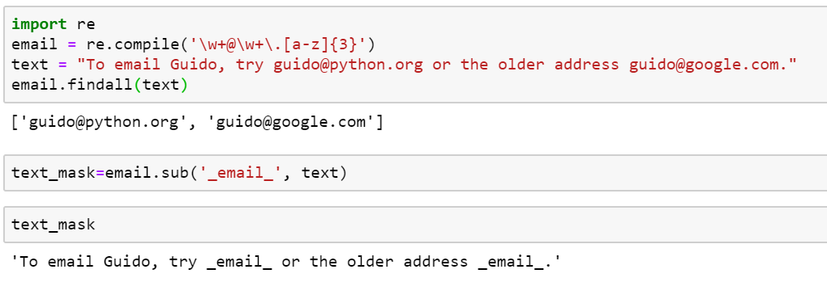
Entity Masking

Slide 23
Feature Extraction
Change word feature into number →called indexing
Example on unigram word feature for spam filtering:
INPUT: “Ini mama … tolong kirim pulsa ke nomor hp ini” (English: This is mom.. Please send balance to this phone number”
Word List: mama (mom), tolong (please), kirim (send), pulsa (balance), nomor (number), hp (phone)
Training data
Feature: unigram words
What about bigram?
Mama (mom) | Tolong (please) | Kirim (send) | Pulsa (balance) | Nomor (number) | Hp (phone) | … | Class
1 | 1 | 1 | 1 | 1 | 1 | … | Spam
1 | 0 | 0 | 0 | 0 | 0 | … | Not spam

Slide 24
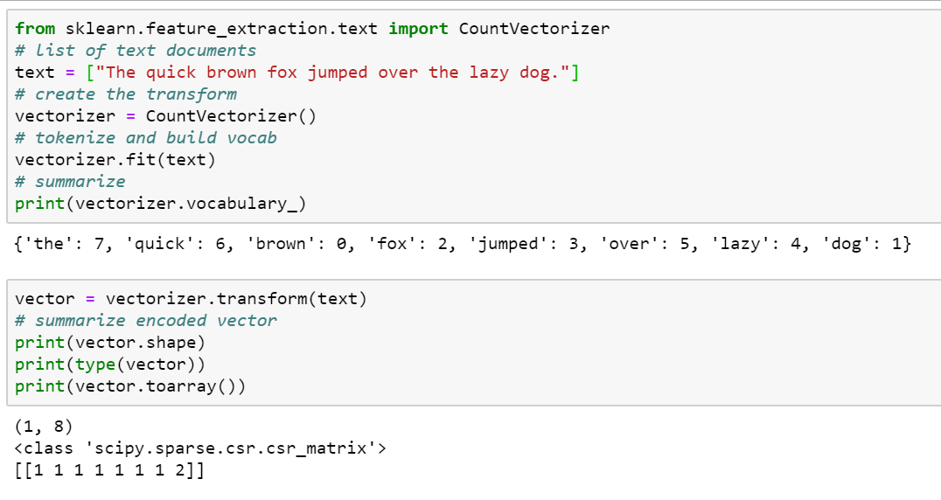

Slide 25
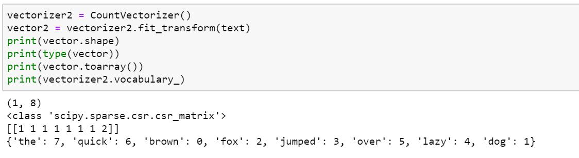

Slide 26
Project NLP
Read file “spam.csv” which consists of spam text data
The spam text data should be divided into training data (90%) and testing data (10%) (use random_state=123)
Please write a program to classify each testing data using only the training data by:
Manual classification: training data is used to build important keywords
Machine learning algorithm: training data is used to build the model of sentiment classification

Slide 27
Content of ipynb Script
Preprocessing
Give information on each preprocessing code
Feature extraction
Give explanation on the feature extraction code
Classification
Conduct manual based classification and machine learning based classification
Classify the test.csv and measure the accuracy of each method above

Slide 28
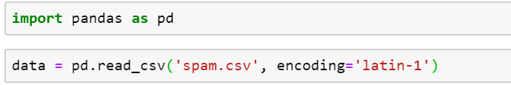
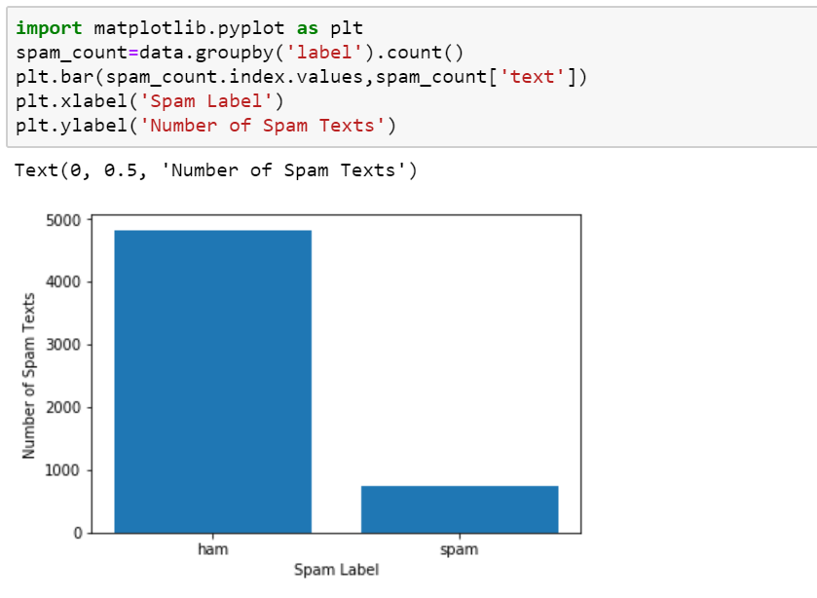

Slide 29
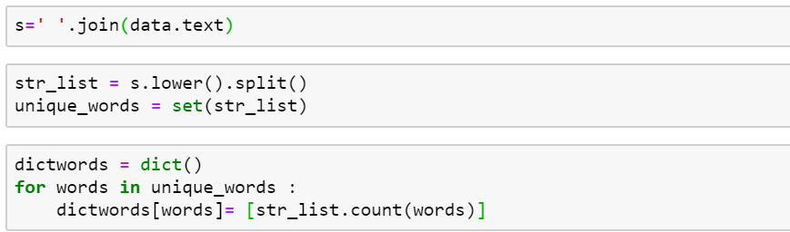
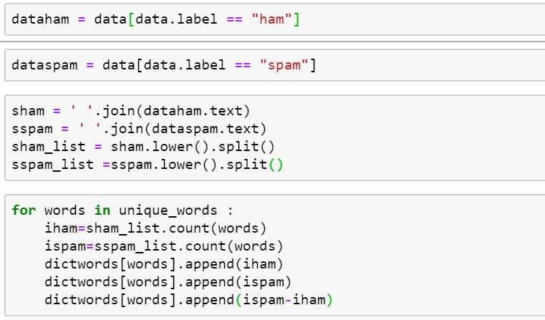
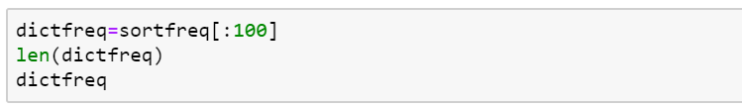
Feature Extraction &
Manual Classification
Exercise
Write a program to label each text in the data using a threshold (number of words included in spam words/ dictfreq)
Check the accuracy for all data

Slide 30
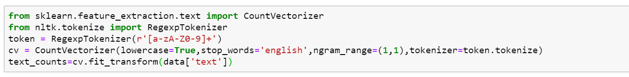
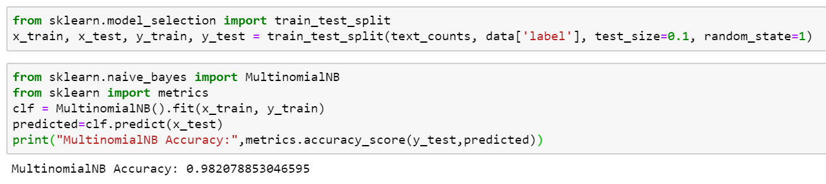
Feature Extraction & Machine Learning

