Slide 1

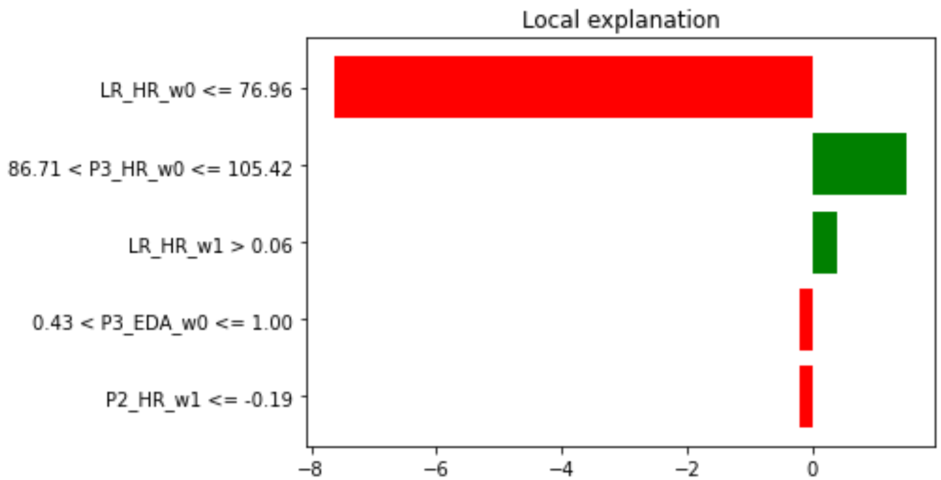
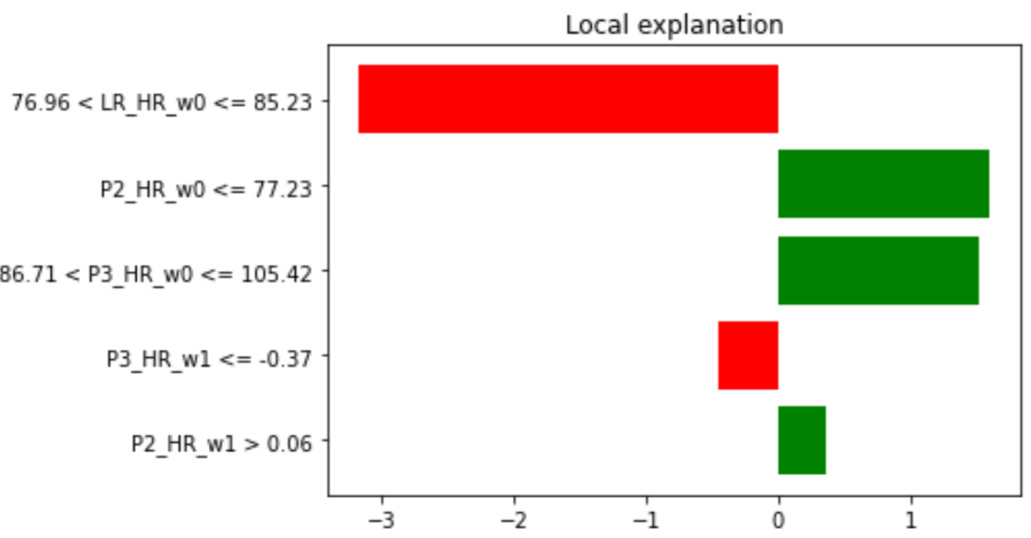
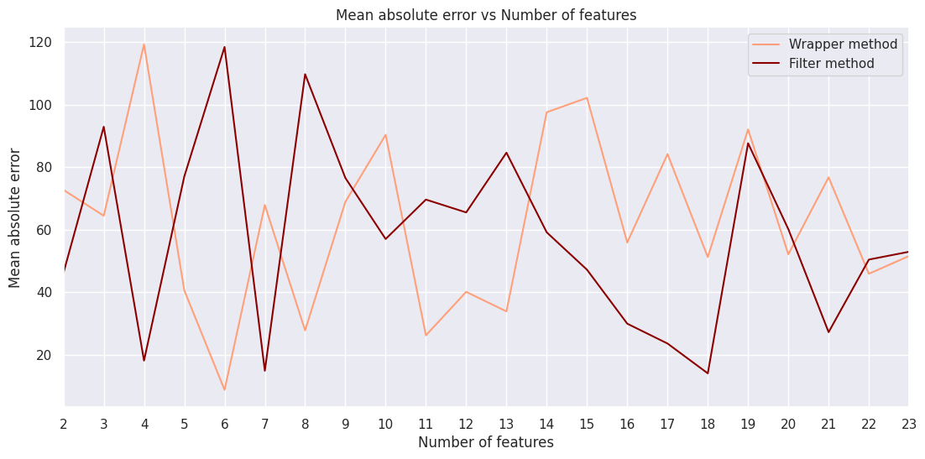
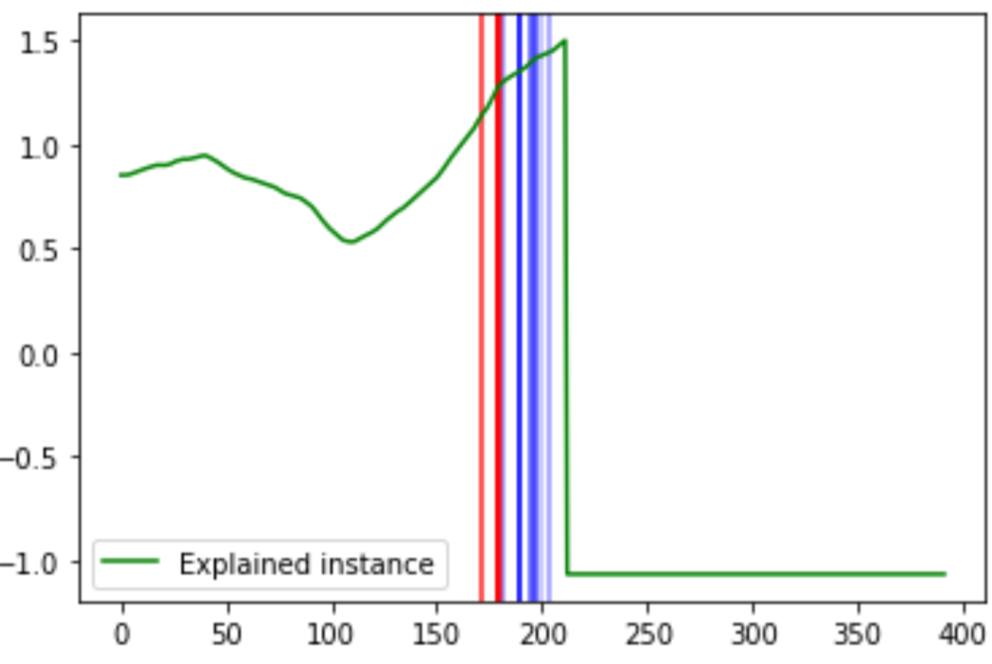
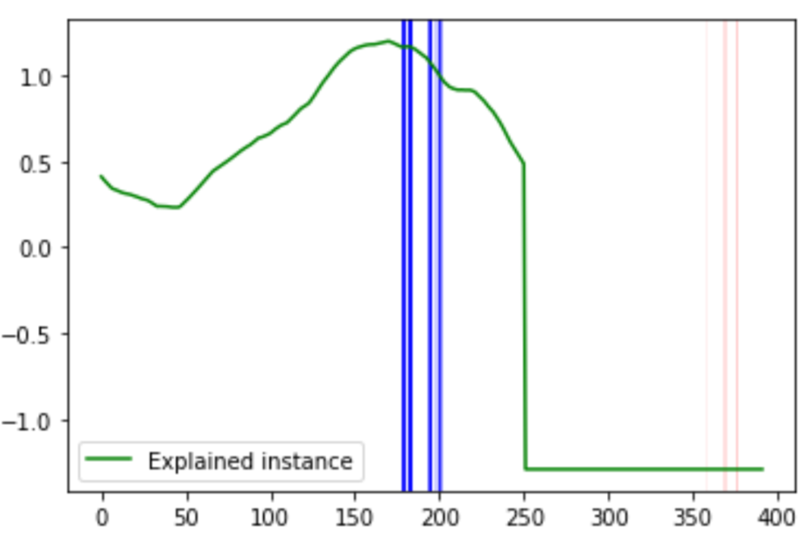
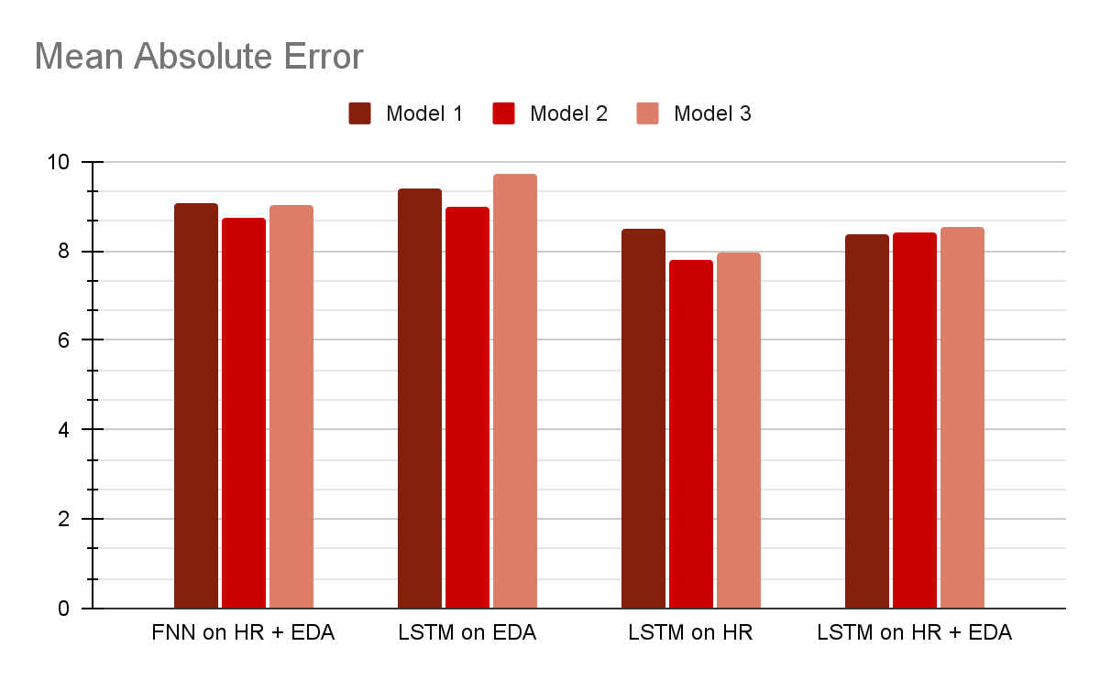
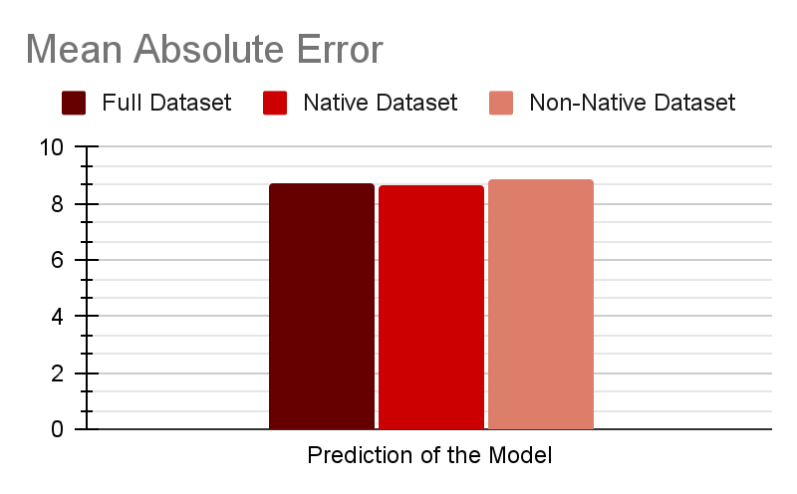
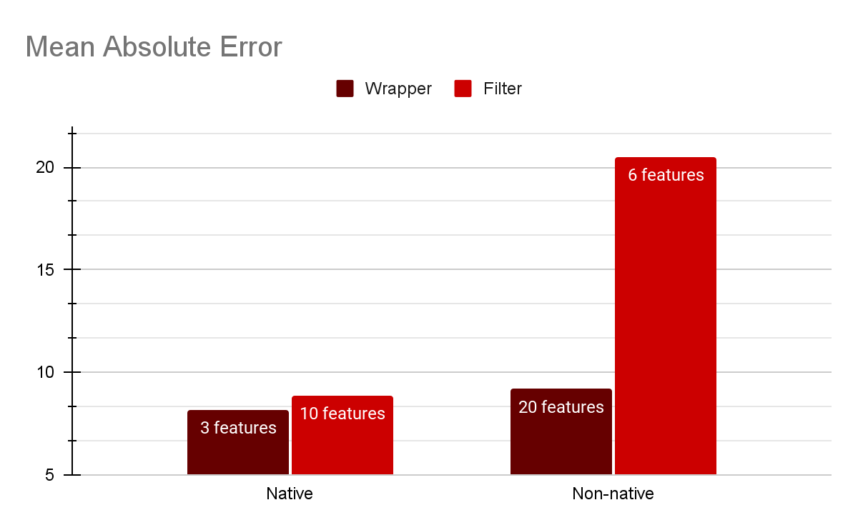
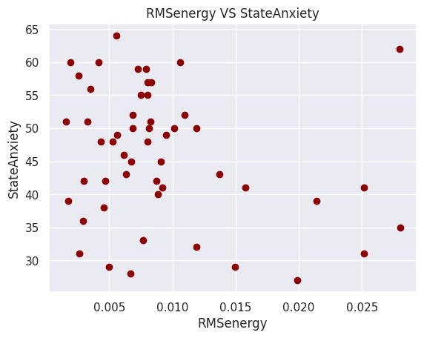
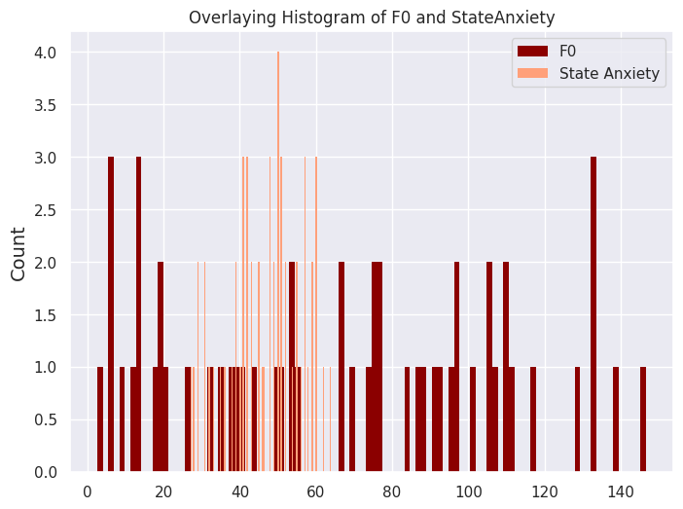
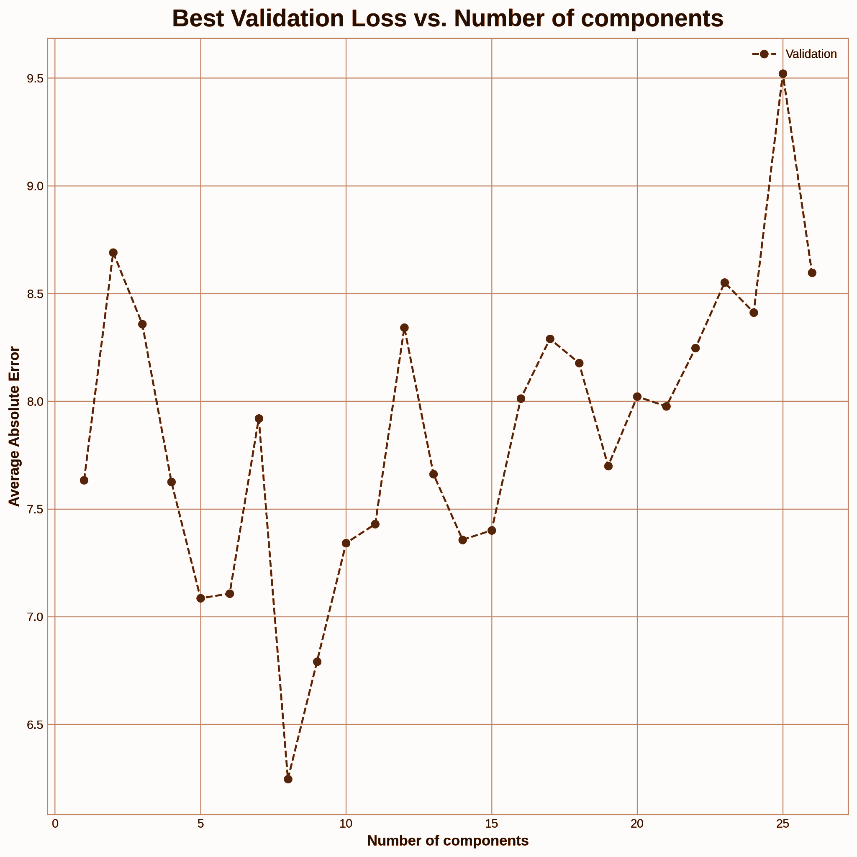
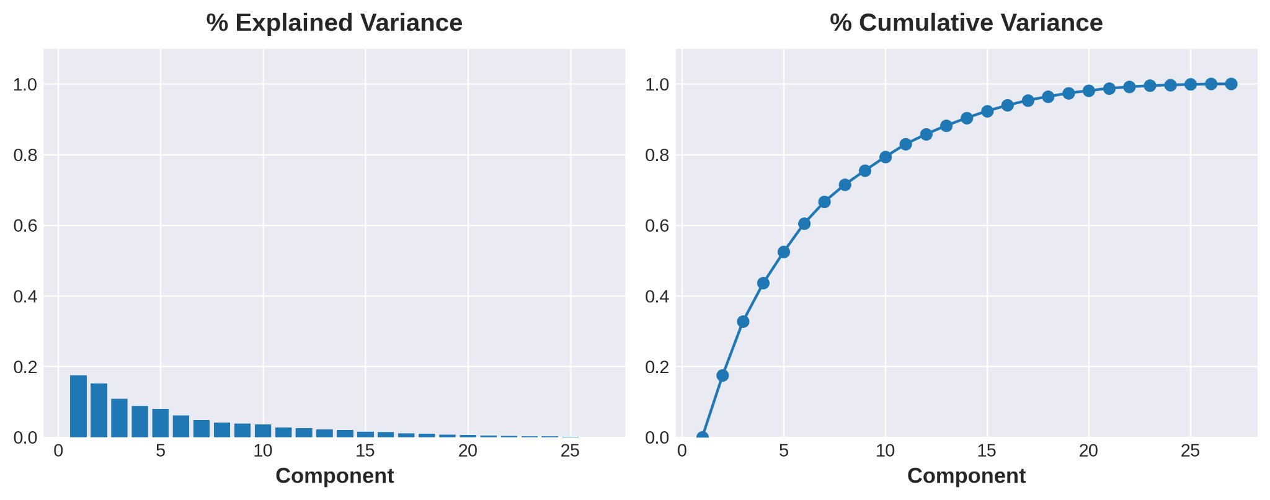
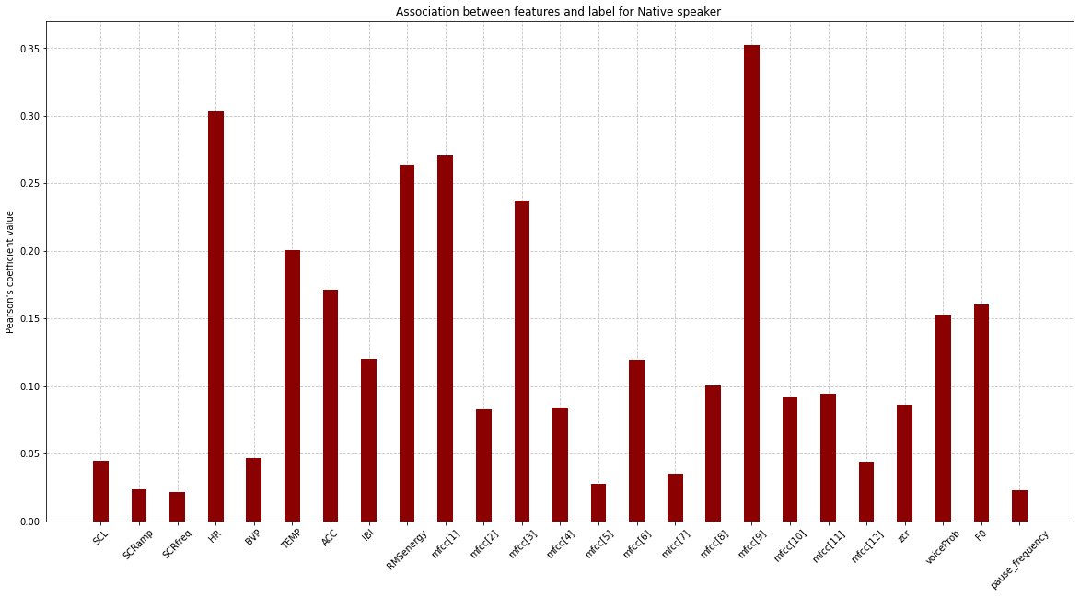
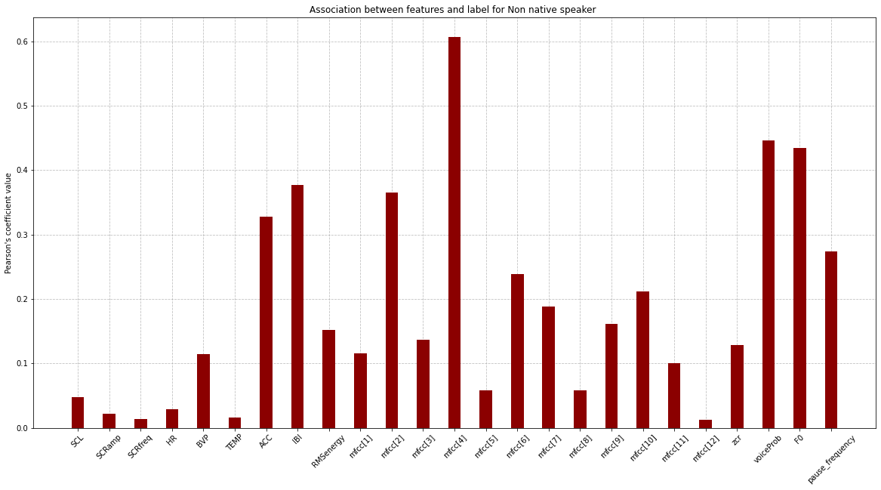
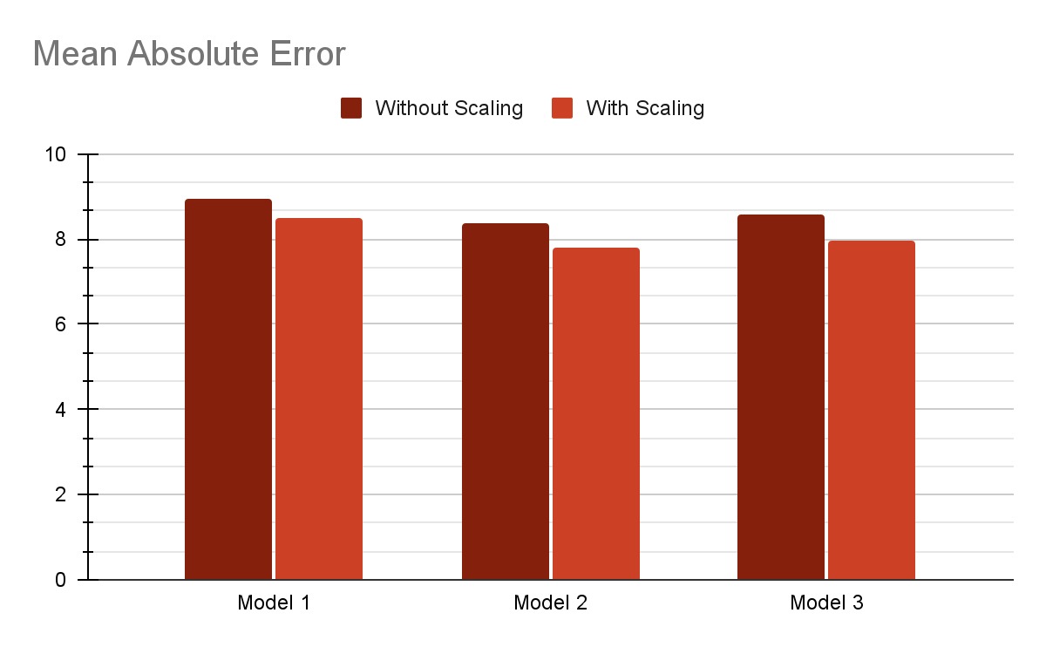
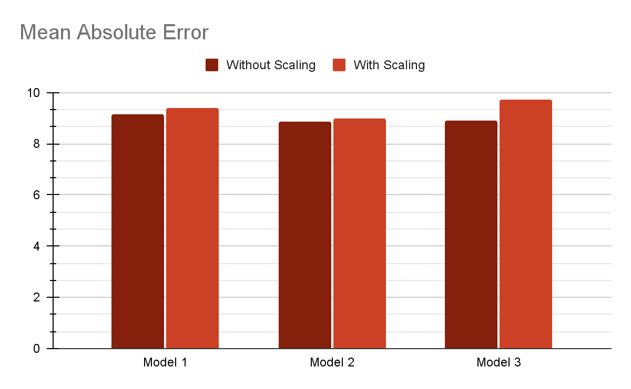
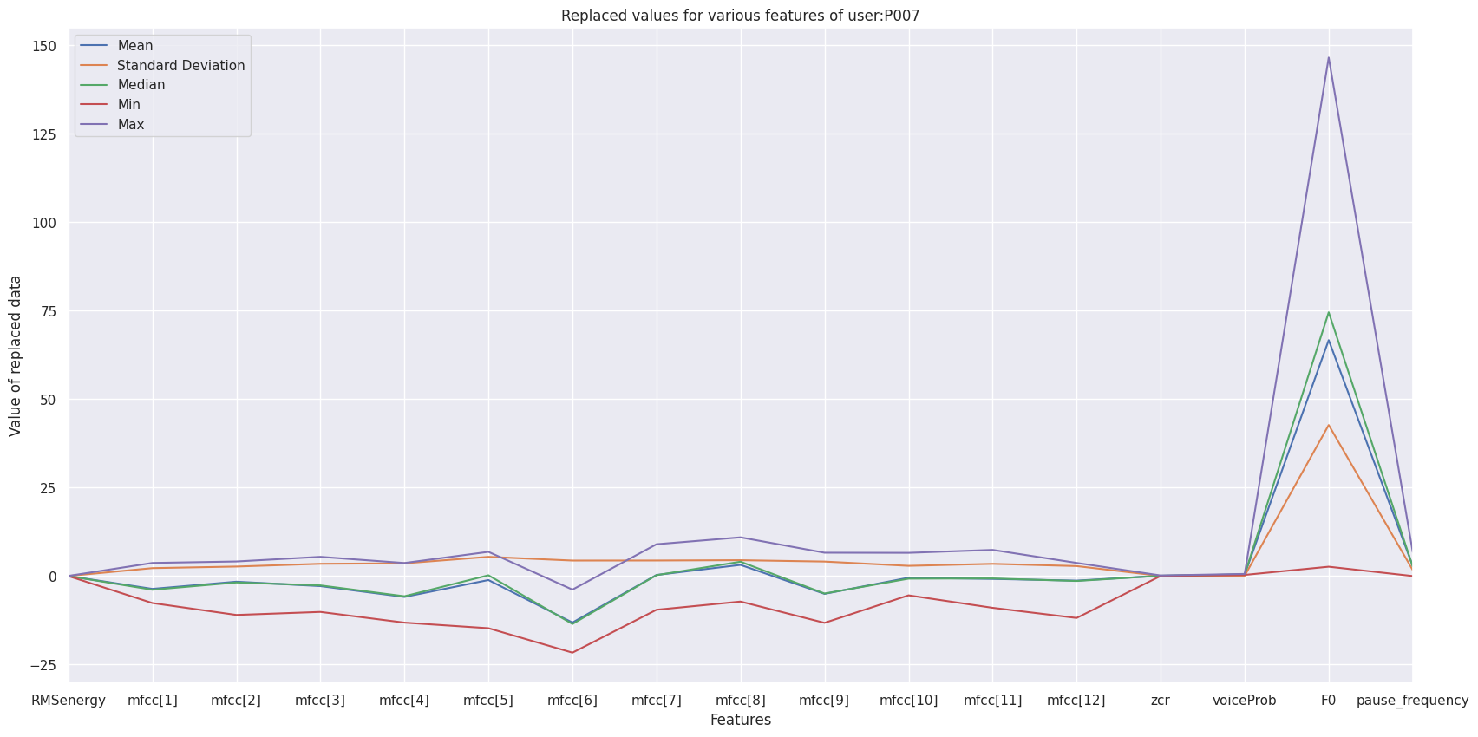
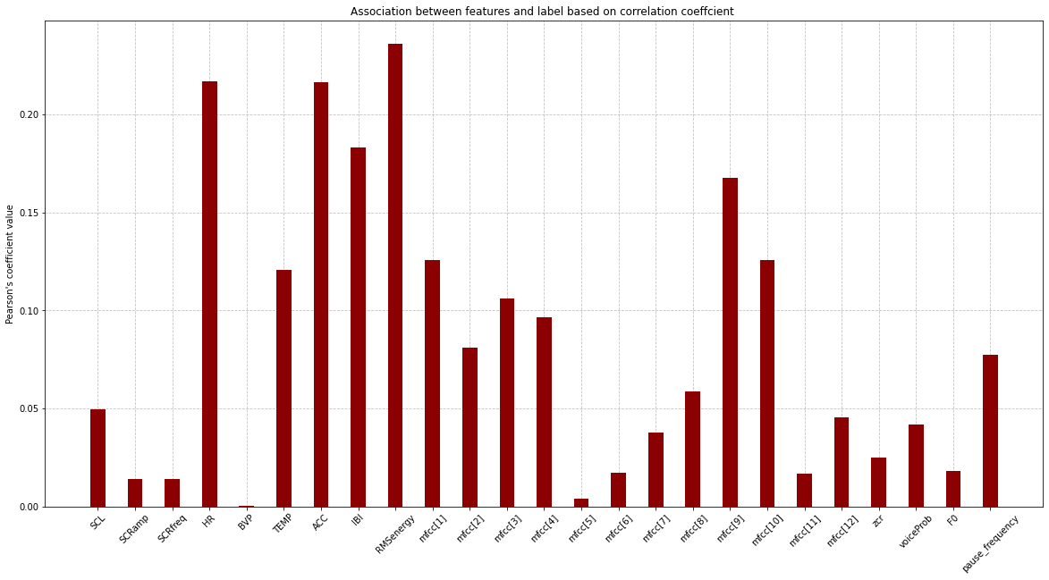
John Smith, MD¹; Jane Doe, PhD²; Frederick Jones, MD, PhD^{1,2}
¹University of Affiliation, ²Medical Center of Affiliation
Speak Up! Exploring Public Speaking Anxiety on VerBio Dataset
Adrita Anika, Md Messal Monem Miah, Prajwal Das, Sri Teja Chamarthy, Ankur Nath
Abstract
Feature Selection
Time Series Data (EDA, HR) Exploration
Interpretability with LIME
Public speaking anxiety (PSA) is among the top social phobias in the world. To quantify PSA in a reliable manner can lay the foundation toward personalized interventions. We study this problem with bio-behavioral features, temporal data- EDA, HR. Estimation of PSA with temporal models and comparison of the performance with non-temporal models is the primary goal of the study. We further investigate the interpretability of the models with LIME and explore variations between native and non-native group of people .
Two feature selection methods named Pearson Coefficient(Filter) and Sequential Forward Selection(Wrapper) have been explored. Best performance is achieved for:
Wrapper Method (n=6): SCRFreq, HR. ACC,IBI, RMSEnergy, mfcc[9]
Filter Method (n=7): RMSEnergy, HR, ACC, IBI, mfcc[9],mfcc[1],mfcc[10]
The mean absolute error between the actual and predicted PSA values using a 5-fold cross-validation for both methods for all features are plotted.
Filter method is faster to compute compared to wrapper method. Our FNN performs better using the features given by the wrapper method (lower mean absolute error).
Electrodermal activity (EDA) signals and heart rate (HR) signals while presenting can be strong indicators of the anxiety state of the presenter. In the dataset, we have access to both EDA and HR time series data, which are used to estimate state anxiety in this section of the experiment.
Feature Extraction & FNN: Linear and non-linear regression models have been applied on the time series data to extract features. For non-linear regression, 2 & 3 degree polynomial regression have been used. Total 18 features are extracted per speaker for further processing. For FNN method, we have experimented with features from HR and both HR and EDA and different polynomial degrees. The results indicate that using upto 4 degree polynomial regression performs better.
LSTM: In the second part of the experiment, 3 LSTM models were trained on each of the datasets containing EDA, HR and EDA + HR data to predict state anxiety.
FNN:
Intercepts of regression models have large weights on the FNN
Intercept of linear regression contributed the most for the prediction
LSTM:
HR: Non-zero samples have large weights, that is why models performance is better with HR data.
EDA: Padded zero samples also have large weights, which corresponds why model’s performance is poor with EDA data
The above graph shows the weights on HR data.
Motivation
Public speaking is a key form of communication. Even though this is an essential skill to have, recent studies show that a lot of people experience public speaking anxiety which involves physiological arousal such as increased heart rate and negative affect such as feelings of disappointment.
Studying bio-behavioral patterns of an individual while presententing can allow us to gain insight about his/her PSA and suggesting possible remedies. The purpose of this project is to build machine learning models to estimate public speaking anxiety from bio-behavioral data. The VerBio dataset containing bio behavioral features, EDA, HR data of 55 participant while public speaking, have been studied with machine learning models such as Linear Regression, FNN, LSTM for estimation of state anxiety.
Examining Individual Differences
Data Pre-processing and Exploration
With model trained on full dataset, no variation between native and non-native people.
With wrapper method, model performs slightly better for native people
With Filter method, the model performs much better for native people
The important features for native and non-native people have been shown.
Various feature amputation methods have been explored and feature mean is finally selected to replace the missing values.
Plotted the variation of replaced value for a given user P007 across different methods. Some visualizations of the features with respect to PSA.
The associations between the bio-behavioral features and anxiety label using pearson’s correlation coefficient and plotted the absolute values in the following graph. We observe that RMSEnergy, HR and ACC are most highly correlated to StateAnxiety.
Feature Transformation
In our experiment, we discovered that our model performs better when the dimensionality of the bio-behavioral features is decreased to 8.
This is reasonable because the cumulative variance graph shows that when the number of components is reduced to 8, it captures nearly 80% of the original variance.
HR is a more predictive of anxiety state compared to EDA. Testing error was as low as 3.92 using the best model.
The fluctuations in HR values depend on the personal resting baseline. This different levels of HR can affect the performance of the model. Scaling the HR values improves the model performance. Whereas the performance for the model trained with EDA does not improve.
Table 1. Label in 20pt Calibri.
 | Heading | Heading | Heading
Item | 800 | 790 | 4001
Item | 356 | 856 | 290
Item | 228 | 13 | 238
Item | 954 | 875 | 976
Item | 324 | 325 | 301
Item | 199 | 137 | 186
References
[1] M. Yadav, M. N. Sakib, E. H. Nirjhar, K. Feng, A. Behzadan and T. Chaspari, “Exploring individual differences of public speaking anxiety in real-life and virtual presentations,” in IEEE Transactions on Affective Computing, doi: 10.1109/TAFFC.2020.3048299.
[2] Nirjhar, Ehsanul Haque & Behzadan, Amir & Chaspari, Theodora. (2020). Exploring Bio-Behavioral Signal Trajectories of State Anxiety During Public Speaking. 1294-1298. 10.1109/ICASSP40776.2020.9054160.
Overall, LSTM models are performing better compared to feature extraction and FNN method.

