Slide 1


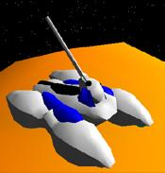
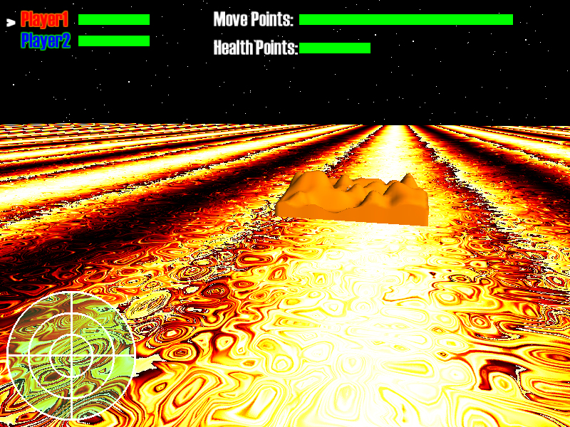
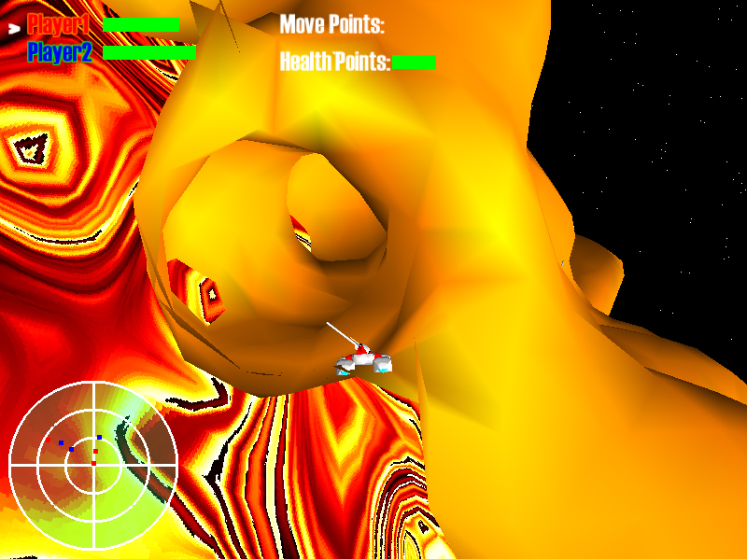
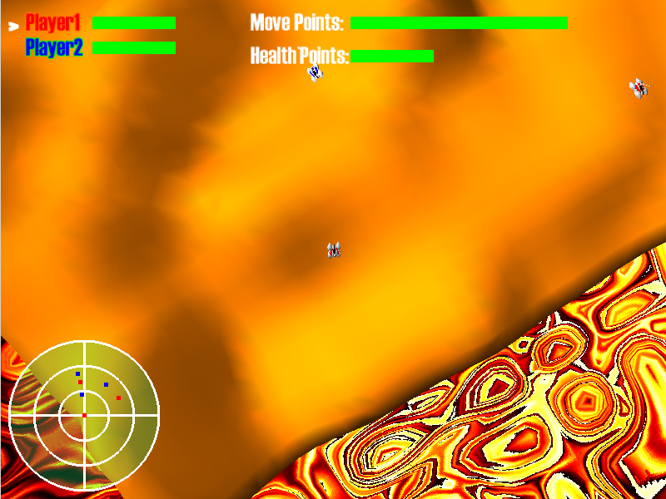
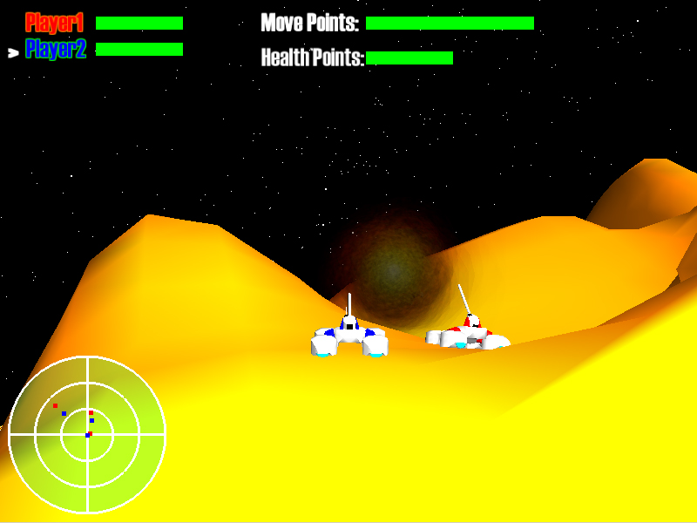
CS378 Game Technology Final Project
Terra-form to Victory!
Conquer the enemy and become the supreme ruler of the Island. Move your tanks strategically and fire land carving missiles . Be mindful of the terrain around you, it could be your worst enemy.
Completely deformable terrain offers a new and unique challenge. The technology is based on the Marching Cubes algorithm, one of the techniques used for medical scan imaging, such as MRI and CAT scans.
Randomly generated terrain, based on Fractal Perlin noise, provides for an infinite number of scenarios, no two matches will be the same
Game by Adrian Mayorga,
Models by Andres Mayorga
Check out the webpage at http://www.cs.utexas.edu/~adrm/cs378

